Slide 1

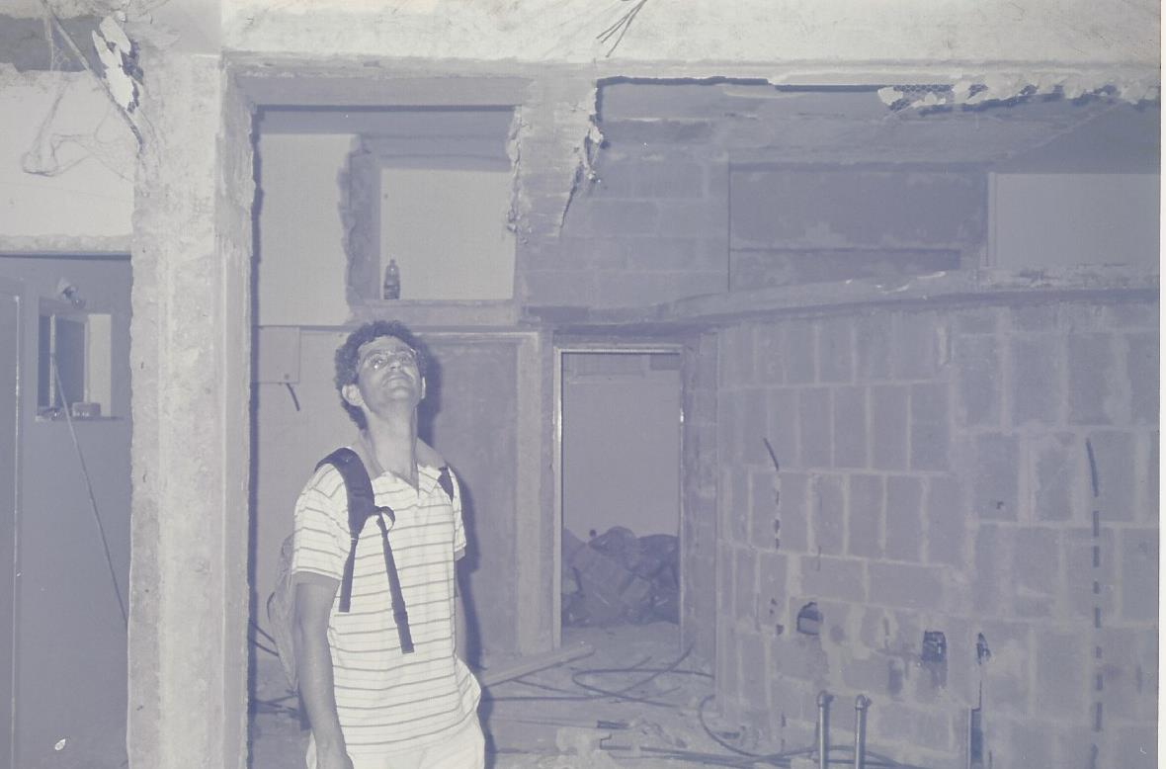



Highlights of Benny’s Research
Part 1: Works in Cryptography and complexity
Notes:
My perspective… Oded

Slide 2
Notes:
Old logos, prior to sabotage by mgmt. & PR consultants
שום חגיגה אקדמית אינה שלמה ללא ברכות להנהלה

Slide 3
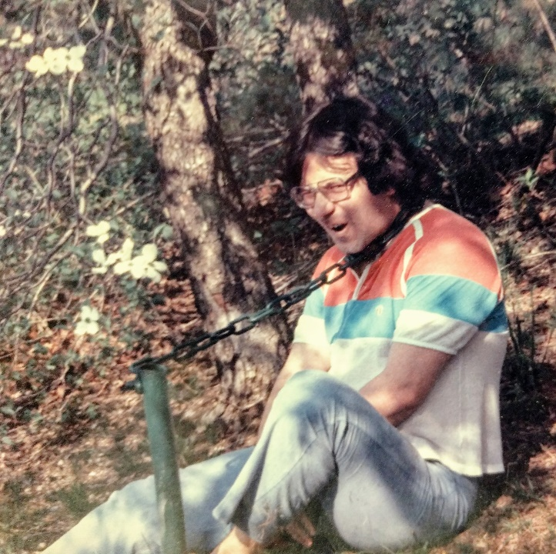
Security of RSA Bits (with Oded and others)
The ¾ bound [BCS, 1983]
The hardcore result [ACGS, 1984].
An aside: The two-point based sampling
Tedious scholarly comments: [ACGS] was mostly forgotten because of the general hardcore result of [G+Levin], which is currently proved using the technique of [ACGS]. The two-point sampling is extensively used, usually with no reference.
Notes:
Some said they were abused by Benny. How about this? Venting on the scholarly practices of TOC.

Slide 4
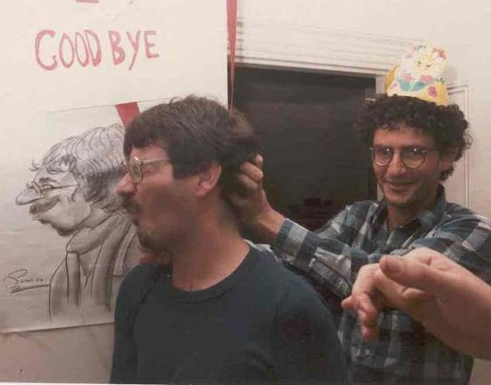
Randomness Extraction (with Oded and others)
Probability bounded sources (aka min-entropy sources). [CG 1985]
Perfect extraction from Bit Fixing Sources. [CFGHRS 1985]
Tedious scholarly comments: The notion of min-entropy became the pivot of the study of randomness extraction. Other forgotten credits include the observation that min-entropy sources are a convex combination of “flat sources”, the existential bounds, and the Paley construction.
The two-source extractor based on inner product mod 2 is remembered since it held the record for two decades…
The Bit Fixing source is also quite popular, but the focus is on almost perfect extraction.
Notes:
Venting…

Slide 5

Randomized Byzantine Agreement (with others) and beyond (with Lior and Lee-Bath)
On the round complexity of randomized BA protocols: Presenting an improvement over the deterministic lower bound without using any additional assumptions (i.e., neither computational nor physical).
Constant-rounds in async msg-oblivious faults model. [1985]
Shaving a log factor in general BA in sync model. [1984]
Characterization of tasks that can be resiliently solved by randomized protocols in the two main asynchronous models (i.e., Msg Pass and Shared Mem), where resilience is with respect to a bounded number of computationally unbounded adversaries. [1989, 1991]
Tedious scholarly comments: These results seem unjustifiably forgotten.
Notes:
The t/log t factor seems unimproved (for adaptive, but improved to log for non-adaptive)
Bar-Joseph & Ben-Or (1998): Theta(t/((sqrt n)(log n)) for adaptive fail-stop model!

Slide 6
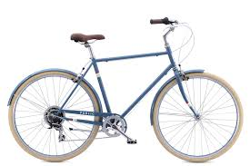

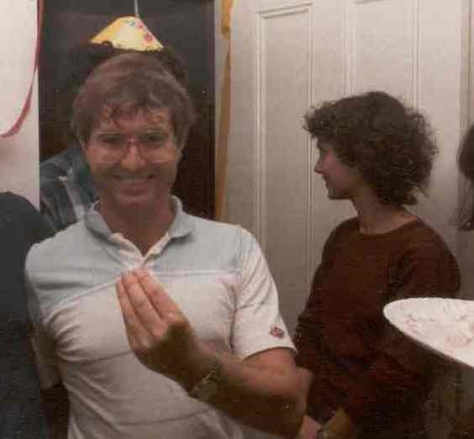
VSS and friends (with others)
Verifiable Secret Sharing [CGMA 1985]
Achieving independence in logarithmic number of rounds [CR 1987].
Tedious scholarly comments: VSS is a major component in all subsequent secure MPCs.
Notes:
The 2nd work refers to executing VSS by n different parties, while guaranteeing independence.
Note Ron in background of Shafi, and Benny behind Silvio. Metzada also there.

Slide 7

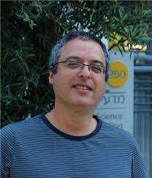
Privacy in computation
(with Eyal, Netta, Mihaly, Reuven, Alon, Yuval)
Characterizations of private functions
  Boolean functions [CK89],
  Dense Symmetric functions [CS95],
  over the integers [CGK90].
  Privacy Hierarchy [CGK94],
  Privacy and Partition Arguments [CI96]
Quantifying Privacy Loss [BCK90,BCKO93]
Tedious scholarly comment (by Eyal):
some of it was later re-defined
by the Information-Complexity people
FCRC 1993
(San Diego)
Notes:
Photo: From Technion’s webpage. (S = Netta, G = Gereb, O = Alon, B = Reuven)
Video obtained by click

Slide 8
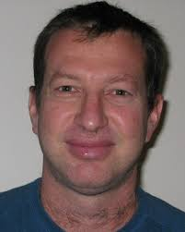
Secret Sharing (with AmosB and EyalK)
Universally Ideal Secret Sharing Schemes [BC92]:
Characterization of the existence of ideal secret sharing schemes over all domains
Secret Sharing Over Infinite Domains [CK89]:
Impossibility of secret sharing over countable domains
  Secret Sharing with Public Reconstruction [BC95]:
  Sets can reconstruct the secret over a public channels without disclosing the secret to others
Notes:
No tedious comments by me, since this is out of my expertise…

Slide 9
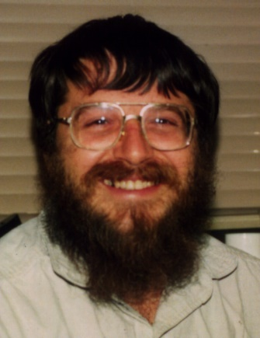
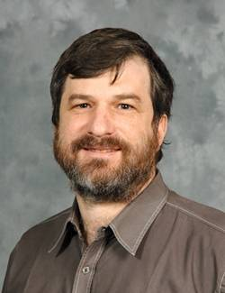
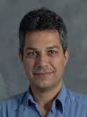
Tracing Traitors
(with AmosF, Moni and BennyP)
Traitor tracing is a method for providing personal decryption keys to users, such that (1) there is a single encryption key corresponding to all the decryption keys, and (2) any possible decryption key, even one that was generated by a coalition of corrupt users (traitors), identifies personal keys that were used to generate it.
[Ency. of Crypto. and Security, pp 1313-1316, Traitor Tracing, Benny Pinkas.]
Traitor tracing schemes help trace the source of leaks when secret or proprietary data is sold to many customers. In a traitor tracing scheme, each customer is given a different personal decryption key. [https://en.wikipedia.org/wiki/Traitor_tracing]
Notes:
Too crypto-oriented for me, so I feel unqualified to comment and cite others.

Slide 10

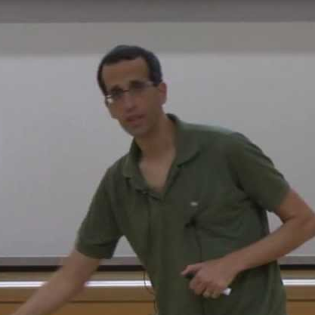
PIR and CPIR (with Oded+Eyal+Madhu, and Niv)
The PIR [CGKS 1995]
The CPIR [CG 1997]
By Keywords [CGN 1998]
Tedious scholarly comments: The PIR is remembered mostly (but not solely…) because the two-server scheme held the record for almost two decades. The CPIR is considered superseded by [KO 1997].
Notes:
Venting again.
Niv’s photo from YouTube talk on broadcast encryption (2013). Madhu is more photogenic.

Slide 11
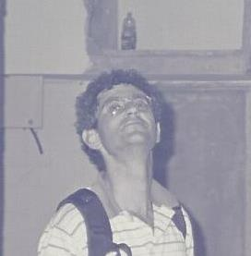
Misc.
Chor-Rivest Knapsack (*)
GCD (who is worried)
Average-case complexity (w.r.t samplable distributions).
On the failure of the Random oracle Hypothesis (w.r.t IP=PSPACE).
A Geometric Approach to Betweenness [1995]: the missing link?
*) This is a public key knapsack system which (like all knapsack systems) has been broken. However, it took longer to break than most, and is a very elegant use of finite fields. I like to use it for two things: as a nice example of finite fields in practice for students, and as a test for a computer algebra system (CAS). All CAS’s can do calculus and some algebra, but not all of them are equal when it comes to abstract algebra. [http://numbersandshapes.net/2012/04/the-chor-rivest-cryptosystem/]
Notes:
Missing link = link between complexity and bioinformatics

Slide 12
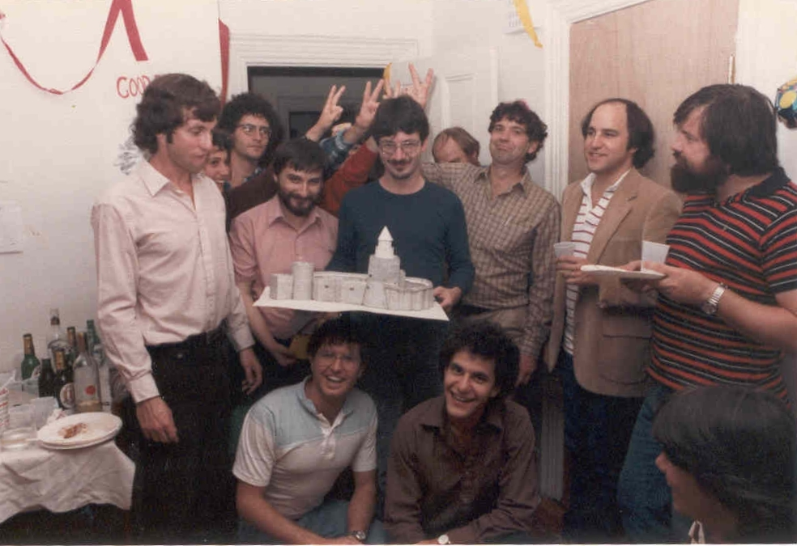
Notes:
From the Oded-dress-a-like contest: 1st prize to Oded, 2nd to Tom.

Slide 13
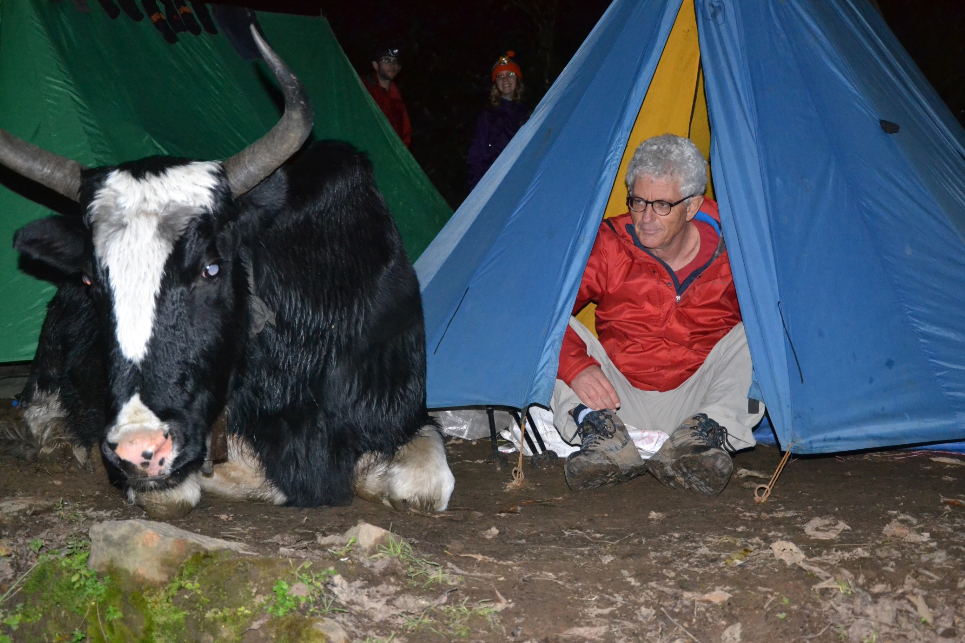
מה טובו אוהליך בני, מרבצותיך שור
Notes:
Steeling Sagi Snir’s slide.

