Slide 1
Property Testing on Product Distributions:
Optimal Testers for Bounded Derivative Properties
Deeparnab Chakrabarty
Microsoft Research
Bangalore
Kashyap Dixit (PSU), Madhav Jha (Sandia), C. Seshadhri (Sandia)

Slide 2

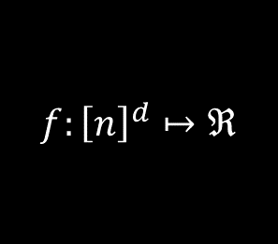
Functional Property Testing
$$f:{\left[n\right]}^{d}↦ℜ$$
f(x₁, x₂ ,… , x_{d})
(x₁ x₂ … x_{d} )
GOAL: Test if $f$ has certain property.
Blackbox access.
quality = #queries.
Notes:
Domain and Range (State what they are – hypergrids)
Close-By: Stress on the contrapositive

Slide 3

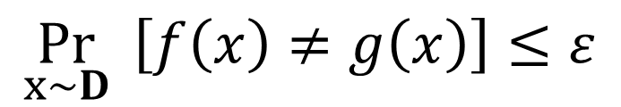
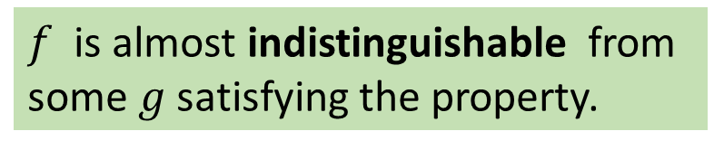
False Positives via Stat. Indistinguishability
REAL
Either, the tester finds a violation and REJECTS.
IDEAL WORLD:
Or tester concludes that function satisfies property, and ACCEPTS.
$f$ is almost indistinguishable from
some $g$ satisfying the property.
D: ambient distribution over inputs.
$$\underset{x∼D}{Pr}{ \left[f\left(x\right)≠g\left(x\right)\right]≤ε}$$
dist_{D}(f,g)
Notes:
** WORK ON THIS METAPHOR

Slide 4
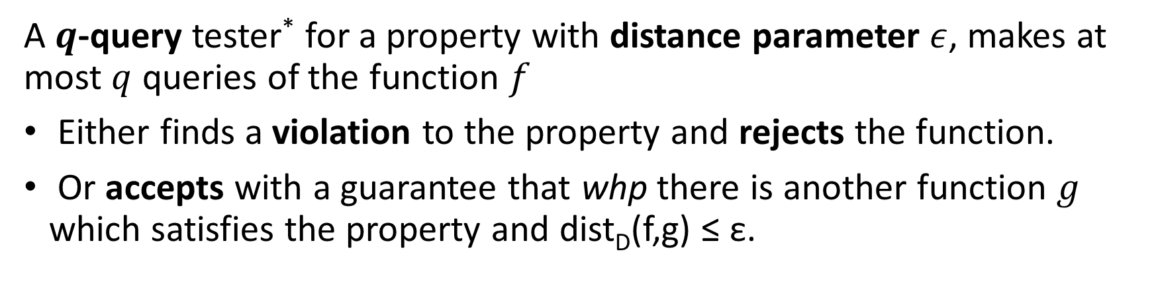
Formal Definition
A $q$-query tester* for a property with distance parameter $ε$, makes at most $q$ queries of the function $f$
Either finds a violation to the property and rejects the function.
Or accepts with a guarantee that whp there is another function $g$ which satisfies the property and dist_{D}(f,g) ≤ ε.
*: one-sided tester, which never rejects a function satisfying the property.

Slide 5


Monotonicity
f
$$f\left(x_{1}, ⋯, x_{d}\right) ≥ f(y_{1}, ⋯, y_{d})$$
whenever $x_{i}≥y_{i}$ for all $i$.
Property of being sorted.
Relevant even when domain and range is {0,1}.
Monotone concepts in learning theory.

Slide 6
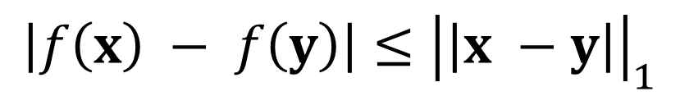
Smoothness (Lipschitz Continuity)
f
$$\left|f\left(x\right) − f\left(y\right)\right|≤{\left|\left|x −y\right|\right|}_{1}$$
Robustness of Programs.
Fundamental in Differential Privacy.

Slide 7
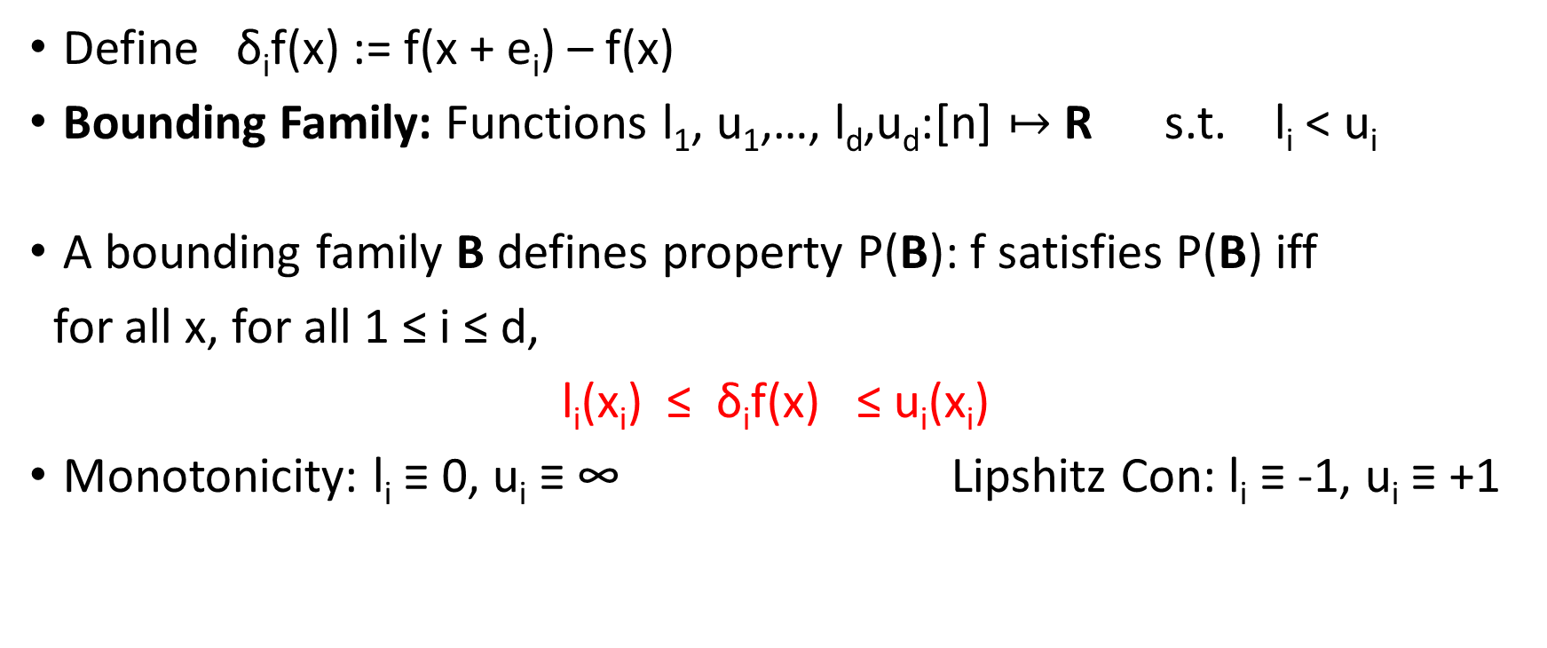
Bounded Derivative Properties
Define δ_{i}f(x) := f(x + e_{i}) – f(x)
Bounding Family: Functions l₁, u₁,…, l_{d},u_{d}:[n] $↦$ R s.t. l_{i} < u_{i}
A bounding family B defines property P(B): f satisfies P(B) iff
for all x, for all 1 ≤ i ≤ d,
l_{i}(x_{i}) ≤ δ_{i}f(x) ≤ u_{i}(x_{i})
Monotonicity: l_{i} ≡ 0, u_{i} ≡ ∞ Lipshitz Con: l_{i} ≡ -1, u_{i} ≡ +1
Optimal Testers for all bounded derivative properties
with respect to arbitrary product distributions.

Slide 8
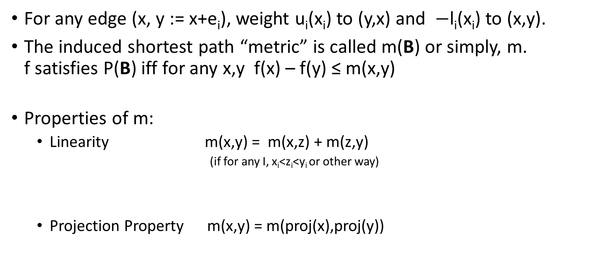
Quasimetric form Bounding Family
For any edge (x, y := x+e_{i}), weight u_{i}(x_{i}) to (y,x) and $−$l_{i}(x_{i}) to (x,y).
The induced shortest path “metric” is called m(B) or simply, m.
f satisfies P(B) iff for any x,y f(x) – f(y) ≤ m(x,y)
Properties of m:
  Linearity m(x,y) = m(x,z) + m(z,y)
  (if for any I, x_{i}<z_{i}<y_{i} or other way)
  Projection Property m(x,y) = m(proj(x),proj(y))
y
z
x
y
x
y’
x’

Slide 9
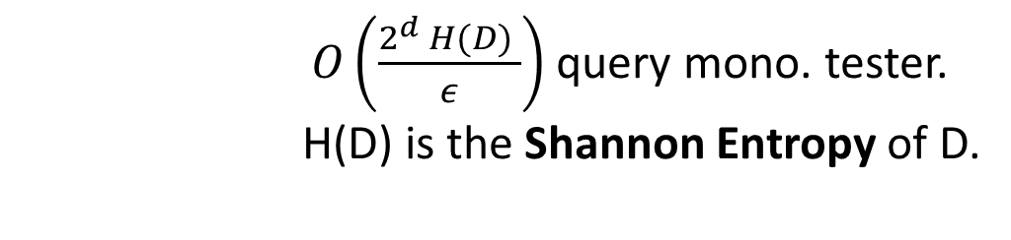
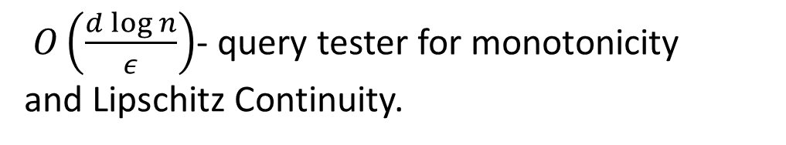
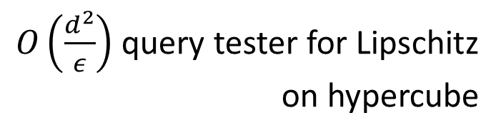
Previous Work
Goldreich-Goldwasser-Lehman-Ron 1998, Ergun et al 1998, Dodis et al 1999
Lehman-Ron 2001, Fischer et al. 2002, Fischer 2004,
Parnas-Ron-Rubinfeld 2006, Ailon et al 2007,
Bhattacharya et al 2009, Briet et al 2010, Blais-Brody-Matulef 2011,
Jha-Raskhodnikova 2011, Awasthi et al. 2012, Chakrabarty-Seshadhri 2013a
Ailon-Chazelle 2004, Halevy Kushilevitz 2007,
Dixit et al. 2013
$O\left(\frac{2^{d} H(D) }{ε}\right)$ query mono. tester.
H(D) is the Shannon Entropy of D.
$O\left(\frac{d\log{n}}{ε}\right)$- query tester for monotonicity
and Lipschitz Continuity.
Ailon-Chazelle 2004
$O\left(\frac{d^{2}}{ε}\right)$ query tester for Lipschitz
on hypercube
Chakrabarty-Seshadhri 2013a
Dixit et al 2013
Uniform Distribution
Product Distribution

Slide 10
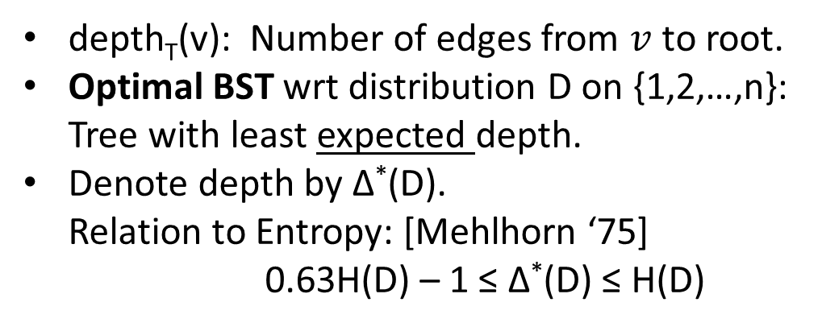
Binary Search Trees
4
Rooted Binary Tree with n vertices marked 1 to n.
label(left-child) < label(v) < label(right-child)
2
6
depth_{T}(v): Number of edges from $v$ to root.
Optimal BST wrt distribution D on {1,2,…,n}:
Tree with least expected depth.
Denote depth by ∆*(D).
Relation to Entropy: [Mehlhorn ‘75]
0.63H(D) – 1 ≤ ∆*(D) ≤ H(D)
1
3
5
7
6
2
7
Give product Distribution D = D₁ X … X D_{d},
∆*(D) = ∆*(D₁) + … + ∆*(D_{d})
At most the entropy, but could be less by additive d.
1
4
3
5

Slide 11
Statement of Results
Upper Bounds. Given any product distribution D and any bounded derivative property P(B), there exists a 100ε⁻¹∆*(D)-query P(B)-tester.
Lower Bounds. For any bounded derivative property P(B), and any stable product distribution D, for some constant ε, Ω(∆*(D))-queries are necessary.
Dimension Reduction Theorem. dist_{i}(f) be the distance of the function restricted to a “random” i-line. Then,
dist₁(f) + dist₂(f) + … + dist_{d}(f) ≥ dist(f)/4

Slide 12
The Line

Slide 13
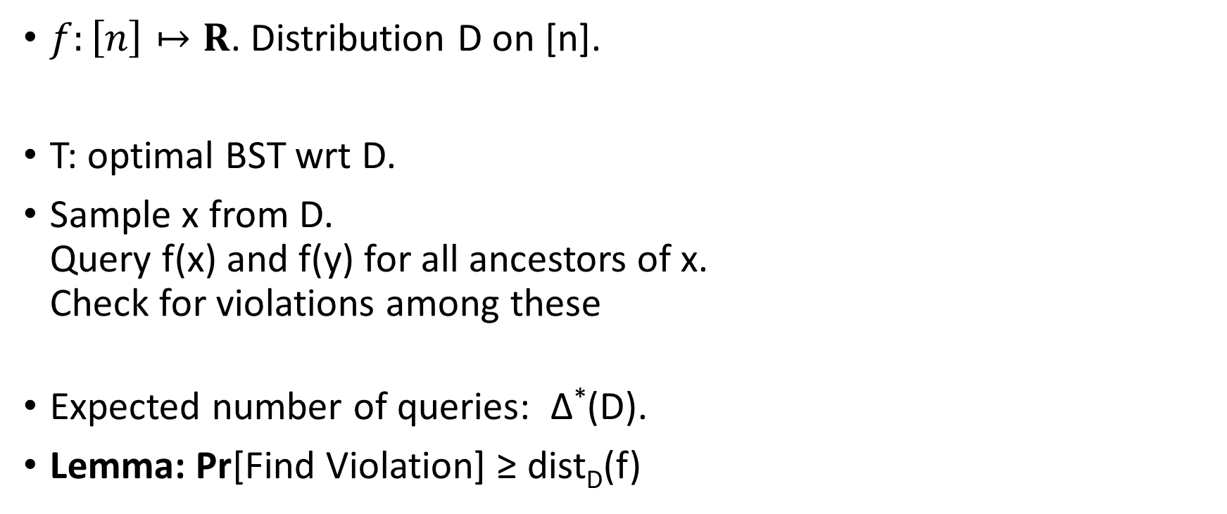
Algorithm
6
$f:\left[n\right]↦R$. Distribution D on [n].
T: optimal BST wrt D.
Sample x from D.
Query f(x) and f(y) for all ancestors of x.
Check for violations among these
Expected number of queries: $\text{∆}\text{∗}$(D).
Lemma: Pr[Find Violation] ≥ dist_{D}(f)
2
7
1
4
x
3
5

Slide 14
Analysis
Lemma: Pr[Find Violation] ≥ dist_{D}(f).
Certificate of distance:
dist_{D}(f) = min μ_{D}(VC)
where VC is a “hitting set” of all violations.
Triangle inequality of m
z
X be set of points which have violn with
some ancestor. Pr[Violation] = μ_{D}(X)
x
y
X forms a vertex cover.
Linearity of m
If (x,y) is a violation then either (x,z) or (y,z) is a violation, where z = lca(x,y)

Slide 15
Lower Bound (monotonicity)
Setting:[Fischer’04, CS’13]
Collection of ‘hard’ functions: g₁,…,g_{L} each ε-far, and q-queries “distinguishes” at most q of these g_{i}’s from a specified monotone function h, implies Ω(L) lower bnd
Hard function from each level k of the median BST.
Properties of g_{k}:
- (x,y) is a violation iff lca(x) is in level k
- dist_{D}(g_{k}) ≥ μ_{≥k}(T)/2
μ_{≥k}(T): mass beyond level k
Intervals
For stable distributions, μ_{≥k}(T) is constant after Ω(∆*(D)) levels

Slide 16
Dimension Reduction

Slide 17
Statement and Application
Dimension Reduction Theorem. dist_{i}(f) be the distance of the function restricted to a “random” i-line. Then,
dist₁(f) + dist₂(f) + … + dist_{d}(f) ≥ dist(f)/4
Algorithm for [n]^{d}: Sample x←D and choose a line passing through it uar.
Run algorithm for line on function restricted to this line.
Exp[Queries] = 1/d•(∆*(D₁) + … + ∆*(D_{d})) = ∆*(D)/d
Pr[Find Violation] ≥ 1/d•(dist₁(f) + … + dist_{d}(f)) ≥ dist(f)/4d

Slide 18
First Try
Dimension Reduction Theorem. dist_{i}(f) be the distance of the function restricted to a “random” i-line. Then,
dist₁(f) + dist₂(f) + … + dist_{d}(f) ≥ dist(f)/4
Contrapositive: if most lines can be fixed with small changes, then
so can the whole hypergrid.
4
2
5
Fixing one dimension may introduce
new violations in other dimensions.
3
6
1
Our Approach: Non-constructive based on Matchings and Alternating Paths.

Slide 19
Matchings and Alternating Paths
Violation Graph of f has an edge for every
pair of violations.
Folklore Lemma: If dist_{U}(f) = ε, then any
maximal matching in VG has cardinality
larger than ε•n^{d}/2.
Main Structural Theorem
If f has no violations along dimension i,
then there exists a maximal matching that
doesn’t cross dimension i.
Maximum weight matching wrt certain weighing scheme

Slide 20
Proof from Structure Thm
Given f, let M_{i} be the maximum weight matching which has no j-cross pairs for 1 ≤j ≤ i. So, |M₀| ≥ dist(f)•n^{d}/2, and |M_{d}| = 0
Bounded Drop Lemma. For any k, |M_{k-1}| - |M_{k}| ≤ 2dist_{k}(f)•n^{d}
Implies: dist₁(f) + dist₂(f) + … + dist_{d}(f) ≥ dist(f)/4
Proof. Let f_{k} be the closest function to f with no viol along dir k.
dist(f,f_{k}) = dist_{k}(f). Let N be the maximum weight matching wrt f_{k}.
|M₀| - |N| ≤ dist(f,f_{k})•n^{d} ≤ dist_{k}(f)•n^{d}
(Look at M₀ ∆ N)
|N| - |M₁| ≤ dist(f,f_{k}) •n^{d} ≤ dist_{k}(f)•n^{d}
N has no
k-cross pairs.

Slide 21
Take Home Points and Points to Ponder on
Optimal Testers for the class of bounded (first) derivative properties under any product distribution. Inherent connection to search trees.
Subsumes many results known for monotonicity and Lipschitz Continuity testing.
Near Optimal Dimension Reduction.
What we didn’t cover today: proof of the structure theorem, uniform to arbitrary product distributions, and proof of the general lower bound.
More general distributions?
Can we do a general distribution on a 2D grid? What’s the answer?
Bounded Second derivative property? Can we test submodularity?

