Slide 1

Randomized Algorithms
Lecture 2
Lecturers:
Robert (Robi) K.
Moni Naor
Krauthghamer

Slide 2
Administrivia
Meetings: Mondays 14:15-17:00
It is expected that all students attend all lectures and actively participate in classes
  Read material before class
  Present in class – hw solutions etc.
  Interact during lectures
  Test
  Lectures are recorded (please remind the speaker to start)

Slide 3
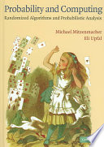
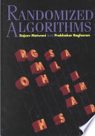
Course:
Sources:
Mitzenmacher and Upfal
Probability and Computing
Motwani and Raghavan
Randomized Algorithms
A few lectures from Ryan O'Donnell's course ``A Theorist's Toolkit"

Slide 4
Last Time
Why?
Min Cut

Slide 5
Homework
Question: What happens if instead of picking a random edge you pick at random a pair of vertices and contract?
  Is the resulting algorithm a good min-cut algorithm?
Question: The algorithm also showed a bound on the number of min-cuts.
  In contrast show that for s-t cuts there can be exponentially many min-cuts.
since for every min-cut the probability of
outputting this specific cut was >1/n²
where there are two input nodes s and t
that should be separated

Slide 6
Question
Suppose you choose an edge by
Picking a random node u
Pick a random neighbor v of u
The result is edge (u,v)
Show that this is not the same as picking a random edge (u,v) among all edges.
Analyze the Karger cut algorithm with this way of picking an edge.

Slide 7
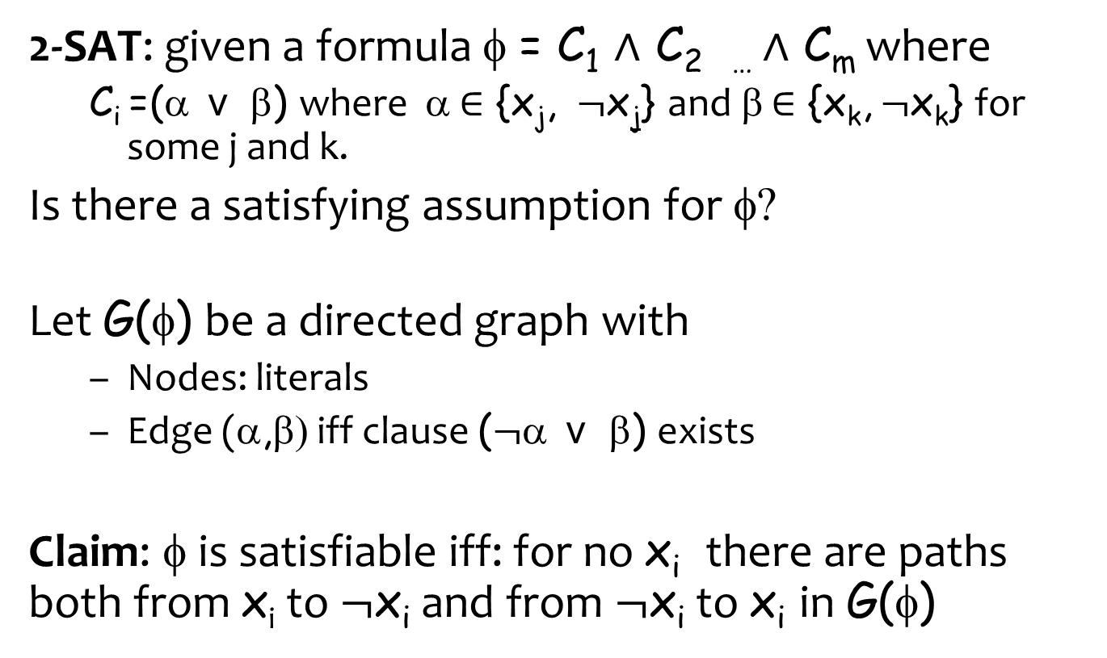
2-SAT

Slide 8
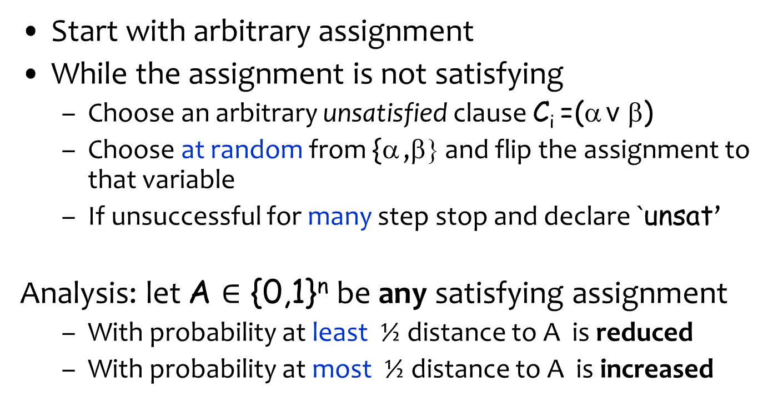
Algorithm for 2-SAT
0
n

Slide 9
Analysis of 2-SAT Algorithm
Distance can never be larger than n
Want to compute how long it takes a pebble to get with high probability to 0
  if it starts at some 0 < i < n
  Dominated by a walk where
  With probability exactly ½ distance to A is reduced
  With probability exactly ½ distance to A is increased
  When pebble hits 0: it is absorbed
  When pebble hits n: it is reflected
Dominated: for all t: The probability exact process takes more than t steps is at least as high as the original process
0
n

Slide 10
Analysis of Random Walks
Would like to be able to say:
Expected time to visit 0
For what time period can we say that there high probability?

Slide 11
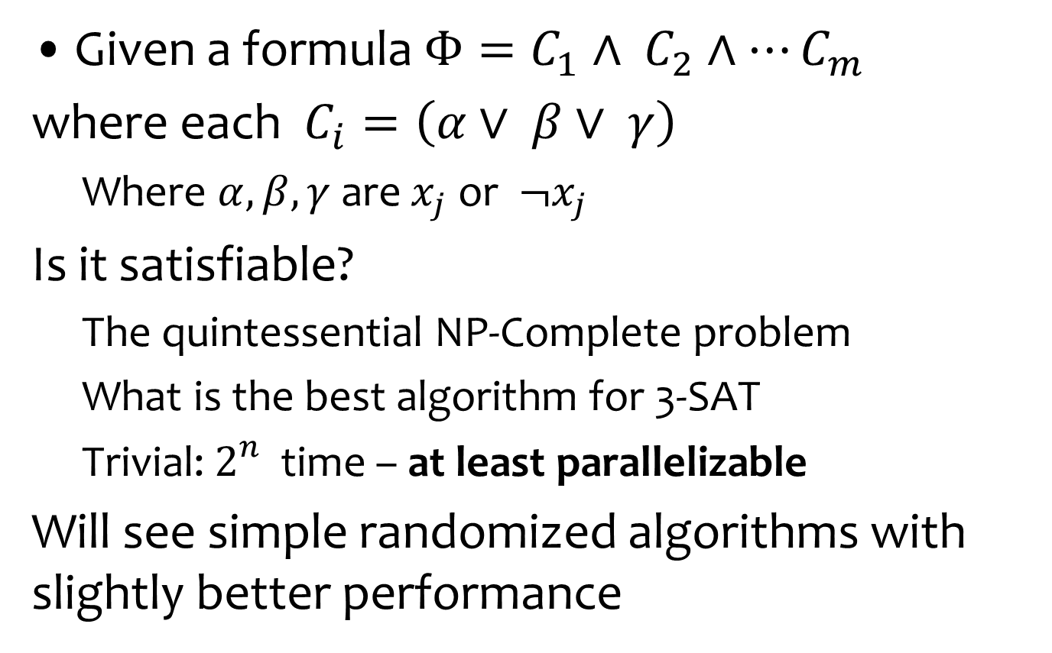
3-SAT
Given a formula $Φ=C_{1}∧ C_{2}∧⋯C_{m}$
where each ${C_{i}=\left(α∨ β∨ γ\right)}_{}$
  Where $α, β, γ$are $x_{j}$or $¬x_{j}$
Is it satisfiable?
  The quintessential NP-Complete problem
  What is the best algorithm for 3-SAT
  Trivial: $2_{}^{n}$ time – at least parallelizable
Will see simple randomized algorithms with slightly better performance

Slide 12
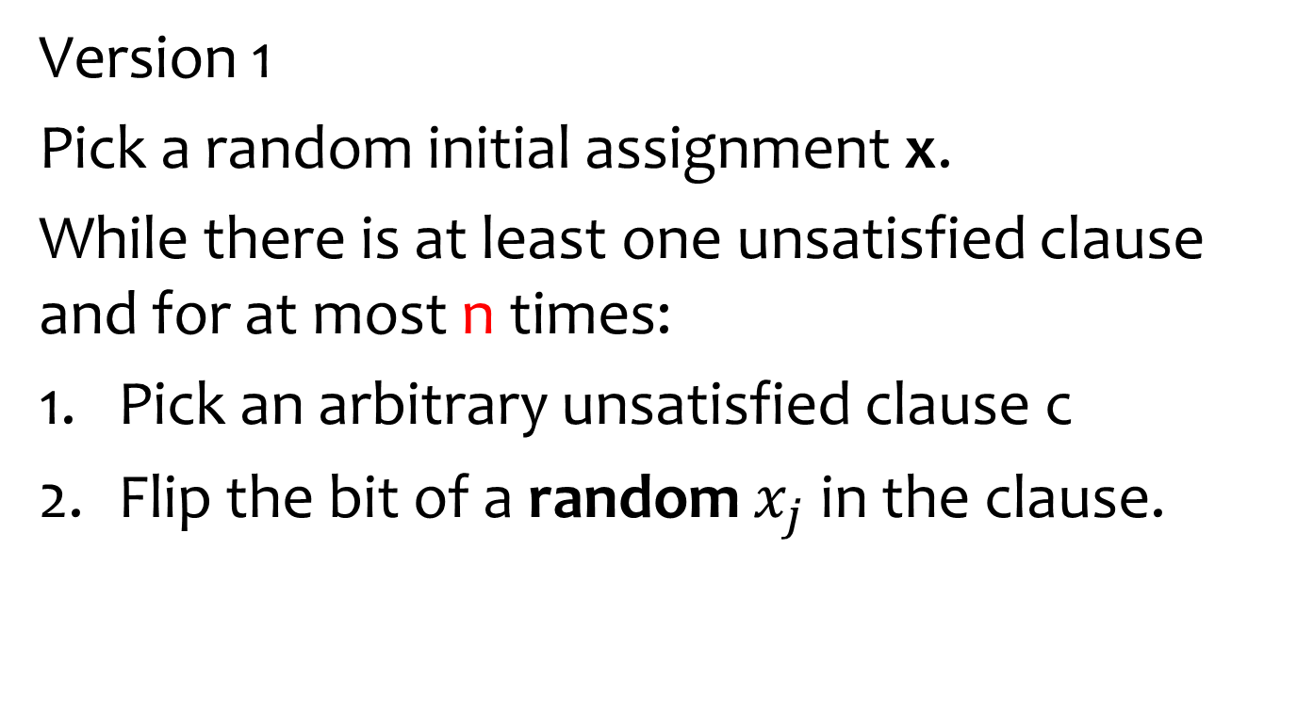
Sch ̈oning’s algorithm
Version 1
Pick a random initial assignment x.
While there is at least one unsatisfied clause and for at most n times:
Pick an arbitrary unsatisfied clause c
Flip the bit of a random $x_{j}$ in the clause.

Slide 13
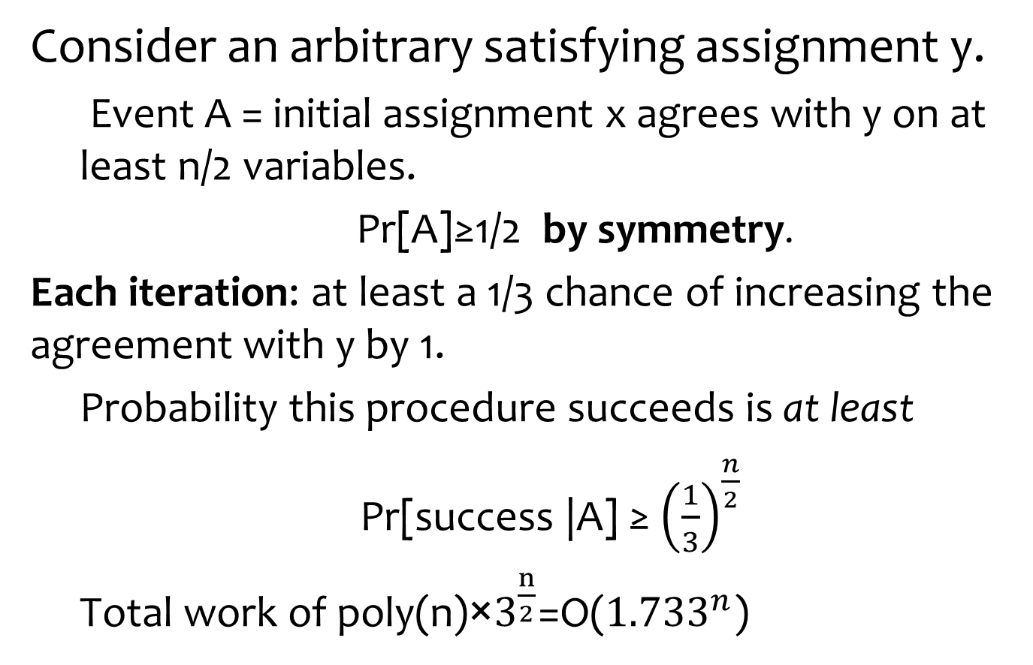
Analysis take 1
Consider an arbitrary satisfying assignment y.
  Event A = initial assignment x agrees with y on at least n/2 variables.
    Pr[A]≥1/2 by symmetry.
Each iteration: at least a 1/3 chance of increasing the agreement with y by 1.
  Probability this procedure succeeds is at least
  Pr[success |A] ≥ ${\left(\frac{1}{3}\right)}^{\frac{n}{2}}$
  Total work of poly(n)×$3^{\frac{n}{2}}$=O(${1.733}^{n}$)

Slide 14
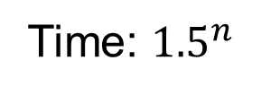
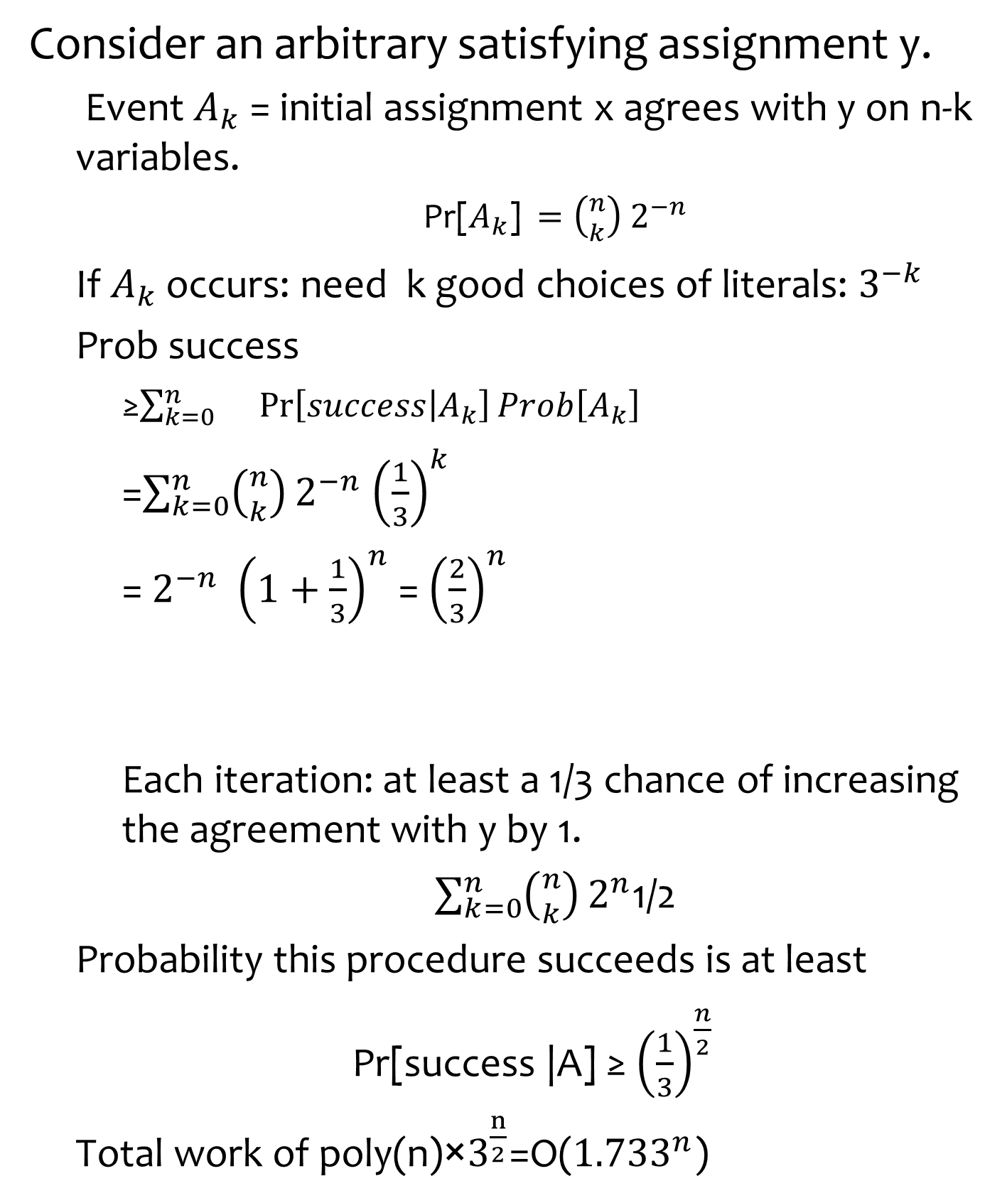
Analysis take 2
Consider an arbitrary satisfying assignment y.
  Event $A_{k}$ = initial assignment x agrees with y on n-k variables.
    Pr[$A_{k}$] $=\left({n \atop k}\right) 2^{−n}$
  If $A_{k}$ occurs: need k good choices of literals: $3^{−k}$
  Prob success
    ≥$\sum_{k=0}^{n}{}{\operatorname{Pr}\left[success | A_{k}\right]Prob\left[A_{k}\right]}^{}$
    =$\sum_{k=0}^{n}{\left({n \atop k}\right)}2^{−n}$ ${\left(\frac{1}{3}\right)}^{k}$
    = $2^{−n}$ ${\left(1+\frac{1}{3}\right)}^{n}$ = ${\left(\frac{2}{3}\right)}^{n}$
    Each iteration: at least a 1/3 chance of increasing the agreement with y by 1.
    $\sum_{k=0}^{n}{\left({n \atop k}\right)}2^{n}$1/2
  Probability this procedure succeeds is at least
  Pr[success |A] ≥ ${\left(\frac{1}{3}\right)}^{\frac{n}{2}}$
  Total work of poly(n)×$3^{\frac{n}{2}}$=O(${1.733}^{n}$)
Binomial
Theorem
Time: ${1.5}^{n}$

Slide 15
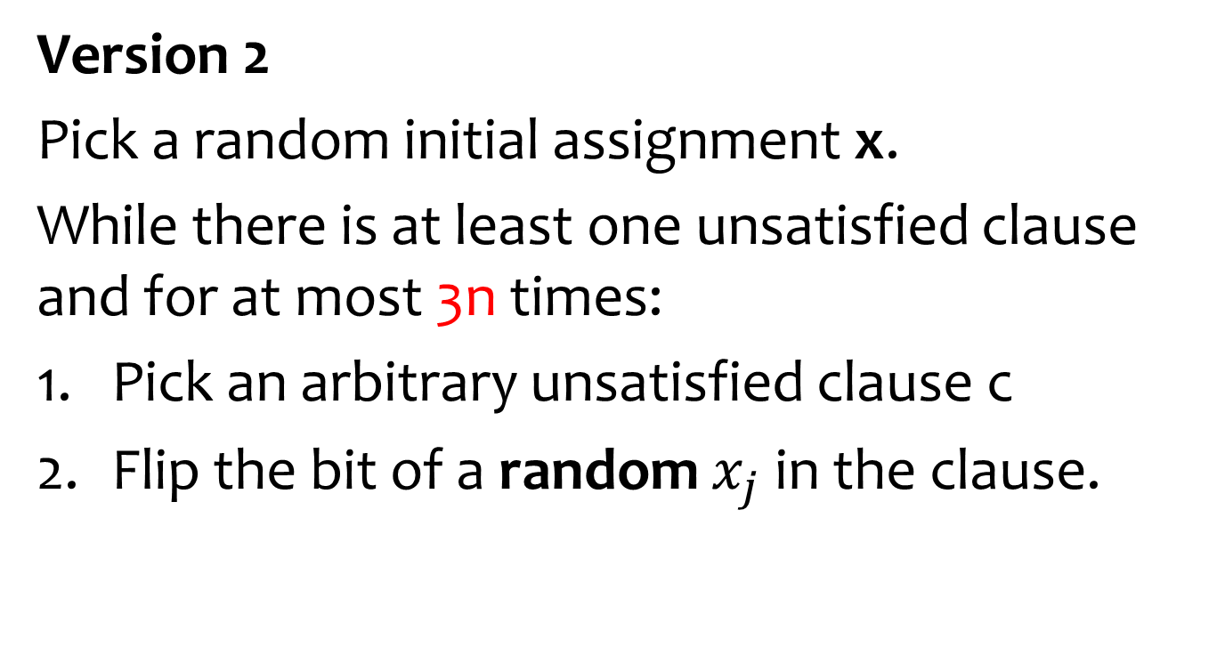
Sch ̈oning’s algorithm
Version 2
Pick a random initial assignment x.
While there is at least one unsatisfied clause and for at most 3n times:
Pick an arbitrary unsatisfied clause c
Flip the bit of a random $x_{j}$ in the clause.

Slide 16
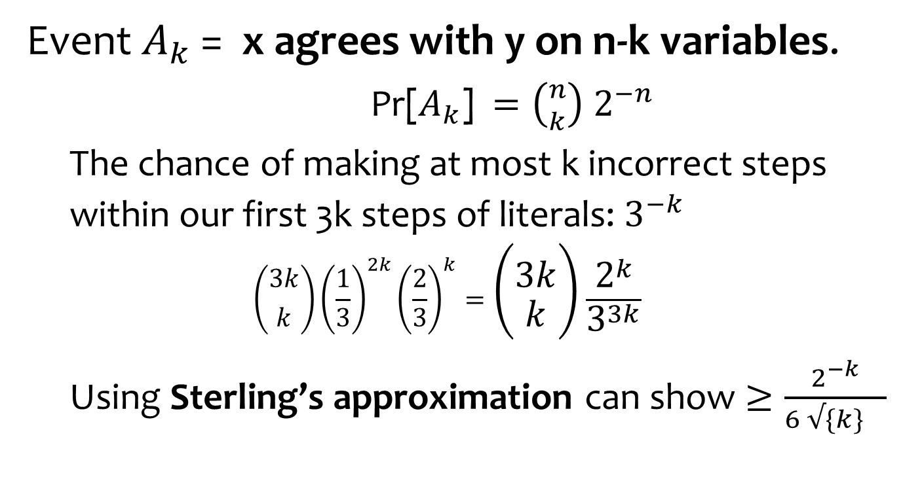
Analysis
Event $A_{k}$ = x agrees with y on n-k variables.
    Pr[$A_{k}$] $=\left({n \atop k}\right) 2^{−n}$
  The chance of making at most k incorrect steps within our first 3k steps of literals: $3^{−k}$
  $$\left({3k \atop k}\right){\left(\frac{1}{3}\right)}^{2k}{\left(\frac{2}{3}\right)}^{k}=\left({3k \atop k}\right)\frac{2^{k}}{3^{3k}}$$
  Using Sterling’s approximation can show $≥\frac{2^{−k}}{{6 √\{k\}}^{}}$

Slide 17
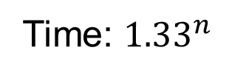
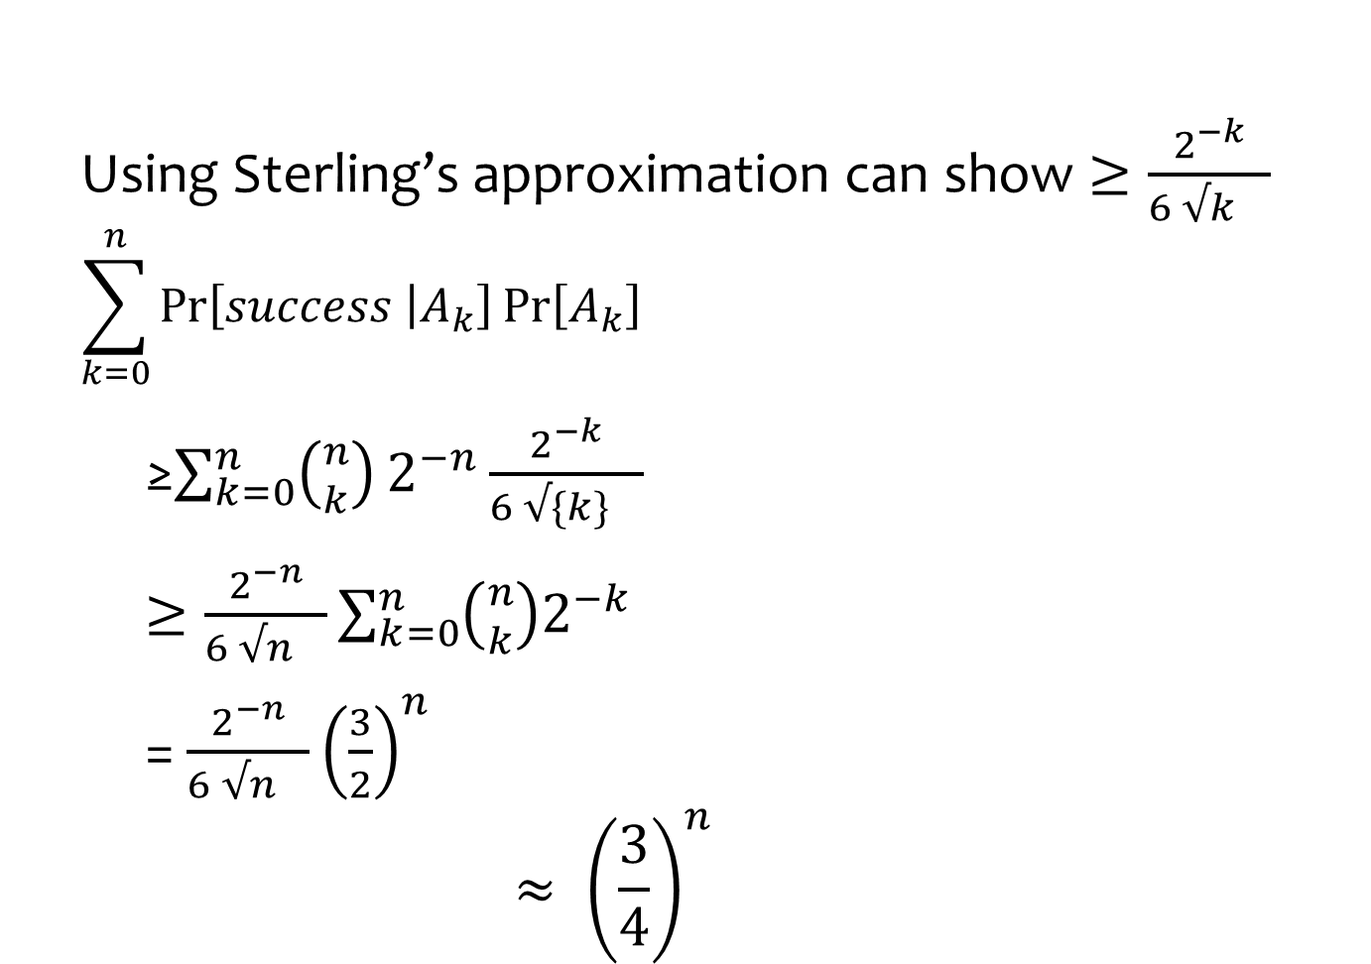
Analysis
  Using Sterling’s approximation can show $≥\frac{2^{−k}}{{6 √k}^{}}$
  $$\sum_{k=0}^{n}{\operatorname{Pr}\left[success | A_{k}\right]}{Pr\left[A_{k}\right]}^{}$$
    ≥$\sum_{k=0}^{n}{\left({n \atop k}\right)}2^{−n}\frac{2^{−k}}{{6 √\{k\}}^{}}$
    $≥\frac{2^{−n}}{{6 √n}^{}}{\sum_{k=0}^{n}{\left({n \atop k}\right)2^{−k}}}^{}$
    = ${\frac{2^{−n}}{{6 √n}^{}}\left(\frac{3}{2}\right)}^{n}$
    $$≈ {\left(\frac{3}{4}\right)}^{n}$$
Time: ${1.33}^{n}$

Slide 18
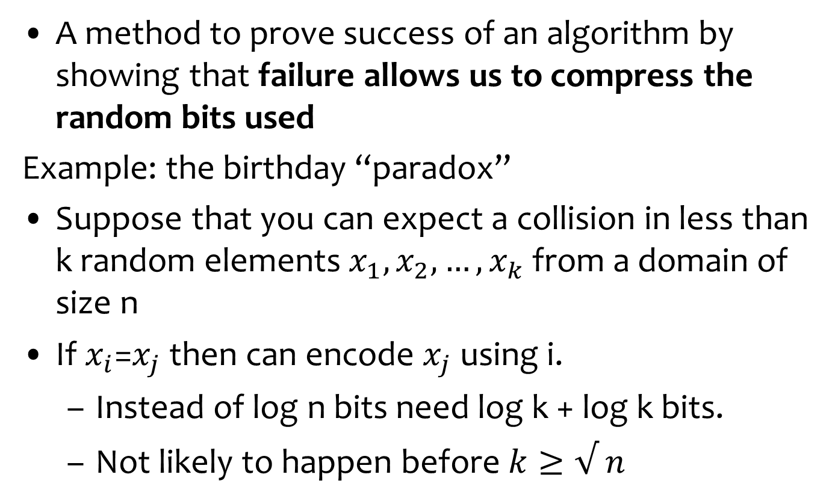
Proof by encoding
A method to prove success of an algorithm by showing that failure allows us to compress the random bits used
Example: the birthday “paradox”
Suppose that you can expect a collision in less than k random elements $x_{1}, x_{2}, …, x_{k}$from a domain of size n
If $x_{i}$=$x_{j}$then can encode $x_{j}$ using i.
  Instead of log n bits need log k + log k bits.
  Not likely to happen before $k≥√ n$
For i
LZ style
For j

Slide 19
Monte Carlo vs. Las Vegas Algorithms
Monte Carlo algorithm: Guaranteed to run in poly-time, likely to find correct answer.
  Ex: Contraction algorithm for global min cut.
Las Vegas algorithm: Guaranteed to find correct answer, likely to run in poly-time.
  Ex: Randomized quicksort
  Can always convert a Las Vegas algorithm into Monte Carlo, but no known method to convert the other way

Slide 20
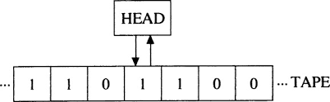

Probabilistic Turing Machines
Probabilistic Turing Machine (PTM):
Transition function
$δ:Σ×Q×\{0,1\}↦Σ×Q×\{left, right\}$
a
c
b
a
a
b
b
a
Input tape
Random tape
Alternative view: the transition function is probabilistic

Slide 21
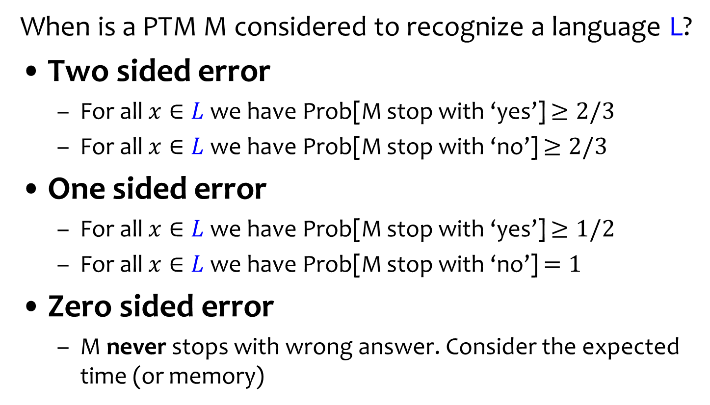
Language Recognition
When is a PTM M considered to recognize a language L?
Two sided error
  For all $x∈L$we have Prob[M stop with ‘yes’] $≥2/3$
  For all $x∈L$we have Prob[M stop with ‘no’] $≥2/3$
One sided error
  For all $x∈L$we have Prob[M stop with ‘yes’] $≥1/2$
  For all $x∈L$we have Prob[M stop with ‘no’] $=1$
Zero sided error
  M never stops with wrong answer. Consider the expected time (or memory)
Always stops
Always stops
Monte Carlo vs. Las Vegas
Might never stop!
Probability is over the random tape!

Slide 22
Complexity Classes
BPP: decision problems with two sided errors
Correct answer returned with prob ≥ 2/3
Monte Carlo
RP: decision problems solvable with one-sided error in poly time:
  If the correct answer is `no’, always return `no’.
  If the correct answer is `yes’, return`yes’ with probability ≥½.
ZPP: Decision problems solvable in expected poly-time.
Theorem: P ⊆ ZPP ⊆ RP ⊆ NP.
To what extent does randomization help?
Does P = ZPP? ZPP = RP? RP = NP?
Las Vegas
BPP
Run till twice expected stopping time
RP
Co-RP
Common belief: P=ZPP=RP=BPP
Strong PRGs
ZPP

Slide 23
Pseudo-Deterministic Algorithms
An algorithm that “with high probability” returns the same answer on all runs
For decision problems: amplify
  Interesting for search or coordination problems
Example: find a prime between N and 2N
Question: turn the Contraction Algorithm into a pseudo-deterministic algorithm
Open question (?) is it possible to turn the more advanced algorithms into pseudo-deterministic one

Slide 24
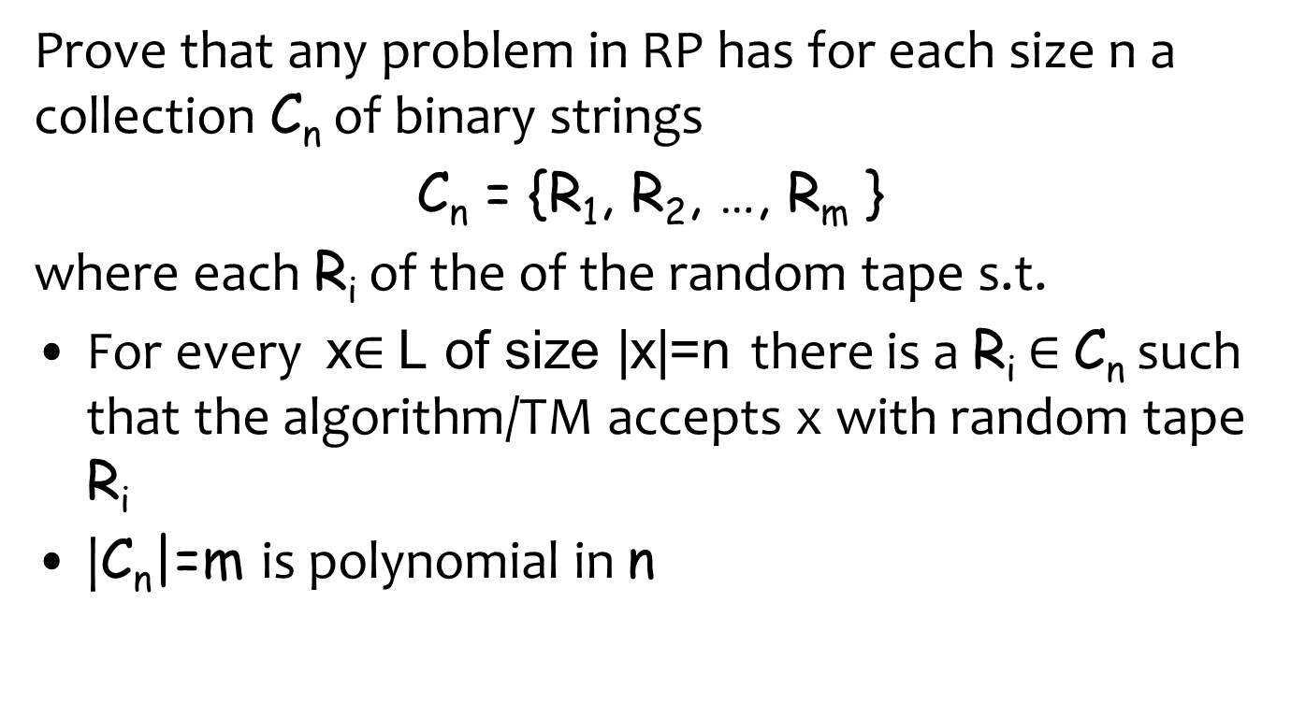
Homework: Hitting set for RP

Slide 25
Watch Lecture on Entropy
Entropy || @ CMU || Lecture 24a and 24b of CS Theory Toolkit
https://www.youtube.com/watch?v=b6x4AmjdvvY
What was the mistake?
  Codes that are uniquely decodable are not necessarily prefix free!
  Sardinas-Patterson algorithm

Slide 27


