Slide 1

Randomized Algorithms
Lecturer: Moni Naor
Lecture 4

Slide 2
Recap and Today
Recap
Complexity Classes
Chernoff Bounds
Amplification
Today
Streaming
Proof by encoding

Slide 3
Homework
Vague: Question: Why choose majority and not some other function for amplification?
Question: why does Freivald’s matrix multiplication checking work?
Question: Why does PP contain NP?

Slide 4
Streaming
Suppose you want to compute a function on a stream of data but do not have enough memory to store it
Which functions are computable?
What accuracy
Randomness essential
A
B

Slide 5
Example of a streaming problem: majority
An array/stream of length n, elements from domain of size u
Promise: there is a majority element, i.e. occurs strictly more than n/2 times.
A simple one-pass algorithm, maintaining only the current candidate majority element and a counter for it.

Slide 6
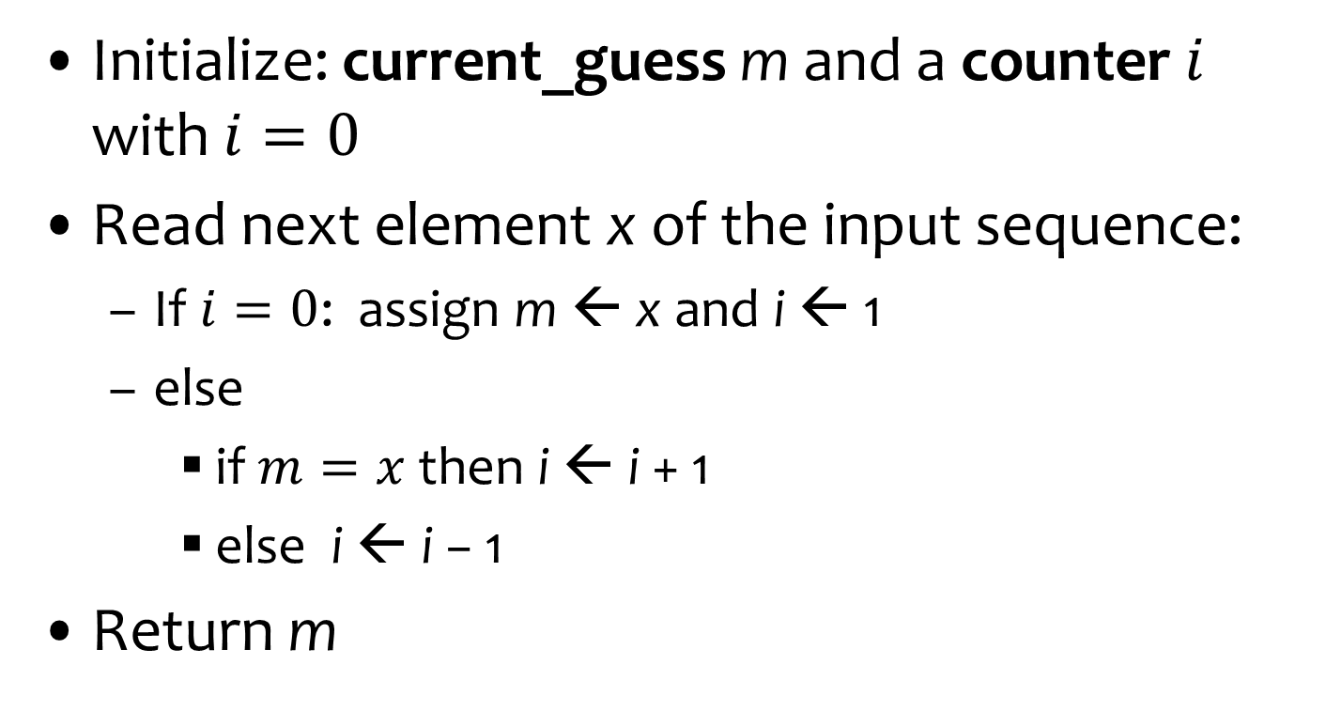
Boyer Moore Majority Algorithm
Initialize: current_guess m and a counter $i$ with $i=0$
Read next element x of the input sequence:
  If $i=0$: assign m ← x and i ← 1
  else
    if $m=x$then i ← i + 1
    else i ← i − 1
Return m
O(log n+ log u) bits
One of the few deterministic algorithms in the area
If a majority element exist, it is always returned

Slide 7
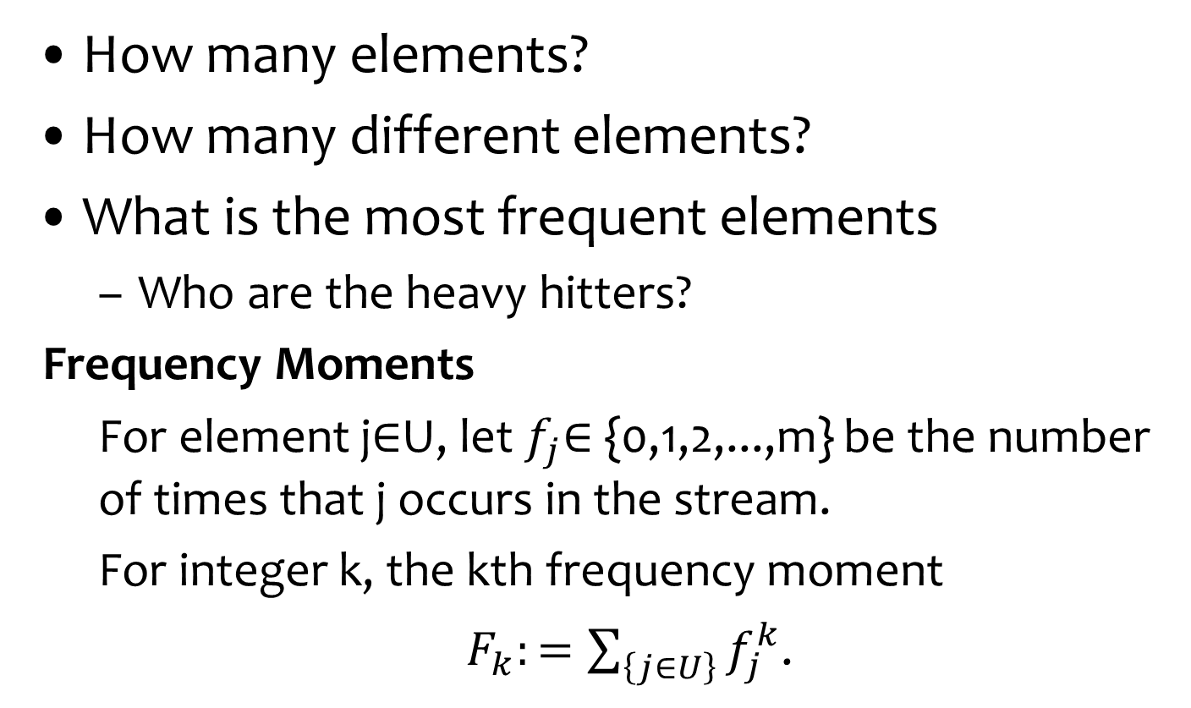
Computing on streams
How many elements?
How many different elements?
What is the most frequent elements
  Who are the heavy hitters?
Frequency Moments
  For element j∈U, let $f_{j}$∈ {0,1,2,...,m} be the number of times that j occurs in the stream.
  For integer k, the kth frequency moment
  $F_{k}:=\sum_{\left\{j∈U\right\}}{f_{j}^{k}}$.

Slide 8
Multi-set equality
We have two multi-sets A and B
  given in an arbitrary order. Once an element is given it cannot be accessed again
    (unless it is explicitly stored) and our
  goal a low memory algorithm for equality.
Idea: choose a function h and compute h(A) and h(B) gradually.
h chosen from a family of hash functions H
  All the randomness comes from choice of h
Cannot hope to have
a deterministic algorithm

Slide 9
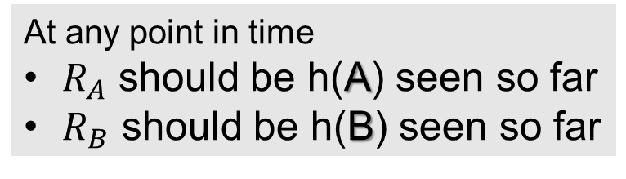
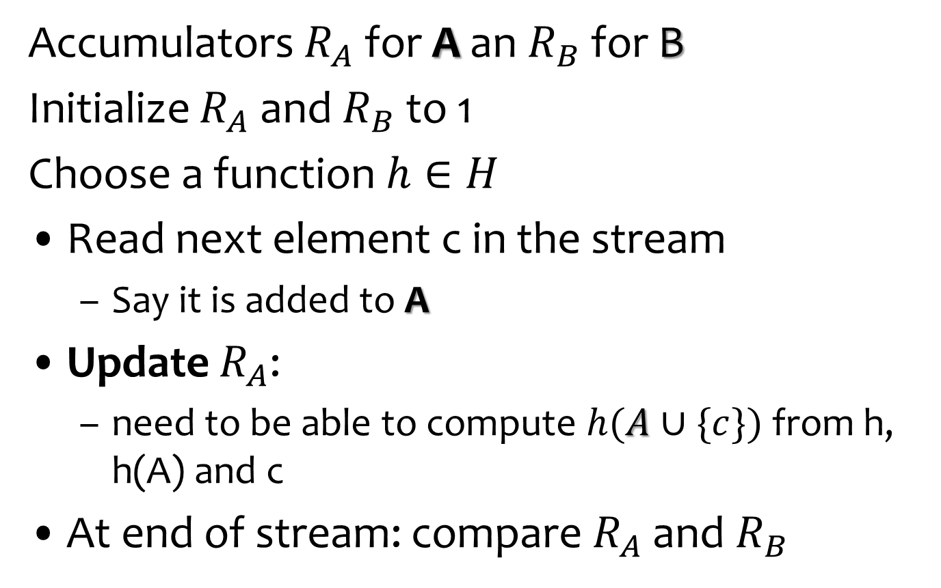
Algorithm
From the range of h
Accumulators $R_{A}$ for A an $R_{B}$ for B
Initialize $R_{A}$ and $R_{B}$ to 1
Choose a function $h∈H$
Read next element c in the stream
  Say it is added to A
Update $R_{A}$:
  need to be able to compute $h(A∪\{c\})$from h, h(A) and c
At end of stream: compare $R_{A}$ and $R_{B}$
At any point in time
$R_{A}$ should be h(A) seen so far
$R_{B}$ should be h(B) seen so far
Uniformly at random

Slide 10
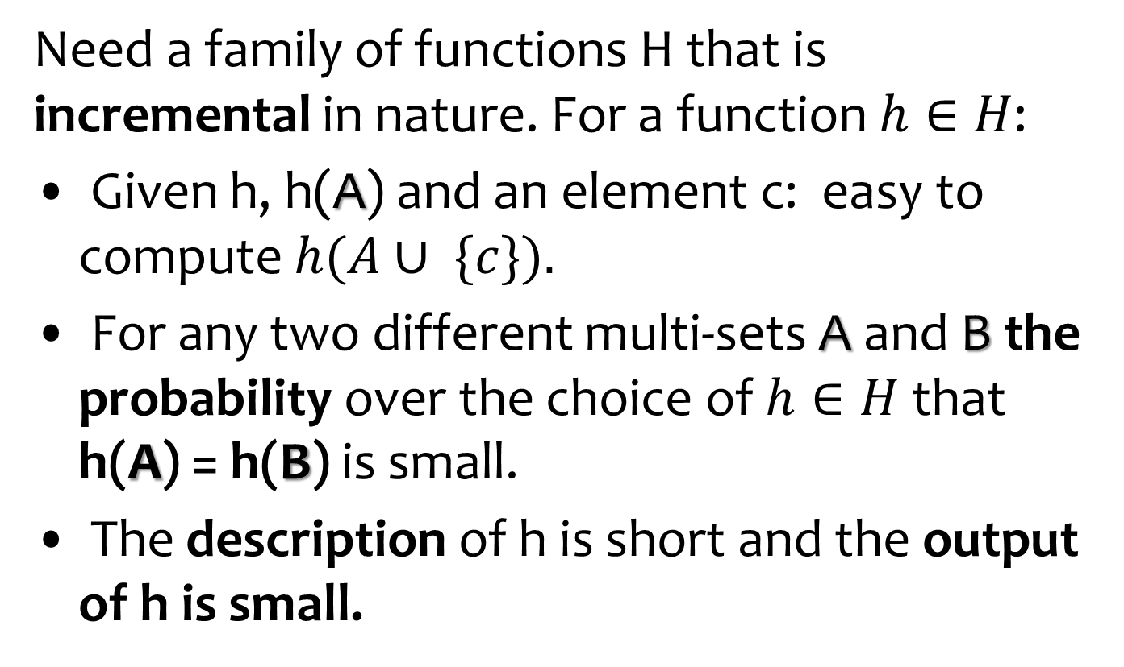
Multi-set equality
Need a family of functions H that is incremental in nature. For a function $h∈H$:
Given h, h(A) and an element c: easy to compute $h(A∪ \{c\}).$
For any two different multi-sets A and B the probability over the choice of $h∈H$that h(A) = h(B) is small.
The description of h is short and the output of h is small.

Slide 11
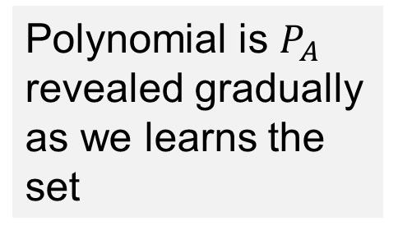
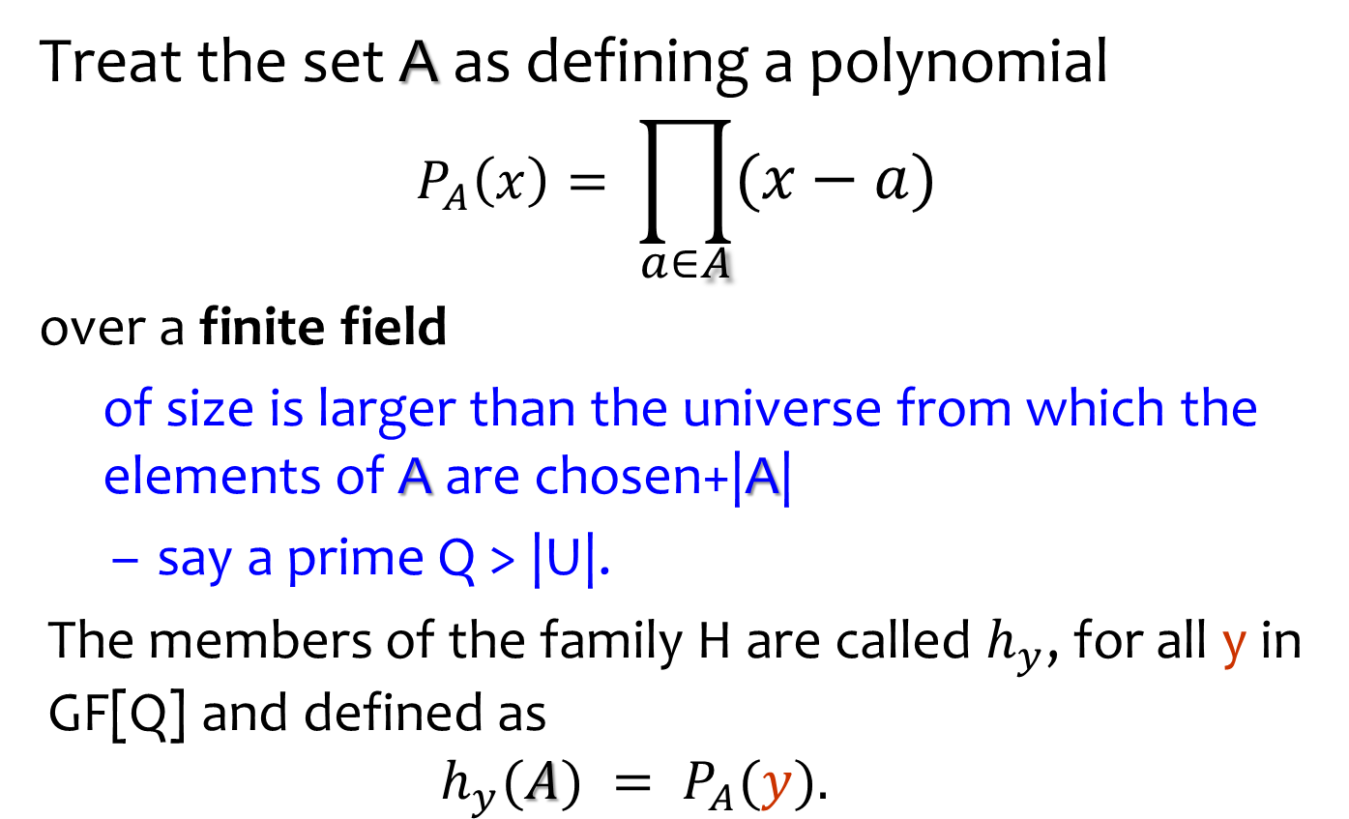
Functions for Multi-set equality
Treat the set A as defining a polynomial
$$P_{A}\left(x\right)= \prod_{a∈A}{(x−a)}$$
over a finite field
  of size is larger than the universe from which the elements of A are chosen+|A|
  say a prime Q > |U|.
The members of the family H are called $h_{y}$, for all y in GF[Q] and defined as
  $$h_{y}(A) = P_{A}(y).$$
Polynomial is $P_{A}$ revealed gradually as we learns the set

Slide 12
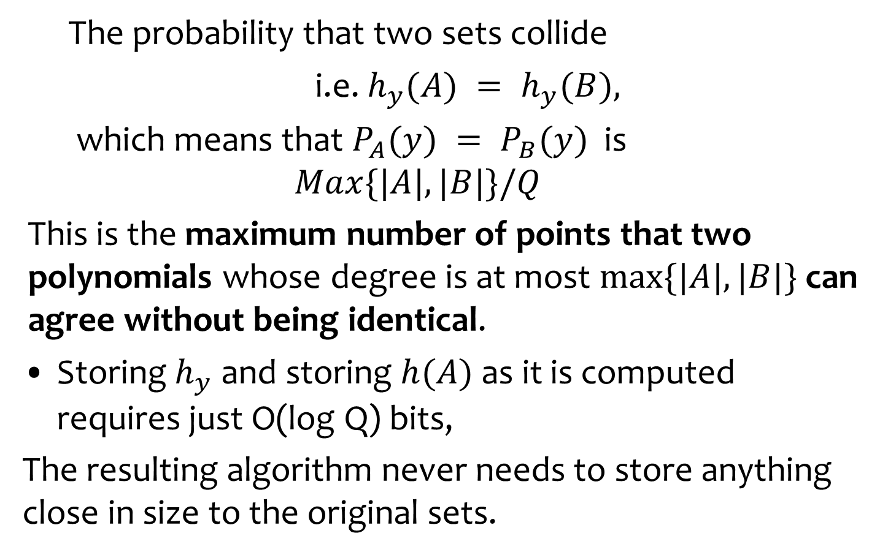
Analysis
  The probability that two sets collide
  i.e. $h_{y}(A) = h_{y}(B),$
  which means that $P_{A}(y) = P_{B}(y)$is
  $$Max\{|A|, |B|\}/Q$$
This is the maximum number of points that two polynomials whose degree is at most $max⁡\{|A|, |B|\}$can agree without being identical.
Storing $h_{y}$ and storing $h(A)$ as it is computed requires just O(log Q) bits,
The resulting algorithm never needs to store anything close in size to the original sets.

Slide 13
Computing on streams
How many elements?
How many different elements?
What is the most frequent elements
  Who are the heavy hitters?
Frequency Moments
  For element j∈U, let $f_{j}$∈ {0,1,2,...,m} be the number of times that j occurs in the stream.
  For integer k, the kth frequency moment
  $F_{k}:=\sum_{\left\{j∈U\right\}}{f_{j}^{k}}$.

