Slide 1

Randomized Algorithms
Lecturer: Moni Naor
Lecture 8

Slide 2
Recap and Today
Recap
Today
Guess the cards
Local Lemma

Slide 3
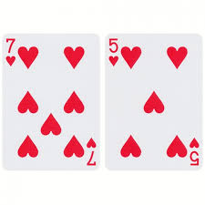
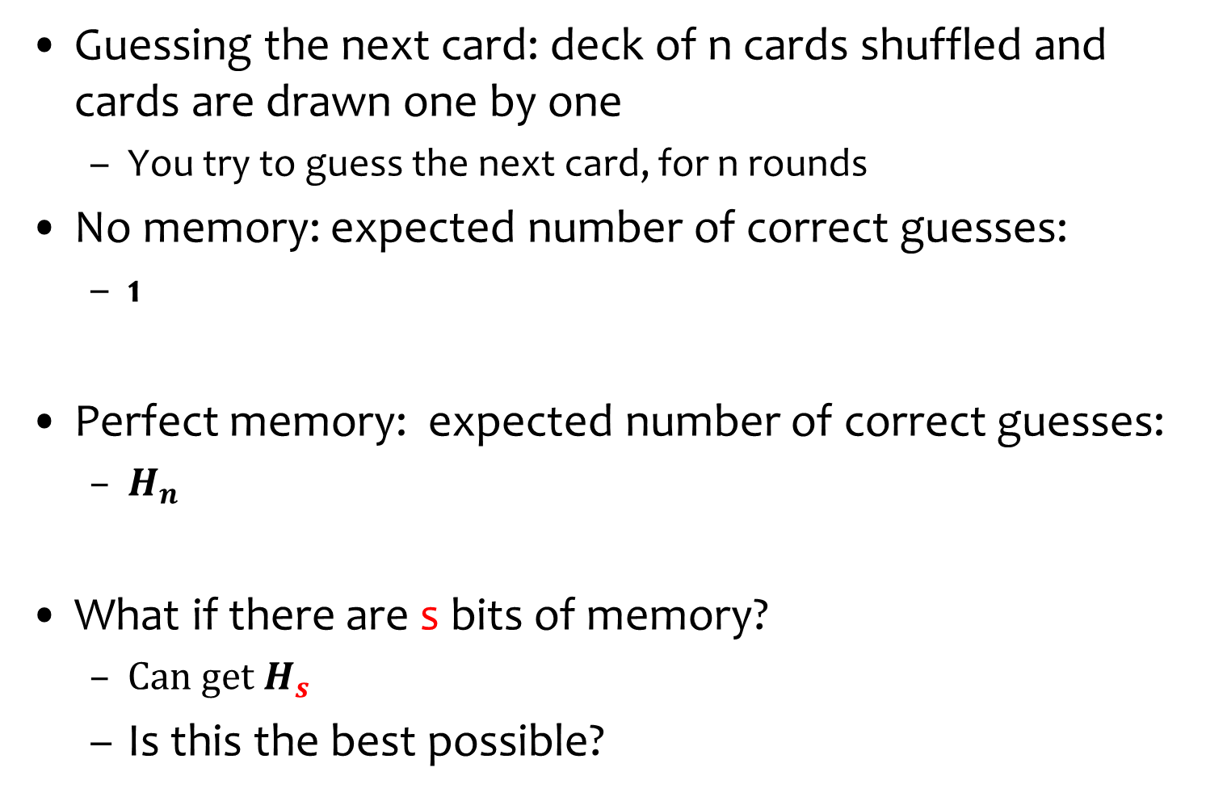
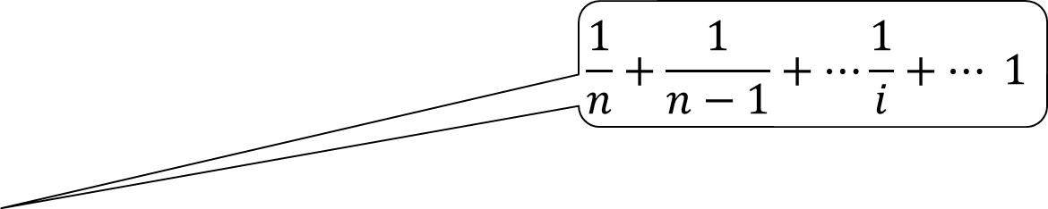
Guess the card
Guessing the next card: deck of n cards shuffled and cards are drawn one by one
  You try to guess the next card, for n rounds
No memory: expected number of correct guesses:
  1
Perfect memory: expected number of correct guesses:
  $H_{n}$
What if there are s bits of memory?
  ${Can get H}_{s}$
  Is this the best possible?
$$\frac{1}{n}+\frac{1}{n−1}+⋯\frac{1}{i}+⋯ 1$$
Idea: remember the first s (in terms of
face value) cards and ignore the rest
No! Can do
much better

Slide 4
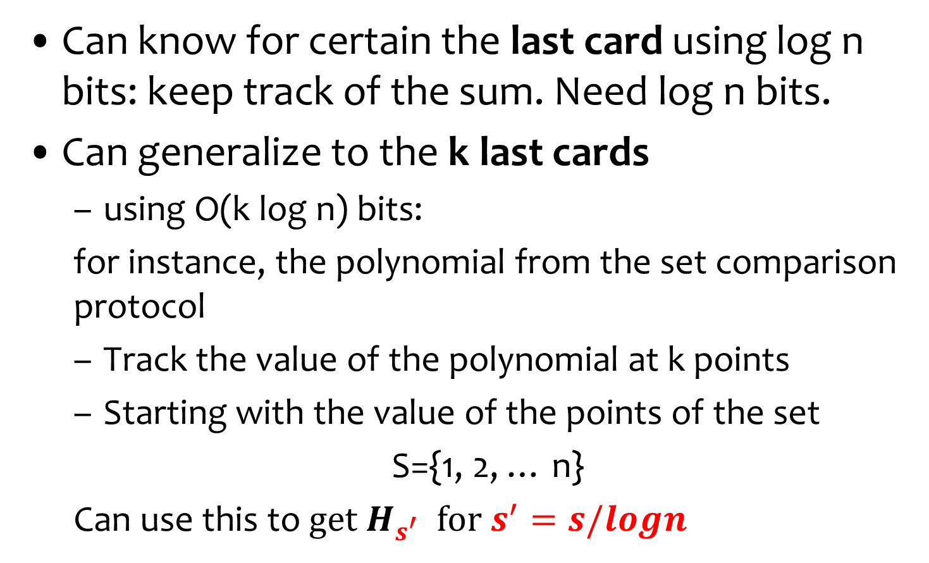
First Idea: Encoding the last cards
Can know for certain the last card using log n bits: keep track of the sum. Need log n bits.
Can generalize to the k last cards
  using O(k log n) bits:
  for instance, the polynomial from the set comparison protocol
  Track the value of the polynomial at k points
  Starting with the value of the points of the set
  S={1, 2, … n}
  Can use this to${ get H}_{s^{′}} {for s}^{′}=s/logn$

Slide 5
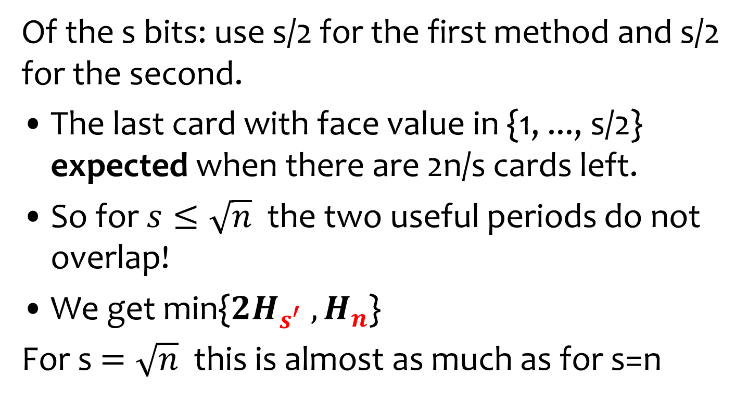
Idea: Two Methods are Compatible!
Of the s bits: use s/2 for the first method and s/2 for the second.
The last card with face value in {1, ..., s/2} expected when there are 2n/s cards left.
So for $s≤\sqrt{n}$the two useful periods do not overlap!
We get min{${2H}_{s^{′}}{ ,H}_{n}$}
For s $=\sqrt{n}$ this is almost as much as for s=n
Optimal split?

Slide 6
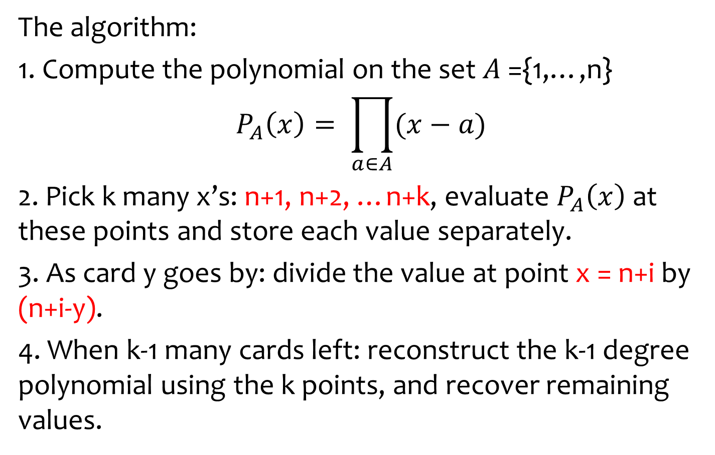
Encoding the Last k Cards
The algorithm:
1. Compute the polynomial on the set $A$={1,…,n}
$$P_{A}\left(x\right)= \prod_{a∈A}{(x−a)}$$
2. Pick k many x’s: n+1, n+2, …n+k, evaluate $P_{A}\left(x\right)$ at these points and store each value separately.
3. As card y goes by: divide the value at point x = n+i by (n+i-y).
4. When k-1 many cards left: reconstruct the k-1 degree polynomial using the k points, and recover remaining values.
over a finite field of size at least n+k

Slide 7
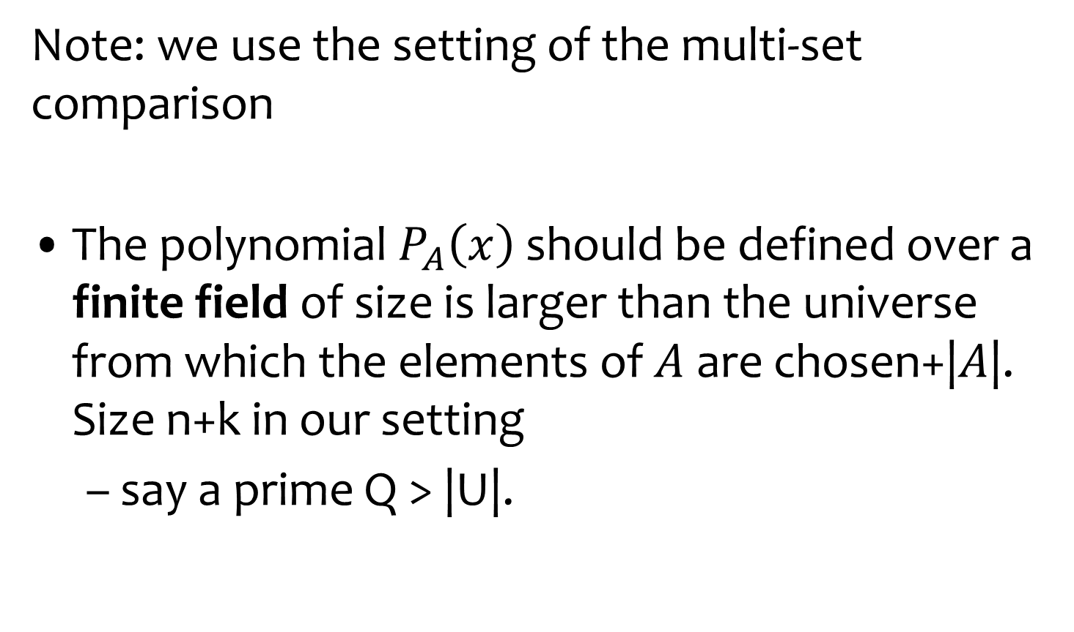
Encoding the Last k Cards
Note: we use the setting of the multi-set comparison
The polynomial $P_{A}\left(x\right)$should be defined over a finite field of size is larger than the universe from which the elements of $A$ are chosen+|$A$|. Size n+k in our setting
  say a prime Q > |U|.

Slide 8
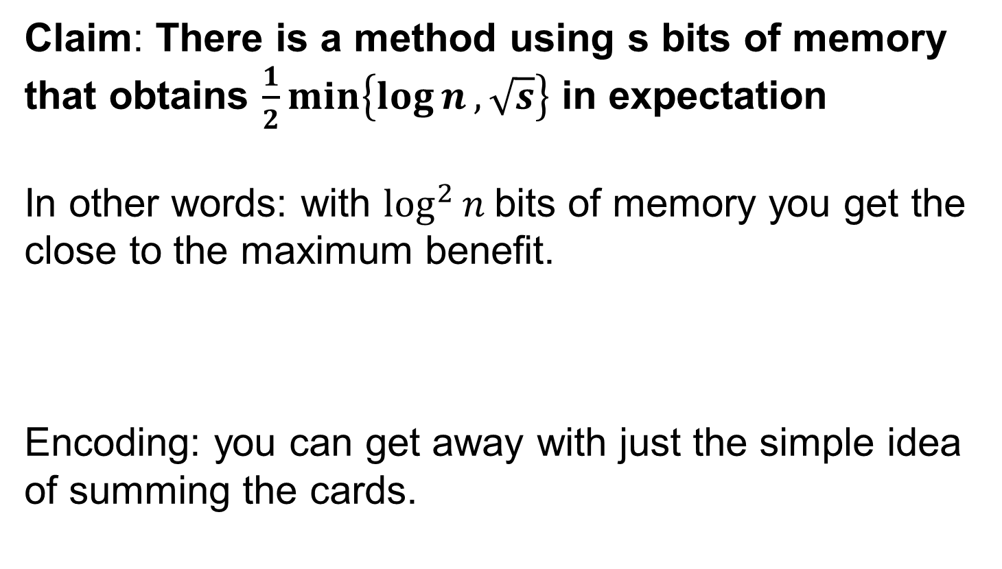
Better Idea: Low Memory Card Guessing by Following Subsets
Claim: There is a method using s bits of memory that obtains $\frac{1}{2}\min\left\{\log{n}, \sqrt{s}\right\}$ in expectation
In other words: with $\log^{2}{n}$bits of memory you get the close to the maximum benefit.
Encoding: you can get away with just the simple idea of summing the cards.

Slide 9
The General Method
Idea: follow the cards that appeared in various subsets of [n].
For each such subset use two accumulators:
  Sum of the values of the cards seen so far
  Number of the cards from the set seen so far
  Memory: O(log n)
If there is such a subset where all but one card appeared
  Can detect it
  The card is a reasonable guess
  What if there are two such subsets?

Slide 10
Subset Construction
Consider the subsets
[1-1][1-2],[1-4],[1-8],[1-16],[1-32], ..., [1-n]
If there is a range where a single card is missing then this card is the current guess.
Property: In this construction there cannot be competing good cards to guess:
For all k and k’:
  If card i is the missing one from [1-k], then there cannot be a different one missing from [1-k’]
The Algorithm!

Slide 11
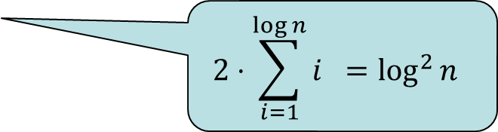
Analysis
Call a subset [1,w] useful if the last card from it that appears in the permutation is not the last card in the next range/subset [1,2w].
  If a range is useful: then it necessarily contributes a good guess.
  And the only one to which this guess is attributed
So the number of good guesses is simply the number of useful ranges.
Number of bits for a set of size w:
  log w bits for the counter
  log w bits for the sum
$$2⋅\sum_{i=1}^{\log{n}}{i} =\log^{2}{n}$$

Slide 12
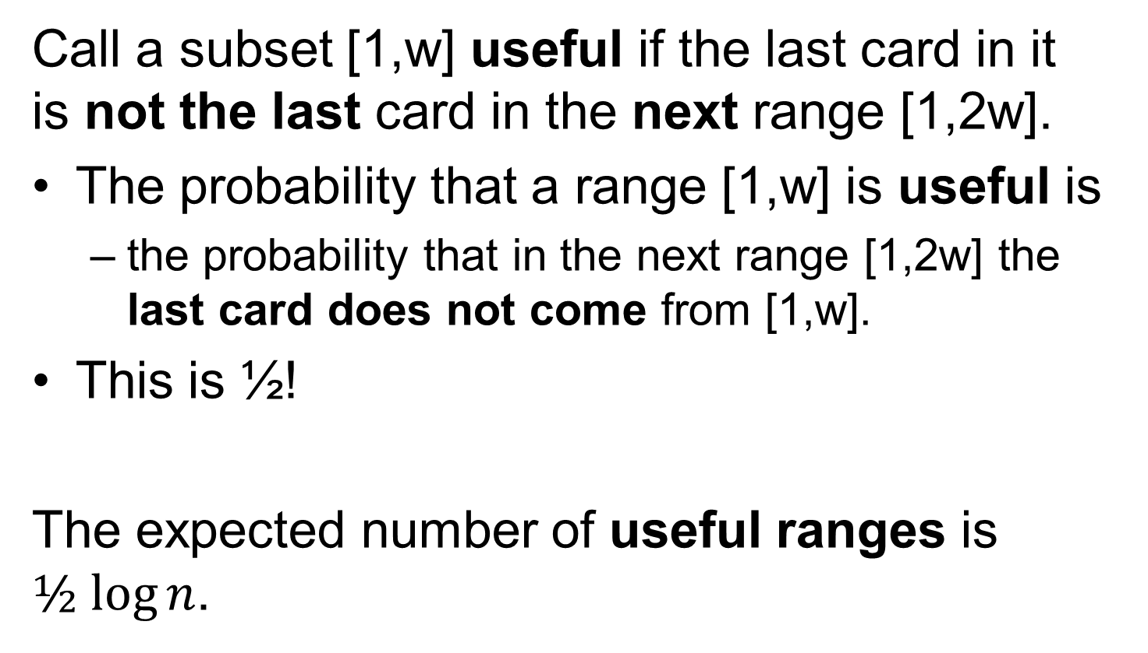
…Analysis
Call a subset [1,w] useful if the last card in it is not the last card in the next range [1,2w].
The probability that a range [1,w] is useful is
  the probability that in the next range [1,2w] the last card does not come from [1,w].
This is ½!
The expected number of useful ranges is $½ log⁡n$.
1
w
2w

Slide 13

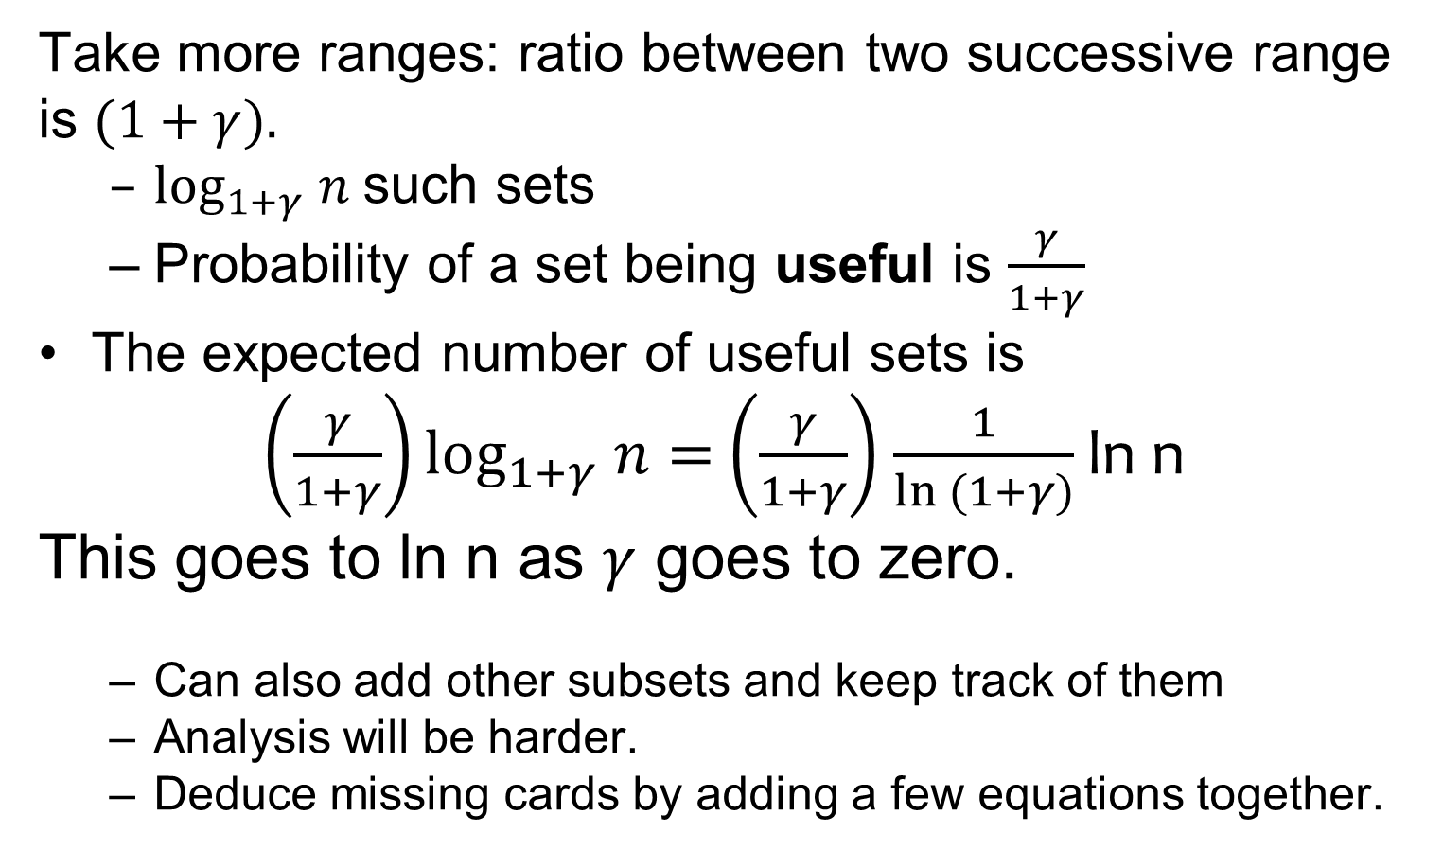
Improvements
Take more ranges: ratio between two successive range is $(1+γ).$
  $\log_{1+γ} n$such sets
  Probability of a set being useful is $\frac{γ}{1+γ}$
The expected number of useful sets is
$\left(\frac{γ}{1+γ}\right)\log_{1+γ} n$ $=$ $\left(\frac{γ}{1+γ}\right)$ $\frac{1}{ln (1+γ)}$ ln n
This goes to ln n as $γ$ goes to zero.
  Can also add other subsets and keep track of them
  Analysis will be harder.
  Deduce missing cards by adding a few equations together.
1
w
$(1+γ)$w

Slide 14
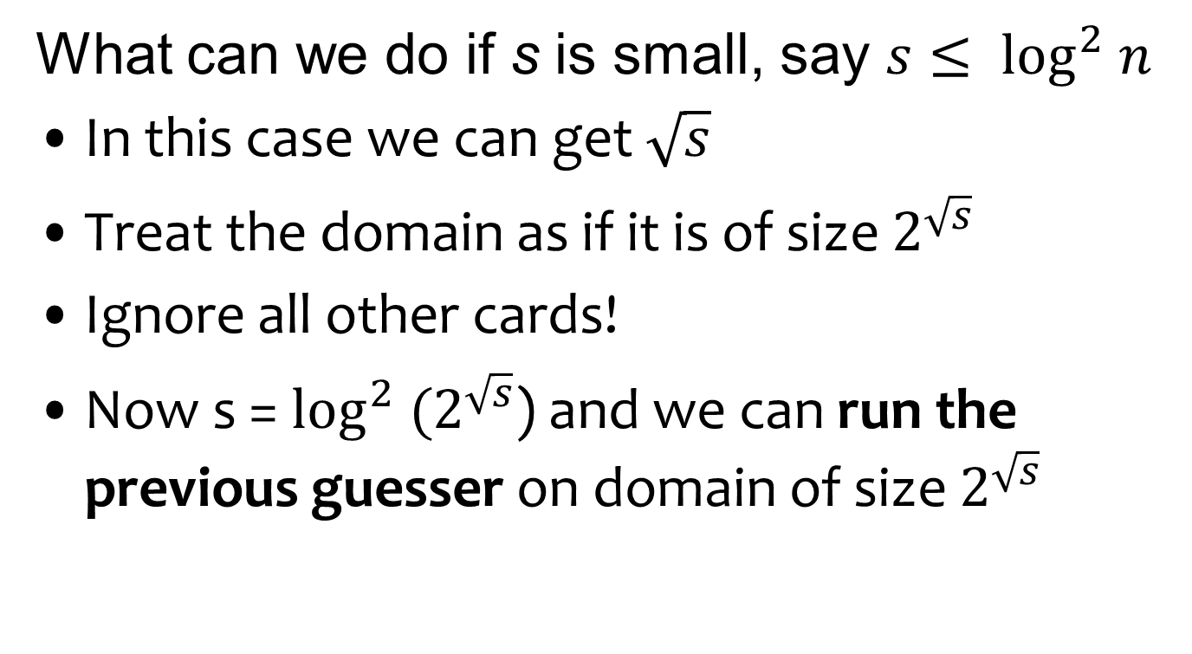
The Low Memory Case
What can we do if s is small, say $s≤ \log^{2} n$
In this case we can get $\sqrt{s}$
Treat the domain as if it is of size $2^{\sqrt{s}}$
Ignore all other cards!
Now s = $\log^{2} (2^{\sqrt{s}}$) and we can run the previous guesser on domain of size $2^{\sqrt{s}}$

Slide 15
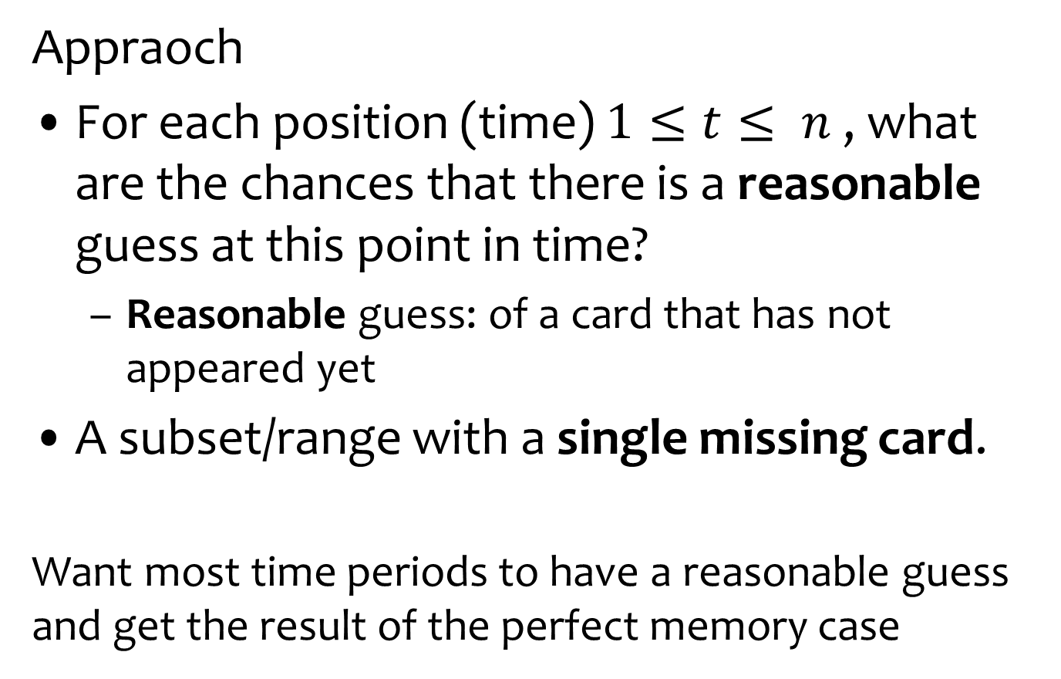
Different Analysis
Appraoch
For each position (time) $1≤t≤ n$ , what are the chances that there is a reasonable guess at this point in time?
  Reasonable guess: of a card that has not appeared yet
A subset/range with a single missing card.
Want most time periods to have a reasonable guess and get the result of the perfect memory case

Slide 16
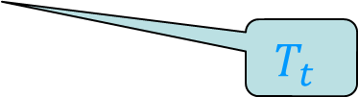
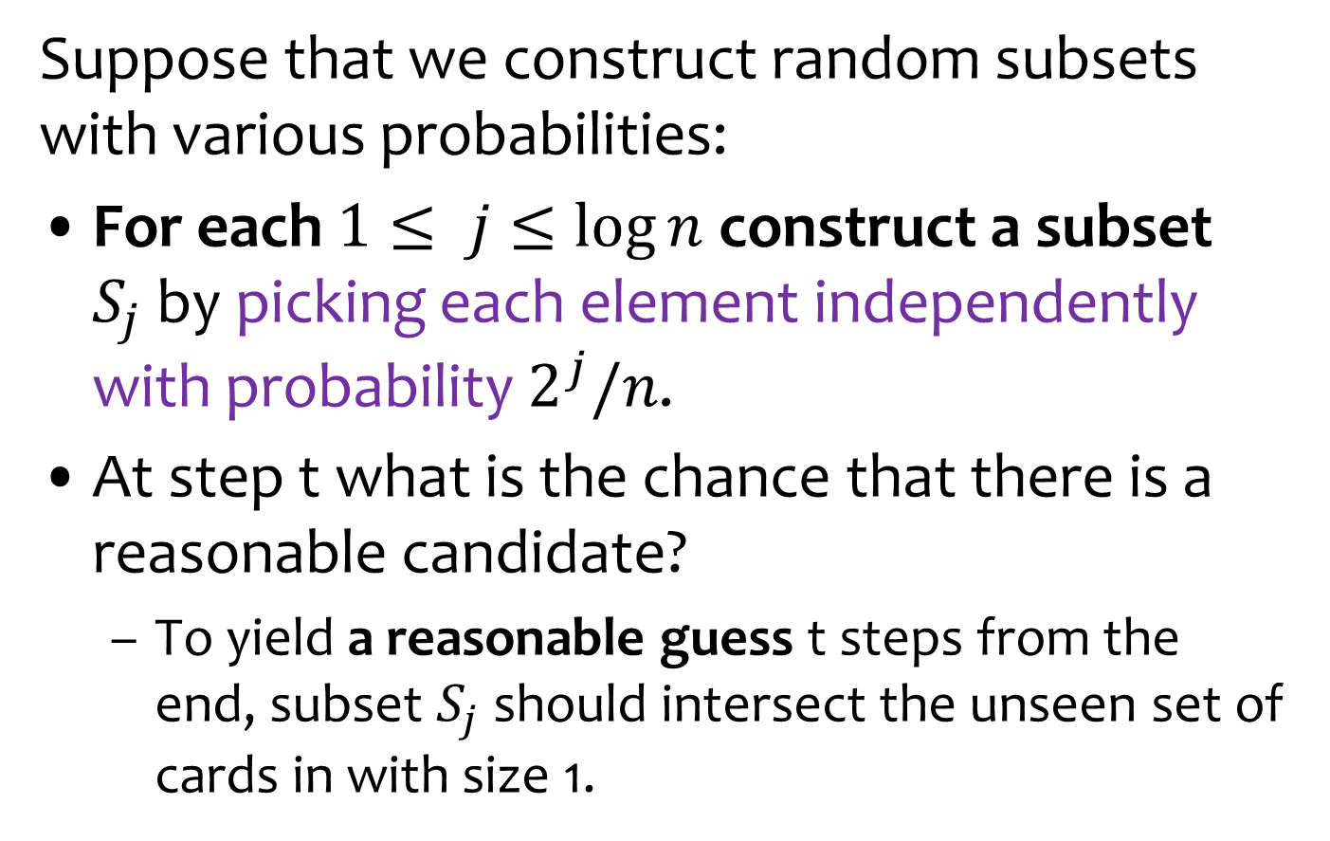
Probabilistic Construction
Suppose that we construct random subsets with various probabilities:
For each $1≤ j≤\log{n}$construct a subset $S_{j}$by picking each element independently with probability $2^{j}/n$.
At step t what is the chance that there is a reasonable candidate?
  To yield a reasonable guess t steps from the end, subset $S_{j}$ should intersect the unseen set of cards in with size 1.
Appearing in time slots n-t+1,...,n
$$T_{t}$$

Slide 17
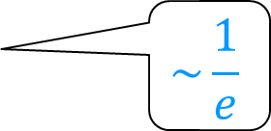
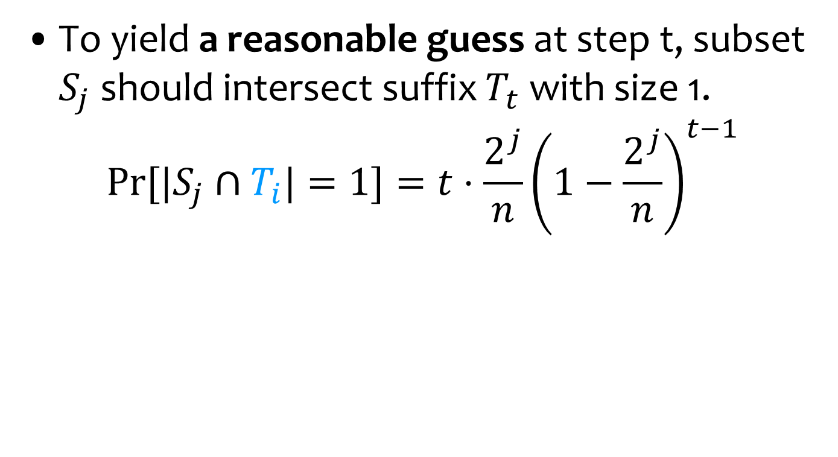
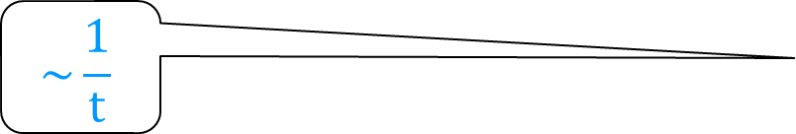
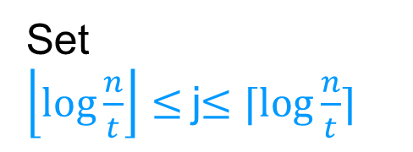
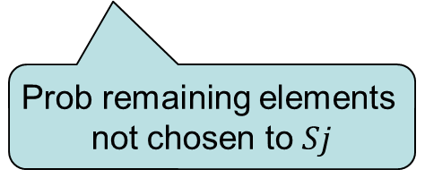
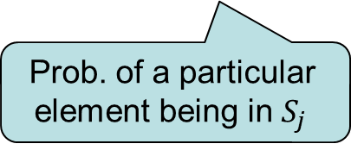

Analysis
$S_{j}$ random set prob $\frac{2^{j}}{n}$
$T_{t}$ cards unseen so far
To yield a reasonable guess at step t, subset $S_{j}$ should intersect suffix $T_{t}$ with size 1.
$$Pr⁡[|S_{j}∩T_{i}|=1]=t⋅\frac{2^{j}}{n}{\left(1−\frac{2^{j}}{n}\right)}^{t−1}$$
$$\sim \frac{1}{t}$$
$$\sim \frac{1}{e}$$
Number of possible
intersection
Prob. of a particular
element being in $S_{j}$
Prob remaining elements
not chosen to $Sj$
Prob. of reasonable guess - constant
Set
$\left\lfloor \log{\frac{n}{t}}\right\rfloor ≤$j$≤⌈\log{\frac{n}{t}}⌉$
n-t
t

Slide 18
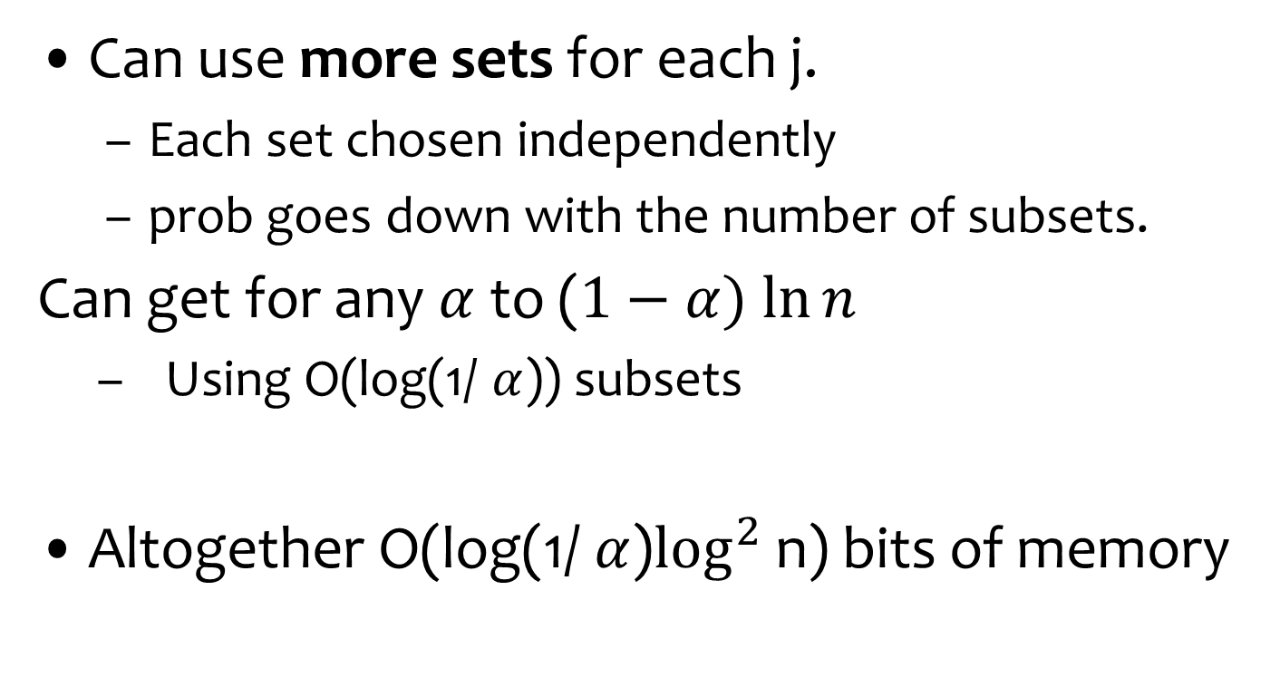
Amplification
Can use more sets for each j.
  Each set chosen independently
  prob goes down with the number of subsets.
Can get for any $α$to ($1−α) ln⁡n$
  Using O(log(1/ $α$)) subsets
Altogether O(log(1/ $α$)$\log^{2}$ n) bits of memory

Slide 19
New: Working Against a Static Adversary
  Adversary chooses the sequence of cards ahead of time and independent of the guesses it sees
  Knows the algorithm
  Any randomness that should be accessed again and again is charged to the memory
  As a first step: assume the guesser has access to the randomness “for free”
  The [1][1-2]… construction does not work: simply put 1 at the end.
  The probabilistic construction works – but the issue is the size of the representation

Slide 20
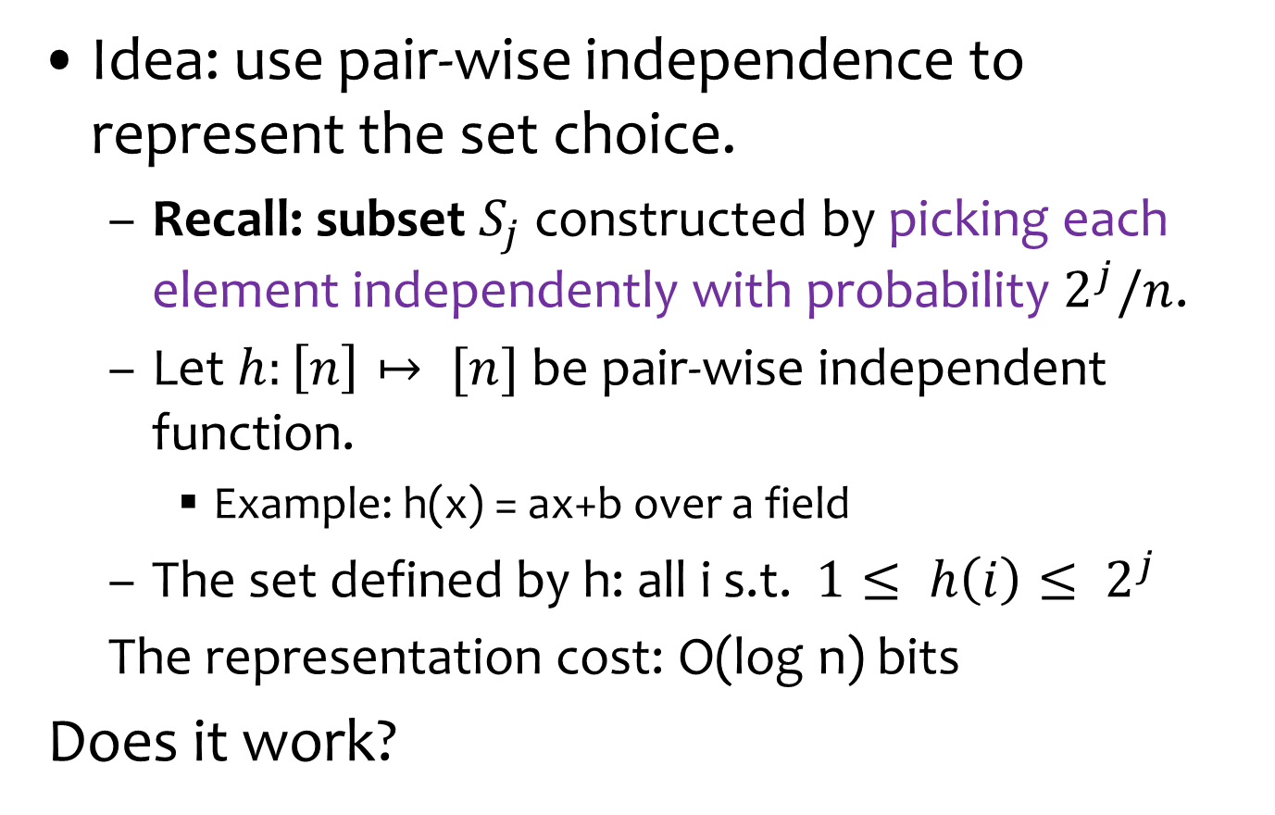
Pair-Wise Independence Representation
Idea: use pair-wise independence to represent the set choice.
  Recall: subset $S_{j}$constructed by picking each element independently with probability $2^{j}/n$.
  Let $h:\left[n\right]↦ [n]$ be pair-wise independent function.
    Example: h(x) = ax+b over a field
  The set defined by h: all i s.t. $1≤ h\left(i\right)≤ 2^{j}$
  The representation cost: O(log n) bits
Does it work?
Assume n is a power of 2

Slide 21
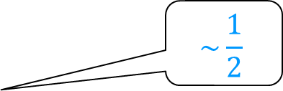
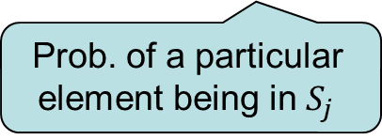
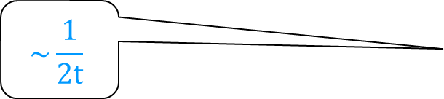

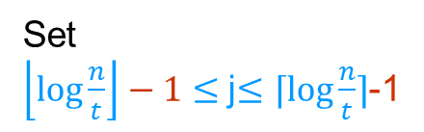
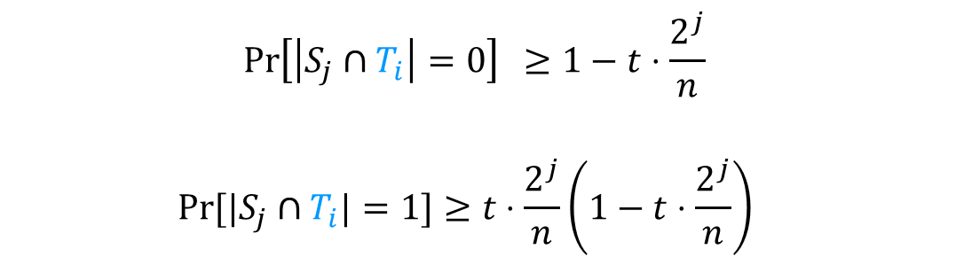
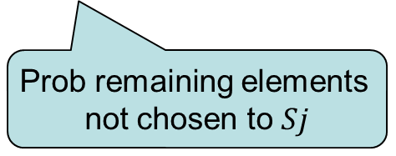
Analysis of Pair-Wise Independence Representation
To yield a reasonable guess at step t, subset $S_{j}$ should intersect suffix $T_{t}$ with size 1.
$$Pr⁡[|S_{j}∩T_{i}|=1]=t⋅\frac{2^{j}}{n}{\left(1−\frac{2^{j}}{n}\right)}^{t−1}$$
Used:
Using full
independence
Number of possible
intersection
Prob. of a particular
element being in $S_{j}$
Prob remaining elements
not chosen to $Sj$
Now only pair-wise:
Union Bound
$$\operatorname{Pr}\left[\left|S_{j}∩T_{i}\right|=0\right] ≥1−t⋅\frac{2^{j}}{n}$$
$$Pr⁡[|S_{j}∩T_{i}|=1]≥t⋅\frac{2^{j}}{n}{\left(1−t⋅\frac{2^{j}}{n}\right)}^{}$$
$$\sim \frac{1}{2}$$
$$\sim \frac{1}{2t}$$
Set
$\left\lfloor \log{\frac{n}{t}}\right\rfloor −1≤$j$≤⌈\log{\frac{n}{t}}⌉$-1

Slide 22
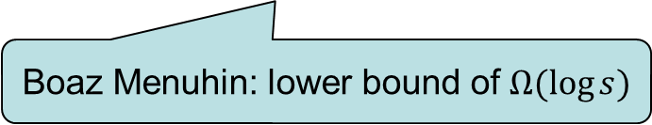
An Adaptive Adversary
What happens in the adversarial case, when the memory is wide open for the adversary to see
  Each subset on its own works fine, but to work together you need that the one subset finishes before the second one starts being effective
  Weaker adversarial model: adaptive card choice.
    Can choose the sequence based on the guesses made
Boaz Menuhin: lower bound of$Ω(\log{s})$

Slide 23
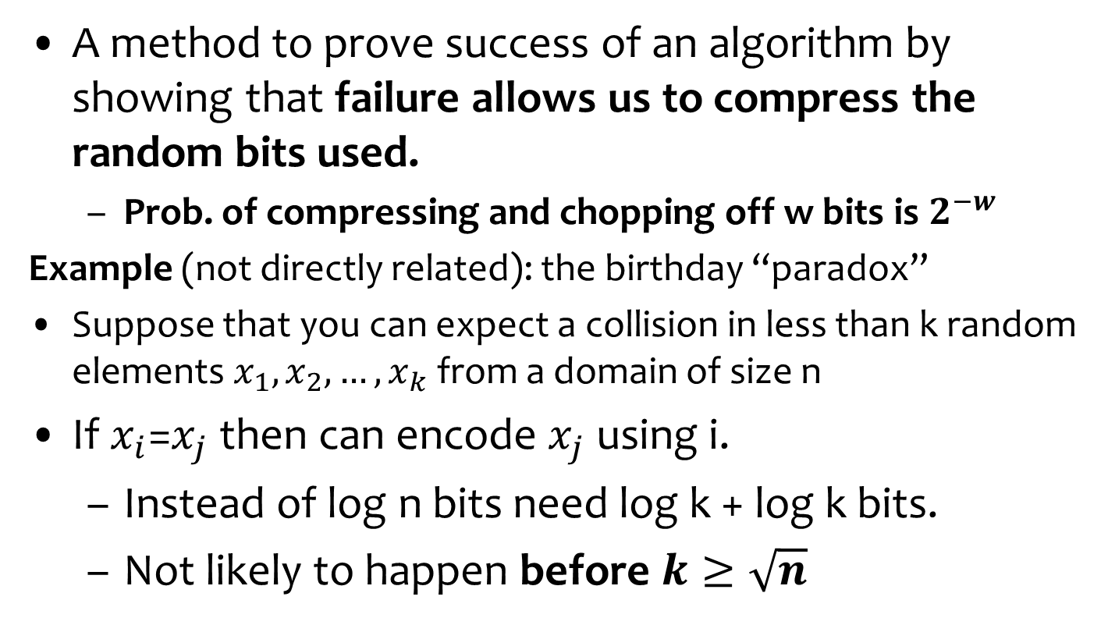
Proof by Encoding:
A general method for analyzing probabilistic events
A method to prove success of an algorithm by showing that failure allows us to compress the random bits used.
  Prob. of compressing and chopping off w bits is $2^{−w}$
Example (not directly related): the birthday “paradox”
Suppose that you can expect a collision in less than k random elements $x_{1}, x_{2}, …, x_{k}$from a domain of size n
If $x_{i}$=$x_{j}$then can encode $x_{j}$ using i.
  Instead of log n bits need log k + log k bits.
  Not likely to happen before $k≥\sqrt{n}$
For i
LZ style
For j

Slide 24
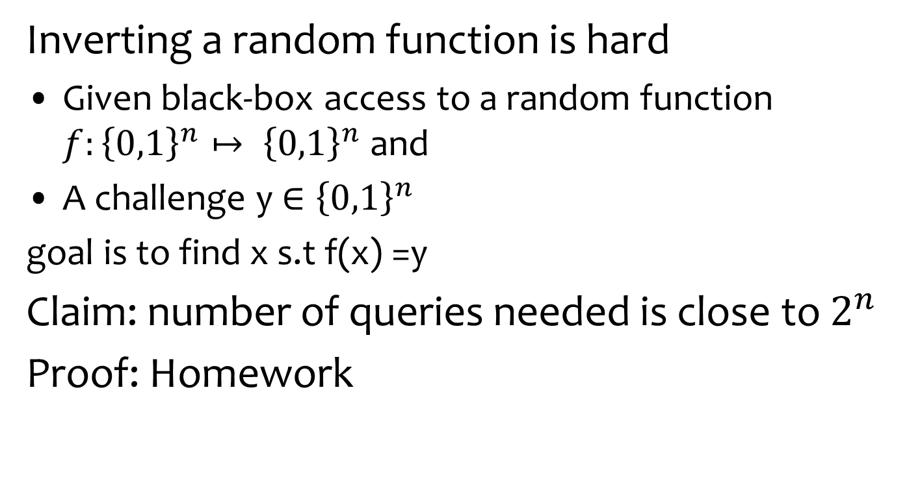
Proof by Encoding
Inverting a random function is hard
Given black-box access to a random function $f:{\left\{0,1\right\}}^{n}↦ {\left\{0,1\right\}}^{n}$and
A challenge y${∈\left\{0,1\right\}}^{n}$
goal is to find x s.t f(x) =y
Claim: number of queries needed is close to $2^{n}$
Proof: Homework

Slide 25
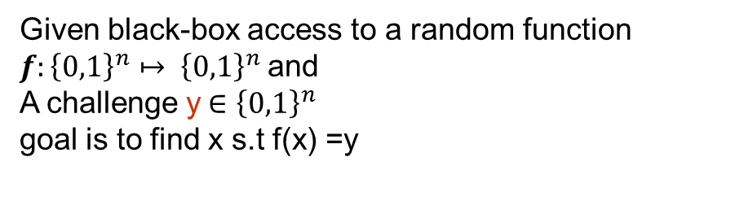
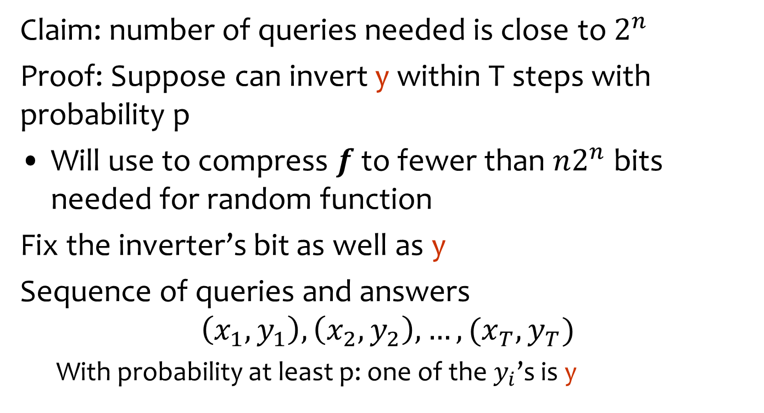

Proof by Encoding
Given black-box access to a random function $f:{\left\{0,1\right\}}^{n}↦ {\left\{0,1\right\}}^{n}$and
A challenge y${∈\left\{0,1\right\}}^{n}$
goal is to find x s.t f(x) =y
Claim: number of queries needed is close to $2^{n}$
Proof: Suppose can invert y within T steps with probability p
Will use to compress $f$ to fewer than $n2^{n}$ bits needed for random function
Fix the inverter’s bit as well as y
Sequence of queries and answers
$$\left(x_{1},y_{1}\right), \left(x_{2},y_{2}\right), …, (x_{T},y_{T})$$
  With probability at least p: one of the $y_{i}$’s is y
Savings: $n−log⁡T$
Only log T
Bit to record
Which one
Only these recorded

Slide 26
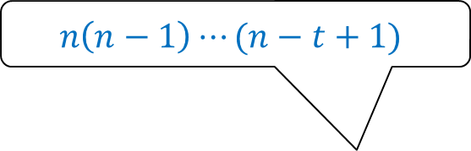
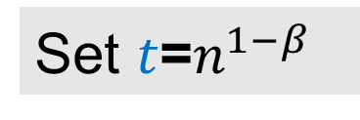
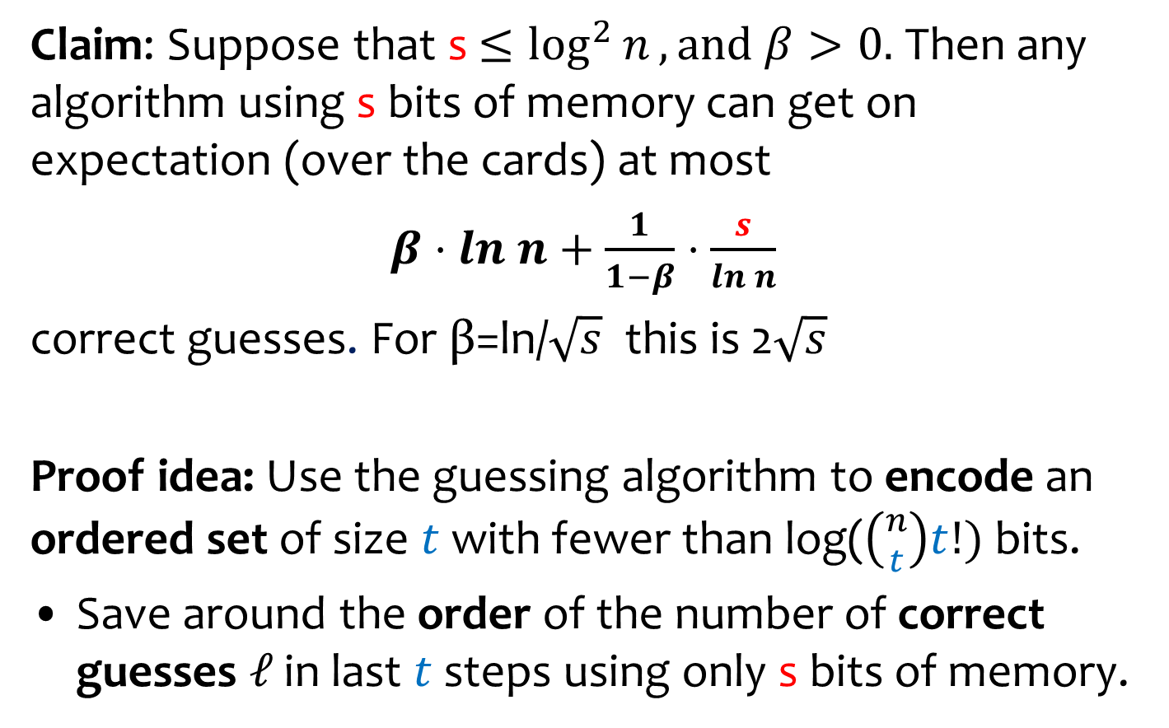
Tight bound on the expected number of guesses
Claim: Suppose that s $≤\log^{2}{n}, and β>0.$ Then any algorithm using s bits of memory can get on expectation (over the cards) at most
$β⋅ln n+\frac{1}{1−β}⋅\frac{s}{ln n}$
correct guesses. For β=ln/$\sqrt{s}$ this is 2$\sqrt{s}$
Proof idea: Use the guessing algorithm to encode an ordered set of size $t$ with fewer than log($\left({n \atop t}\right)t!)$bits.
Save around the order of the number of correct guesses $ℓ$ in last $t$ steps using only s bits of memory.
Set $t$=$n^{1−β}$
$$n\left(n−1\right)⋯(n−t+1)$$
R. V.

Slide 27

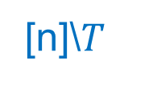

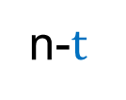

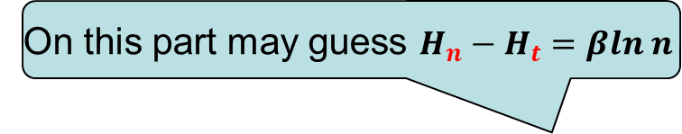
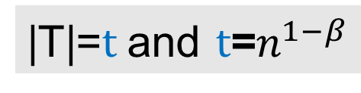
The Encoding
Memory state
of guesser:
s bits
On this part may guess $H_{n}−H_{t}=βln n$
[n]\$T$
$$T$$
These represent
the savings
n-$t$
$$t$$
The $ℓ$correct
guesses
|T|=$t$and $t$=$n^{1−β}$
Simulate the guesser till the end and see when it gives correct guesses
  These can be used to help describe T

Slide 28
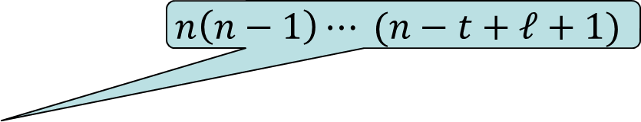

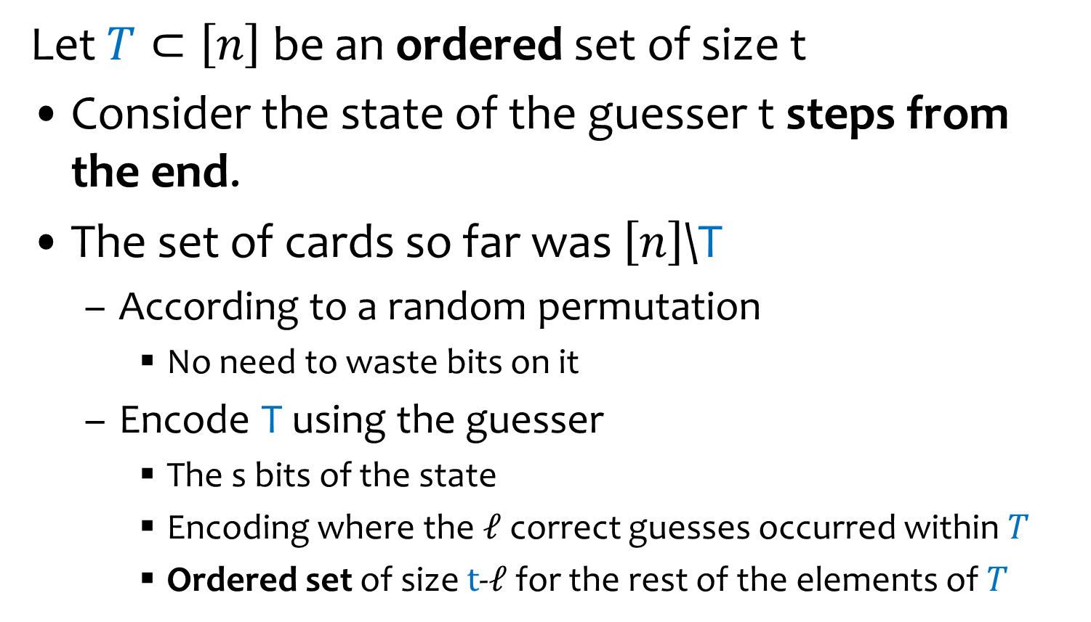
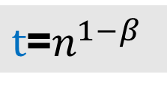
The Encoding
$t$=$n^{1−β}$
Let $T⊂\left[n\right]$ be an ordered set of size t
Consider the state of the guesser t steps from the end.
The set of cards so far was $\left[n\right]$\T
  According to a random permutation
    No need to waste bits on it
  Encode T using the guesser
    The s bits of the state
    Encoding where the $ℓ$correct guesses occurred within $T$
    Ordered set of size $t$-$ℓ$ for the rest of the elements of $T$
To make the
process random
$$\left({t \atop ℓ}\right)$$
$$n\left(n−1\right)⋯ (n−t+ℓ+1)$$

Slide 29



The Encoding
The Encoding of $T$
Memory state
of guesser:
s bits
s bits
Random order
Set of $ℓ$locations of correct guesses
$$T$$
[n]\$T$
$$T$$
Values at incorrect locations
n-$t$
$$t$$
The $ℓ$correct
guesses
Simulate the guesser till the end and see when it gives correct guesses
  These can be used to help describe T

Slide 30
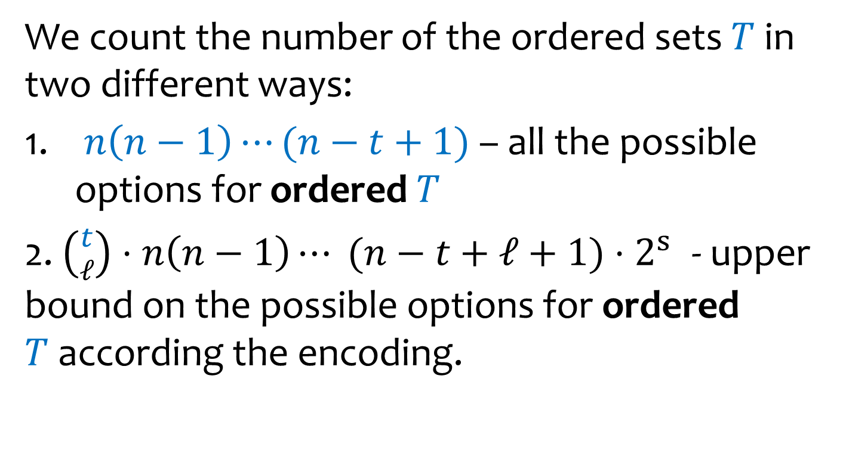
The contradiction
We count the number of the ordered sets $T$ in two different ways:
$n\left(n−1\right)⋯(n−t+1)$ – all the possible options for ordered $T$
2. $\left({t \atop ℓ}\right)⋅n\left(n−1\right)⋯ (n−t+ℓ+1)$ ${⋅2}^{s}$ - upper bound on the possible options for ordered $T$according the encoding.
The s bits of the
state of guesser

Slide 31




The Contradiction
The s bits
of the state
of guesser
The two ways to count:
$n\left(n−1\right)⋯(n−t+1)$ $≤\left({t \atop ℓ}\right)n\left(n−1\right)⋯(n−t+ℓ+1){⋅2}^{s}$
∴$(n−t+ℓ)\left(n−t+ℓ−1\right)⋯(n−t+1)$ $≤\left({t \atop ℓ}\right){⋅2}^{s}$
∴ $({n−t)}^{ℓ}$ $≤t^{ℓ}{ 2}^{s}$
Taking ln:
ℓ$≤\frac{s}{ln({n}−t){ −{\ln{t}}}}={\frac{1}{β}⋅\frac{s}{\ln{n}}}$
Overall guesses at most: $β$ln n+ $\frac{1}{β}⋅\frac{s}{\ln{n}}$
To choose best $β$: $\sqrt{s}/\ln{n}$
  Both summands are $\sqrt{s}$
$t$ = $n^{1−β}$
From the part
before $T$
$$Θ(\sqrt{s})$$

Slide 32

Conclusion
Theorem:
There is a guesser using s bits of memory that obtains $\frac{1}{2}\min\left\{\log{n}, \sqrt{s}\right\}$ correct cards in expectation
and
Any guesser using s bits of memory can get at most O($\min\left\{\log{n}, \sqrt{s}\right\}$) correct cards in expectation

Slide 33
Mirror Games
Two players, `first’ and `second’, game:
A virtual deck with 2n cards
Each round: alternating players should pick a card (value in 1..2n) that has not appeared so far
If any player repeats a card that has appeared: loses the game.
If all cards are picked: draw
With perfect memory a draw is reached
Claim: Second player has a strategy that requires very little memory

Slide 34

Mirror Games
Claim (Sumagha Garg and Jon Schneider): first player does not have a deterministic strategy that uses sublinear space and guarantees a draw.
What about probabilistic strategies?
Garg and Schneider and Feige:
Suppose first player has access to a secret matching
Can use techniques like the subset encoding we saw to figure out numbers that have appeared so far
  Whenever the Second player guesses the `Old Maid’ - the unmatched value

Slide 35

Discussion and Open Problems
Refine getting to (1-o(1))ln n.
  Do we need to go to ${\text{log}\text{(}\text{1}\text{/ }α\text{)}log}^{2} n?$

Slide 36



Homework
What about high concentration?
Relationship with card counting in Blackjack??

Slide 37
Homework: Guess the card
Half of the cards are red half black
Cards turned one by one
At any point can stop and guess that the next card is red
What is the probability of success of best algorithm?
Note: look at exercise 2.32 in the book
The Secretary problem
These are not the same problems

Slide 38
The Lovasz Local Lemma
Statement
Application
“Constructive”
“Algorithmic”

Slide 39

The Union Bound
$U=\left\{A_{1},. . . A_{m}\right\}$ $a collection of$ random events.
For $A_{i}$, the dependencies on $U$\${ \{A}_{i}\}$ may be arbitrary
Theorem: If there are $0≤p_{i}<1$ s.t. for all $A_{i}$:
  $Pr⁡[A_{i}] ≤ p_{i}$
  $\sum_{i=1}^{m}{p_{i}}<1$
then the probability that no event $A_{i}$ happens is positive.
  If all the $p_{i}=p$ then need that $m$ $⋅p<1$
Example: a CNF formula with $m$ clauses where each clause has more than $log ⁡m$ literals is necessarily satisfiable
Event $A_{i}$: clause i is not satisfied. $Pr\left[A_{i}\right]<1/m$
For a uniformly
random assignment

Slide 40


The (Lovasz) Local Lemma
Question: what happens with k-wise independent events?
$U=\left\{A_{1},. . . A_{m}\right\}$ $a collection of$ random events.
For $A_{i}$, let Γ($A_{i}$) be a minimal set of events that $A_{i}$ depends on
  $A_{i}$ is independent of all events in $U$\Γ($A_{i}$)
    information on events not in Γ($A_{i}$)∪{$A_{i}$} does not affect the probability of event $A_{i}$ happening.
Theorem: If there are $0≤p<1$and d s.t. for all $A_{i}$:
  $Pr⁡[A_{i}] ≤ p$
  $|Γ(A_{i})| ≤d$
  $p⋅d⋅e<1$
then the probability that no event $A_{i}$ happens is positive.
Not symmetric
Simultaneously:
$${Prob[∩}_{i∈[m] }{\overline{A}}_{i}]>0$$

Slide 41



Applying The Local Lemma for k-CNF
Theorem: If there are $0≤p< 1$and d s.t. for all $A_{i}$:
  Pr[$A_{i}$] $≤p$
  Γ($A_{i}$) $≤$d
  pde <1
then the probability that no event $A_{i}$ happens is positive.
No dependency on the
number of variables n
or number of clauses m
Theorem: Every k-CNF formula in which each variable appears in less than $2^{k}/ek$clauses is satisfiable.
Proof: for a uniformly random assignment to the variables,
Prob[$C_{i}$ is not satisfied] $≤ 2^{−k}$
Each clause depends on at most $\frac{2^{k}}{ek}⋅ k = 2^{k}/e$clauses.
Taking p= $2^{−k}$ and d= $2^{k}/e$we get that the probability the formula is satisfiable is positive.
How to find the satisfying assignment?
Event $A_{i}$ : Clause $C_{i}$
not satisfied
If two clauses do not
share a variable, their
satisfiability is independent

