Slide 1

Randomized Algorithms
Lecturer: Moni Naor
Lecture 12

Slide 2
Recap and Today
Recap
Cuckoo Hashing
Today
Cuckoo Hashing
Bloom Filters
Random Graphs
Limited Randomness and the Braverman’s Result concerning AC0

Slide 3
The Setting
Dynamic dictionary:
  Lookups, insertions and deletions
  Dynamic vs. static
Performance:
  Lookup time
  Update time
  Memory utilization
  Related problems:
    Approximate set membership (Bloom Filter)
    Retrieval

Slide 4
Major Problem in Hashing Based Schemes: Collisions
Hash Tables
  Hash Function h Table T
  Direct access to memory
    Element x should ``reside” in T[h(x)]
  Collision: two different elements with the same value under h
Unless |T| ≥ |U|
...
U
T

Slide 5
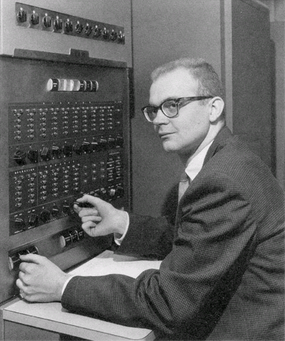
Dealing with Collisions
Lots of methods
Common one: Linear Probing
  Proposed by Amdahl
  Analyzed by Donald Knuth 1963
“Birth” of analysis of algorithms
  Probabilistic analysis

Slide 6
Linear Probing
To insert x: try location h(x) in table T
  If occupied, try h(x)+1
  and if occupied, try h(x)+2
  Until we find a vacant place
Looking for x:
Similar to insert: search until finding x or a vacant place.
••••••• •••••• ••••••••••• ••••••• •

Slide 7
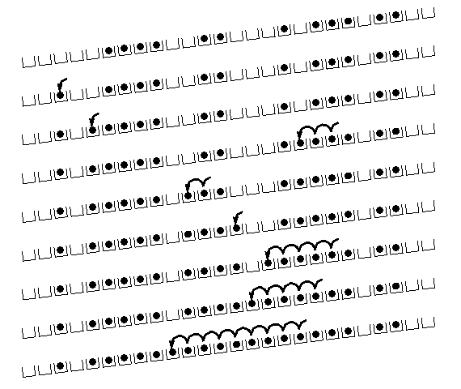
Linear Probing: situation after a while

Slide 8
Cuckoo Hashing: Basics
Introduced by Pagh and Rodler (2001)
Extremely simple:
  2 tables: T₁ and T₂
    Each of size r = (1+ε)n
  2 hash functions:
  h₁ and h₂
Lookup:
  Check in T₁ and T₂
d
t
h₂(x)
c
y
x
h₁(x)
x
b
a
Where is x?
...
...
z
T₁
T₂

Slide 9
Cuckoo Hashing: Insertion Algorithm
To insert element x, call Insert(x, 1)
Insert(x, i):
1. Put x into location h_{i}(x) in T_{i}
2. If T_{i}[h_{i}(x)] was empty: return
3. If T_{i}[h_{i}(x)] contained element y: do Insert(y, 3–i)
Example:
To insert x:
  Put in first location and displace residing element if needed
  Put displaced element in its other location
  Until finding a free spot
d
t
c
y
h₂(y) = h₂(a)
x
b
h₁(e) = h₁(a)
a
e
...
...
h₁(y)
z
T₁
T₂

Slide 10
Cuckoo Hashing: Insertion
What happens if we are not successful?
Unsuccessful stems from two reasons
  Not enough space
    The path goes into loops
  Too long chains
Can detect both by a time limit.

Slide 11
Cuckoo Hashing: Deletion
Extremely simple:
  2 tables: T₁ and T₂
    Each of size r = (1+ε)n
  2 hash functions:
  h₁ and h₂
As in Lookup:
  Check in T₁ and T₂
  Remove wherever found
d
t
h₂(x)
c
y
x
h₁(x)
x
b
a
Where is x?
...
...
z
T₁
T₂

Slide 12
The Cuckoo Graph
Set S ⊂ U containing n elements
h₁,h₂ : U {0,...,r-1}
Insertion algorithm achieves this
Bipartite graph with |L|=|R|=r
Edge (h₁(x), h₂(x)) for every x∈S
Claims:
S is successfully stored
Every connected component in the cuckoo graph has at most one cycle
Expected insertion time: O(1)
occupied
vacant

Slide 13
Why?
A dense component: simply not enough places to put the elements
No dense component:
  Tree: put elements towards the leaves
    Can pick any node as the root
    The root remains vacant
  Cycle: two possibilities
  Cycle plus trees: make the nodes on cycles the roots of the trees

Slide 14
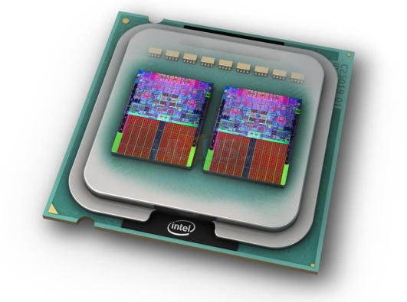
Cuckoo Hashing: Properties
Many attractive properties:
  Lookup and deletion in 2 accesses in the worst case
    May be done in parallel
  Insertion takes amortized constant time
  Reasonable memory utilization
  No dynamic memory allocation
Lots of Generalizations
Lots of applications to related problems
Growing evidence of practicality on current architectures

Slide 15
More than One Cycle
With probability Θ(1/n) Cuckoo Hashing fails
  Recall: connected component with more than one cycle
  Standard solution: rehashing
    Meaning: insertion worst case may be O(n)
[KMW08] suggested stash
  Saves rehashing
    Actually reduces insertion worst case to O(log n)
  Constant-sized stash is sufficient whp
Kirsch, Mitzenmacher,
Wieder
Prob of more
than k: 1/n^{k+1}

Slide 16
The Stash
Because of stash, need also
Cycle Detection Mechanism:
  Can accommodate log n elements
  Supporting O(1) lookups and resets
  Detecting second cycle
  as it happens
...
Queue
Cuckoo
graph
Notes:
Another explanation (Omer): there is BIG failure (rehash) amd SMALL (more than constant # of moves).
For both use Queue.

Slide 17
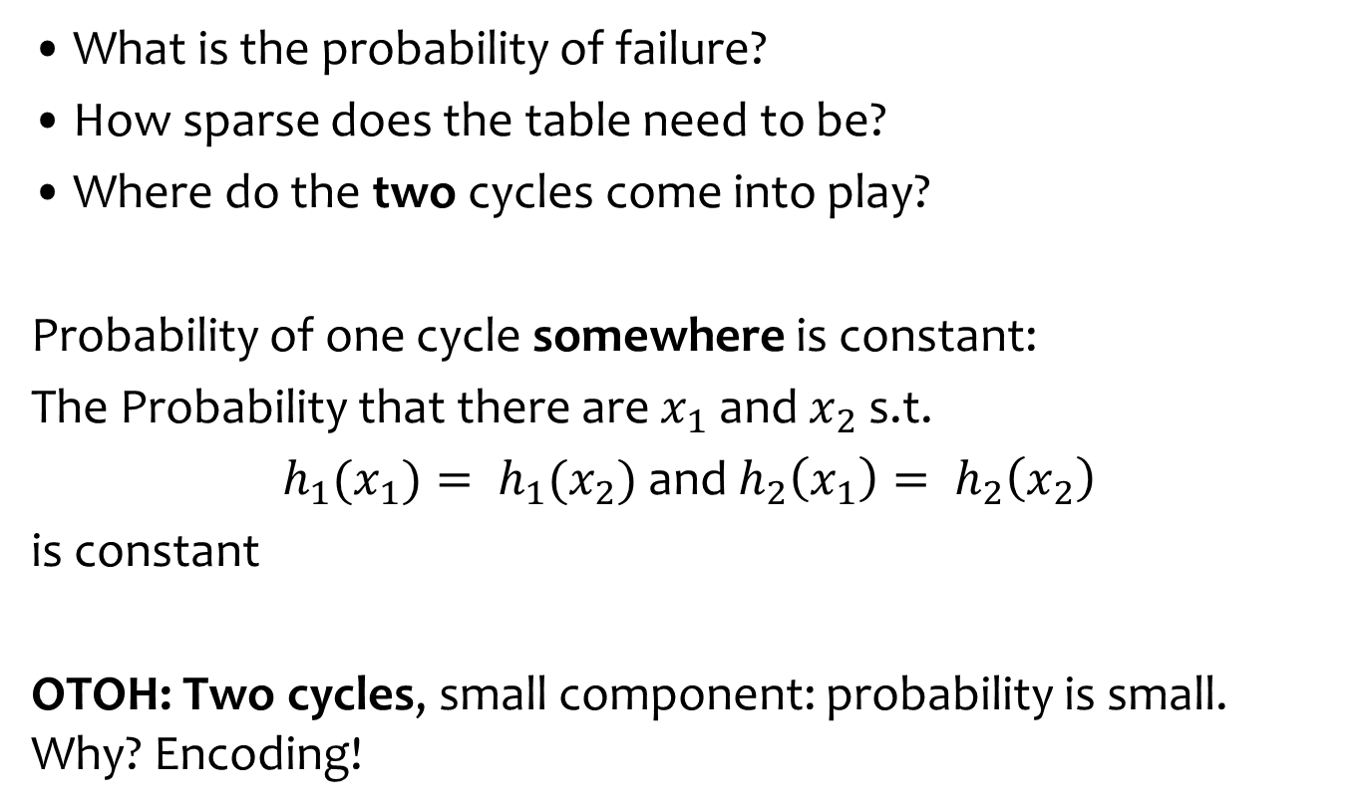
Analysis: why Does it work?
What is the probability of failure?
How sparse does the table need to be?
Where do the two cycles come into play?
Probability of one cycle somewhere is constant:
The Probability that there are $x_{1}$ and $x_{2}$ s.t.
$h_{1}(x_{1})= h_{1}(x_{2})$and $h_{2}\left(x_{1}\right)= h_{2}\left(x_{2}\right)$
is constant
OTOH: Two cycles, small component: probability is small. Why? Encoding!

Slide 18
Encoding Idea
WebDiarios de Motocicleta
Mihai Pătrașcu (1982-2012)

Slide 19
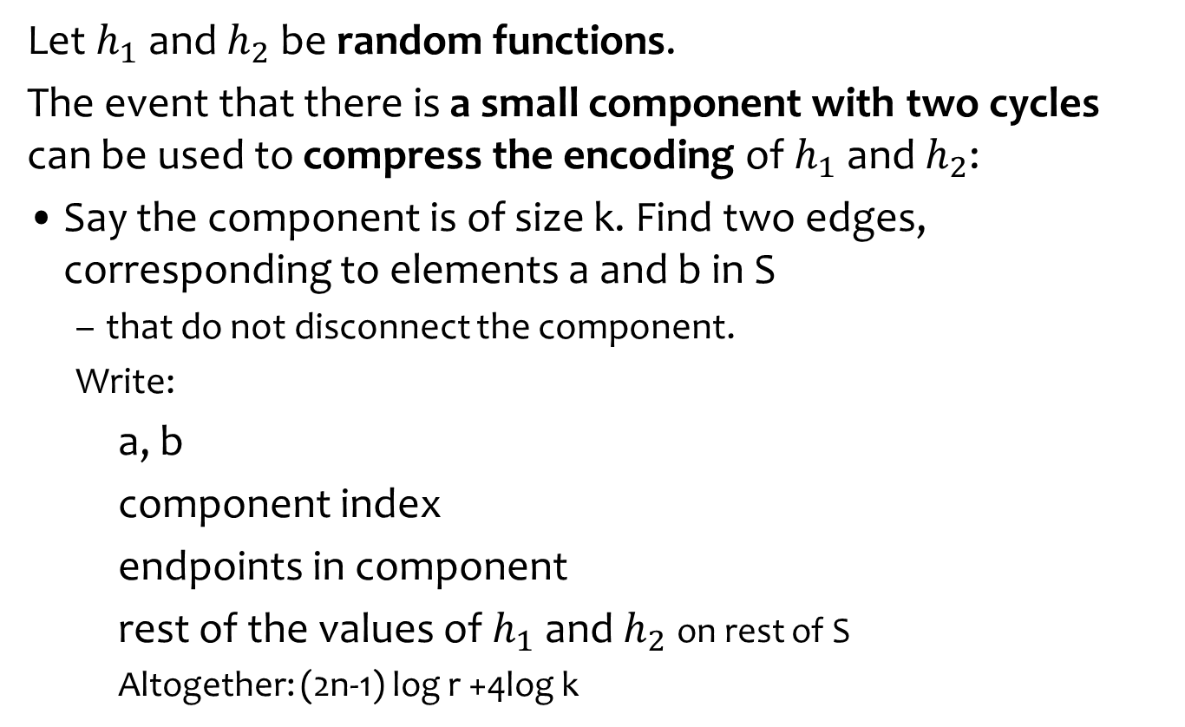
Two cycles, small component
2n log r bits on S
...
Let $h_{1}$ and $h_{2}$ be random functions.
The event that there is a small component with two cycles can be used to compress the encoding of $h_{1}$ and $h_{2}$:
Say the component is of size k. Find two edges, corresponding to elements a and b in S
  that do not disconnect the component.
  Write:
    a, b
    component index
    endpoints in component
    rest of the values of $h_{1}$ and $h_{2}$on rest of S
    Altogether: (2n-1) log r +4log k
That forms a path once
a and b removed
Saving is almost log r.
Happens with probability ≈ 1/n
2 log n bits
log n bits
Where we use
the small component
4 log k bits
2(n-2) log r bits

Slide 20
Analysis: long walk
What is the probability when inserting x that we need a chain of length k?
  Assuming x is the nth element

Slide 21
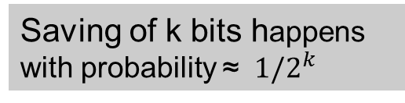
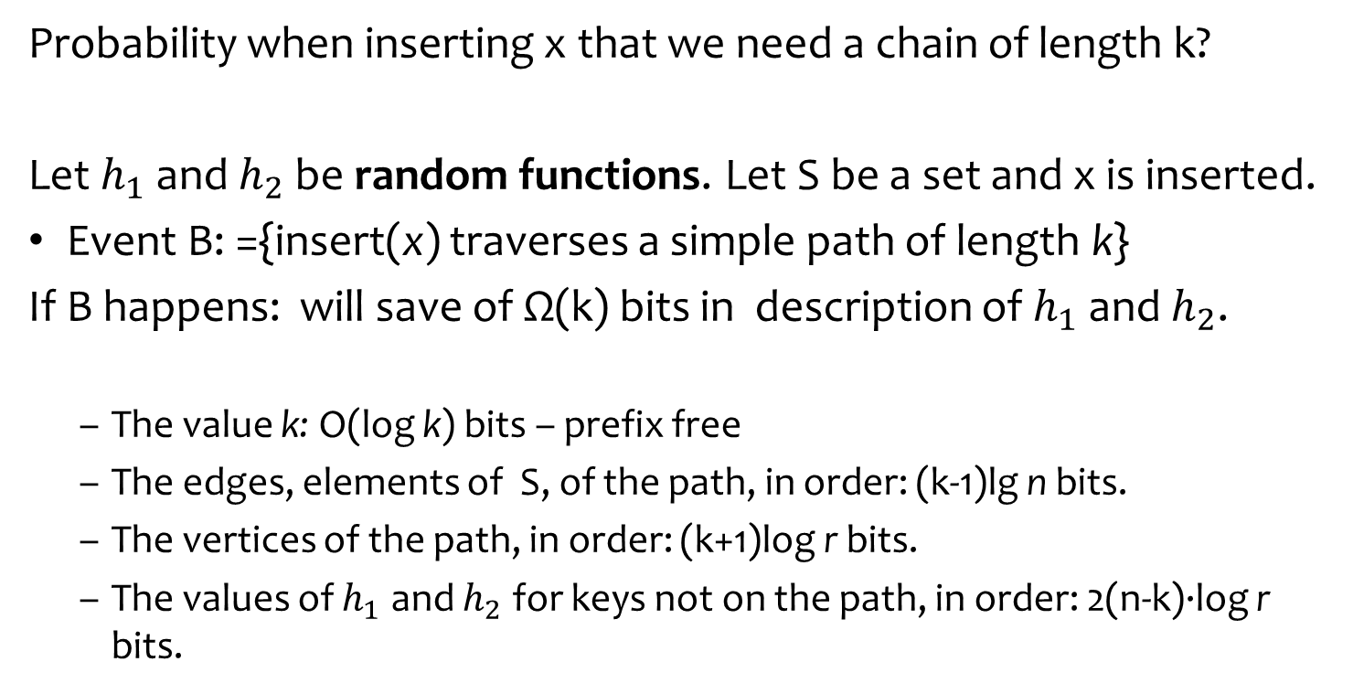
Analysis: long walk when inserting x
Probability when inserting x that we need a chain of length k?
Let $h_{1}$ and $h_{2}$ be random functions. Let S be a set and x is inserted.
Event B: ={insert(x) traverses a simple path of length k}
If B happens: will save of Ω(k) bits in description of $h_{1}$ and $h_{2}$.
  The value k: O(log k) bits – prefix free
  The edges, elements of S, of the path, in order: (k-1)lg n bits.
  The vertices of the path, in order: (k+1)log r bits.
  The values of $h_{1}$ and $h_{2}$ for keys not on the path, in order: 2(n-k)·log r bits.
2n log r bits on S
Saving of k bits happens with probability ≈ ${ 1/2}^{k}$

Slide 22
Towards Limited Independence
So far: truly random functions
Really want:
  Succinct representation: o(n)
  Fast evaluation: O(1)
  Close-to-random behavior
Approach: use k-wise independence for smallest k possible
  Good news: many such efficient constructions
  [Sie89, ÖP03, DW03,...]
But: does k-wise independence suffice for k < n?
  I.e., does analysis still hold?
Siegel
Östlin,
Pagh
Dietzfelbinger,
Woelfel

Slide 23
k-wise Independent Hash Functions
Family H of hash functions {h_{i}}_{hi ∈H}
 i h_{i} : U  [0,...,m-1]
Definition: A family H of hash functions is k-wise
independent if for any distinct x₁,...,x_{k}∈U and for
any y₁,...,y_{k}∈[0,...,m-1]:
Pr [h(x₁)=y₁ ^ h(x₂)=y₂ ^ ... ^ h(x_{k})=y_{k}] = 1/m^{k}
_{h∈H}


Slide 24
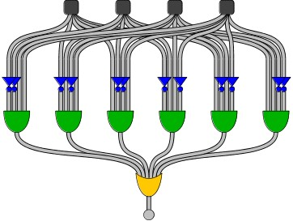
Boolean Circuits and Randomness
Boolean circuit:
  DAG
  size
  fan-in
  n inputs, m outputs
  depth
AC⁰ circuit: poly size, constant depth, unbounded fan-in
  [LN90] conjecture: any function computable by depth d, size s circuit is fooled by (log s)^{d–1} -wise independence
Linial, Nisan
Fooled: probability of outputting 1 close on both distributions

Slide 25
Braverman’s Result
Braverman (2009):
Theorem:
Let C be circuit of depth d and size m.
Let μ be r-independent distribution for
r ≥ c^{d} · (log m)^{O(d2)}
Then C cannot tell μ from the uniform distribution.
Theorem:
Any AC⁰ circuit is fooled by polylog(n)-wise distribution.
Special case of DNF formulas proved by Bazzi and Razborov
  Note: for m = n^{O(log n)}, r is polylog(m)

Slide 26
Back to Our Story: Limited Independence
Recall: the randomness assumption in analysis used for two events:
  Event1: sum of sizes of connected components is larger than a threshold
  Event2: the number of stashed elements is larger than a threshold
Each of these events: can be recognized by depth 3 circuit of size n^{O(log n)}
The technique is quite general:
  May be useful in similar scenarios
  For example, implies a similar result for [KMW08]
h₁(x₁)
h₂(x₁)
h₁(x₂)
h₂(x₂)
h₁(x_{k})
h₂(x_{k})
...
...
...
...
...
Kirsch, Mitzenmacher,
Wieder
...
0/1

Slide 27
Random Graphs
Several models
Erdős–Rényi models
G(n,p): n nodes, each edge exists with probability p
G(n, M): n nodes, the graph is chosen uniformly at random from the collection of all graphs which have n nodes and M edges.
The questions relevant to Cuckoo Hashing:
What happens with very sparse graphs.

Slide 28

Properties of graphs in G(n,p)
A graph generated by G(n,p):
If np < 1, then a.s. no connected components of size larger than O(log(n)).
If np = 1, then a.s. graph has a largest component whose size is of order $n^{2/3}$.
If np → c > 1, where c is a constant, there is a.s. a unique giant component with a constant fraction of the vertices.
  No other component with more than O(log(n)) vertices.
If $np< (1−ε) ln⁡n$, a.s. isolated vertices and the graph is disconnected.
If $np> (1+ε) ln⁡n/n$, then a.s. graph is connected.
  Also Hamiltonian!

Slide 29

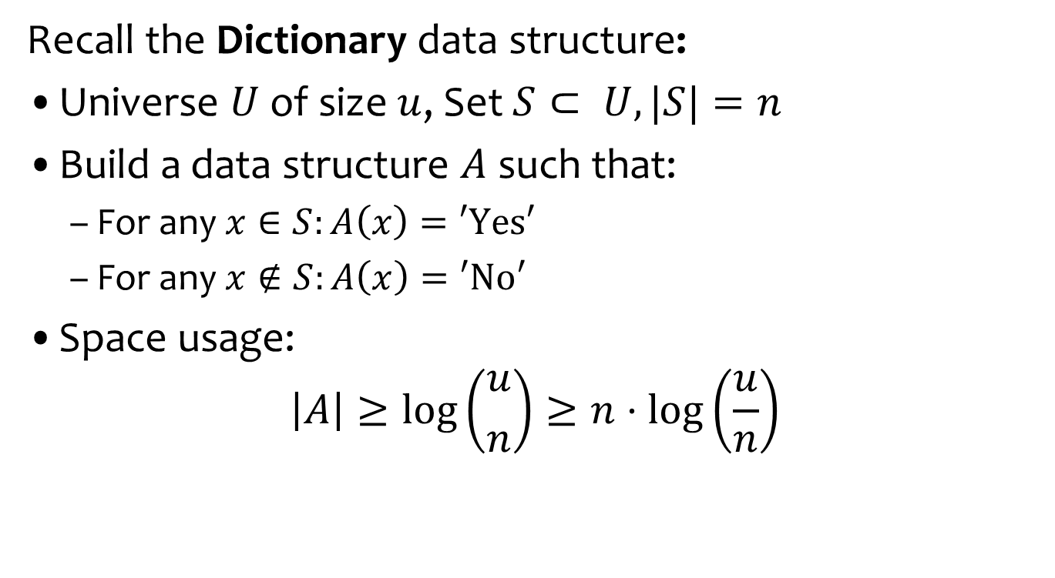
Set Membership
Recall the Dictionary data structure:
Universe $U$ of size $u$, Set $S⊂ U, |S|=n$
Build a data structure $A$ such that:
  For any $x∈S:A\left(x\right)=\text{′}\text{Yes}\text{′}$
  For any $x∉S:A\left(x\right)=\text{′}\text{No}\text{′}$
Space usage:
$\left|A\right|≥log\left({u \atop n}\right)≥n⋅\log\left(\frac{u}{n}\right)$
Information theoretic bound $ℬ$

Slide 30
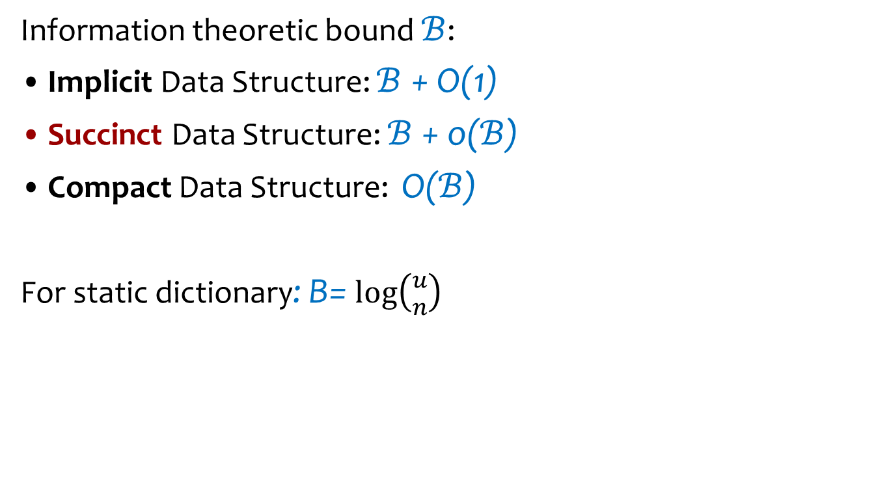
Space Consumption Terminology
Information theoretic bound $ℬ$:
Implicit Data Structure: $ℬ$ + O(1)
Succinct Data Structure: $ℬ$ + o($ℬ$)
Compact Data Structure: O($ℬ$)
For static dictionary: B= $log\left({u \atop n}\right)$

Slide 31
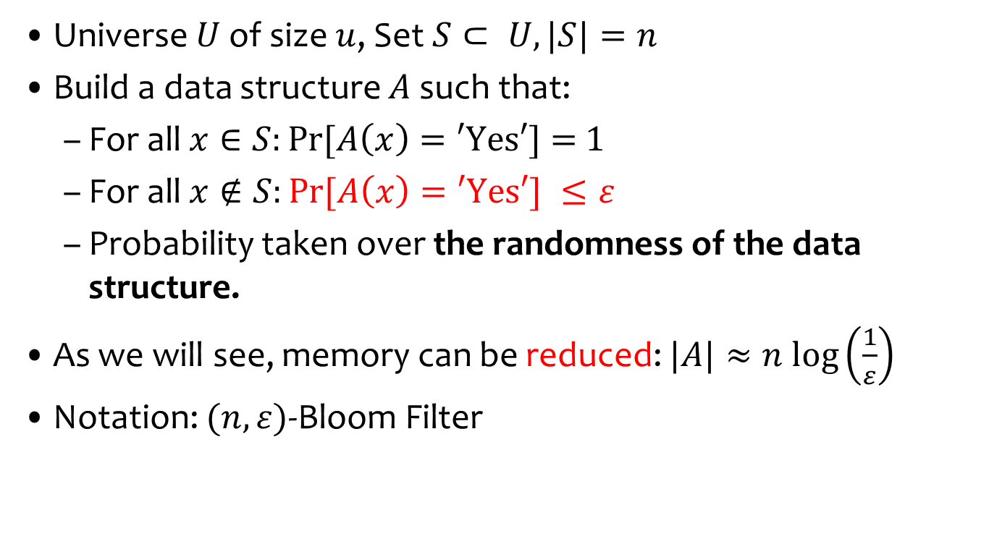
Approximate Set Membership
Universe $U$ of size $u$, Set $S⊂ U, |S|=n$
Build a data structure $A$ such that:
  For all $x∈S:Pr⁡[A\left(x\right)=\text{′}\text{Yes}\text{′}\text{] = }\text{1}$
  For all $x∉S:Pr⁡[A\left(x\right)=\text{′}\text{Yes}\text{′}\text{] }≤ε$
  Probability taken over the randomness of the data structure.
As we will see, memory can be reduced: $|A|≈n log\left(\frac{1}{ε}\right)$
Notation: $(n,ε)$-Bloom Filter

Slide 32

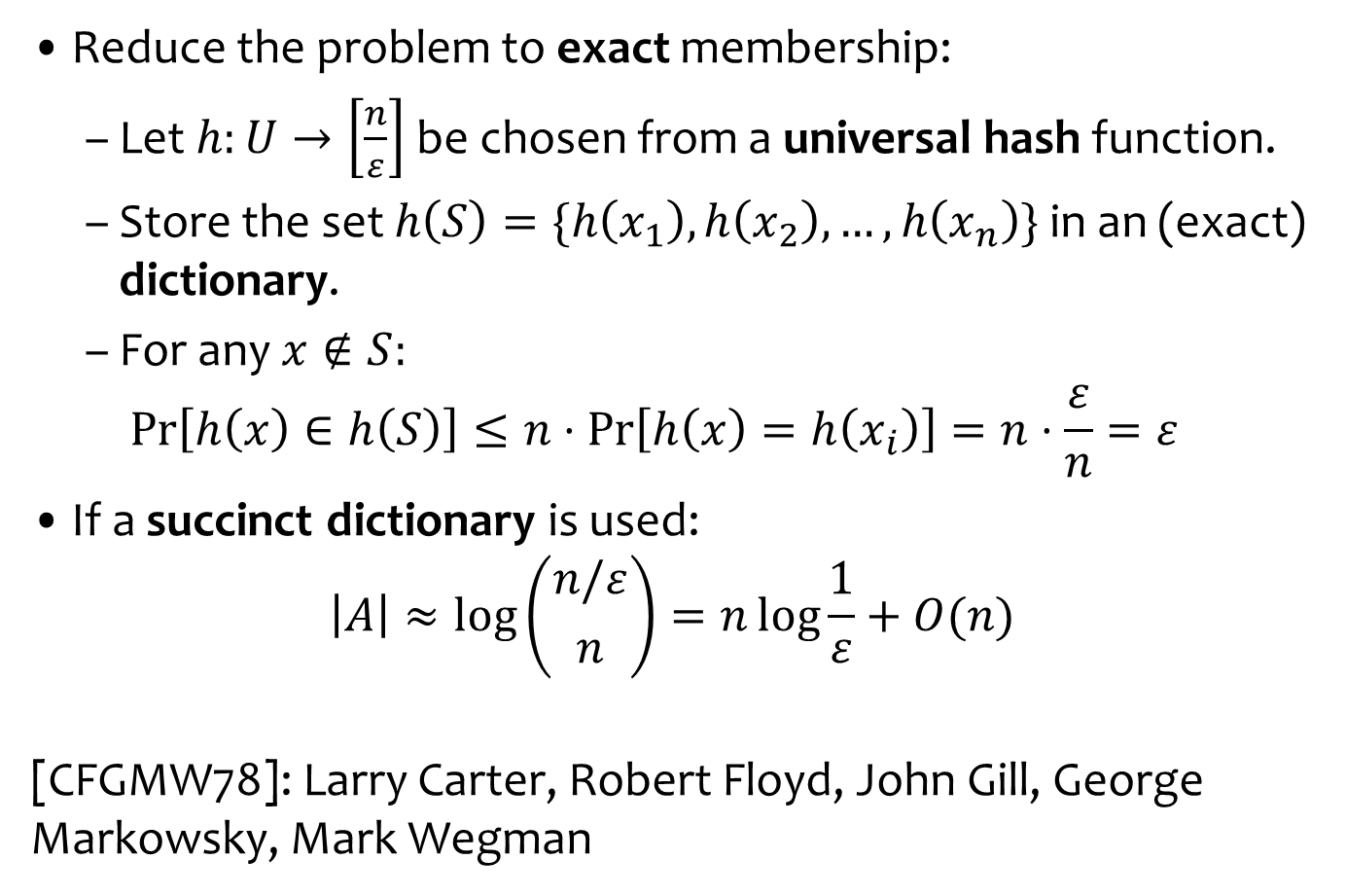
Approximate Set Membership Construction
Larry Carter
,
Reduce the problem to exact membership:
  Let $h:U→\left[\frac{n}{ε}\right]$ be chosen from a universal hash function.
  Store the set $h\left(S\right)=\{h\left(x_{1}\right),h\left(x_{2}\right),…,h\left(x_{n}\right)\}$ in an (exact) dictionary.
  For any $x∉S:$
  $\operatorname{Pr}\left[h\left(x\right)∈h\left(S\right)\right]≤n⋅\operatorname{Pr}\left[h\left(x\right)=h\left(x_{i}\right)\right]=n⋅\frac{ε}{n}=ε$
If a succinct dictionary is used:
$\left|A\right|≈\log\left({n/ε \atop n}\right)=n\log{\frac{1}{ε}+O(n)}$
[CFGMW78]: Larry Carter, Robert Floyd, John Gill, George Markowsky, Mark Wegman
Union bound
The non standard construction

Slide 33
Construction using Cuckoo Hashing
Simpler: static case
Choose a pair-wise independent hash function g(x)
  In addition to h₁ and h₂
g(d)
g(t)
h₂(x)
g(c)
g(y)
x
h₁(x)
g(x)
g(b)
g(a)
There is a false positive if g(x) happens to be equal to one of two values
...
...
g(z)
T₁
T₂
Is x in S?
Compare to g(x)

Slide 34
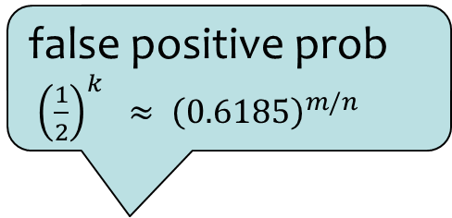
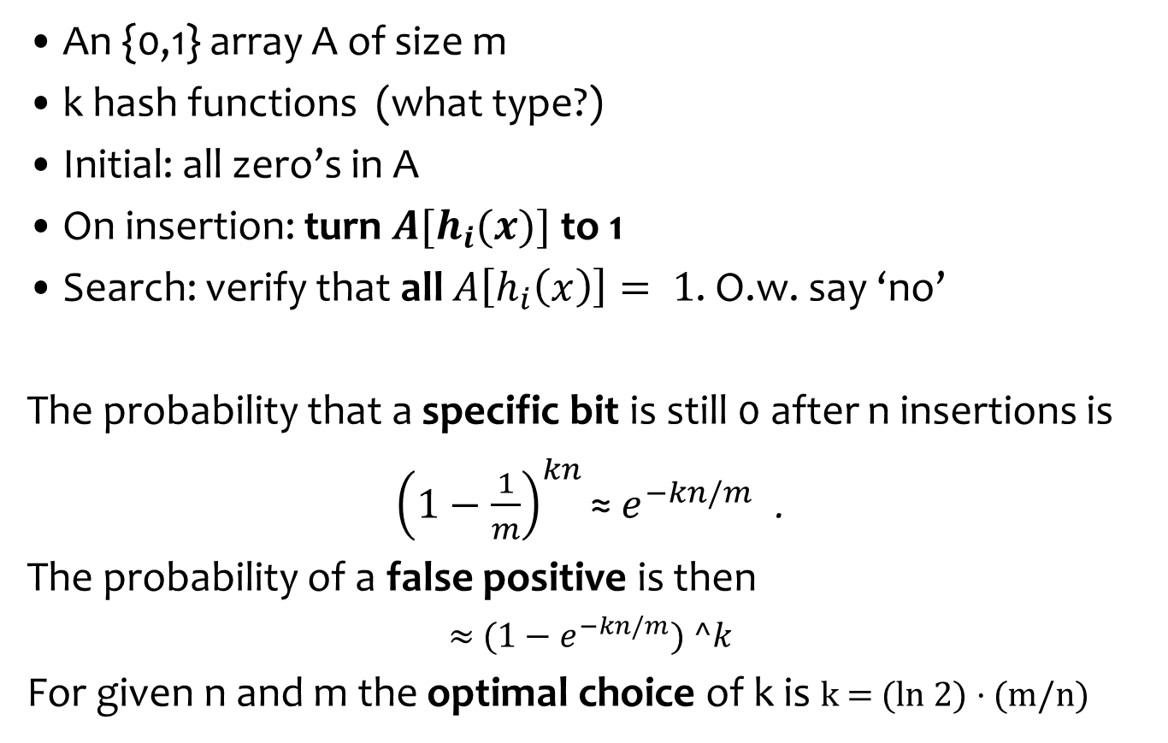

Bloom Filters
Traditional Presentation
m
An {0,1} array A of size m
k hash functions (what type?)
Initial: all zero’s in A
On insertion: turn $A[h_{i}(x)]$to 1
Search: verify that all $A\left[h_{i}\left(x\right)\right]= 1$. O.w. say ‘no’
The probability that a specific bit is still 0 after n insertions is
${\left(1−\frac{1}{m}\right)}^{kn}\text{≈}$ $e^{−kn/m}$ .
The probability of a false positive is then
≈ (1 − $e^{−kn/m}) ^k$
For given n and m the optimal choice of k is k = (ln 2) · (m/n)
$$h_{1}, h_{2}, … h_{k}$$
0
0
0
false positive prob
${\left(\frac{1}{2}\right)}^{k} ≈ {\left(0.6185\right)}^{m/n}$
Optimal choice

Slide 35
Some advantages of bit representation
Very easy to produce an approximate representation of
Union of sets.
Intersection of sets

Slide 36
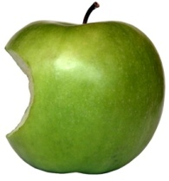
Using Permutations to Save Space
Invertible Permutations
  Can use π(x) as “new” identity of x
Prefix of new name – identity of cell/bin
  Know the prefix when the cell is probed
...
1
2
3
m
...
1
2
3
m

Slide 37

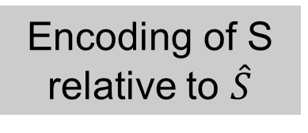
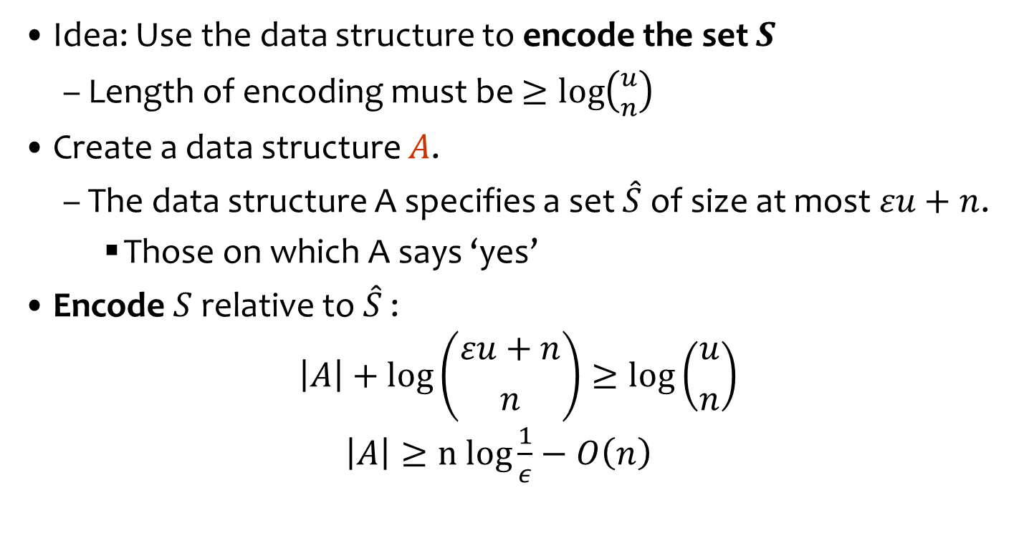



Approximate Set Membership Lower Bound
Idea: Use the data structure to encode the set $S$
  Length of encoding must be $≥\log\left({u \atop n}\right)$
Create a data structure $A$.
  The data structure A specifies a set $\hat{S}$ of size at most $εu+n$.
    Those on which A says ‘yes’
Encode $S$ relative to $\hat{S}$:
$\left|A\right|+\log\left({εu+n \atop n}\right)≥\log\left({u \atop n}\right)$
$\left|A\right|≥n log{\frac{1}{ε}−O\left(n\right)}$
$$U$$
$$S$$
$$\hat{S}$$
False
positives
True
positives
$$A$$
Encoding of S relative to $\hat{S}$
+
S

Slide 38

Applications
Many and very common in practice:
  Databases, networking, SPAM filtering and more
Common practice: cache
  Approximate the cache’s content
External Web
Filter:
Approximation of the Cache
Request
Web Proxy Cache

Slide 39
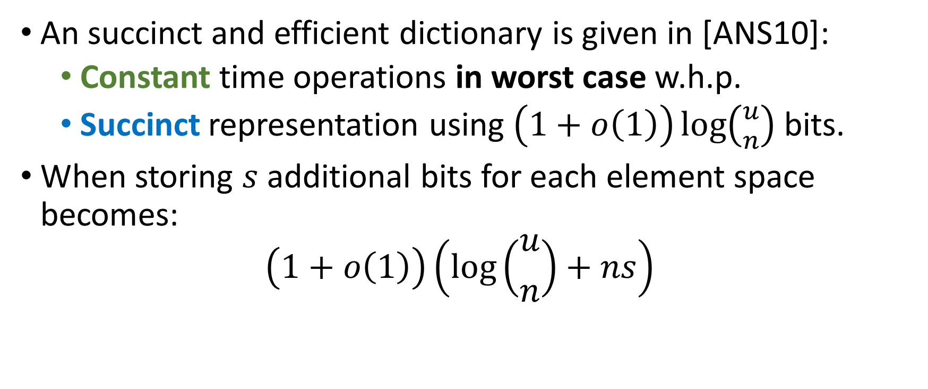
A Succinct Dictionary
An succinct and efficient dictionary is given in [ANS10]:
  Constant time operations in worst case w.h.p.
  Succinct representation using $\left(1+o\left(1\right)\right)\log\left({u \atop n}\right)$ bits.
When storing $s$ additional bits for each element space becomes:
$\left(1+o\left(1\right)\right)\left(\log\left({u \atop n}\right)+ns\right)$

