Slide 1
Randomized Algorithms
Lecturer: Moni Naor
Lecture 9

Slide 2
Recap and Today
Today
Cuckoo Hashing
Proofs by compression
Bloom Filters
Random Graphs
Limited Randomness and the Braverman’s Result concerning AC0

Slide 3
Structure of Proofs by Compression or Encoding
Relevant to both upper and lower bounds
Consider a random string used in the system
Could be
The random function that should be inverted
The randomness used by an algorithm
Show that the event you want to bound implies a compression of the randomness
Probability of compressing $w$ bits is $2^{−w}$
Hence: probability of bad event is bound by $2^{−w}$
Sometimes need extra randomness to help us

Slide 4
Proof by Encoding
Inverting a random function is hard
Given black-box access to a random function $f:{\left\{0,1\right\}}^{n}↦ {\left\{0,1\right\}}^{n}$and
A challenge y${∈\left\{0,1\right\}}^{n}$
goal is to find x s.t f(x) =y
Claim: number of queries needed is close to $2^{n}$
Proof: Homework
How to phrase exactly?

Slide 5
Proof by Encoding
Given black-box access to a random function $f:{\left\{0,1\right\}}^{n}↦ {\left\{0,1\right\}}^{n}$and
A challenge y${∈\left\{0,1\right\}}^{n}$
goal is to find x s.t $f(x) =y$
Probability over what?
Claim: number of queries needed is close to $2^{n}$
Proof: Suppose can invert y within T steps with probability p for $y=f(x)$ for random $x∈_{ R}{\left\{0,1\right\}}^{n}$
Will use to compress $f$ to fewer than $n2^{n}$ bits needed for random function
Fix the inverter’s bit as well as y
Sequence of queries and answers
$$\left(x_{1},y_{1}\right), \left(x_{2},y_{2}\right), …, (x_{T},y_{T})$$
With probability at least p: one of the $y_{i}$’s is y
Savings: $n−log⁡T$
Only log T
Bit to record
Which one
Only these recorded

Slide 6
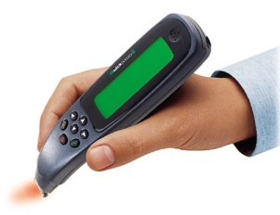
The Setting
Dynamic dictionary:
Lookups, insertions and deletions
Dynamic vs. static
Performance:
Lookup time
Update time
Memory utilization
Related problems:
Approximate set membership (Bloom Filter)
Retrieval

Slide 7
Space Consumption Terminology
Information theoretic bound $ℬ$:
Implicit Data Structure: $ℬ$ + O(1)
Succinct Data Structure: $ℬ$ + o($ℬ$)
Compact Data Structure: O($ℬ$)
Universe $U$ of size $u$. Set size $n$.
For static dictionary: $ℬ$ = $log\left({u \atop n}\right)$

Slide 8
Major Problem in Hashing Based Schemes: Collisions
Hash Tables
Hash Function h Table T
Direct access to memory
Element x should ``reside” in T[h(x)]
Collision: two different elements with the same value under h
Unless |T| ≥ |U|
...
U
T

Slide 9
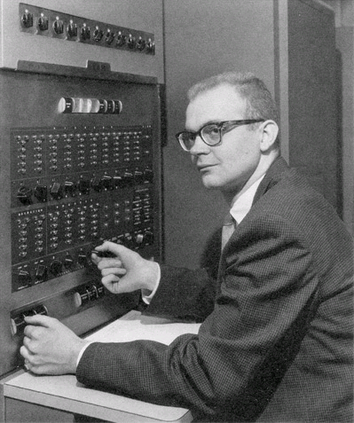
Dealing with Collisions
Lots of methods
Common one: Linear Probing
Proposed by Amdahl
Analyzed by Donald Knuth 1963
“Birth” of analysis of algorithms
Probabilistic analysis

Slide 10
Linear Probing
To insert x: try location h(x) in table T
If occupied, try h(x)+1
and if occupied, try h(x)+2
Until we find a vacant place
Looking for x:
Similar to insert: search until finding x or a vacant place.
••••••• •••••• ••••••••••• ••••••• •

Slide 11
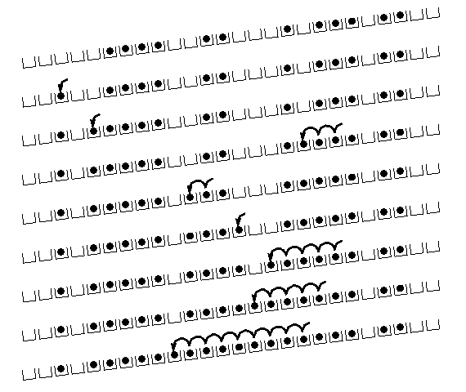
Linear Probing: situation after a while

Slide 12
Cuckoo Hashing: Basics
Introduced by Pagh and Rodler (2001)
Extremely simple:
2 tables: T₁ and T₂
Each of size r = (1+ε)n
2 hash functions: h₁ and h₂
Lookup:
Check in T₁ and T₂
d
t
h₂(x)
c
y
x
h₁(x)
x
b
a
Where is x?
...
...
z
T₁
T₂

Slide 13
Cuckoo Hashing: Insertion Algorithm
To insert element x, call Insert(x, 1)
Insert(x, i):
1. Put x into location h_{i}(x) in T_{i}
2. If T_{i}[h_{i}(x)] was empty: return
3. If T_{i}[h_{i}(x)] contained element y: do Insert(y, 3–i)
Example:
To insert x:
Put in first location and displace residing element if needed
Put displaced element in its other location
Until finding a free spot
d
t
c
y
h₂(y) = h₂(a)
x
b
h₁(e) = h₁(a)
a
e
...
...
h₁(y)
z
T₁
T₂

Slide 14
Cuckoo Hashing: Insertion
What happens if we are not successful?
Unsuccessful stems from two reasons
Not enough space
The path goes into loops
Too long chains
Can detect both by a time limit.

Slide 15
Cuckoo Hashing: Deletion
Extremely simple:
2 tables: T₁ and T₂
Each of size r = (1+ε)n
2 hash functions: h₁ and h₂
As in Lookup:
Check in T₁ and T₂
Remove wherever found
d
t
h₂(x)
c
y
x
h₁(x)
x
b
a
Where is x?
...
...
z
T₁
T₂

Slide 16
The Cuckoo Graph
Set S ⊂ U containing n elements
h₁,h₂ : U {0,...,r-1}
Insertion algorithm achieves this
Bipartite graph with |L|=|R|=r
Edge (h₁(x), h₂(x)) for every x∈S
Claims:
S is successfully stored
Every connected component in the cuckoo graph has at most one cycle
Expected insertion time: O(1)
occupied
vacant

Slide 17
Why?
A dense component: simply not enough places to put the elements
No dense component:
Tree: put elements towards the leaves
Can pick any node as the root
The root remains vacant
Cycle: two possibilities
Cycle plus trees: make the nodes on cycles the roots of the trees

Slide 18
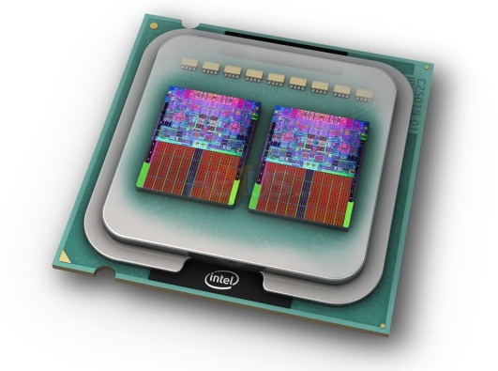
Cuckoo Hashing: Properties
Many attractive properties:
Lookup and deletion in 2 accesses in the worst case
May be done in parallel
Insertion takes amortized constant time
Reasonable memory utilization
No dynamic memory allocation
Lots of Generalizations
Lots of applications to related problems
Growing evidence of practicality on current architectures

Slide 19
Animation of Insertions
T₁
T₂
h₁( ) = 8
h₁( ) = 6
h₁( ) = 2
h₁( ) = 10
h₁( ) = 4
h₁( ) = 8
h₁( ) = 4
h₁( ) = 4
h₁( ) = 10
h₁( ) = 6
0
1
2
3
4
5
6
7
8
9
10
11
0
1
2
3
4
5
6
7
8
9
10
11
h₁( ) = 2
Input
h₂( ) = 6
h₂( ) = 1
h₂( ) = 8
h₂( ) = 10
h₂( ) = 4
h₂( ) = 4
h₁( ) = 6
h₂( ) = 8
Queue
With queue for de-amortization
Notes:
n = 10, epsilon = 0.2, so r = 12
log_2 10 = 3.3, so |Q| = 4, 0.7 for stash
L = 3 for simplicity (can explain 2.5 orally)

Slide 20
More than One Cycle
With probability Θ(1/n) Cuckoo Hashing fails
Recall: connected component with more than one cycle
Standard solution: rehashing
Meaning: insertion worst case may be O(n)
[KMW08] suggested stash
Saves rehashing
Actually reduces insertion worst case to O(log n)
Constant-sized stash is sufficient whp
Kirsch, Mitzenmacher,
Wieder
Prob of more
than k: 1/n^{k+1}

Slide 21
The Stash
Because of stash, need also Cycle Detection Mechanism:
Can accommodate log n elements
Supporting O(1) lookups and resets
Detecting second cycle as it happens
...
Queue
Cuckoo
graph
Notes:
Another explanation (Omer): there is BIG failure (rehash) amd SMALL (more than constant # of moves).
For both use Queue.

Slide 22
Analysis: why Does it work?
What is the probability of failure?
How sparse does the table need to be?
Where do the two cycles come into play?
Probability of one cycle somewhere is constant:
The Probability that there are $x_{1}$ and $x_{2}$ s.t.
$h_{1}(x_{1})=h_{1}(x_{2})$and $h_{2}\left(x_{1}\right)=h_{2}\left(x_{2}\right)$
is constant
OTOH: Two cycles, small component: probability is small. Why? Encoding!
Probability of saving $c$ bits for a random string is $2^{−c}$

Slide 23
Components in the Cuckoo Graph
Order the components by the least numbered vertex
Assign numbers in 1-n based on this ranking
Ranking remains the same even if we remove some edges,
as long as we do not disconnect a component
...
Cuckoo
graph

Slide 24
Two cycles, small component
2n log r bits on S
...
Let $h_{1}$ and $h_{2}$ be random functions.
The event that there is a small component with two cycles can be used to compress the encoding of $h_{1}$ and $h_{2}$:
Say the component is of size k. Find two edges, corresponding to elements a and b in S
that do not disconnect the component.
Write:
a, b
component index
endpoints in component
rest of the values of $h_{1}$ and $h_{2}$on S\{a,b}
Altogether: (2n-1) log r +4log k
Number them
1-n
Saving is almost log r.
Happens with probability ≈ 1/n
2log n bits
log n bits
Where we use
the small component
4log k bits
2(n-2)log r bits

Slide 25
Analysis: long walk
What is the probability when inserting x that we need a chain of length k?

Slide 26
Analysis: long walk when inserting x
Probability when inserting x that we need a chain of length k?
Let $h_{1}$ and $h_{2}$ be random functions. Let S be a set and x is inserted.
Event B: ={insert(x) traverses a simple path of length k}
If B occurs: will save of Ω(k) bits in description of $h_{1}$ and $h_{2}$.
The value k: $O(log⁡k)$bits – prefix free
The edges of the path, in order$: (k−1)log⁡n$bits.
The vertices of the path, in order: $(k+1)log⁡r$bits.
The values of $h_{1}$ and $h_{2}$ for keys not on the path, in order:
$2(n−k)·log⁡r$bits.
2n log r bits on S
elements of S
Saving of k bits happens with probability ≈ ${ 1/2}^{k}$
Replaced log r with log n

Slide 27
WebDiarios de Motocicleta Mihai Pătrașcu (1982-2012)
This is a nice idea that looks like another application of "Moser's Method," but there's something I don't quite get. In your encoding proof, H is entropy of the bitstring h(x_1),g(x_1),...,h(x_n),g(x_n). Can you recover this bitstring from the encoding? As far as I can see, you can discover which edges are in the Cuckoo graph, but not which keys generated those edges. Or did I miss something?

Slide 28
I haven't looked at Moser's paper, but, given the blog-hype it received, I sincerely hope he does something smarter than just expressing probabilities in encoding terminology. This is a trivial idea that I presume many people had. As for the encoding, an edge is identical to a key. In other words, I may assume that the keys are {1,...,n}. You notice how I always say that I am encoding an edge with lg n bits. To put it in your terminology, there are n edges h(x_i)--g(x_i). I can encode which edge is involved in some subgraph using lg n bits. So I do indeed recover the h and g values for all edges.

Slide 29
Towards Limited Independence
So far: truly random functions
Really want:
Succinct representation: o(n)
Fast evaluation: O(1)
Close-to-random behavior
Approach: use k-wise independence for smallest k possible
Good news: many such efficient constructions [Sie89, ÖP03, DW03,...]
But: does k-wise independence suffice for k < n?
I.e., does analysis still hold?
Siegel
Östlin,
Pagh
Dietzfelbinger,
Woelfel

Slide 30
k-wise Independent Hash Functions
Family H of hash functions {h_{i}}_{hi ∈H}
 i h_{i} : U  [0,...,m-1]
Definition: A family H of hash functions is k-wise
independent if for any distinct x₁,...,x_{k}∈U and for
any y₁,...,y_{k}∈[0,...,m-1]:
Pr [h(x₁)=y₁ ^ h(x₂)=y₂ ^ ... ^ h(x_{k})=y_{k}] = 1/m^{k}
_{h∈H}


Slide 31
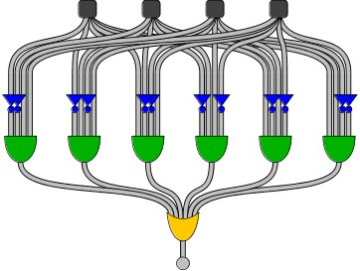
Boolean Circuits and Randomness
Boolean circuit:
DAG
size
fan-in
n inputs, m outputs
depth
AC⁰ circuit: poly size, constant depth, unbounded fan-in
[LN90] conjecture: any function computable by depth d, size s circuit is fooled by (log s)^{d–1} -wise independence
Linial, Nisan
Fooled: probability of outputting 1 close on both distributions

Slide 32
Braverman’s Result
Braverman (2009):
Theorem:
Let C be circuit of depth d and size m.
Let μ be r-independent distribution for
r ≥ c^{d} · (log m)^{O(d2)}
Then C cannot tell μ from the uniform distribution.
Theorem:
Any AC⁰ circuit is fooled by polylog(n)-wise distribution.
Special case of DNF formulas proved by Bazzi and Razborov
Note: for m = n^{O(log n)}, r is polylog(m)

Slide 33
Back to Our Story: Limited Independence
Recall: the randomness assumption in analysis used for two events:
Event1: sum of sizes of connected components is larger than a threshold
Event2: the number of stashed elements is larger than a threshold
Each of these events: can be recognized by depth 3 circuit of size n^{O(log n)}
The technique is quite general:
May be useful in similar scenarios
For example, implies a similar result for [KMW08]
h₁(x₁)
h₂(x₁)
h₁(x₂)
h₂(x₂)
h₁(x_{k})
h₂(x_{k})
...
...
...
...
...
Kirsch, Mitzenmacher,
Wieder
...
0/1

Slide 34
Random Graphs
Several models
Erdős–Rényi models
G(n,p): n nodes, each edge exists with probability p
G(n, M): n nodes, the graph is chosen uniformly at random from the collection of all graphs which have n nodes and M edges.
The questions relevant to Cuckoo Hashing:
What happens with very sparse graphs.

Slide 35
Properties of graphs in G(n,p)
A graph generated by G(n,p):
If np < 1, then a.s. no connected components of size larger than O(log(n)).
If np = 1, then a.s. graph has a largest component whose size is of order $n^{2/3}$.
If np → c > 1, where c is a constant, there is a.s. a unique giant component with a constant fraction of the vertices.
No other component with more than O(log(n)) vertices.
If $np< (1−ε) ln⁡n$, a.s. isolated vertices and the graph is disconnected.
If $np> (1+ε) ln⁡n/n$, then a.s. graph is connected.
Also Hamiltonian!

Slide 36
Set Membership
Recall the Dictionary data structure:
Universe $U$ of size $u$, Set $S⊂ U, |S|=n$
Build a data structure $A$ such that:
For any $x∈S:A\left(x\right)=\text{′}\text{Yes}\text{′}$
For any $x∉S:A\left(x\right)=\text{′}\text{No}\text{′}$
Space usage: $\left|A\right|≥log\left({u \atop n}\right)≥n⋅\log\left(\frac{u}{n}\right)$
Information theoretic bound $ℬ$

Slide 37
Space Consumption Terminology
Information theoretic bound $ℬ$:
Implicit Data Structure: $ℬ$ + O(1)
Succinct Data Structure: $ℬ$ + o($ℬ$)
Compact Data Structure: O($ℬ$)
For static dictionary: B= $log\left({u \atop n}\right)$

Slide 38
Approximate Set Membership
Universe $U$ of size $u$, Set $S⊂ U, |S|=n$
Build a data structure $A$ such that:
For all $x∈S:Pr⁡[A\left(x\right)=\text{′}\text{Yes}\text{′}\text{] = }\text{1}$
For all $x∉S:Pr⁡[A\left(x\right)=\text{′}\text{Yes}\text{′}\text{] }≤ε$
Probability taken over the randomness of the data structure.
As we will see, memory can be reduced: $|A|≈n log\left(\frac{1}{ε}\right)$
Notation: $(n,ε)$-Bloom Filter

Slide 39
Approximate Set Membership Construction
Larry Carter
,
Reduce the problem to exact membership:
Let $h:U→\left[\frac{n}{ε}\right]$ be chosen from a universal hash function.
Store the set $h\left(S\right)=\{h\left(x_{1}\right),h\left(x_{2}\right),…,h\left(x_{n}\right)\}$ in an (exact) dictionary.
For any $x∉S:$ $\operatorname{Pr}\left[h\left(x\right)∈h\left(S\right)\right]≤n⋅\operatorname{Pr}\left[h\left(x\right)=h\left(x_{i}\right)\right]=n⋅\frac{ε}{n}=ε$
If a succinct dictionary is used: $\left|A\right|≈\log\left({n/ε \atop n}\right)=n\log{\frac{1}{ε}+O(n)}$
[CFGMW78]: Larry Carter, Robert Floyd, John Gill, George Markowsky, Mark Wegman
Union bound
The non standard construction

Slide 40
Construction using Cuckoo Hashing
Simpler: static case
Choose a pair-wise independent hash function g(x)
In addition to h₁ and h₂
g(d)
g(t)
h₂(x)
g(c)
g(y)
x
h₁(x)
g(x)
g(b)
g(a)
There is a false positive if g(x) happens to be equal to one of two values
...
...
g(z)
T₁
T₂
Is x in S?
Compare to g(x)

Slide 41
Bloom Filters Traditional Presentation
m
An {0,1} array A of size m
k hash functions (what type?)
Initial: all zero’s in A
On insertion: turn $A[h_{i}(x)]$to 1
Search: verify that all $A\left[h_{i}\left(x\right)\right]= 1$. O.w. say ‘no’
The probability that a specific bit is still 0 after n insertions is
${\left(1−\frac{1}{m}\right)}^{kn}\text{≈}$ $e^{−kn/m}$ .
The probability of a false positive is then
≈ (1 − $e^{−kn/m}) ^k$
For given n and m the optimal choice of k is k = (ln 2) · (m/n)
$$h_{1}, h_{2}, … h_{k}$$
0
0
0
false positive prob
${\left(\frac{1}{2}\right)}^{k} ≈ {\left(0.6185\right)}^{m/n}$
Optimal choice

Slide 42
Some advantages of bit representation
Very easy to produce an approximate representation of
Union of sets.
Intersection of sets

Slide 43
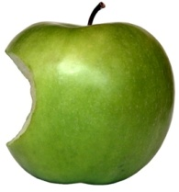
Using Permutations to Save Space
Invertible Permutations
Can use π(x) as “new” identity of x
Prefix of new name – identity of cell/bin
Know the prefix when the cell is probed
...
1
2
3
m
...
1
2
3
m

Slide 44
Approximate Set Membership Lower Bound
Idea: Use the data structure to encode the set $S$
Length of encoding must be $≥\log\left({u \atop n}\right)$
Create a data structure $A$.
The data structure A specifies a set $\hat{S}$ of size at most $εu+n$.
Those on which A says ‘yes’
Encode $S$ relative to $\hat{S}$: $\left|A\right|+\log\left({εu+n \atop n}\right)≥\log\left({u \atop n}\right)$ $\left|A\right|≥n log{\frac{1}{ε}−O\left(n\right)}$
$$U$$
$$S$$
$$\hat{S}$$
False
positives
True
positives
$$A$$
Encoding of S relative to $\hat{S}$
+
S

Slide 45
Applications
Many and very common in practice:
Databases, networking, SPAM filtering and more
Common practice: cache
Approximate the cache’s content
External Web
Filter:
Approximation of the Cache
Request
Web Proxy Cache

Slide 46
Applications - Cache
Serves as a filter for accessing slow storage
Requests arrive first at the filter which determines which requests reside in the proxy’s cache and which should be fetched from the network.
The cost of a false positive is a cache miss.
What happens if the cache uses an LRU policy?
External Web
Filter:
Approximation of the Cache
Request
Web Proxy Cache

Slide 47
A Succinct Dictionary
A succinct and efficient dictionary is given in [ANS10]:
Constant time operations in worst case w.h.p.
Succinct representation using $\left(1+o\left(1\right)\right)\log\left({u \atop n}\right)$ bits.
When storing $s$ additional bits for each element space becomes: $\left(1+o\left(1\right)\right)\left(\log\left({u \atop n}\right)+ns\right)$

Slide 48
Communication Complexity Protocol Variants
Deterministic complexity is often $n$
Example: equality
Protocols differ by
Network layout
Who talk to who and number of rounds
Interactive Model
Simultaneous Message Model
Use of Randomness
Shared public randomness
Independent of the inputs
Private Randomness
Orthogonal!
SMMPC: Simultaneous Message Model with Private Coins

Slide 49
Simultaneous Messages Model
x
y
$${m_{A}∈M}_{A}$$
$${m_{B}∈M}_{B}$$
$$ρ(m_{A},m_{B})$$
Probability of error: $ε$
f(x,y)
No shared randomness: Private Coins

Slide 50
Simultaneous Equality Testing
x
n
y
C(x)
C(y)
n^{1/2} x n^{1/2}
C should be a good error correcting code
Communication $O(n1/2)$

Slide 51
Simultaneous Messages Model: Lower Bound
Newman-Segedy 96
$${|m}_{A}| +|m_{B}| =√n$$
Babai-Kimmel 97
$${|m}_{A}|⋅|m_{B}|=n$$
x
y
In general:
Deterministic complexity
$${m_{A}∈M}_{A}$$
$${m_{B}∈M}_{B}$$
Bottesch, Gavinsky, and Klauck 2015
$$ρ(m_{A},m_{B})$$
f(x,y)

Slide 52
Structure of Proofs by Compression or Encoding
Relevant to both upper and lower bounds
Consider a random string used in the system
Could be
The random function that should be inverted
The randomness used by an algorithm
Show that the event you want to bound implies a compression of the randomness
Probability of compressing $w$ bits is $2^{−w}$
Hence: probability of bad event is bound by $2^{−w}$
Sometimes need extra randomness to help us

Slide 53
Proof by Encoding
Inverting a random function is hard
Given black-box access to a random function $f:{\left\{0,1\right\}}^{n}↦ {\left\{0,1\right\}}^{n}$and
A challenge y${∈\left\{0,1\right\}}^{n}$
goal is to find x s.t f(x) =y
Claim: number of queries needed is close to $2^{n}$
Proof: Homework

Slide 54
Proof by Encoding
Given black-box access to a random function $f:{\left\{0,1\right\}}^{n}↦ {\left\{0,1\right\}}^{n}$and
A challenge y${∈\left\{0,1\right\}}^{n}$
goal is to find x s.t $f(x) =y$
Claim: number of queries needed is close to $2^{n}$
Proof: Suppose can invert y within T steps with probability p
Will use to compress $f$ to fewer than $n2^{n}$ bits needed for random function
Fix the inverter’s bit as well as y
Sequence of queries and answers
$$\left(x_{1},y_{1}\right), \left(x_{2},y_{2}\right), …, (x_{T},y_{T})$$
With probability at least p: one of the $y_{i}$’s is y
Savings: $n−log⁡T$
Only log T
Bit to record
Which one
Only these recorded

Slide 55
The Lovasz Local Lemma
Statement
Application
“Constructive”
“Algorithmic”

Slide 56
The Union Bound
$U=\left\{A_{1},. . . A_{m}\right\}$ $a collection of$ random events.
For $A_{i}$, the dependencies on $U$\${ \{A}_{i}\}$ may be arbitrary
Theorem: If there are $0≤p_{i}<1$ s.t. for all $A_{i}$:
$Pr⁡[A_{i}] ≤ p_{i}$
$\sum_{i=1}^{m}{p_{i}}<1$
then the probability that no event $A_{i}$ happens is positive.
If all the $p_{i}=p$ then we need that $m$ $⋅p<1$
Example: a CNF formula with $m$ clauses where each clause has more than $log ⁡m$ literals is necessarily satisfiable
Event $A_{i}$: clause i is not satisfied. $Pr\left[A_{i}\right]<1/m$
For a uniformly
random assignment

Slide 57
The (Lovasz) Local Lemma
Question: what happens with k-wise independent events?
$U=\left\{A_{1},. . . A_{m}\right\}$ $a collection of$ random events.
For $A_{i}$, let Γ($A_{i}$) be a minimal set of events that $A_{i}$ depends on
$A_{i}$ is independent of all events in $U$\Γ($A_{i}$)
information on events not in Γ($A_{i}$)∪{$A_{i}$} does not affect the probability of event $A_{i}$ happening.
Theorem: If there are $0≤p<1$and d s.t. for all $A_{i}$:
$Pr⁡[A_{i}] ≤ p$
$|Γ(A_{i})| ≤d$
$p⋅d⋅e<1$
then the probability that no event $A_{i}$ happens is positive.
Not symmetric
Simultaneously:
$${Prob[∩}_{i∈[m] }{\overline{A}}_{i}]>0$$

