Slide 1
Cut-Query Algorithms and Streaming Data Structures

Slide 2
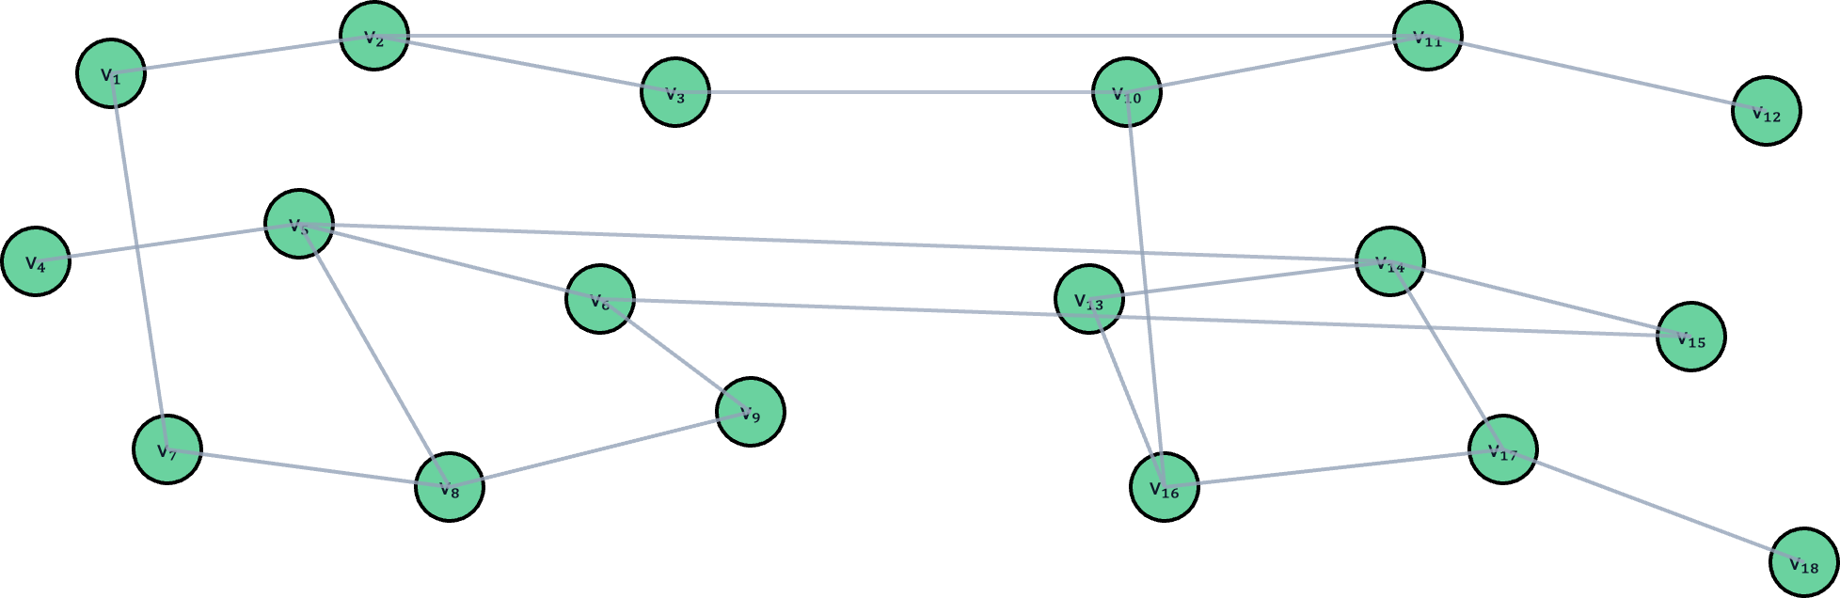

Cut-Query Model
Let $G=(V,E,w)$ be a hidden graph with oracle access
Cut-Query Oracle
Algorithm

Slide 3
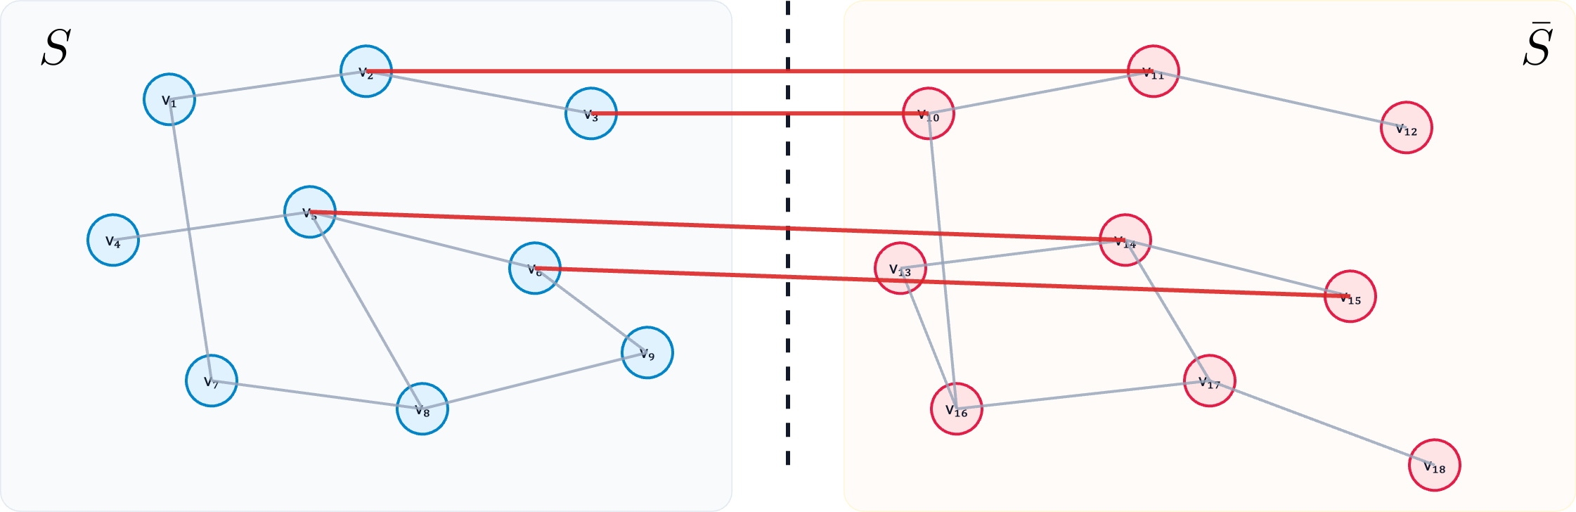


Cut-Query Model
Let $G=(V,E,w)$ be a hidden graph with oracle access
Cut-Query Oracle
Algorithm
$$S⊆V$$
$$cut_{G}(S)$$

Slide 4
Algorithms in the Cut-Query Model
Solve some optimization problem
  Find a global minimum cut, approximate the maximum cut, …
What is an efficient algorithm? – two natural answers
  Query Complexity – number of queries
    Classical question
    Focus of existing literature [RSW18, MN20, AEG+22, PRW24, ASW25]
  Round Complexity – number of query rounds
    Informally, can the solution to the problem be parallelized
      Also known as adaptivity
    Focus of this talk
Notes:
Two natural questions
[RSW18] - Aviad Rubinstein, Tselil Schramm, and S. Matthew Weinberg. Computing exact minimum cuts without knowing the graph
[ACK21] - Sepehr Assadi, Deeparnab Chakrabarty, and Sanjeev Khanna. Graph connectivity and single element recovery via linear and OR queries
[MN20] - Sagnik Mukhopadhyay and Danupon Nanongkai. Weighted min-cut: sequential, cut-query, and streaming algorithms
[AEG+22] - Simon Apers, Yuval Efron, Pawel Gawrychowski, Troy Lee, Sagnik Mukhopadhyay, and Danupon Nanongkai. Cut query algorithms with star contraction
[PRW24] - Orestis Plevrakis, Seyoon Ragavan, and S. Matthew Weinberg. On the cut-query complexity of approximating Max-Cut
Why are rounds expensive?
Communication cost
Parallel architecture

Slide 5
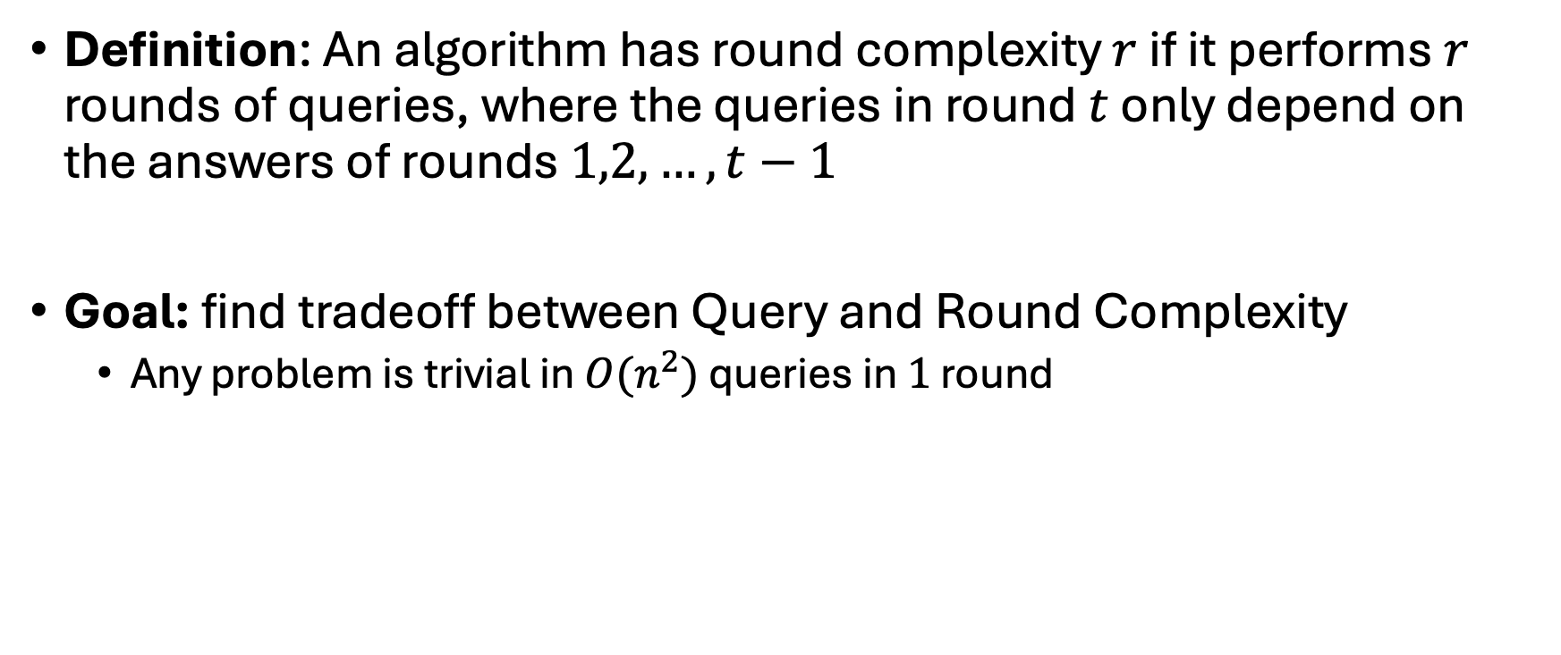
Round Complexity
Definition: An algorithm has round complexity $r$ if it performs $r$ rounds of queries, where the queries in round $t$ only depend on the answers of rounds $1,2,…,t−1$
Goal: find tradeoff between Query and Round Complexity
  Any problem is trivial in $O(n^{2})$ queries in $1$ round

Slide 6
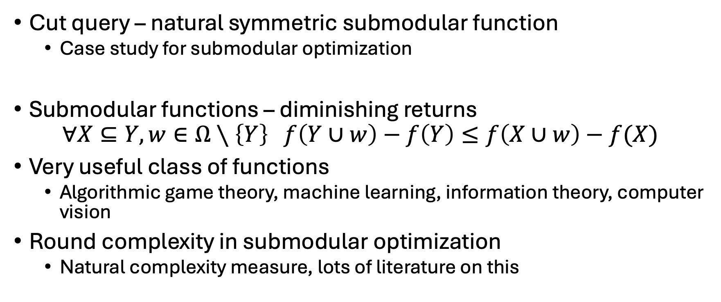
Motivation to Study
Cut query – natural symmetric submodular function
  Case study for submodular optimization
Submodular functions – diminishing returns
$$∀X⊆Y,w∈Ω∖\left\{Y\right\} f\left(Y∪w\right)−f\left(Y\right)≤f\left(X∪w\right)−f(X)$$
Very useful class of functions
  Algorithmic game theory, machine learning, information theory, computer vision
Round complexity in submodular optimization
  Natural complexity measure, lots of literature on this
Notes:
Submodular maximization for both monotone, non monotone
Constant factor approximation quality
[BS18] Eric Balkanski and Yaron Singer. The adaptive complexity of maximizing a submodular function.
[BBS18] Eric Balkanski, Adam Breuer, and Yaron Singer. Non-monotone submodular maximization in exponentially fewer iterations
[EN19] Alina Ene and Huy L. Nguyen. Submodular maximization with nearly-optimal approximation and adaptivity in nearly-linear time
[FMZ19] Matthew Fahrbach, Vahab S. Mirrokni, and Morteza Zadimoghaddam. Submodular maximization with nearly optimal approximation, adaptivity and query complexity
[CDK21] Yixin Chen, Tonmoy Dey, and Alan Kuhnle. Best of both worlds: Practical and theoretically optimal submodular maximization in parallel
[BRS19] Eric Balkanski, Aviad Rubinstein, and Yaron Singer. An exponential speedup in parallel running time for submodular maximization without loss in approximation
[BS20] Eric Balkanski and Yaron Singer. A lower bound for parallel submodular minimization.
[CCK21] Deeparnab Chakrabarty, Yu Chen, and Sanjeev Khanna. A polynomial lower bound on the number of rounds for parallel submodular function minimization
[CGJS22] Deeparnab Chakrabarty, Andrei Graur, Haotian Jiang, and Aaron Sidford. Improved lower bounds for submodular function minimization
[ACK19] Sepehr Assadi, Yu Chen, and Sanjeev Khanna. Polynomial pass lower bounds for graph streaming algorithms

Slide 7
What we’ll cover today
Cut-Query Primitives
Uniform Edge Sampling
Minimum Cut in 2 Rounds
Weighted Edge Sampling
  Time permitting

Slide 8
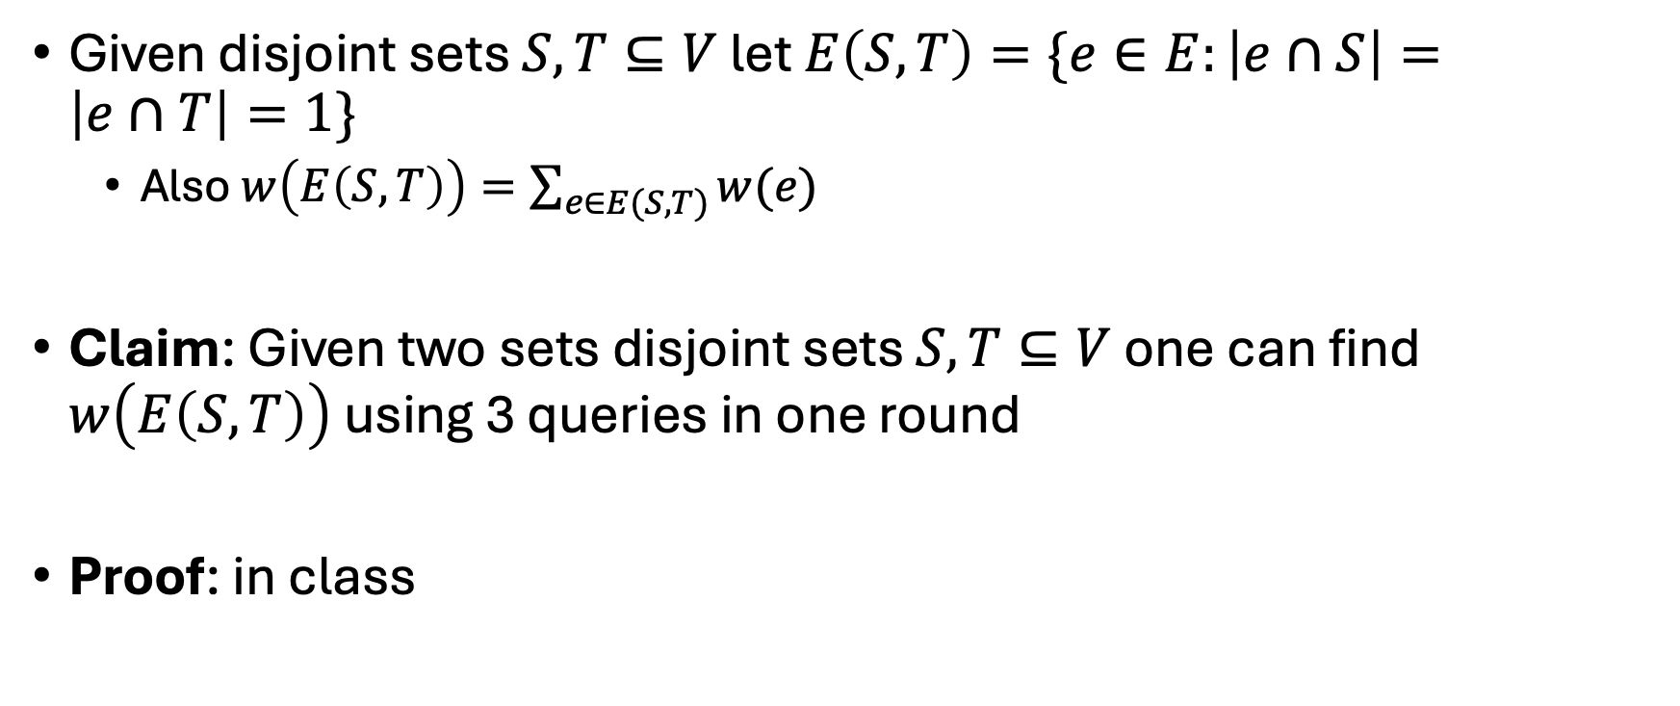
Cut Query Primitives
Given disjoint sets $S,T⊆V$ let $E\left(S,T\right)=\{e∈E:\left|e∩S\right|=\left|e∩T\right|=1\}$
  Also $w\left(E\left(S,T\right)\right)=\sum_{e∈E(S,T)}{w(e)}$
Claim: Given two sets disjoint sets $S,T⊆V$ one can find $w\left(E\left(S,T\right)\right)$ using 3 queries in one round
Proof: in class

Slide 9
Uniform Edge Sampling

Slide 10
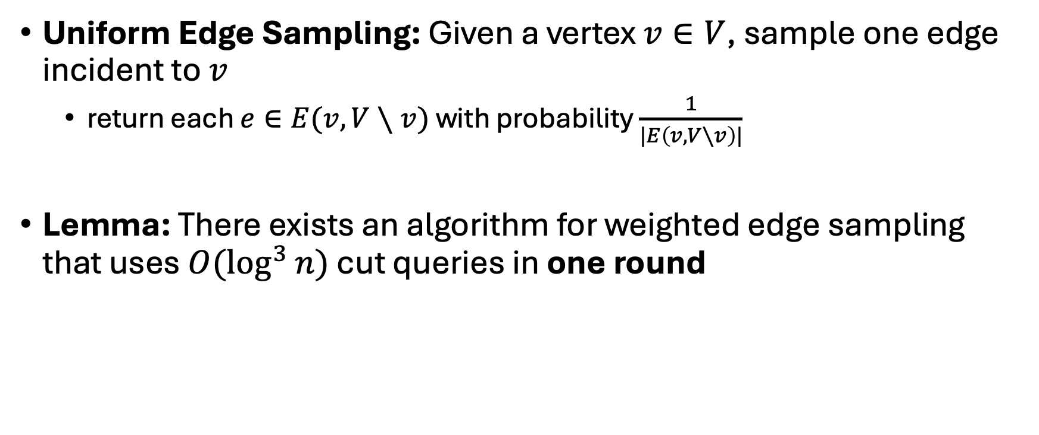
Problem
Uniform Edge Sampling: Given a vertex $v∈V$, sample one edge incident to $v$
  return each $e∈E(v,V∖v)$ with probability $\frac{1}{|E\left(v,V∖v\right)|}$
Lemma: There exists an algorithm for weighted edge sampling that uses $O(\log^{3}{n})$ cut queries in one round

Slide 11
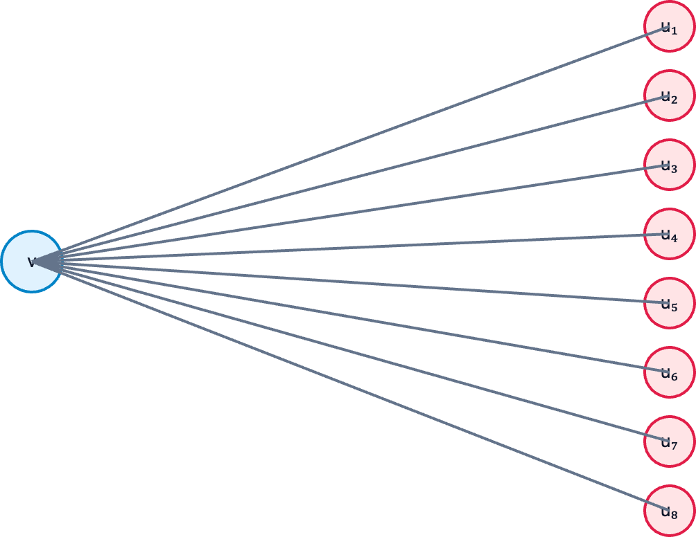
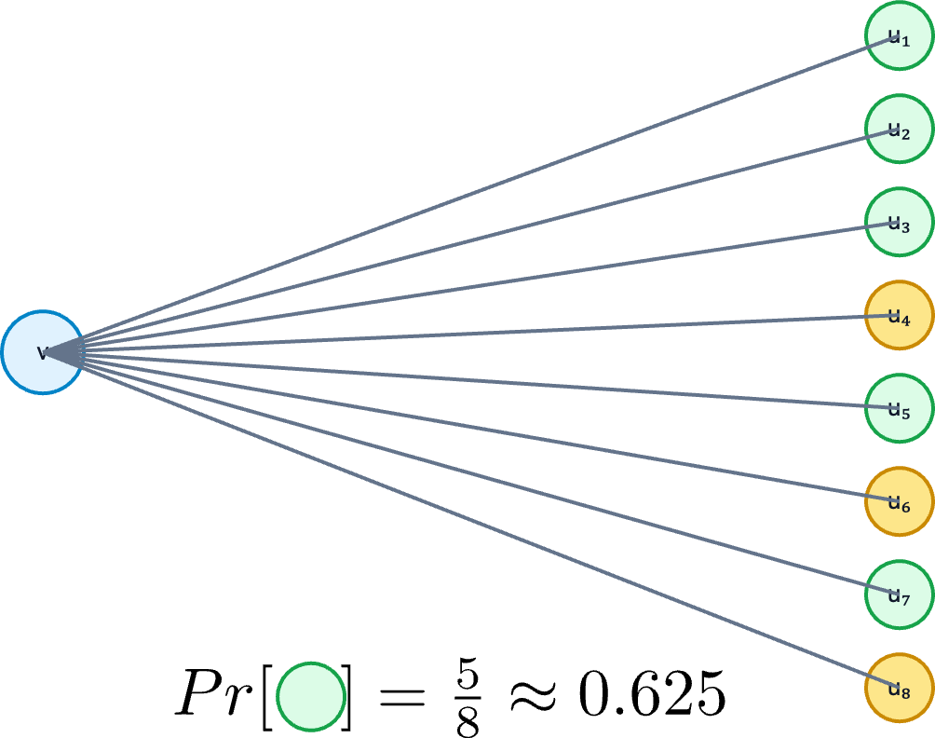

Sequential approach
Split edges in half randomly, and recurse on each half with probability proportional to its weight
  $O(\log{n})$ queries in $O(\log{n})$ rounds

Slide 12
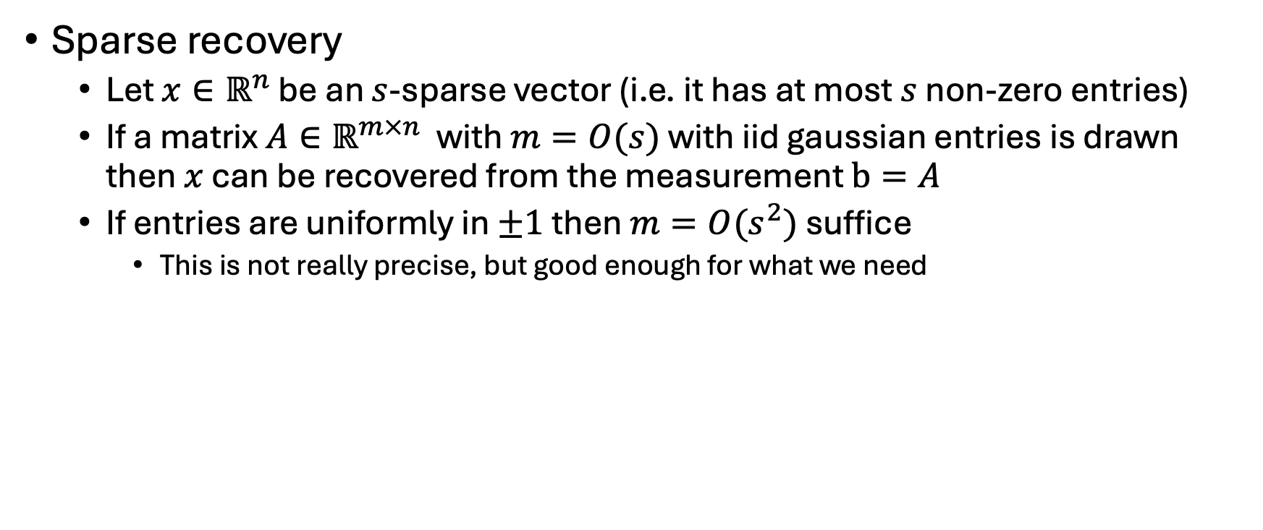
Useful tools
Sparse recovery
  Let $x∈ℝ^{n}$ be an $s$-sparse vector (i.e. it has at most $s$ non-zero entries)
  If a matrix $A∈ℝ^{m×n}$ with $m=O(s)$ with iid gaussian entries is drawn then $x$ can be recovered from the measurement $b=A$
  If entries are uniformly in $±1$ then $m=O(s^{2})$ suffice
    This is not really precise, but good enough for what we need

Slide 13
Proof
On the board

Slide 14
A simple minimum cut algorithm

Slide 15
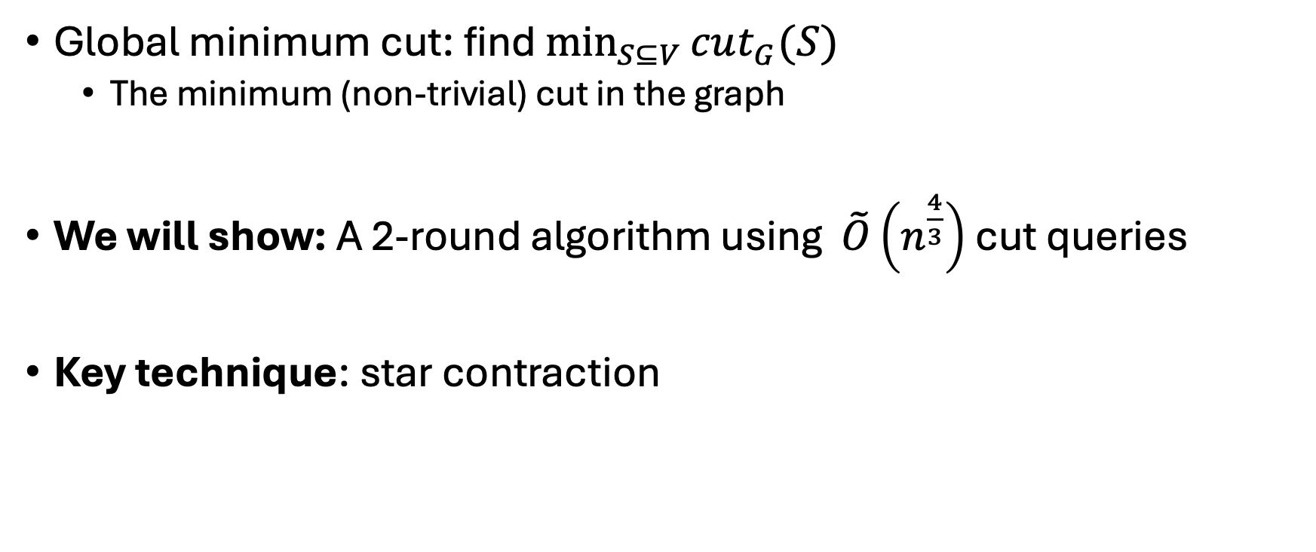
Problem
Global minimum cut: find $\min_{S⊆V}{cut_{G}(S) }$
  The minimum (non-trivial) cut in the graph
We will show: A 2-round algorithm using $\tilde{O}\left(n^{\frac{4}{3}}\right)$ cut queries
Key technique: star contraction

Slide 16

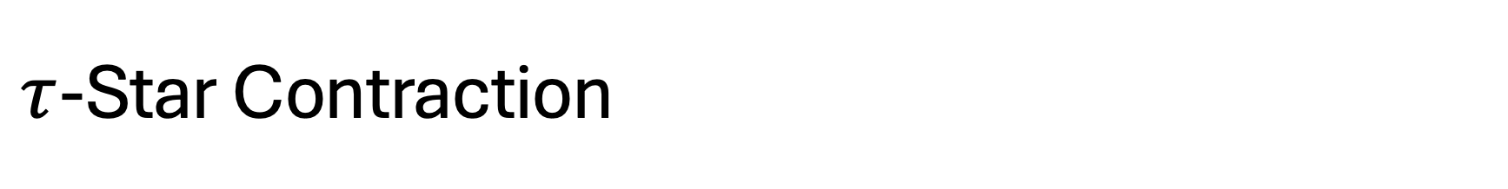



$τ$-Star Contraction
$R←$ sample each $v∈V$ as a center with probability $O(\frac{\log{n}}{τ})$
Let $H=\{v∈V∖R∣\deg\left(v\right)≥τ\}$
For every $w∈H$, sample uniformly a center neighbor (if exists) and contract them together
$$e$$
$$e′$$
Example for $τ=2$

Slide 17

$τ$-Star Contraction
Sample uniformly each $v∈V$ as a center with probability $O(\frac{\log{n}}{τ})$
Let $H=\{v∈V∣\deg\left(v\right)≥τ\}$
For every $w∈H$, sample uniformly a center neighbor (if exists) and contract them together
$$e$$
$$e′$$
Example for $τ=2$

Slide 18
$τ$-Star Contraction
Sample uniformly each $v∈V$ as a center with probability $O(\frac{\log{n}}{τ})$
Let $H=\{v∈V∣\deg\left(v\right)≥τ\}$
For every $w∈H$, sample uniformly a center neighbor (if exists) and contract them together
$$e$$
$$e′$$
Example for $τ=2$

Slide 19
$τ$-Star Contraction
Sample uniformly each $v∈V$ as a center with probability $O(\frac{\log{n}}{τ})$
Let $H=\{v∈V∣\deg\left(v\right)≥τ\}$
For every $w∈H$, sample uniformly a center neighbor (if exists) and contract them together
$$e$$
$$e′$$
Example for $τ=2$

Slide 20
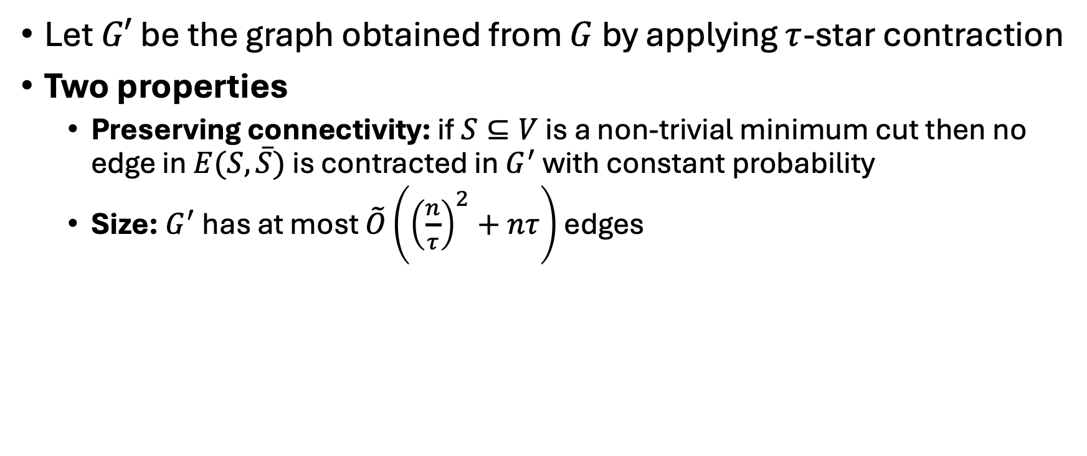
$τ$-Star Contraction
Let $G′$ be the graph obtained from $G$ by applying $τ$-star contraction
Two properties
  Preserving connectivity: if $S⊆V$ is a non-trivial minimum cut then no edge in $E(S,\overline{S})$ is contracted in $G^{′}$ with constant probability
  Size: $G^{′}$ has at most $\tilde{O}\left({\left(\frac{n}{τ}\right)}^{2}+nτ\right)$ edges

Slide 21
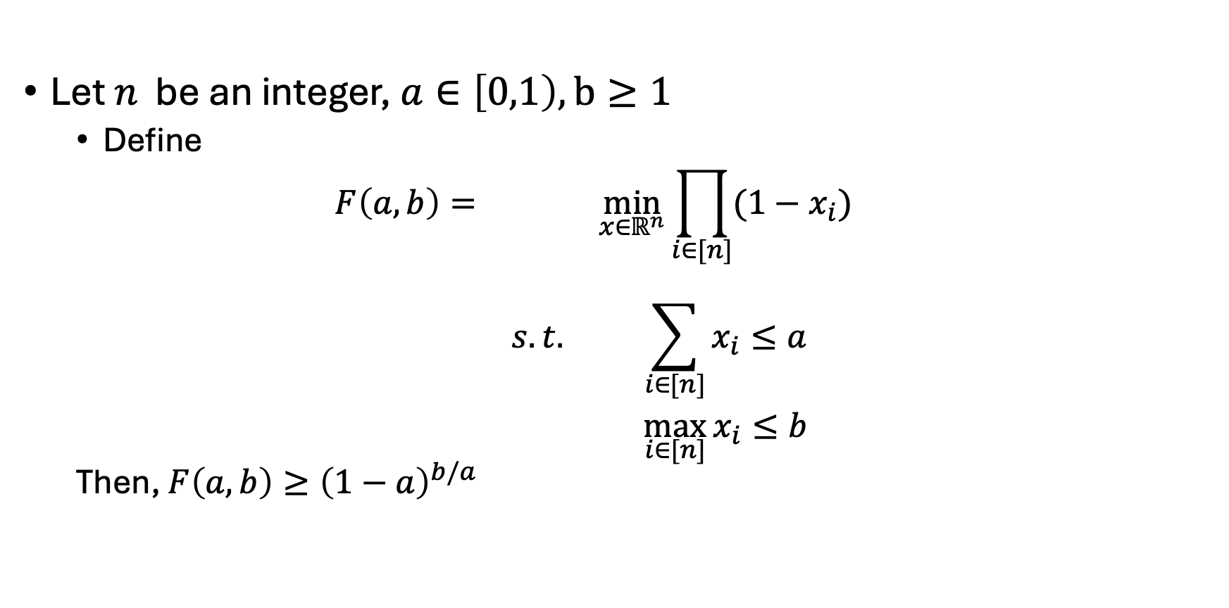
Useful tool
Let $n$ be an integer, $a∈\left[0,1\right),b≥1$
  Define
  $$\begin{matrix}F\left(a,b\right)= & & \min_{x∈ℝ^{n}}\prod_{i∈[n]}{(1−x_{i})} \\ & s.t. & \sum_{i∈[n]}{x_{i}≤a} \\ & & \max_{i∈[n]}{x_{i}≤b}\end{matrix}$$
  Then, $F\left(a,b\right)≥{\left(1−a\right)}^{b/a}$

Slide 22
Weighted Edge Sampling

Slide 23
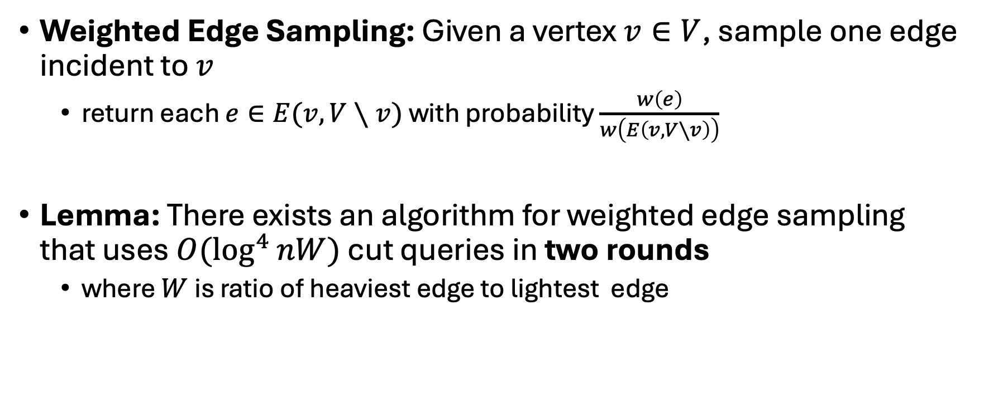
Problem
Weighted Edge Sampling: Given a vertex $v∈V$, sample one edge incident to $v$
  return each $e∈E(v,V∖v)$ with probability $\frac{w\left(e\right)}{w\left(E\left(v,V∖v\right)\right)}$
Lemma: There exists an algorithm for weighted edge sampling that uses $O(\log^{4}{nW})$ cut queries in two rounds
  where $W$ is ratio of heaviest edge to lightest edge

Slide 24
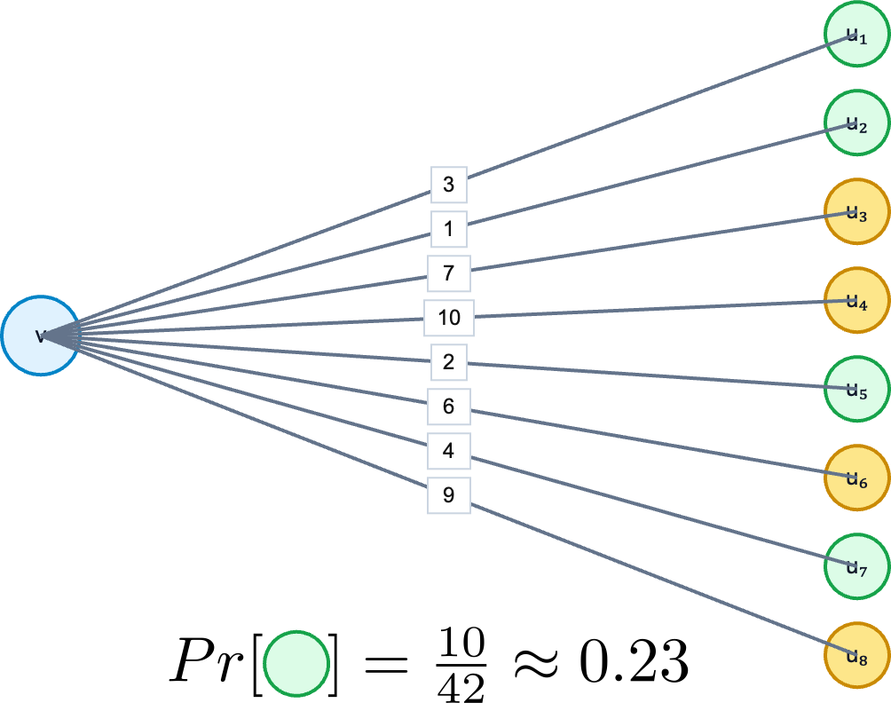
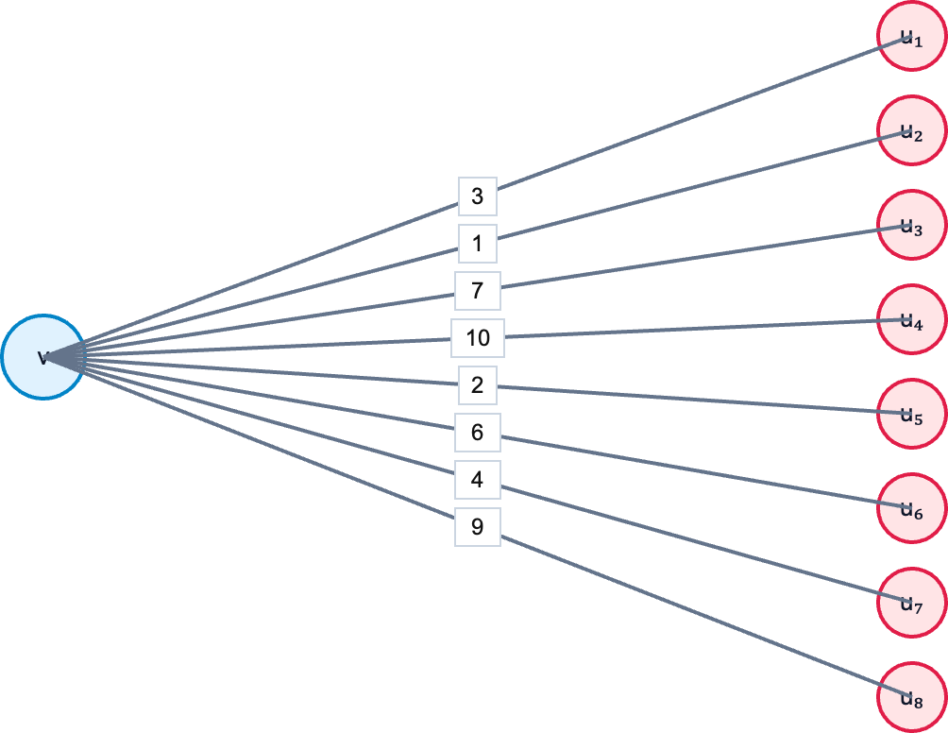
Sequential approach
Split edges in half randomly, and recurse on each half with probability proportional to its weight
  $O(\log{n})$ queries in $O(\log{n})$ rounds

Slide 25
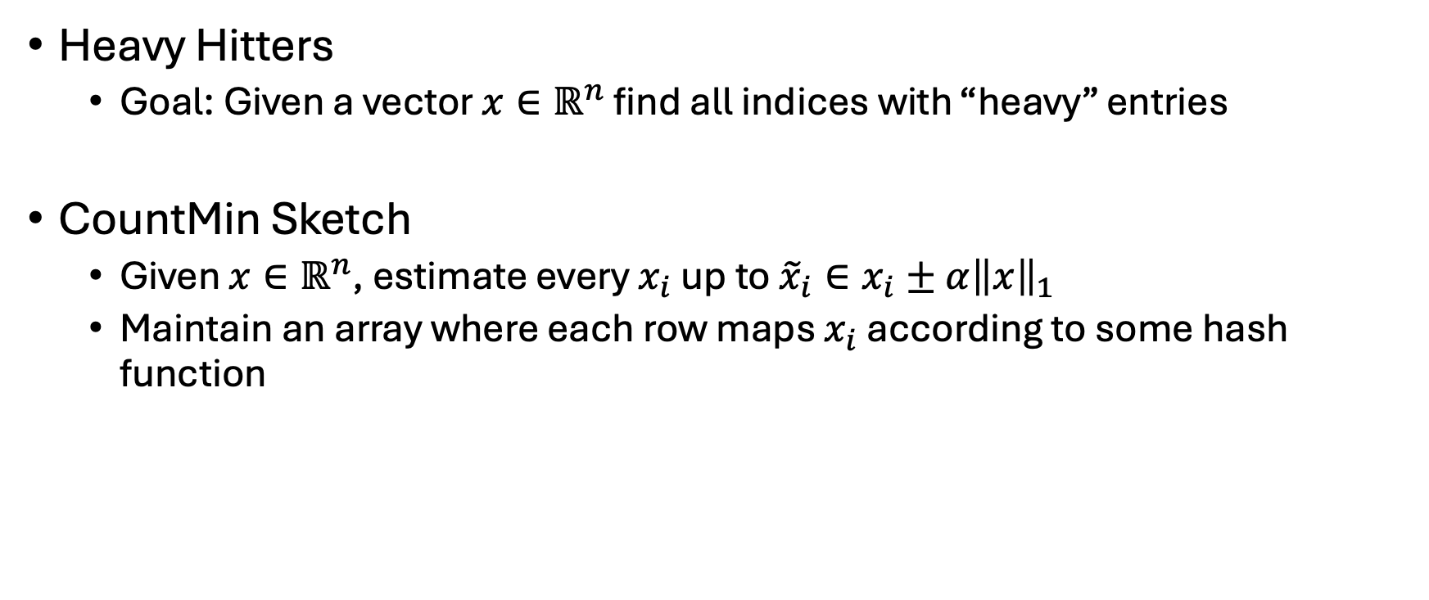
Key Tool
Heavy Hitters
  Goal: Given a vector $x∈ℝ^{n}$ find all indices with “heavy” entries
CountMin Sketch
  Given $x∈ℝ^{n}$, estimate every $x_{i}$ up to ${\tilde{x}}_{i}∈x_{i}±α{\left\|x\right\|}_{1}$
  Maintain an array where each row maps $x_{i}$ according to some hash function

Slide 26
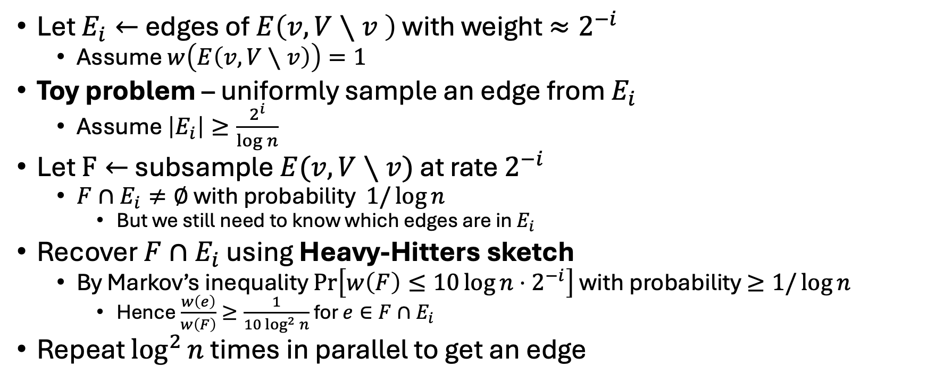
Two Rounds – Toy Problem
Let $E_{i}←$ edges of $E\left(v,V∖v \right)$ with weight $≈2^{−i}$
  Assume $w\left(E\left(v,V∖v\right)\right)=1$
Toy problem – uniformly sample an edge from $E_{i}$
  Assume $\left|E_{i}\right|≥\frac{2^{i}}{\log{n}}$
Let $F←$ subsample $E(v,V∖v)$ at rate $2^{−i}$
  $F∩E_{i}≠∅$ with probability $1/\log{n}$
    But we still need to know which edges are in $E_{i}$
Recover $F∩E_{i}$ using Heavy-Hitters sketch
  By Markov’s inequality $Pr\left[w\left(F\right)≤10\log{n}⋅2^{−i}\right]$ with probability $≥1/\log{n}$
    Hence $\frac{w\left(e\right)}{w\left(F\right)}≥\frac{1}{10\log^{2}{n}}$ for $e∈F∩E_{i}$
Repeat $\log^{2}{n}$ times in parallel to get an edge
Notes:
Don’t know which edges are in E_i
Linear sketching data structure for finding large elements
Streaming data structure based on linear sketching, which we can implement using cut queries

Slide 27
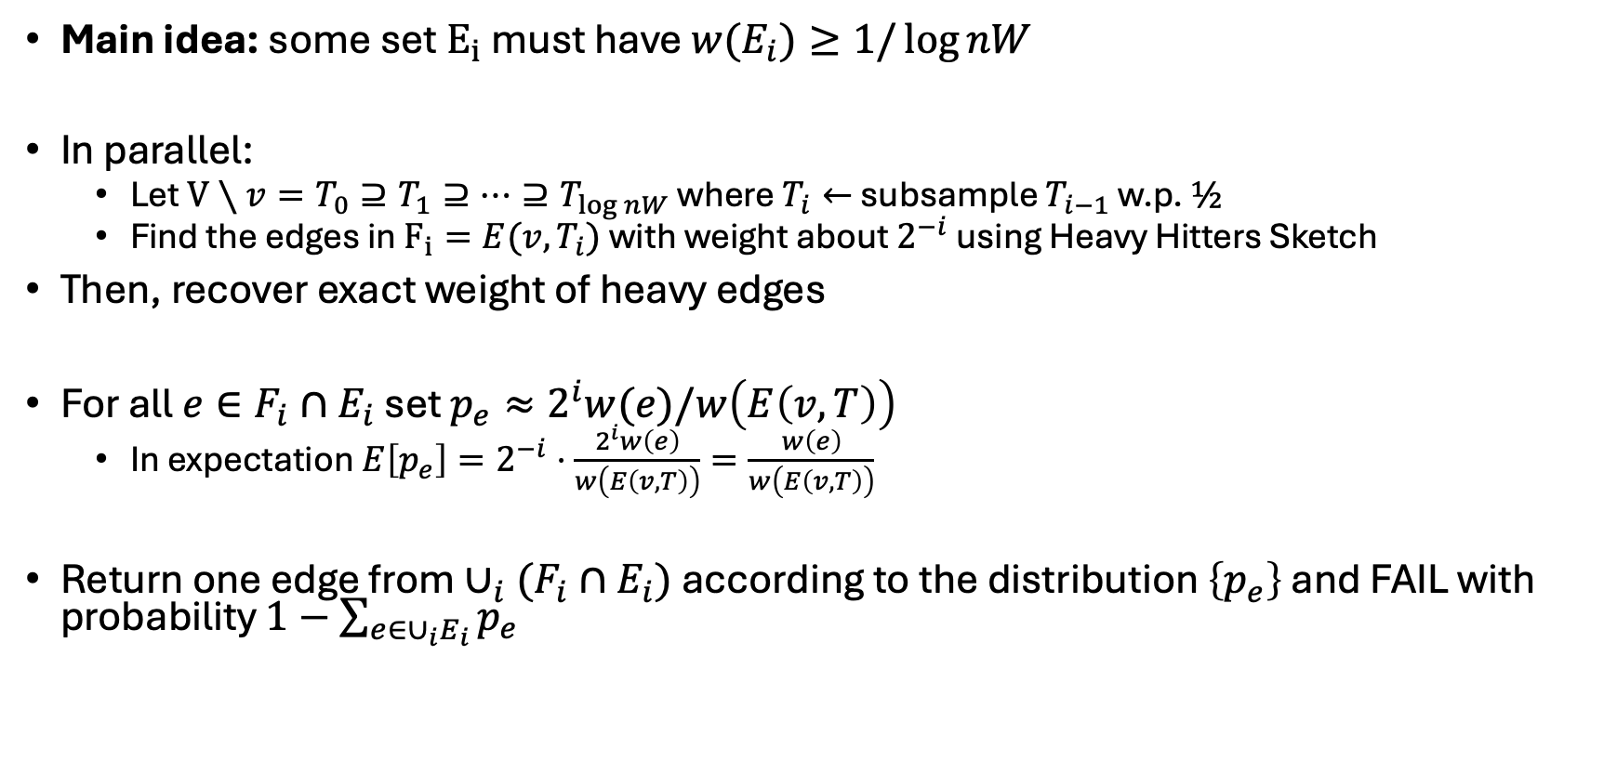
Two Rounds – Implementation
Main idea: some set $E_{i}$ must have $w(E_{i})≥1/\log{nW}$
In parallel:
  Let $V∖v=T_{0}⊇T_{1}⊇…⊇T_{\log{n}W}$ where $T_{i}←$ subsample $T_{i−1}$ w.p. $½$
  Find the edges in $F_{i}=E(v,T_{i})$ with weight about $2^{−i}$ using Heavy Hitters Sketch
Then, recover exact weight of heavy edges
For all $e∈F_{i}∩E_{i}$ set $p_{e}≈2^{i}w(e)/w\left(E\left(v,T\right)\right)$
  In expectation $E\left[p_{e}\right]=2^{−i}⋅\frac{2^{i}w\left(e\right)}{w\left(E\left(v,T\right)\right)}=\frac{w\left(e\right)}{w\left(E\left(v,T\right)\right)}$
Return one edge from $∪_{i}(F_{i}∩E_{i})$ according to the distribution $\left\{p_{e}\right\}$ and FAIL with probability $1−\sum_{e∈∪_{i}E_{i}}{p_{e}}$

Slide 28
Questions?

