Slide 1
Geometry 1:
Projection and Epipolar Lines
Introduction to Computer Vision
Ronen Basri
Weizmann Institute of Science

Slide 2
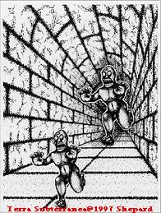
Perspectivity

Slide 3
Material covered
Pinhole camera model, perspective projection
Two view geometry, general case:
  Epipolar geometry, the essential matrix
  Camera calibration, the fundamental matrix
Two view geometry, degenerate cases
  Homography (planes, camera rotation)
  A taste of projective geometry
Stereo vision: 3D reconstruction from two views
Multi-view geometry, reconstruction through factorization

Slide 4
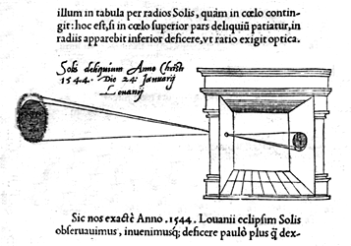
Camera obscura (“dark room”)
"Reinerus Gemma-Frisius, observed an eclipse of the sun at Louvain on January 24, 1544, and later he used this illustration of the event in his book De Radio Astronomica et Geometrica, 1545. It is thought to be the first published illustration of a camera obscura..."
(Hammond, John H., The Camera Obscura, A Chronicle)

Slide 5
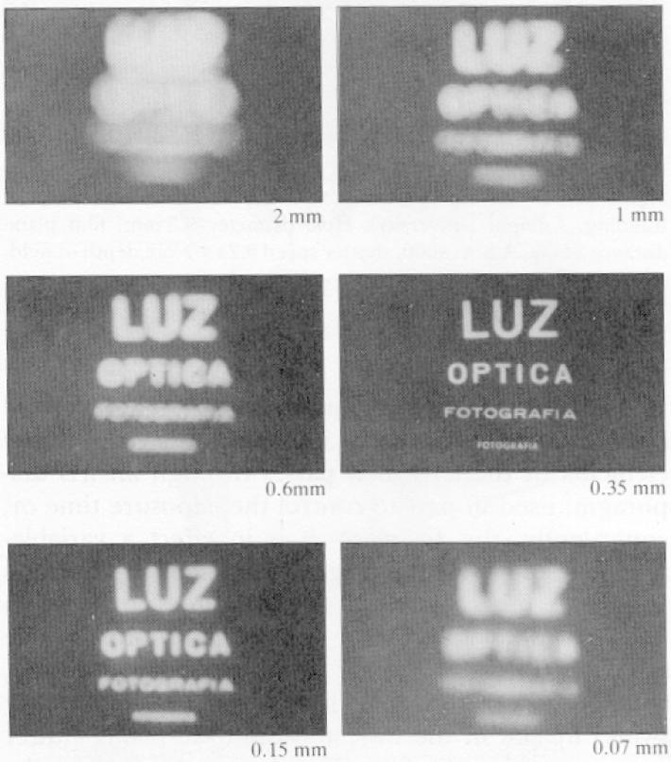
Why not use a pinhole camera?
Pinhole cameras are dark
Pinhole too big –
blurry image
Pinhole too small –
diffraction

Slide 6
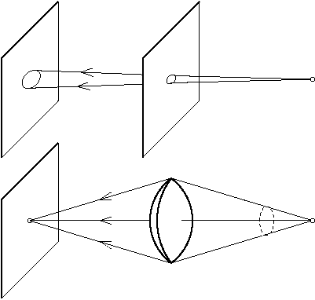
Lenses

Slide 7
Lenses
Lenses collect light from a large hole and direct it to a single point
Overcome the darkness of pinhole cameras
But there is a price
  Focus
  Radial distortions
  Chromatic abberations
  …
Pinhole is useful as a geometric model
Perspective: “perspicere” – to see through

Slide 8
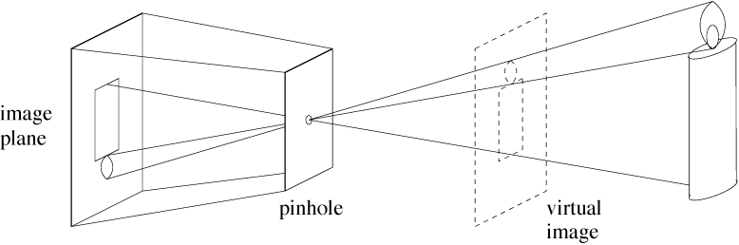
Pinhole camera model

Slide 9



Perspective projection
$$P=\left(X,Y,Z\right)$$
$$p=\left(x,y\right)$$
$$O$$

Slide 10
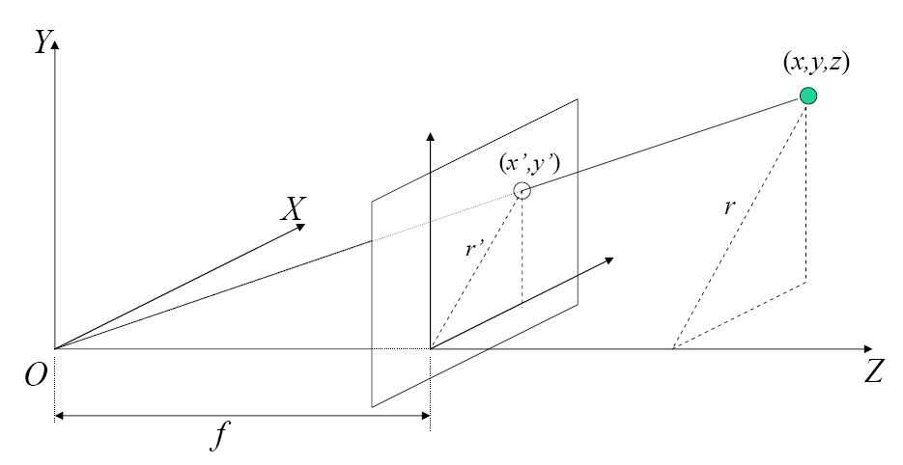
Perspective projection
O – Focal center
π – Image plane
Z – Optical axis
f – Focal length

Slide 11







Perspective projection
$$y$$
$$x$$
$$f$$
$$Y$$
$$X$$
$$Z$$
$$\frac{x}{X}=\frac{y}{Y}=\frac{f}{Z}$$

Slide 12

Perspective projection
Perspective rule
$$x=\frac{fX}{Z} y=\frac{fY}{Z}$$
In homogeneous coordinates
$$\left(\begin{matrix}x \\ y \\ f\end{matrix}\right)=\frac{f}{Z}\left(\begin{matrix}X \\ Y \\ Z\end{matrix}\right)$$

Slide 13
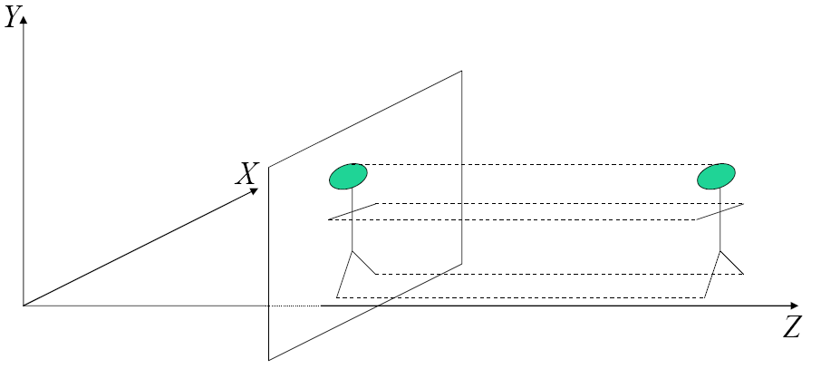

Orthographic projection
When objects are far from the camera
Projection rays are nearly parallel
Camera center at infinity
$$x=X$$
$$y=Y$$

Slide 14
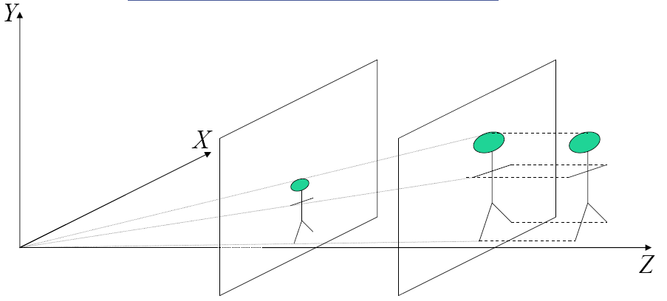
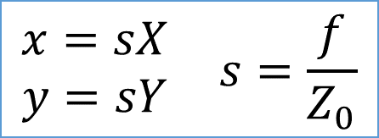
Scaled orthographic
How would a tilted rectangle
look like under perspective
projection? And under
scaled orthography?
$$\begin{matrix}\begin{matrix}x=sX \\ y=sY\end{matrix} & s=\frac{f}{Z_{0}}\end{matrix}$$

Slide 15
Which projection model should I use?
Perspective model is needed
  In scenes that contain many depth differences
  For accurate 3D reconstruction (stereo, structure from motion)
Scaled orthographic can be used
  When objects are small relative to their distance from the camera
  Often sufficient for recognition applications

Slide 16
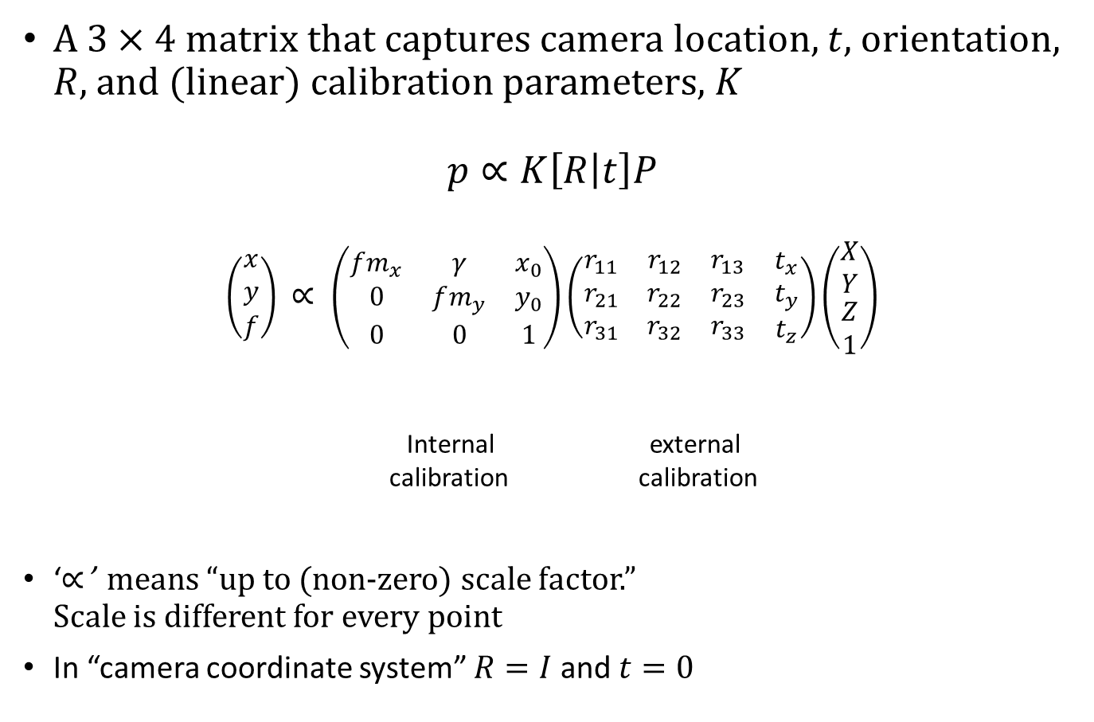
Camera matrix
A $3×4$ matrix that captures camera location, $t$, orientation, $R$, and (linear) calibration parameters, $K$
$$p∝K\left[R | t\right]P$$
$$\left(\begin{matrix}x \\ y \\ f\end{matrix}\right) ∝ \left(\begin{matrix}fm_{x} & γ & x_{0} \\ 0 & fm_{y} & y_{0} \\ 0 & 0 & 1\end{matrix}\right)\left(\begin{matrix}\begin{matrix}r_{11} & r_{12} & r_{13} \\ r_{21} & r_{22} & r_{23} \\ r_{31} & r_{32} & r_{33}\end{matrix} & \begin{matrix}t_{x} \\ t_{y} \\ t_{z}\end{matrix}\end{matrix}\right)\left(\begin{matrix}\begin{matrix}X \\ Y\end{matrix} \\ \begin{matrix}Z \\ 1\end{matrix}\end{matrix}\right)$$
Internal external
calibration calibration
‘$∝$’ means “up to (non-zero) scale factor.”
Scale is different for every point
In “camera coordinate system” $R=I$ and $t=0$

Slide 17
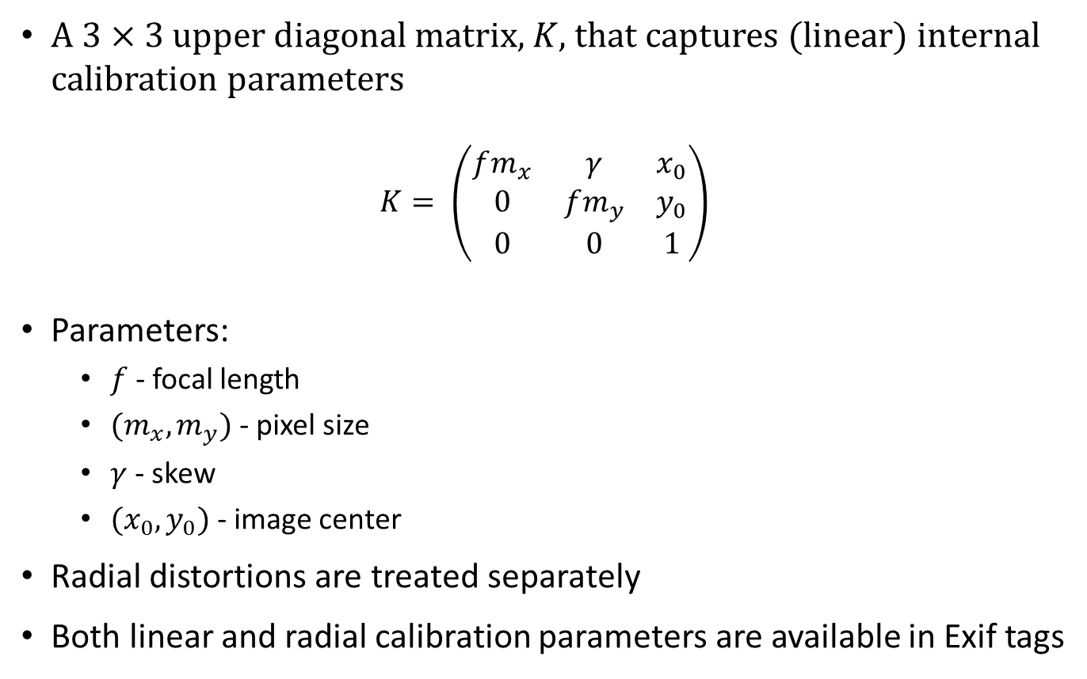
Calibration matrix
A $3×3$ upper diagonal matrix, $K$, that captures (linear) internal calibration parameters
$$K= \left(\begin{matrix}fm_{x} & γ & x_{0} \\ 0 & fm_{y} & y_{0} \\ 0 & 0 & 1\end{matrix}\right)$$
Parameters:
  $f$ - focal length
  ${(m}_{x},m_{y})$ - pixel size
  $γ$ - skew
  ${(x}_{0},y_{0})$ - image center
Radial distortions are treated separately
Both linear and radial calibration parameters are available in Exif tags

Slide 18
X

Slide 19
Two view geometry
epipolar line

Slide 20



Epipolar plane
Definition:
Epipolar plane: a plane that contains the baseline
$$P$$
epipolar plane
epipolar line
epipolar line
$$O$$
Baseline
$$O’$$

Slide 21


Epipoles
Each epipolar plane produces a pair of epipolar lines
There is a 1-D system of epipolar planes
All epipolar planes contain the baseline, therefore all epipolar lines contain its intersection with the respective image planes
These intersection points are called epipoles
An epipole is the projection of the right focal center onto the left image (and vice versa)
epipolar lines
epipolar lines
$$O$$
$$O’$$
Baseline

Slide 22
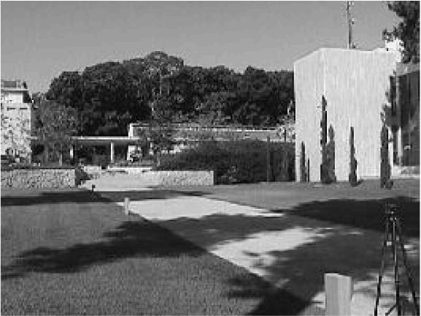
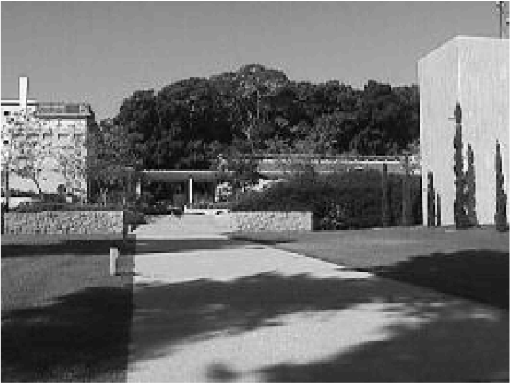
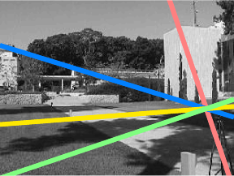
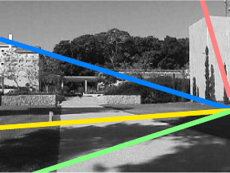

Slide 23



Epipolar constraints: derivation
We derive the constraints by requiring $p,q,O,O′$ to lie in the same plane
$$P$$
$$p$$
epipolar plane
$$q$$
$$O$$
Baseline
$$O’$$

Slide 24
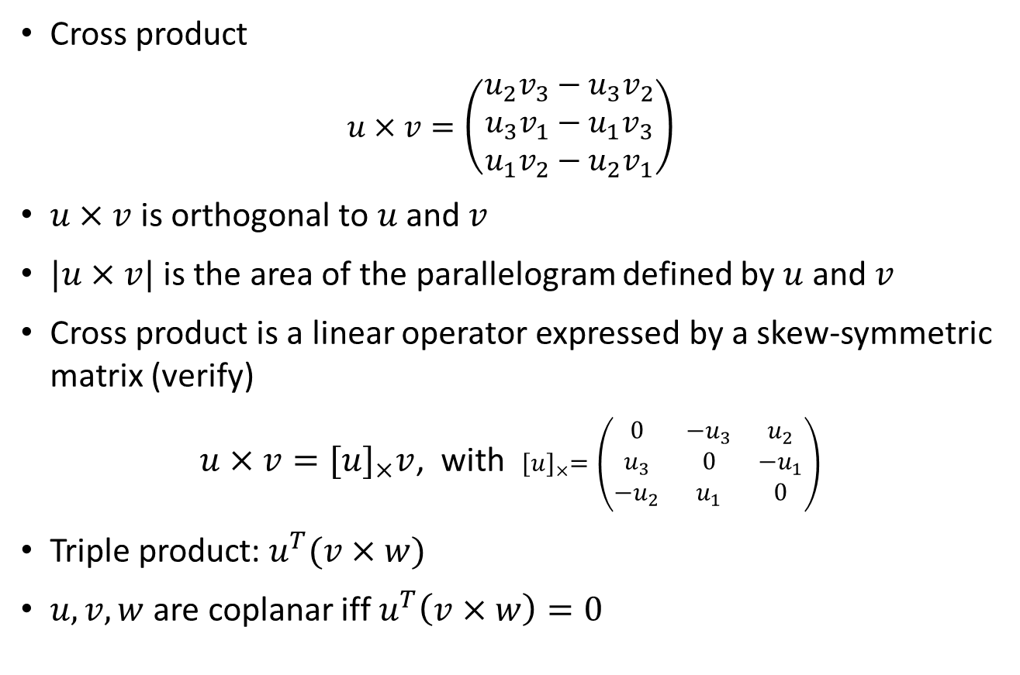
Cross product, triple product
Cross product
$$u×v=\left(\begin{matrix}u_{2}v_{3}−u_{3}v_{2} \\ u_{3}v_{1}−u_{1}v_{3} \\ u_{1}v_{2}−u_{2}v_{1}\end{matrix}\right)$$
$u×v$ is orthogonal to $u$ and $v$
$|u×v|$ is the area of the parallelogram defined by $u$ and $v$
Cross product is a linear operator expressed by a skew-symmetric matrix (verify)
$u×v={[u]}_{×}v$, with ${[u]}_{×}=\left(\begin{matrix}0 & −u_{3} & u_{2} \\ u_{3} & 0 & −u_{1} \\ −u_{2} & u_{1} & 0\end{matrix}\right)$
Triple product: $u^{T}(v×w)$
$u,v,w$ are coplanar iff $u^{T}\left(v×w\right)=0$

Slide 25
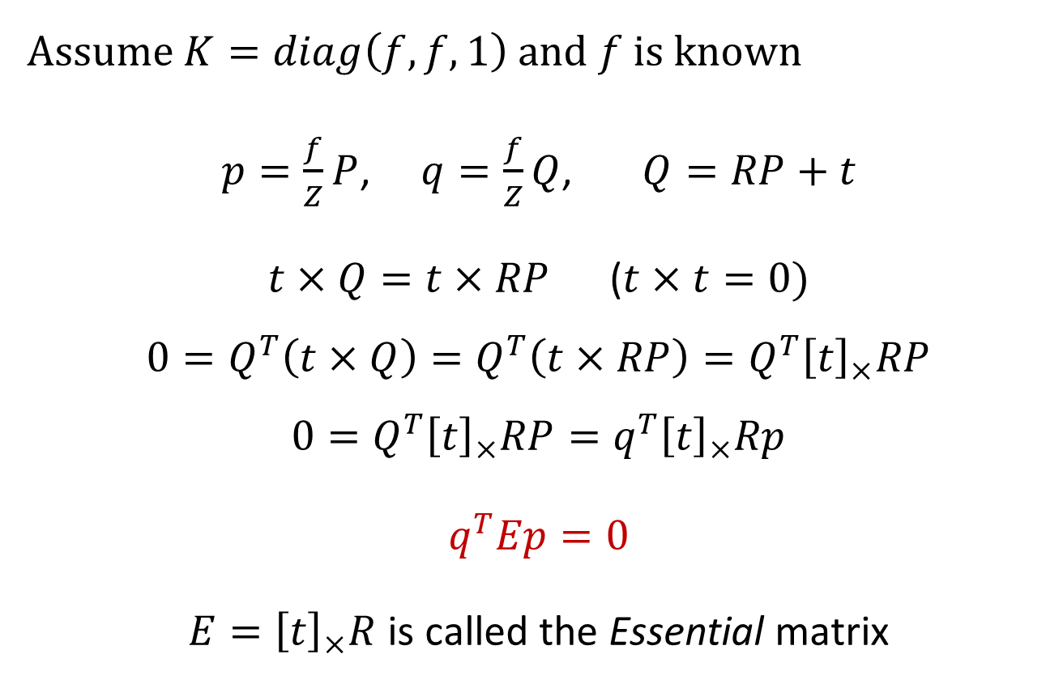
Epipolar constraints: the Essential matrix
Assume $K=diag\left(f,f,1\right)$ and $f$ is known
$p=\frac{f}{Z}P$, $q=\frac{f}{Z}Q$, $Q=RP+t$
$t×Q=t×RP$ ($t×t=0)$
$$0=Q^{T}\left(t×Q\right)=Q^{T}\left(t×RP\right)=Q^{T}{\left[t\right]}_{×}RP$$
$$0=Q^{T}{\left[t\right]}_{×}RP=q^{T}{\left[t\right]}_{×}Rp$$
$$q^{T}Ep=0$$
$E={\left[t\right]}_{×}R$ is called the Essential matrix

Slide 26

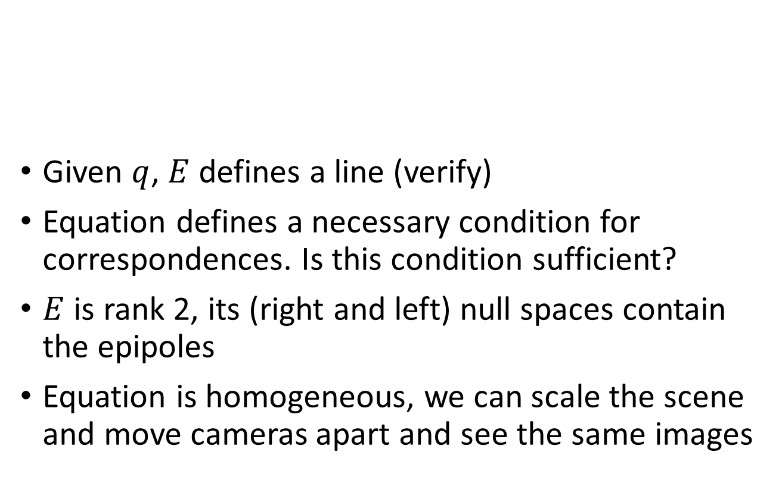
The Essential matrix
Given $q$, $E$ defines a line (verify)
Equation defines a necessary condition for correspondences. Is this condition sufficient?
$E$ is rank 2, its (right and left) null spaces contain the epipoles
Equation is homogeneous, we can scale the scene and move cameras apart and see the same images
$$q^{T}Ep=0$$

Slide 27

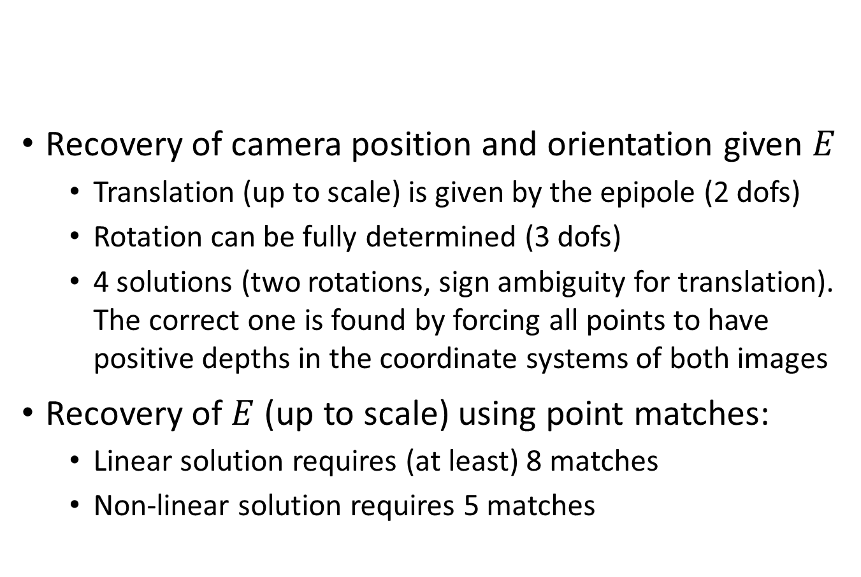
The Essential matrix
Recovery of camera position and orientation given $E$
  Translation (up to scale) is given by the epipole (2 dofs)
  Rotation can be fully determined (3 dofs)
  4 solutions (two rotations, sign ambiguity for translation). The correct one is found by forcing all points to have positive depths in the coordinate systems of both images
Recovery of $E$ (up to scale) using point matches:
  Linear solution requires (at least) 8 matches
  Non-linear solution requires 5 matches
$$q^{T}Ep=0$$

