Slide 1
Introduction to
Computer Vision
Ronen Basri, Michal Irani, Shimon Ullman
Teaching Assistants
Hadar Gorodissky, Yam Kushinsky, Assaf Shocher

Slide 2
Misc...
Course website – look under:
www.wisdom.weizmann.ac.il/~vision
To be added to course mailing-list:
Send email to one of the TAs:
<hadar.gorodissky@weizmann.ac.il>
<yam.kushinsky@weizmann.ac.il>
<assaf.shocher@weizmann.ac.il>
Vision & Robotics Seminar (not for credit):
Thursdays at 12:15-13:15 (Ziskind 1)
  Send email to Amir Gonen:
<amir.gonen@weizmann.ac.il>
Tutorial in Deep Neural-Networks for Vision:
by Greg Shakhnarovich (TTIC) – in December (TBA)

Slide 3
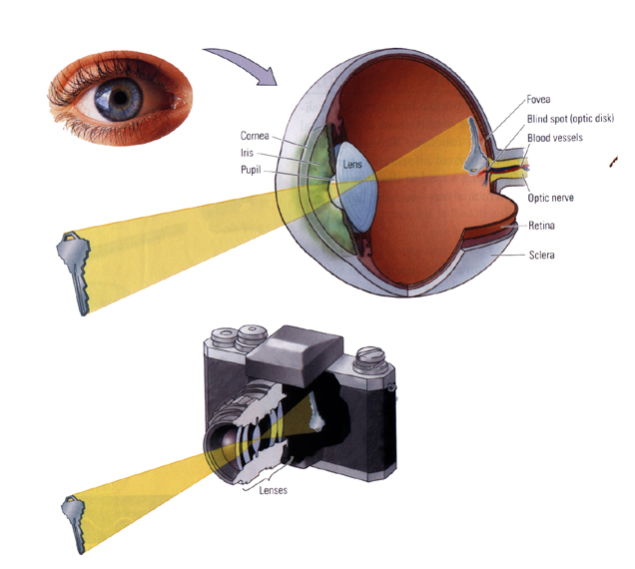
Applications:
- Robot navigation
- Autonomous vehicles
- Guiding tools for blind
- Security and monitoring
- Object/face recognition; OCR.
- Medical Applications
- Visualization; NVS
- Manufacturing and inspection; QA
- Visual communication
- Digital libraries and video search
- Video manipulation and editing
How is an image formed?
(geometry and photometry)
How is an image represented?
What kind of operations
can we apply to images?
What do images tell us
about the world?
(analysis & interpretation)

Slide 4
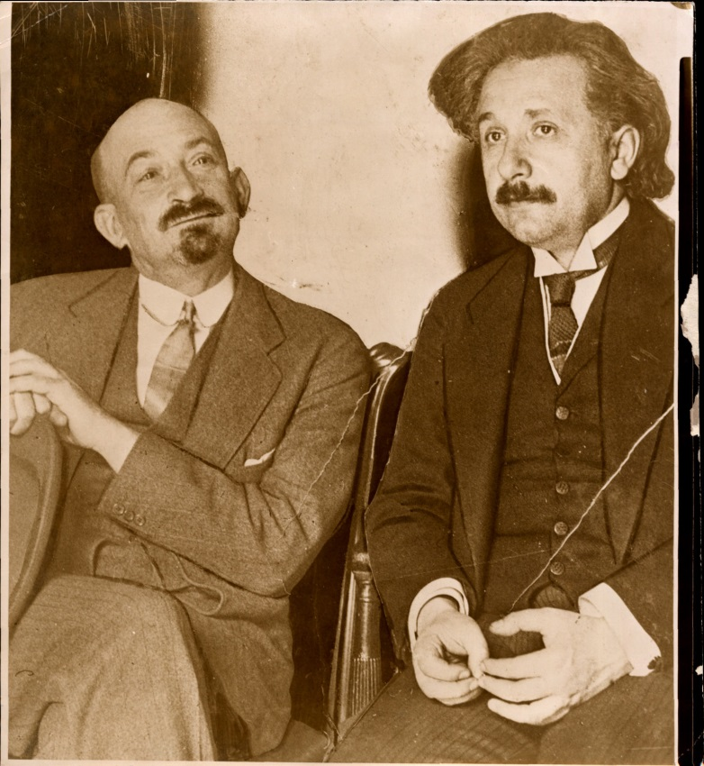
Digital Image
Pixels:
0 = Black
255 = White
137 74 52 16 128 217 207 221 220 179 188 193 195 189 188 193
73 64 23 68 228 243 225 120 94 138 140 116 210 173 162 142
29 59 43 246 246 151 99 74 185 188 214 205 127 138 203 186
65 19 187 244 170 37 153 255 233 245 255 236 252 182 123 197
30 72 255 118 20 232 235 218 184 50 41 9 55 147 207 110
19 139 108 42 244 253 130 75 5 207 40 73 31 81 11 181
42 147 69 235 187 81 222 236 59 62 4 55 0 141 81 9
33 111 231 139 67 217 255 240 20 119 155 158 39 91 84 15
76 251 160 71 195 255 241 255 255 55 54 80 176 188 245 231
255 155 103 237 224 240 255 253 250 255 248 243 247 227 194 137
237 239 255 222 220 219 205 191 203 206 180 168 147 140 96 85
Notes:
REPLACE PICTURE!!!!!!!!! [PRESIDENT ELECT]
So how difficult is it to make an artificial seeing system? What are the difficulties associated with analyzing visual information with a computer?

Slide 5
Topics covered
Fourier and Applications (2 lessons)
Geometry, Stereo, 3D Structure (4 lessons)
Motion & video analysis (3 lessons)
Human Vision (1 lesson)
Object Recognition (2 lessons)
Lighting (1 lesson)
2-3 programming exercises (MATLAB) -- CAN SUBMIT IN PAIRS
2-3 theoretical exercises -- MUST SUBMIT INDIVIDUALLY
EXAM

Slide 6
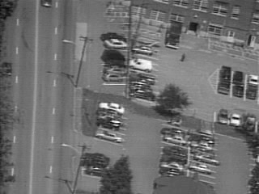

Slide 7
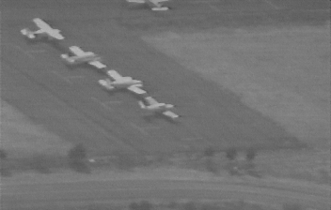
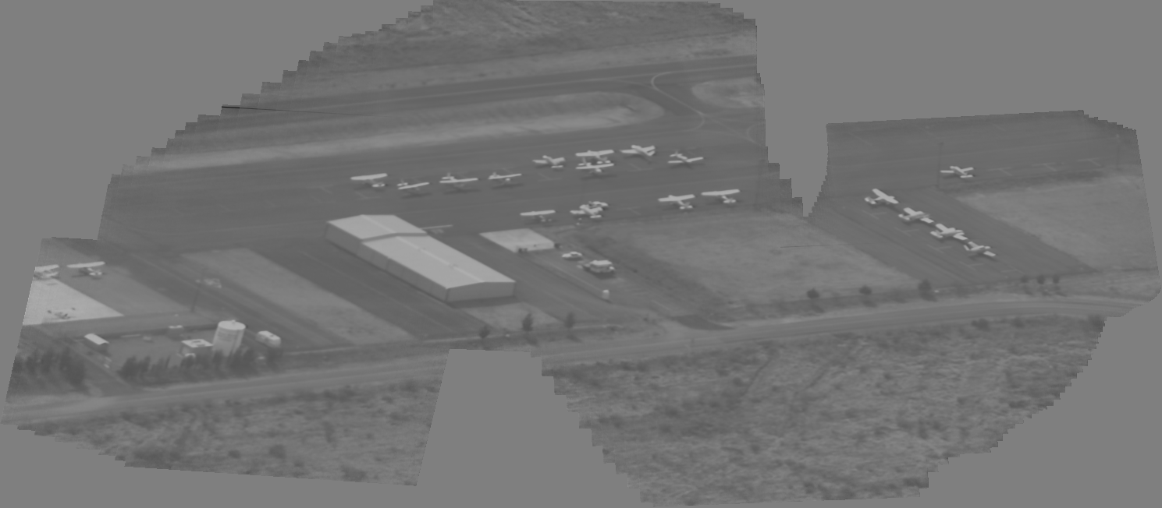
Panoramic Mosaic Image
Original video clip
Optical Flow
Image Alignment
Sequence Alignment
Generated Mosaic image

Slide 8
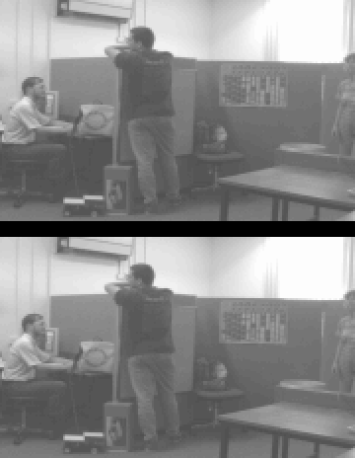
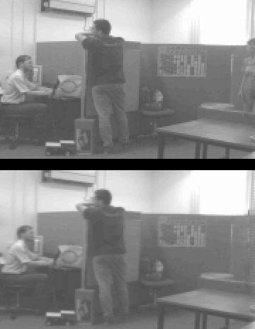
Video Removal
Original
Original
Outliers
Synthesized

Slide 9
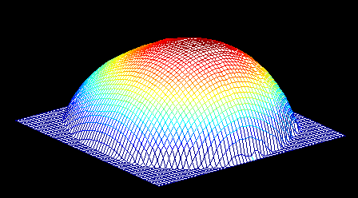
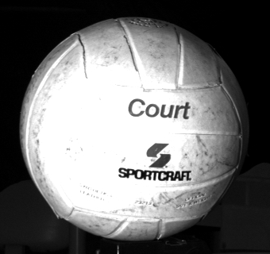
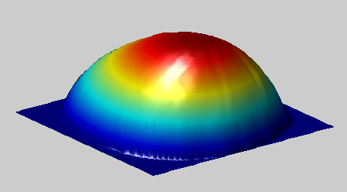
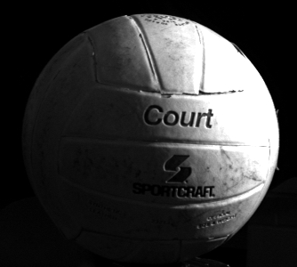
Photometric Stereo

Slide 10
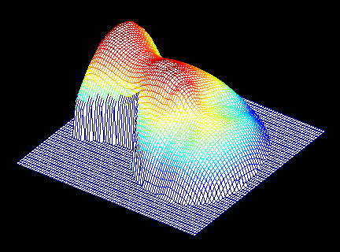
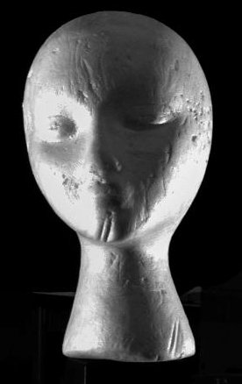
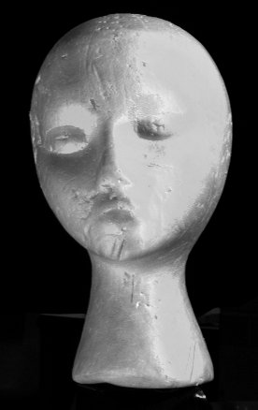
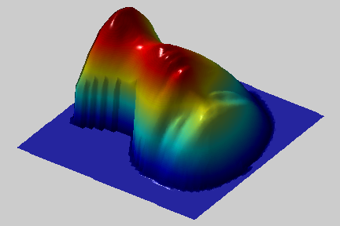
Photometric Stereo

Slide 11
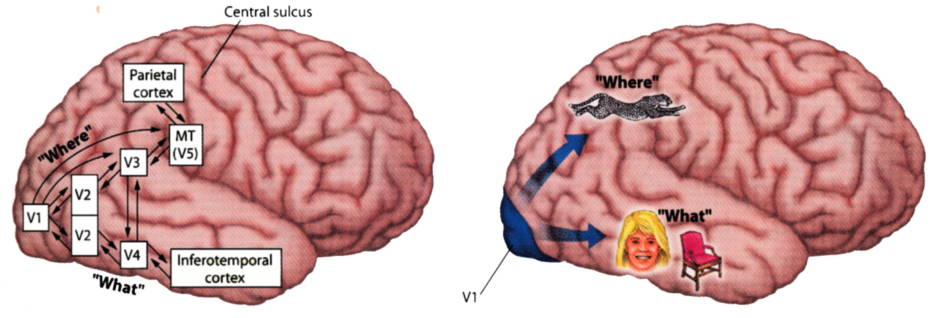

Slide 12
