Slide 1
RNNs & LSTM
Hadar Gorodissky
Niv Haim

Slide 2
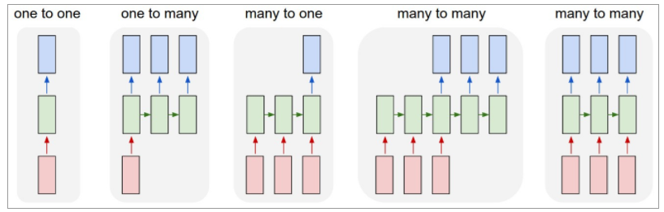
Notes:
(1) Vanilla mode of processing without RNN, from fixed-sized input to fixed-sized output (e.g. image classification)
(2) image captioning takes an image and outputs a sentence of words
(3) sentiment analysis where a given sentence is classified as expressing positive or negative sentiment
(4) Machine Translation: an RNN reads a sentence in English and then outputs a sentence in French
(5) Synced sequence input and output, video classification where we wish to label each frame of the video)

Slide 3
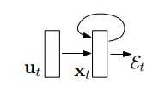

RNN

Slide 4
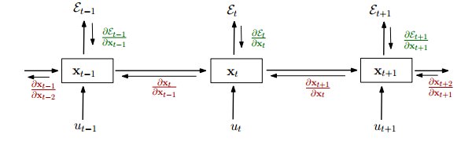


BPTT
Notes:
It is sufficient for the largest eigenvalue λ1 of the recurrent weight matrix to be smaller than 1 for long term components to vanish (as t → ∞) and necessary for it to be larger than 1 for gradients to explode. We can generalize these results for nonlinear functions σ where the absolute values of σ 0 (x) is bounded

Slide 5


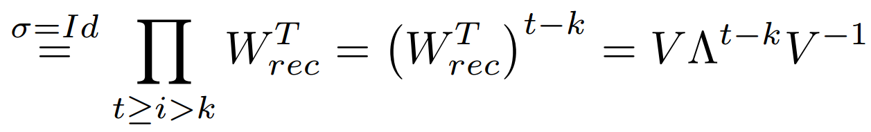
BPTT
Notes:
It is sufficient for the largest eigenvalue λ1 of the recurrent weight matrix to be smaller than 1 for long term components to vanish (as t → ∞) and necessary for it to be larger than 1 for gradients to explode. We can generalize these results for nonlinear functions σ where the absolute values of σ 0 (x) is bounded

Slide 6
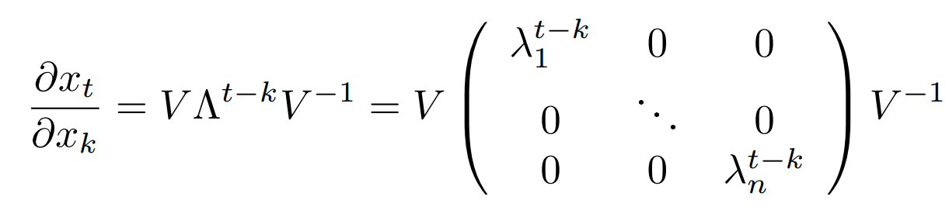
RNN - exploding / vanshing gradients
Notes:
It is sufficient for the largest eigenvalue λ1 of the recurrent weight matrix to be smaller than 1 for long term components to vanish (as t → ∞) and necessary for it to be larger than 1 for gradients to explode. We can generalize these results for nonlinear functions σ where the absolute values of σ 0 (x) is bounded

Slide 7
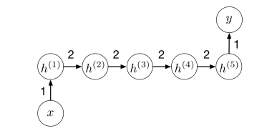

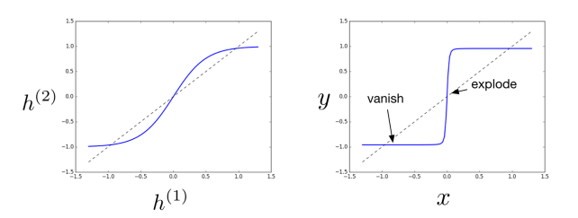


RNN - exploding / vanshing gradients
Desmos demo...
Notes:
It’s a bit easier to analyze iterated functions if they’re monotonic
Eventually, the iterates either shoot off to infinity or wind up at a fixed point
called sinks, or attractors
Observe that fixed points with derivatives f 0 (x) < 1 are sinks and fixed points with f 0 (x) > 1 are sources

Slide 8
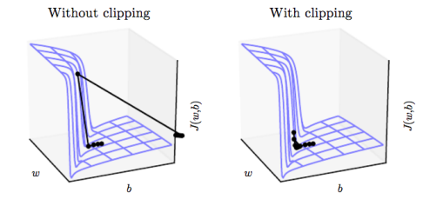

RNN - Gradient Clipping
Handles Exploding gradients.
What about vanishing?

Slide 9
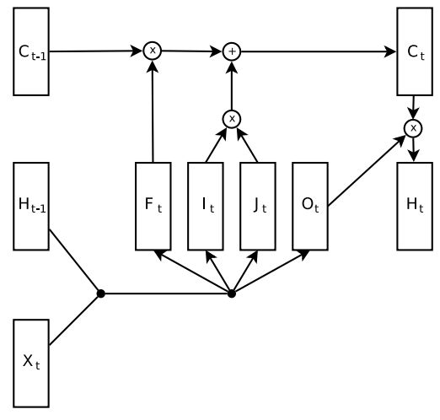
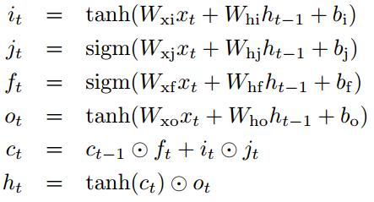


LSTM
forget
gate
new
candidates
input
gate
=
Notes:
architecture was designed to make it easy to remember information over long time periods until it’s needed

Slide 10
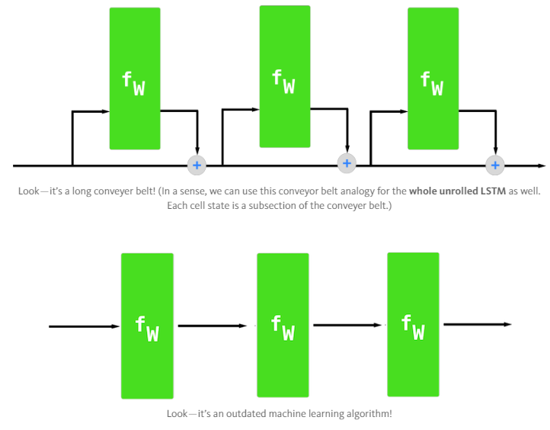
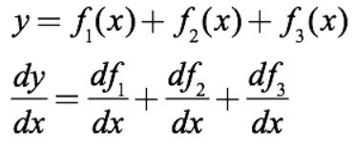
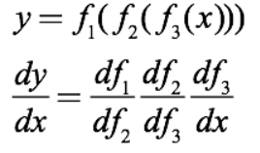
LSTM - How it solves the vanshing problem
Boom
Puff

Slide 11
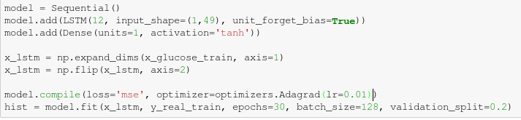
LSTM - Keras Implementation

Slide 12
References
http://karpathy.github.io/2015/05/21/rnn-effectiveness/
https://arxiv.org/pdf/1211.5063.pdf
https://colah.github.io/posts/2015-08-Understanding-LSTMs/
http://www.cs.toronto.edu/~rgrosse/courses/csc321_2017/readings/L15%20Exploding%20and%20Vanishing%20Gradients.pdf
https://ayearofai.com/rohan-lenny-3-recurrent-neural-networks-10300100899b
http://proceedings.mlr.press/v37/jozefowicz15.pdf

Slide 13
