Slide 1
Dnn: A hands on Challenge session 2: 26.2.17
Challenge set up
Home work
Open questions
Tensorflow tutorial by Eran Amar
Cluster tutorial - optional

Slide 2
Challenge set up
Raw data
1000 people 7 days
Data per a person
  Glucose value
  Personal parameters:
    Blood tests
    Bacterial species
    Measurements
  Events
    Test foods
    Exercises
    Meals
    Sleep

Slide 3
Challenge set up
Sets
1000 connection Ids
Days 1-7
800 connection Ids
Days 1-7
100 connection Ids
Days 1-7
100 connection Ids
Days 1-7
Test 1
Val 1
800 connection Ids
Days 1-6
400 connection Ids
day 7
400 connection Ids
day 7
Train
Test 2
Val 2

Slide 4
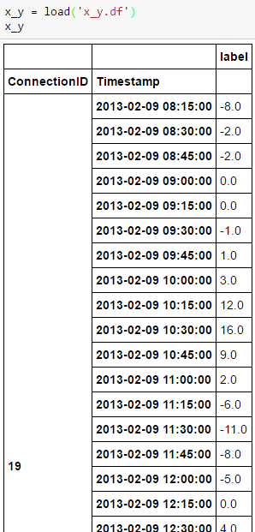
Challenge set up objective
Input : connection Id and timestamp
Output: Glucose level of connection Id at ts+1H - Glucose level of connection Id at ts
Test + val
Training

Slide 5
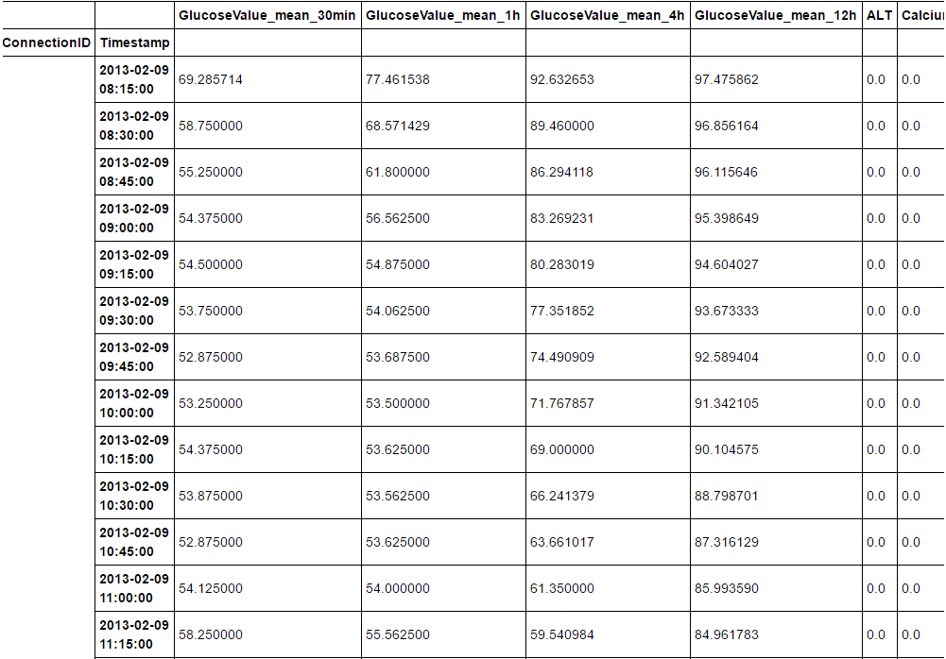
Challenge set up input
Connection ID, timestamp
Legal features:
ts – 12H : ts
Predict
Glucose(ts+1H) – Glucose(ts)
Use the ready code
Pay attention: not using illegal data
Example

Slide 6
Home Work
Analyze the data
Understand the glucose behavioral – histogram of differences in glucose level (1 hour)
Prioritizing events features
Prioritizing Personal parameters

Slide 7
Questions

