Slide 1
Deep Neural Networks: A Hands on Challenge Deep Neural Networks: A Hands on Challenge Deep Neural Networks: A Hands on Challenge Deep Neural Networks: A Hands on Challenge Dnn: A hands on Challenge session 3: 19.03.17
Predictor.py
Building features

Slide 2
Predictor.py
Find here http://www.wisdom.weizmann.ac.il/~vision/courses/2017_2/DNN%20Challenge/files/code/predictor.py
Will be used for testing → keep signatures
Useful functions
Don’t have to use for training

Slide 3
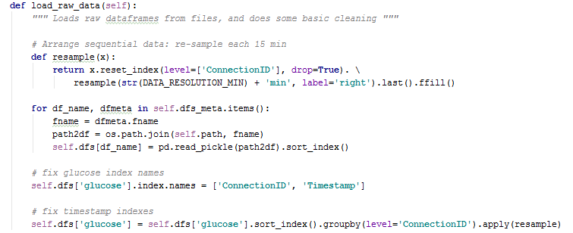
Predictor.py
Initialize: path to raw data
8 data frames
no x_y.df
Keep signature
Resample the glucose –every round 15 minutes
labels were generated after resampling

Slide 4
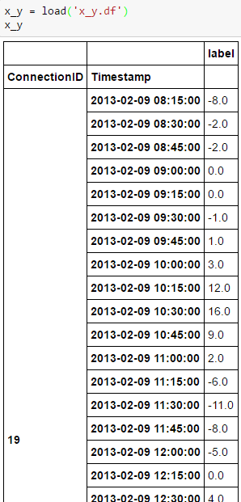
Predictor.py
Keep signature
Input: X
Output: predictions (numpy array)
Build features
Feed to the trained network
Return output

Slide 5
Predictor.py
Generating features
Good to know
Example

Slide 6
Questions

