Slide 1
Gal Yona

Slide 2
DNN Challenge
Gal Yona

Slide 3
Data
“Dynamic” data:
Glucose
Sleep
Meals
“Static” data:
Measurements
Questions

Slide 4
“Simple” Architecture: A classic “Alex-Net” style CNN: two convolutional layers + 2 fully connected layers
“Complex” Architecture: An RNN to process the dynamic data, with the static data “injected” to each hidden state

Slide 5
Hardly ideal for the task + uses partial data, but easy to optimize
“Simple” Architecture: A classic “Alex-Net” style CNN: two convolutional layers + 2 fully connected layers
“Complex” Architecture: An RNN to process the dynamic data, with the static data “injected” to each hidden state
Ideal for the task, but difficult to optimize and likely to overfit

Slide 6
Hardly ideal for the task + uses partial data, but easy to optimize
“Simple” Architecture: A classic “Alex-Net” style CNN: two convolutional layers + 2 fully connected layers
“Complex” Architecture: An RNN to process the dynamic data, with the static data “injected” to each hidden state
Ideal for the task, but difficult to optimize and likely to overfit

Slide 7
Final Submission: Simple + Small Twist
Observation:
For glucose prediction, a receptive field close to #time-steps is useful - can learn patterns from previous hours.
In regular CNN, this will require many layers - overfitting potential!

Slide 8
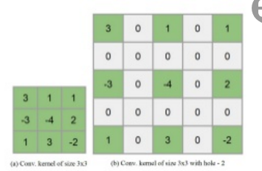
Final Submission
Solution: Dilated causal convolutions (convolution with “holes”).

Slide 9
Final Submission
Properties:
The filter is applied over an area larger than its length by skipping input values with a certain step (dilation rate)
Equivalent to a convolution with a larger filter derived from the original filter by dilating it with zeros
Similar to pooling or strided convolutions, but here the output has the same size as the input

Slide 10
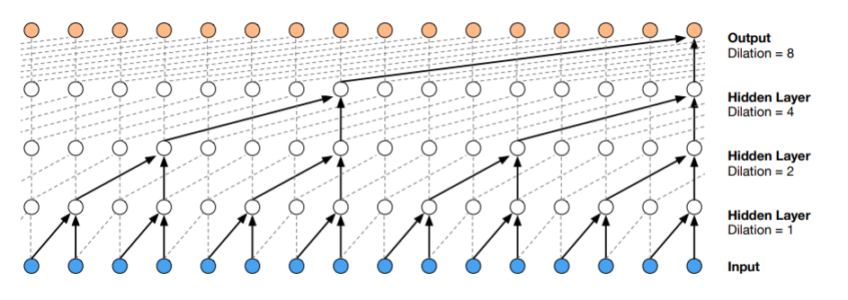
Stacked 1D Dilated Convolution

Slide 11
Final Submission
Advantages:
Can get very large receptive fields with just a few layers
Preserve input resolution throughout the network
Computational efficiency

Slide 12
Nitzan and Heli

Slide 13
Features used in the model
Temporal features:
Glucose data
Meals:
Total weight
Energy
Carbohydrates
Sugars
Water
Sleep
Constant features:
Time and weekday
Measurements:
BMI
Age
BP
Heart rate
Body weight
WHR
Blood (all)

Slide 14
Temporal
features
7x49
~20x22
~10x8
Output
~10
Constant features
~20
~95
~15
37
1D Convolutional Layer
Fully-Connected Layer
Merge/Flatten Layer

Slide 15
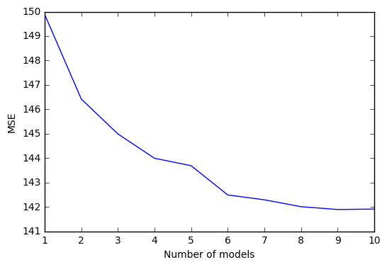
Insight: ensemble
Several networks were trained, with randomly selected meta-parameters
Prediction is made using a linear combination of the outputs

Slide 16
Gal and Adam

Slide 17
DNN CHALLENGE
https://www.kornferry.com/kf4d/kf4d
Gal Benor & Adam Yaari

Slide 18
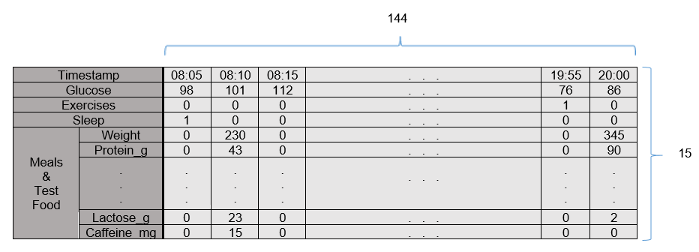
INPUT
Serial data:
Timestamps (every 5 minutes)
Glucose (raw data)
Exercises (binary vector)
Sleep (binary vector)
Meals & Test Foods (specific values on time of consumption)
Constant data:
All physical measurements
A portion of the blood measurements (we identified is significant)

Slide 19
ARCHITECTURE
Serial branch:
3 Convolutional layers with 32 kernels of size 15X5, padding = ‘same’ and stride of 2
1 Convolutional layers with 32 kernels of size 1X5, with no padding and a stride of 1
Constant branch:
One fully connected layer of 15 neurons
Branches merge:
After flattening the serial branch’s output the data was concatenated and transformed directly to the output single neuron final layer

Slide 20
INSIGHTS
Glucose levels has local nature
RNN based approach was inferior to CNN over the serial data (even when a short chain of RNN cells was used)
The less parameters – the better
Addition of kernels to convolutional layers, fully connected layers or neurons to fully connected layers caused the network to over-fit
Combination of bacteria included model may improve prediction further
0.67 correlation was reached without any bacterial data and a complex model, where in “Personalized Nutrition by Prediction of Glycemic Responses.” the same correlation was reached via the use of bacterial data and a simpler model (gradient boosting model)

Slide 21
Tomer

Slide 22
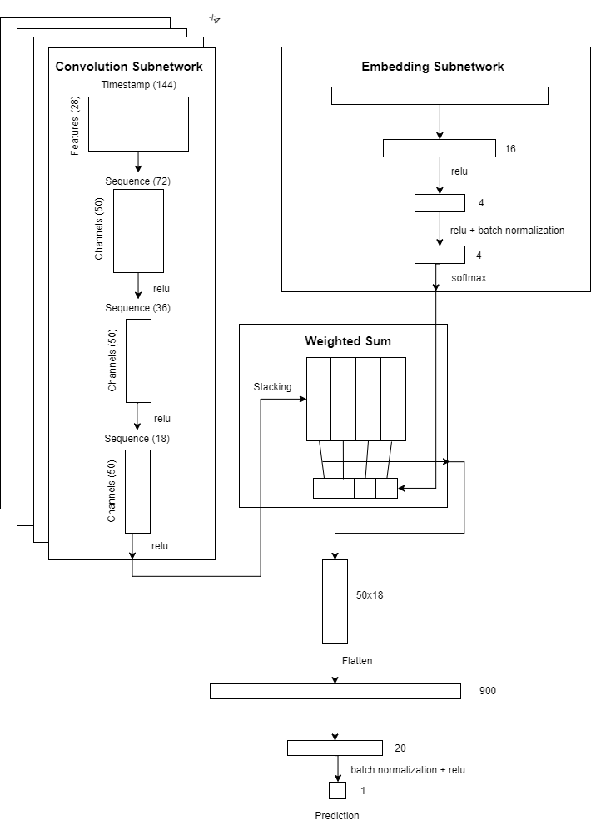
Network Structure
Single Model
4 convolution subnetworks to deal with temporal data
Embedding of the static data into the 4 dimensional simplex
Hopefully, each convolution subnetwork will represent a different group of users, and the embedding will decide which user belongs to which group
Regularizations
L1 regularizations on the matrices multiplied by the input layer
“Low entropy” regularization on the embedding
Ensemble
Choosing features randomly
Predicting the average

Slide 23
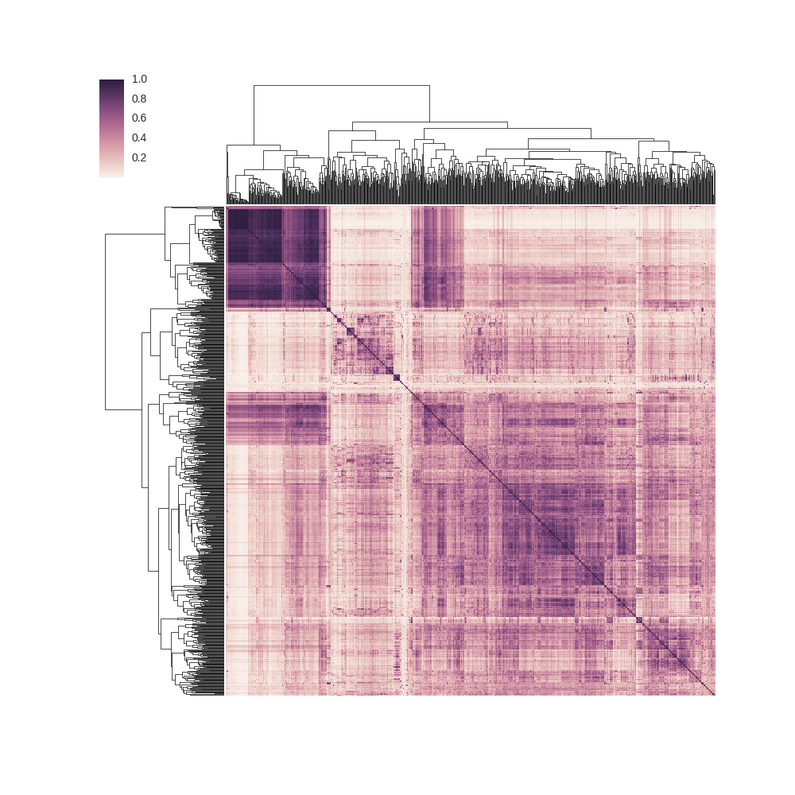
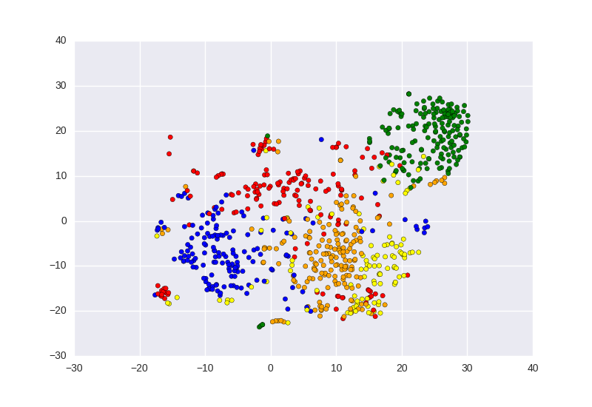
Feature Building
Temporal data is matrix for each sample
Glucose
Food
Sleep
Static data is vector for each sample
Small fixes (based on common sense)
Representations (indicators for questions)
Special case - bacteria data
The bacterial data had many missing entries and problematic structure
Due to network structure - group of users matter more than than actual values
Used cosine similarity as affinity measure
Clustered the train data, and learned to predict the cluster labels using simple models (random forest)
Clustermap of Users
TSNE embedding, color by Cluster

Slide 24
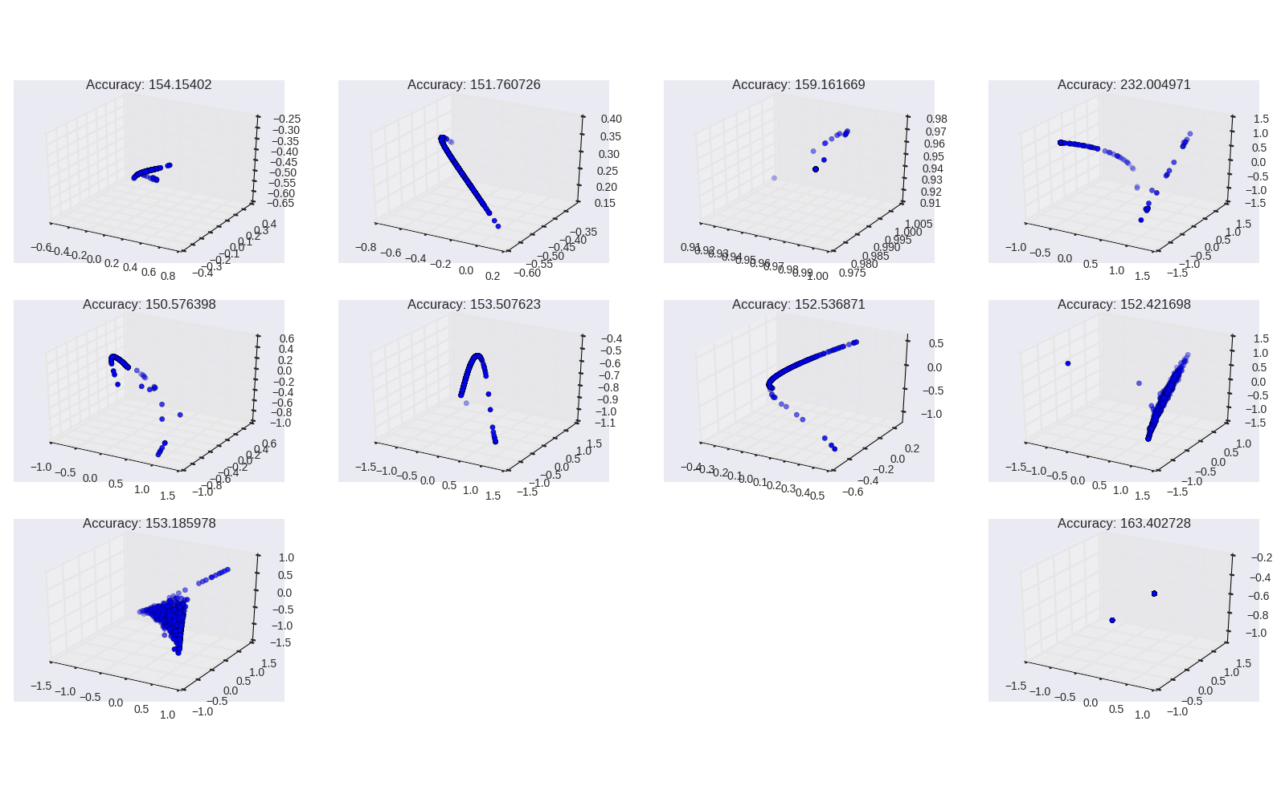
Significant Insights
Training embedding and convolution separately
Training together leads to quick overfitting
In fact, static data is scarce (only 800 different samples)
Imbalanced training - slower, but more stable
“Low entropy” regularization
The embedding is in fact into a probability space
Early attempts revealed that the embedding became degenerated quickly
Punishing on low entropy embeddings (as a probability vector)

Slide 25
Elad and Sigal

Slide 26
Final DNN network
Elad Chomsky & Sigal Peled-Leviatan

Slide 27
Basic Network
Convolutional Kernel = N, Depth = 32, Stride = 2
Glucose Nutrition (x7) Sleep
24⋅15 min (6 hours total)
Convolutional.
Add scalars.
Fully connected layers.
Convolutional Kernel = N, Depth = 32, Stride = 1
Convolutional Kernel = N, Depth = 8, Stride = 2
Fully Connected. Width = 32, Dropout = 0.05
Gender Year of birth
HbA1C%
Body weight
BMI
Time of day
Fully Connected. Width = 32, Dropout = 0.05
Fully Connected. Width = 32, Dropout = 0.05

Slide 28
Ensemble of Networks
Different kernel sizes.
Different number of training epochs (Using cross-validation).
Use average of ensemble to predict.
…
Kernel 3
ReLU
Kernel 4
ReLU
Kernel 5
ReLU
Kernel 8
ReLU
Average

Slide 29
The Delta Method
X
Y
One ensemble, ReLU function
Calculate the remainder: y - y_pred
2nd ensemble, Tanh function
prediction of remainder.
Sum result of both networks.
ReLU
Ensemble
Tanh
Ensemble

Slide 30
Other Ideas
Ideas
Multiple starting points for network training.
2 (or more) networks, by variance of 24 hour glucose.
By clustering.
Both ideas worked well
No combination with the delta method proved advantageous.

Slide 31
Adi and Noam

Slide 32
Raw temporal data (145X11)
More features (45)
NN Model
Every 5min
TS
TS-12h
Raw glucose
Vector with:
Rolling glucose means
Glucose trend (slope)
Bac first 5 PCs
Blood, measurements
Time of day
Meals features
Sleep (binary)
Exercise (binary, intensity)
Features
Noam & Adi

Slide 33
Raw temporal data (145X11)
More features (45)
Fully connected (49)
Conv
Conv
Fully connected (25)
Conv
Dropout (0.2)
Conv
Dropout (0.2)
Fully connected (2)
Fully connected (10)
ADAM
Xavier
Sigmoid
MSE
Fully connected (2)
Model Architecture
output
Noam & Adi

Slide 34
Ensemble of models
…
Final output = average over all outputs
Day
Night
Noam & Adi

Slide 35
Roman

Slide 36
Simple Feature selection Roman Beliy

Slide 37
Time dependent features
Goal: We would like to choose “good” features from a large collection of features.
Approach: we can calculate the correlation between the target and the feature in different time points, and choose only features that have high correlation.
Side notes:
We can use Spearman correlation (instead of Pearson), which measures monotonic relationships.
We can use a greedy approach where we sort(by correlation) the features, and add features as long as we improve our results.
Remove features that are highly correlated to features that we are already using, alternatively apply PCA.

Slide 38
Time independent features
Problem: we can’t relate directly time independent features to our predictions.
Approach:
Learn a simple (Linear) predictor from selected time dependent data to the target.
The parameters of the predictor give us indication to the responses of different subjects to different stimuli.
We can calculate the correlation of the scalar features to the predictor parameters.
We will choose features that are highly correlated to the features, hopefully those features capture the subjects response to stimuli.

Slide 39
Yochai

Slide 40
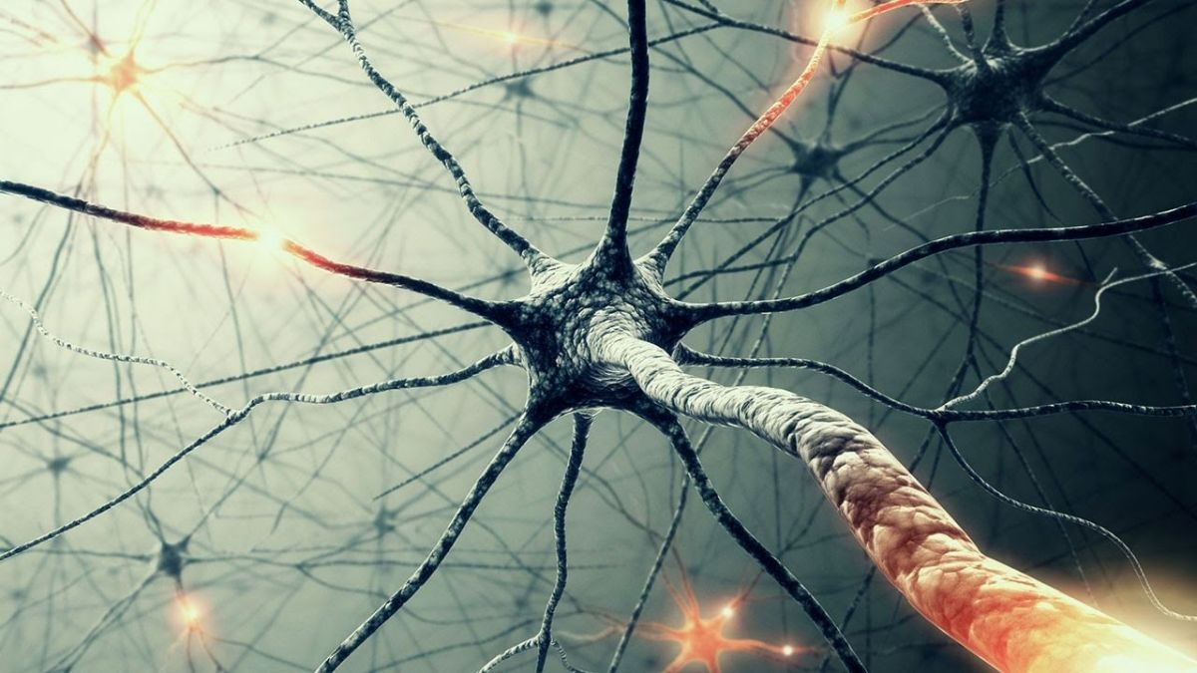
DNN mini-presentation
Yochai Edlitz
10.09.17

Slide 41
Architecture
5 Time Normalized dependent features
Normalized Static features
Conv. +
BN & Drop out
Conv. +
BN & Drop out
Conv. +
BN & Drop out
Conv. +
BN & Drop out
Conv. +
BN & Drop out
Conv. +
BN & Drop out
FC+ BN +DO
FC+ BN +DO
FC+ BN +DO
FC+ BN +DO
FC+ BN +DO
FC+ BN +DO
FC+ BN +DO
FC+ BN +DO
Output
Output
Output
Output
Output
Output
Output
Average output

Slide 42
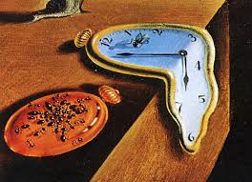
Features
Time dependent Features:
Glucose Value
Day time
Time from last meal
GlucoseValue mean 12h
Glucose derivative
Static Features
Bacteria’s main PCA’s
Blood HbA1C% last_meal Weight Daytime
Glucose Value
Time Since last meal
GlucoseValue mean 12h
GlucoseValue mean 30min
Glucose derivative
Features that did not show significant improvement
Meals components
Bacteria types
Blood components or PCA’s

Slide 43
Insights
Good preparation of the data is the most important part!
Make sure sorting does not change the order of samples.
Normalization
Using normalization of data speed up convergence
Batch normalization also accelerated convergence.
Regularization
Drop out (to the order of 0.4-0.5) helped in preventing the validation loss diverging from test loss values.
Using convolutions
Using past data sequence of 3-4 hours is enough.
Kernel size of 4-6 samples is enough (size of four will speed up process)
2 convolutional layers was enough – adding more layers did not improve the results)
Number of filters of 64-128 presented optimal result (timewise.regularization wise and score)
LSTM
Using LSTM branch was too “flickering and thus was removed from the model”

Slide 44
Tzahi

Slide 45
DNN Challenge Tzahi Gabzi
10 / 9 / 2017

Slide 46
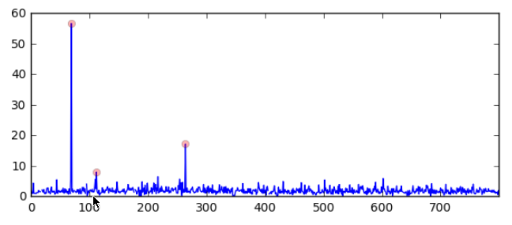
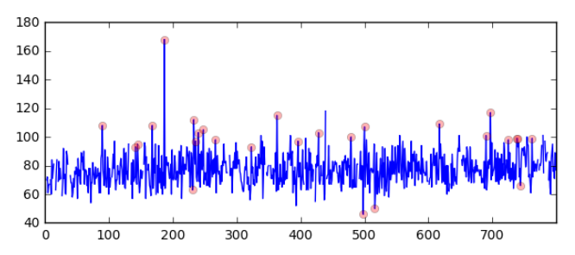
Features I Used
Temporal Data:
Glucose Values.
Meals (Test food and Meals, only some fields were chosen [1])
Sleep
Exercise
Time of day
Non temporal data (Selected fields from each):
Measurements – BMI, Age, Blood Pressure
Blood – TSH, HbA1C%
Questions – Pregnancy, Smoking, Gender and Stress related fields (total of 8 fields)
Preprocessing:
Nans replacement / removal
Outliers detection & truncation
Scaling
[1] - [ 'TotalLipid_g', 'Carbohydrate_g', 'Water_g','Protein_g', 'Energy_kcal', 'TotalDietaryFiber_g', 'Sodium_mg‘ ]

Slide 47
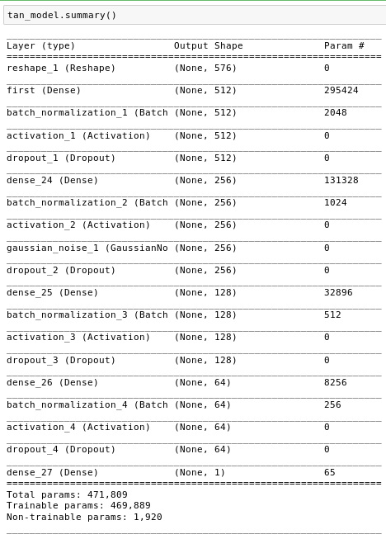
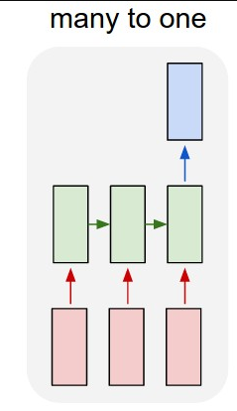
Architecture
Ensemble of:
LSTMs – 48 blocks, 1 layer
FCNN -- >

Slide 48
Interesting Conclusions
Importance of scaling properly, choosing the right activation functions
Robust Scaler
Zero centered activation functions
Overall reduced my score by at least 20 pts
Importance of cross-validation to tackle overfit
Reduce my score by at least 10 pts
Meals’ significance
Failed to learn and generalizing subtle dependencies on long-term features

Slide 49
Aviv and Daniel

Slide 50
DNN Challenge
Daniel Greenfeld
Aviv Netanyahu

Slide 51
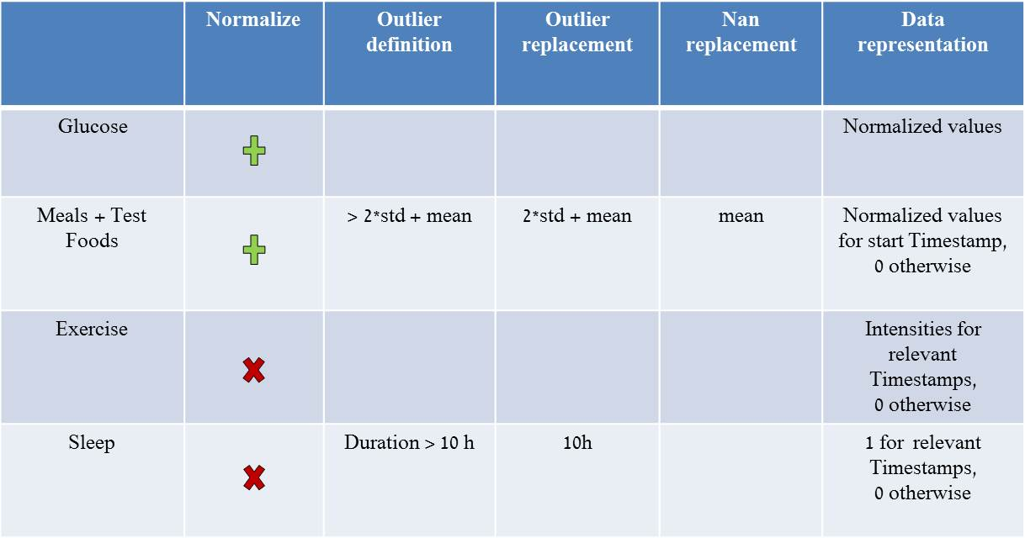
Features
Only temporal features with <5% Nan values
Each feature has 144 measurements per timestamp
Pre processing:

Slide 52
Data representation | Nan replacement | Outlier replacement | Outlier definition | Normalize
Normalized values |  |  |  |  | Glucose
Normalized values for start Timestamp, 0 otherwise | mean | 2*std + mean | > 2*std + mean |  | Meals + Test Foods
Intensities for relevant Timestamps, 0 otherwise |  |  |  |  | Exercise
1 for relevant Timestamps, 0 otherwise |  | 10h | Duration > 10 h |  | Sleep

Slide 53
Architecture
Input
Prediction
20
100
100
3
35
144
71
3
100
1
1D conv
Stride=2
BN
ReLU
1D conv
Stride=2
BN
ReLU
Flatten
Dropout
Dense
BN
Dropout
ReLU
Dense

Slide 54
Batch-Normalization
CNN’s assume data is (spatial)-temporal invariant
Batch-Normalization is usually applied on batch and “feature” axis
We normalize only the batch axis
each kernel treats different timestamps differently

Slide 55
Amnon

Slide 56
Dnn Challenge- Final Results
Amnon Geifman

Slide 57
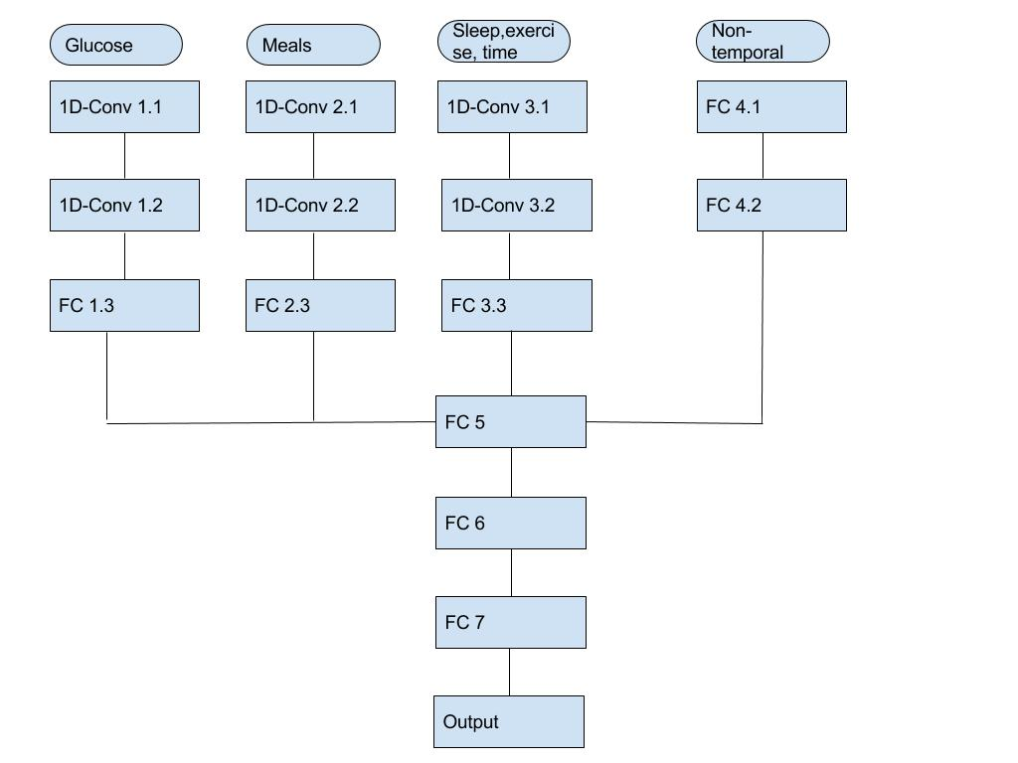
layer/parameters | channel | activation | Regularization rate | # of neurons/filters | (kernel size, stride, dilation) | Drop out
Conv 1.1 | Glucose | relu | 0.001 | 70 | (4,1,4) | 0.1
Conv 1.2 | Glucose | relu | 0.001 | 50 | (2,1,1) | 0
FC 1.3 | Glucose | relu | 0.001 | 20 | - | 0
Conv 2.1 | Meals | relu | 0.001 | 10 | (3,1,1) | 0.15
Conv 2.2 | Meals | relu | 0.001 | 7 | (3,2,1) | 0
FC 2.3 | Meals | relu | 0.001 | 10 | - | 0
Conv 3.1 | Sleep,Ex,time | relu | 0.001 | 30 | (3,1,2) | 0.2
Conv 3.2 | Sleep,Ex,time | relu | 0.001 | 20 | (3,2,1) | 0
FC 3.3 | Sleep,Ex,time | relu | 0.001 | 15 | - | 0
FC 4.1 | Non-temp | relu | 0.05 | 5 | - | 0.1
FC 4.2 | Non-temp | relu | 0.05 | 3 | - | 0
FC 5 | All | relu | 0.001 | 20 | - | 0.1
FC 6 | All | relu | 0.001 | 15 | - | 0
FC 7 | All | relu | 0.001 | 10 | - | 0
Output | All | linear | 0 | 1 | - | 0

Slide 58
Features
Glucose- 3 EMA’s during window of 6 hours
Meals- the most significant meals data such as -'Carbohydrate_g', 'Energy_kcal', 'Energy_kJ', 'SugarsTotal_g', 'TotalDietaryFiber_g'
Sleep &Ex- smoothed indicator for both of the events, only in the sleep data look back of 3 hours
Non-temporal- only the most 20 correlated features in the data

Slide 59
Thoughts and insights
Convolution significantly better than FC
Optimization by channel works
The glucose is the most significant feature
Channels structure reduced over fitting
Problems- BN, Dropout, regularization

Slide 60
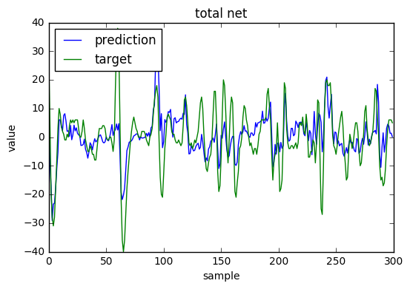
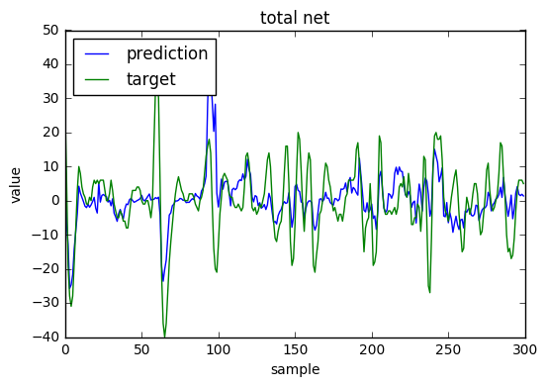
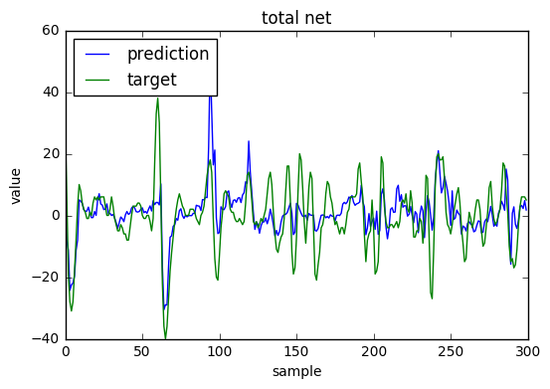
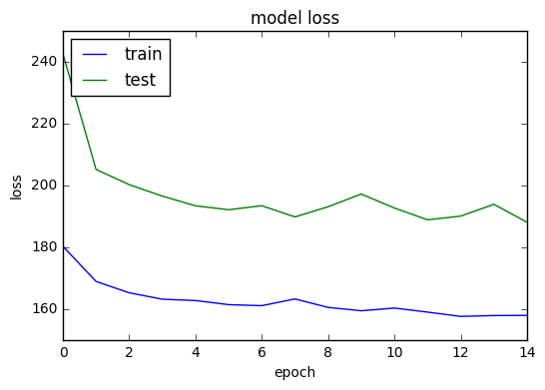
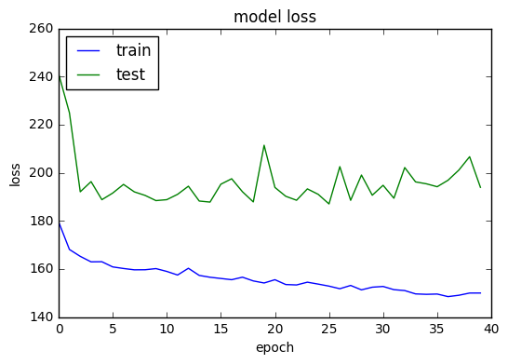
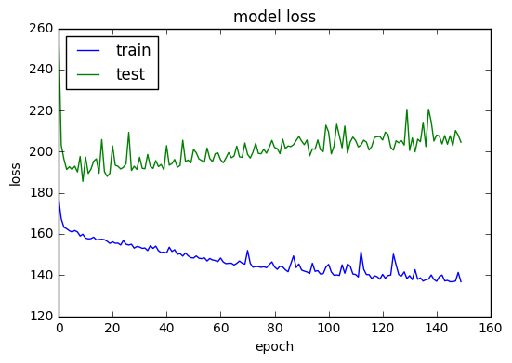

Slide 61
Yotam

Slide 62
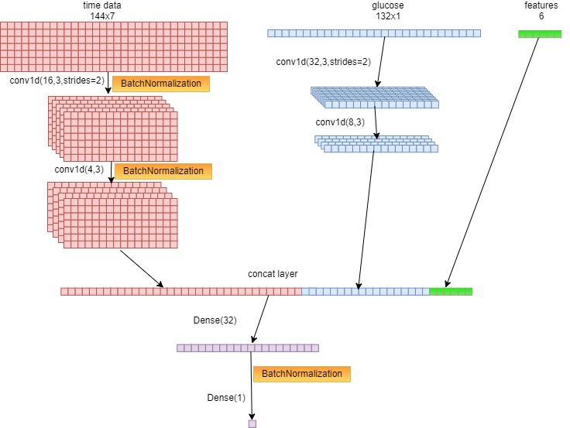
Yotam amar
Arcitacture:
X10 networks and
Random Forest Regressor

Slide 63
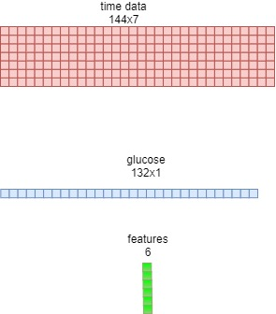
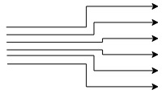
Yotam amar
data:
Weight
Energy_kcal
Protein_g
TotalLipid_g
Carbohydrate_g
SugarsTotal_g
Is Sleeping
g(t) - g(t-1h)
BMI
Most data is normalized
using mean and std
Age
HbA1C%
Evening Hunger
Morning Hunger
Time Of Day

Slide 64
Yotam amar
insights:
• BatchNormalization vs Droupout
• 15 min vs 5 min
• single network vs multiple networks+boosting/averaging
Thank You!

Slide 65
Liad and Sivan

Slide 66
DNN FINAL NETWORK
10/09/2017
Sivan Biham Liad Pollak

Slide 67
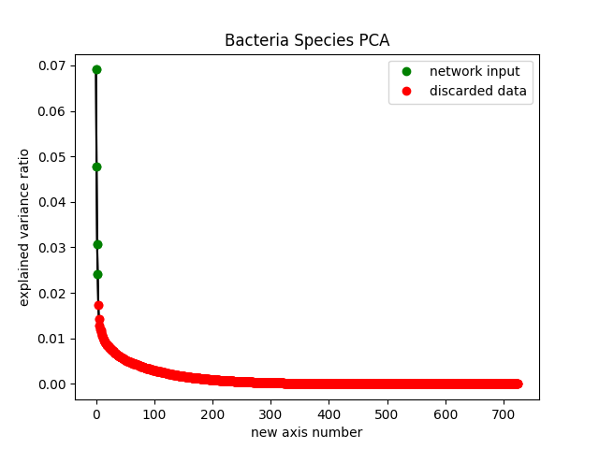
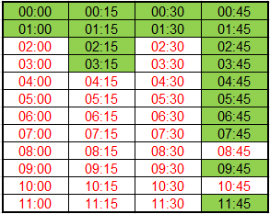
FEATURES
Timeseries Features
Static Features
Glucose
Meals
Exercise
Bacteria
Blood Tests
Measurements
Time of day
Glucose NonUniform Sampling
Bacteria 4 PCA Components

Slide 68
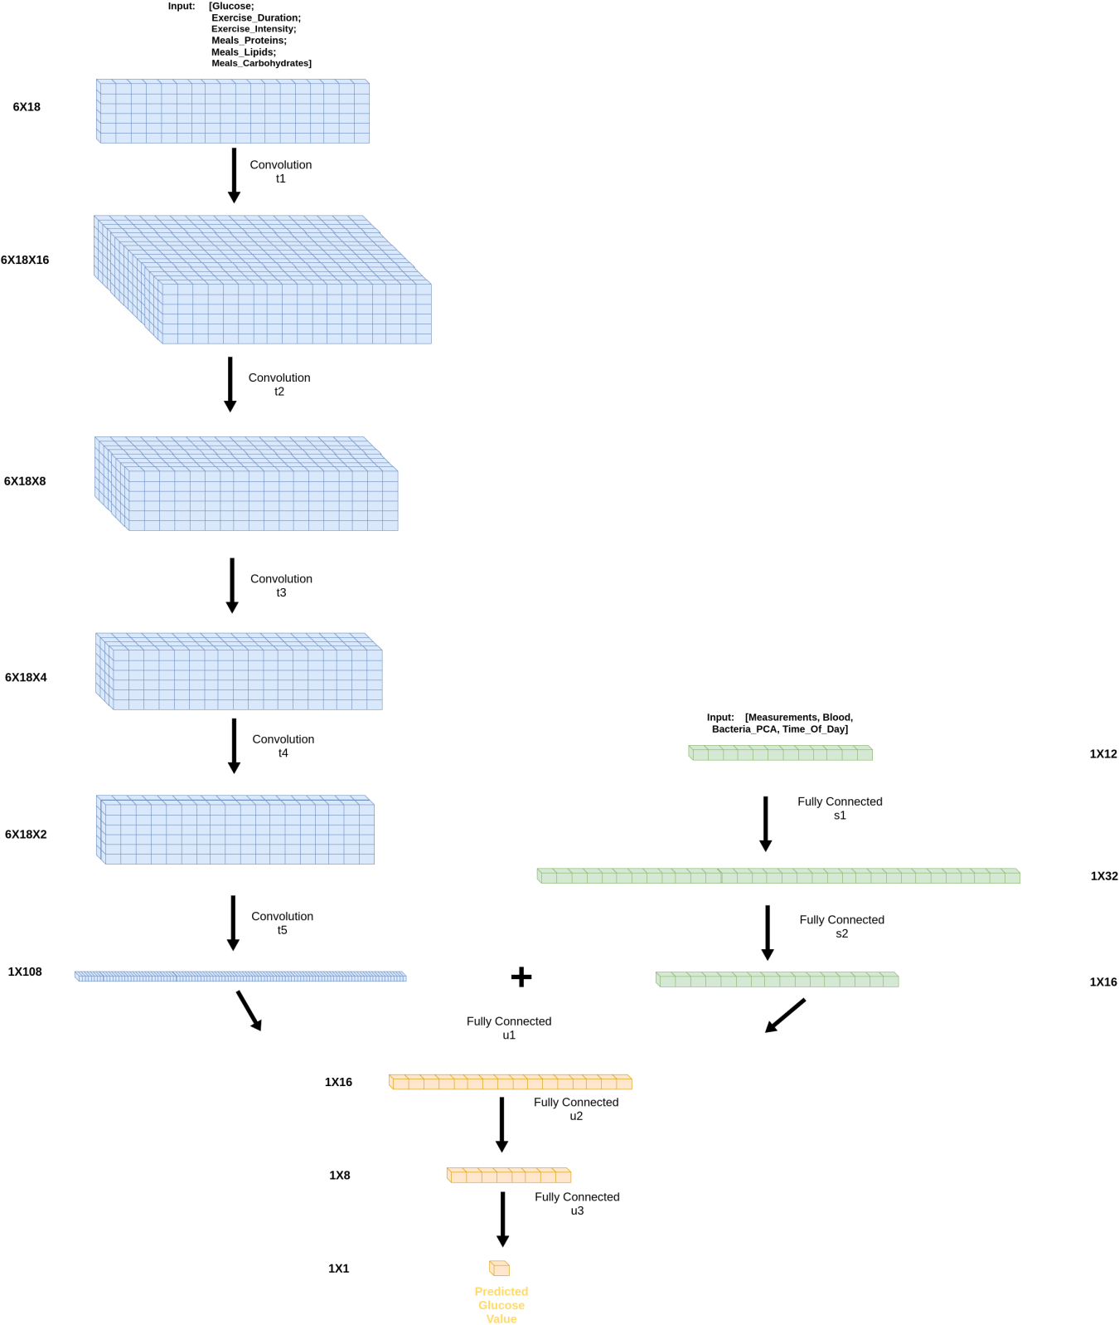
ARCHITECTURE

Slide 69
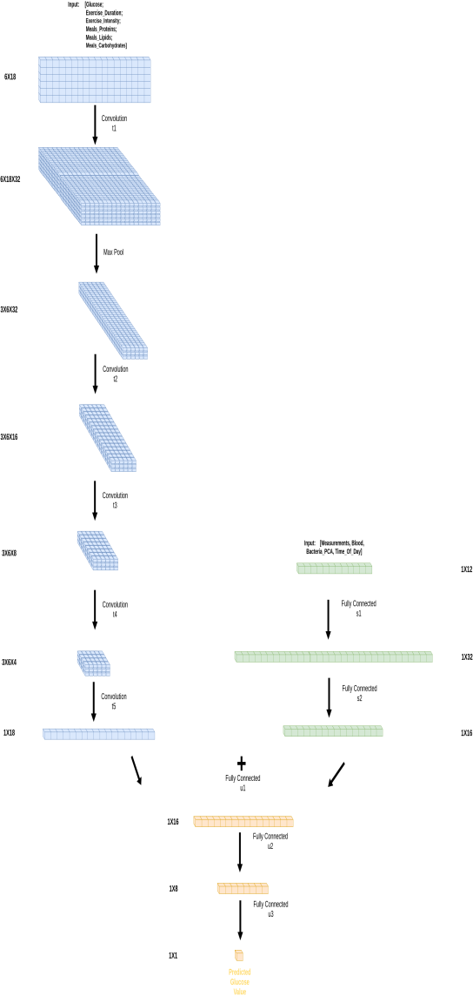
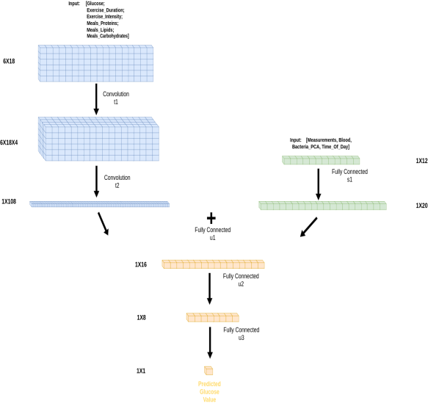
CONCLUSIONS
Most Significant Feature

Slide 70
Guy

Slide 71
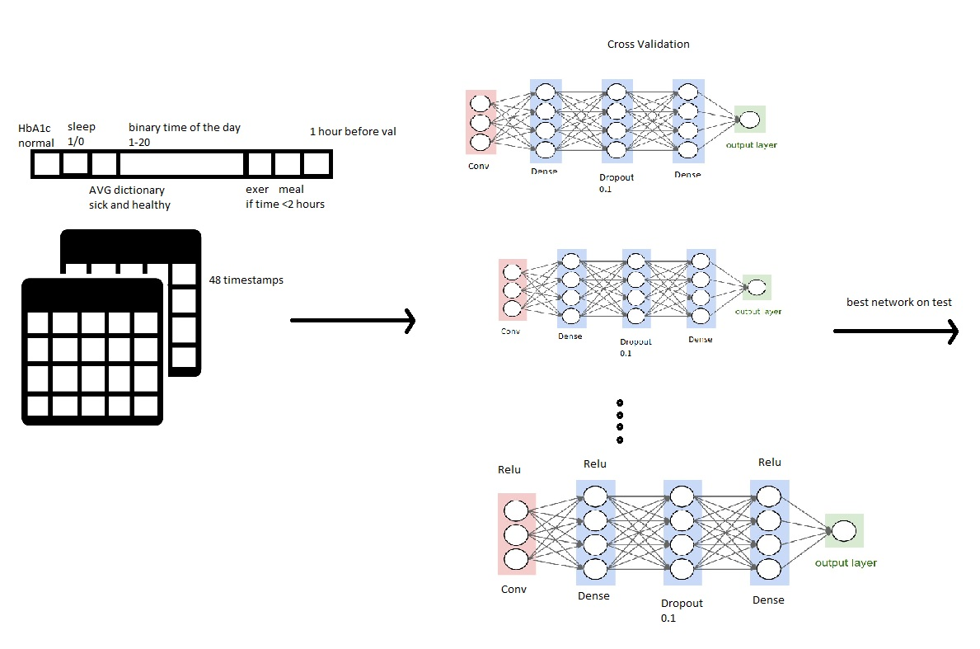

Slide 72
significant insight or discovery that you had during your training process
More features is not necessarily better
Bacteria
K-mean (health status,bacteria)
BMI
...

Slide 73
Meytar and Aharon

Slide 74
DNN challenge
Aharon Ravia
Meytar Zemer

Slide 75
Features
5 features families:
Glucose
Normalized glucose
Food - meals + test food
Carbohydrate
Energy
Sleep
Is sleeping now
How much sleep in past 6 hours
Time in day

Slide 76
Architecture
Parallel LSTM networks merged to one network
Dense network
LSTM networks
Glucose
Norm Glucose
Food
Sleep
Time in day

Slide 77
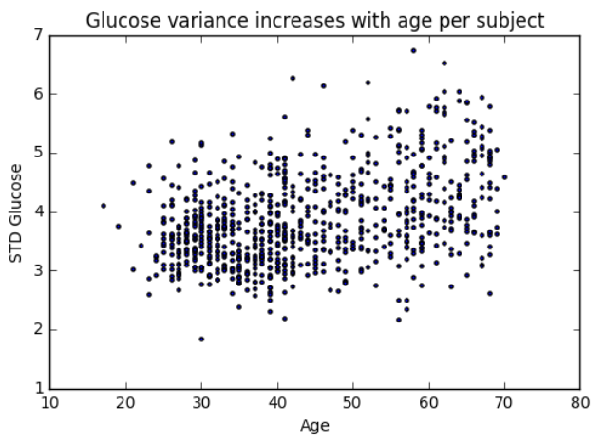
Some thoughts
Glucose variance as a function of age
Architecture flexibility
Some evidence for similar results for shorter time spans

