Slide 1


The Fourier Transform
Jean Baptiste Joseph Fourier

Slide 2
A sum of sines and cosines
=
A
sin(x)
A
3 sin(x)
+ 1 sin(3x)
B
A+B
+ 0.8 sin(5x)
C
A+B+C
+ 0.4 sin(7x)
D
A+B+C+D
…
Notes:
Accept without proof that every function is a sum of
sines/cosines
As frequency increases – more details are added
Low frequency – main details
Hight frequency – fine details
Coef decreases with the frequency

Slide 3
Higher frequencies due
to sharp image variations
(e.g., edges, noise, etc.)

Slide 4
The Continuous Fourier Transform
Basis functions:

Slide 5
Complex Numbers
Imaginary
Z=(a,b)
b
|Z|
θ
a
Real

Slide 6
The 1D Basis Functions
1
x
1/u
The wavelength is 1/u .
The frequency is u .

Slide 7
The Continuous Fourier Transform
1D Continuous Fourier Transform:
The Inverse
Fourier
Transform
Basis functions:
The Fourier
Transform
An orthonormal basis ➔

Slide 8
Some Fourier Transforms
Function
Fourier Transform

Slide 9
The Continuous Fourier Transform
1D Continuous Fourier Transform:
The Inverse
Fourier
Transform
The Fourier
Transform
2D Continuous Fourier Transform:
The Inverse Transform
The Transform

Slide 10
























The 2D Basis Functions
V
u=-2, v=2
u=-1, v=2
u=0, v=2
u=1, v=2
u=2, v=2
u=-2, v=1
u=-1, v=1
u=0, v=1
u=1, v=1
u=2, v=1
U
u=-2, v=0
u=-1, v=0
u=0, v=0
u=1, v=0
u=2, v=0
u=-2, v=-1
u=-1, v=-1
u=0, v=-1
u=1, v=-1
u=2, v=-1
u=-2, v=-2
u=-1, v=-2
u=0, v=-2
u=1, v=-2
u=2, v=-2
The wavelength is . The direction is u/v .

Slide 11
Discrete Functions
f(x)
f(n) = f(x₀ + nΔx)
f(x₀+2Δx)
f(x₀+3Δx)
f(x₀+Δx)
f(x₀)
x₀
x₀+Δx
x₀+2Δx
x₀+3Δx
0 1 2 3 ... N-1
The discrete function f:
{ f(0), f(1), f(2), … , f(N-1) }

Slide 12
The Finite Discrete Fourier Transform
1D Finite Discrete Fourier Transform:
(u = 0,..., N-1)
(x = 0,..., N-1)
2D Finite Discrete Fourier Transform:
(u = 0,..., N-1; v = 0,…,M-1)
(x = 0,..., N-1; y = 0,…,M-1)

Slide 13
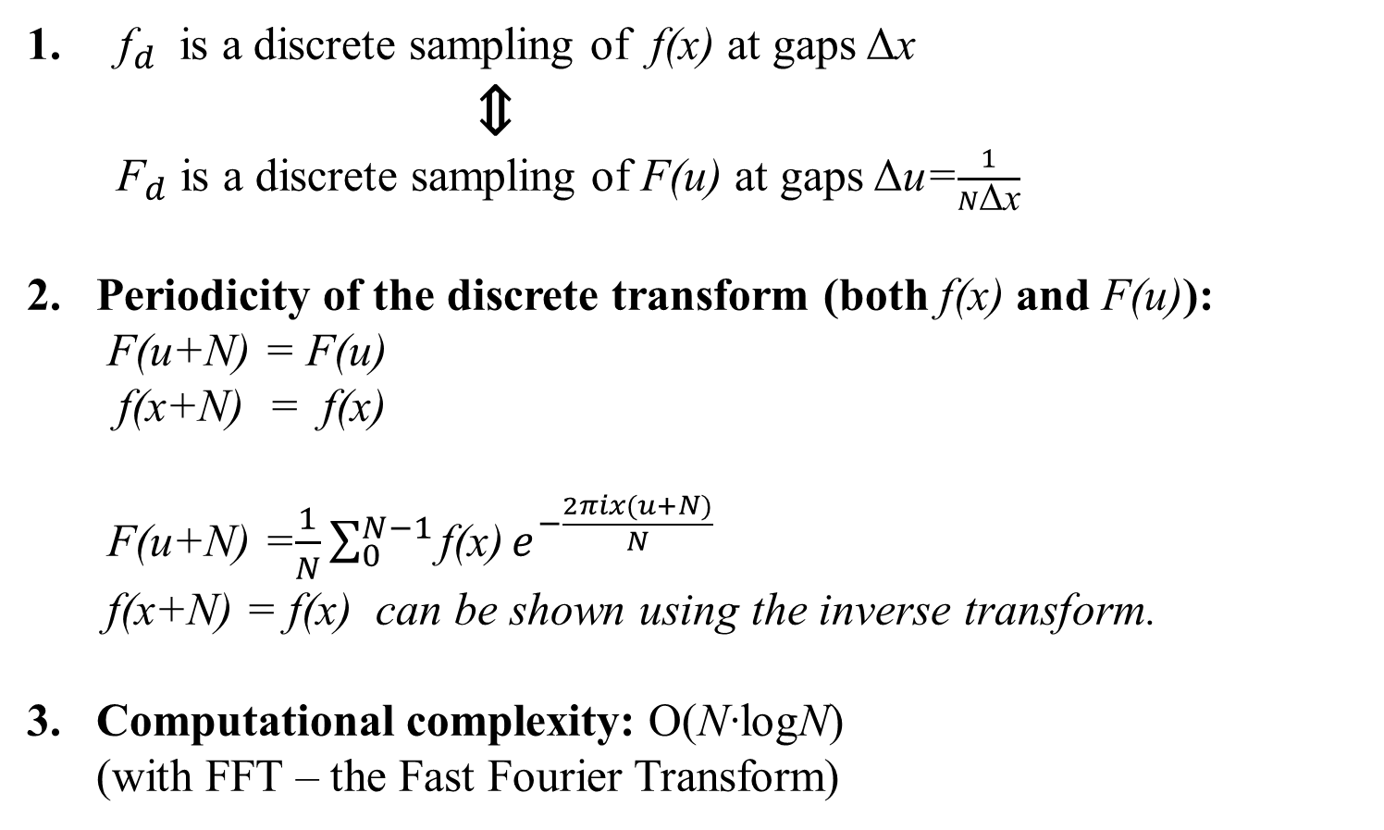
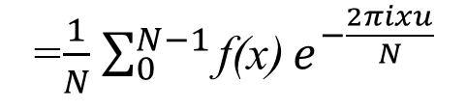

About the Discrete Transform
${\text{f}}_{d}$ is a discrete sampling of $\text{f}$(x) at gaps Δx
⇕
${ \text{F}}_{d}$ is a discrete sampling of $\text{F}$(u) at gaps Δu=$\frac{1}{N\text{Δ}\text{x}}$
Periodicity of the discrete transform (both $\text{f}\text{(}\text{x}\text{)}$ and F(u)):
F(u+N) = F(u)
$\text{f}\text{(}\text{x}\text{+}\text{N}\text{) }\text{= }\text{f}\text{(}\text{x}\text{)}$
F(u+N) =$\frac{1}{N}\sum_{0}^{N−1}{\text{f}\text{(}\text{x}\text{)}}e^{−\frac{2πix(u+N)}{N}}$
$\text{f}\text{(}\text{x}\text{+}\text{N}\text{)}\text{ = }\text{f}\text{(}\text{x}\text{)}$ can be shown using the inverse transform.
Computational complexity: O(N·logN)
(with FFT – the Fast Fourier Transform)
=$\frac{1}{N}$ $\sum_{0}^{N−1}{\text{f}\text{(}\text{x}\text{)}}e^{−\frac{2πixu}{N}}$
= F(u)
$$e^{−2πix}$$
= 1

Slide 14
The Fourier Image
Image f
Fourier spectrum (magnitude)
log(1 + |F(u,v)|)
|F(u,v)|

Slide 15
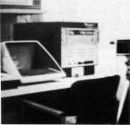
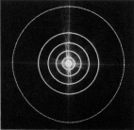
Frequency Bands
Image
Fourier Spectrum
Percentage of image power enclosed in circles (small to large) :
90%, 95%, 98%, 99%, 99.5%, 99.9%

Slide 16
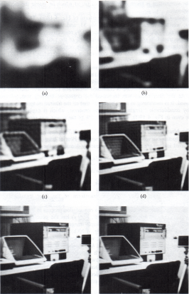
Low pass Filtering
90%
95%
98%
99%
99.5%
99.9%

Slide 17
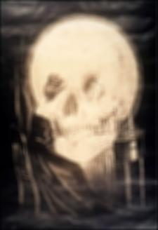

Slide 18


Slide 19
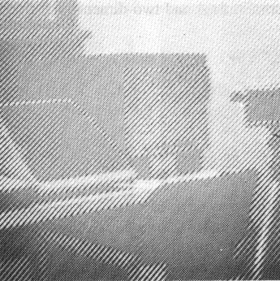
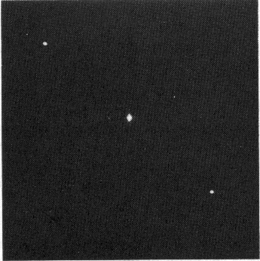
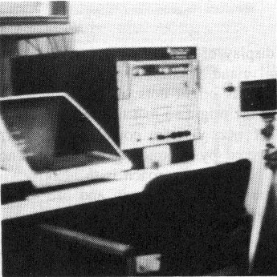
Noise Removal
Noisy image
Fourier Spectrum (magnitude)
Noise-cleaned image

Slide 20
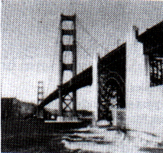
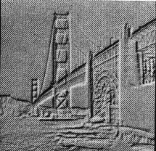
High Pass Filtering
Original
High Pass Filtered

Slide 21
High Frequency Emphasis
+
Original
High Pass Filtered

Slide 22
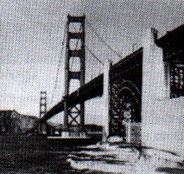
High Frequency Emphasis
Original
High Frequency Emphasis

Slide 23
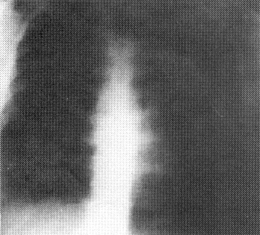
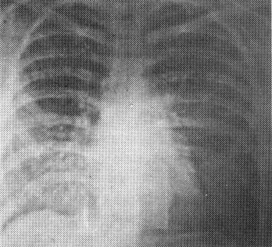
High Frequency Emphasis
Original
High Frequency Emphasis

Slide 24
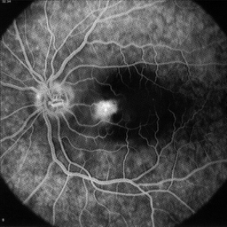
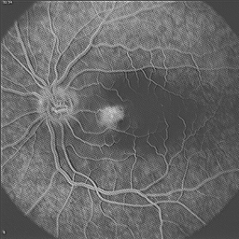
High Frequency Emphasis
Original
High Frequency Emphasis

Slide 25
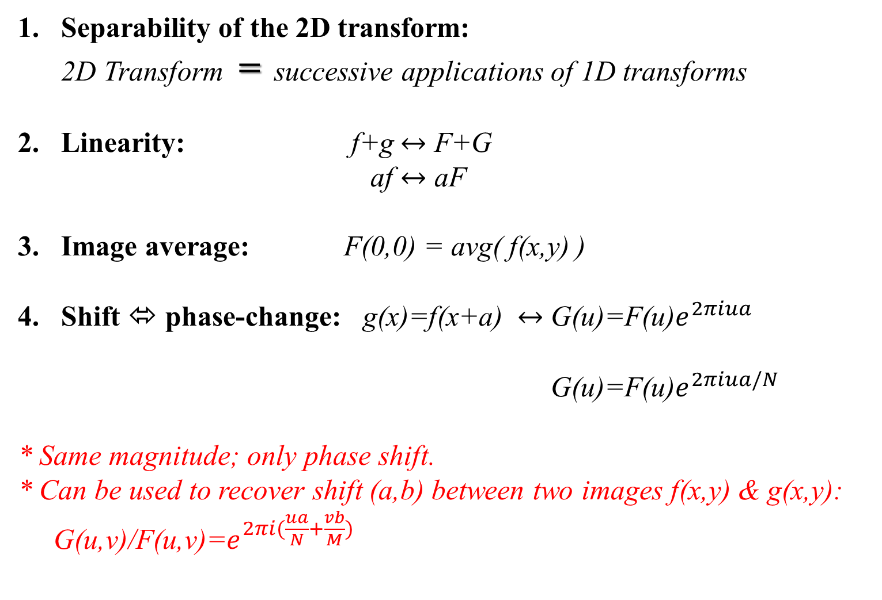
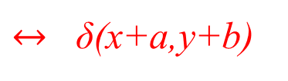
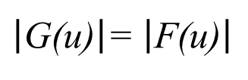


Fourier Properties
Separability of the 2D transform:
2D Transform = successive applications of 1D transforms
Linearity: f+g $↔$ F+G
af $↔$ aF
Image average: F(0,0) = avg( f(x,y) )
Shift ⬄ phase-change: g(x)=f(x+a) $↔$ G(u)=F(u)$e^{2πiua}$
G(u)=F(u)$e^{2πiua/N}$
* Same magnitude; only phase shift.
* Can be used to recover shift (a,b) between two images f(x,y) & g(x,y):
G(u,v)/F(u,v)=$e^{2πi(\frac{ua}{N}+\frac{vb}{M})}$
$$\text{(}\text{continuous}\text{)}$$
$$\text{(}\text{discrete}\text{)}$$
$\left|\text{G}\text{(}\text{u}\text{)}\right|$= $\left|\text{F}\text{(}\text{u}\text{)}\right|$
$↔$ δ(x+a,y+b)

Slide 26
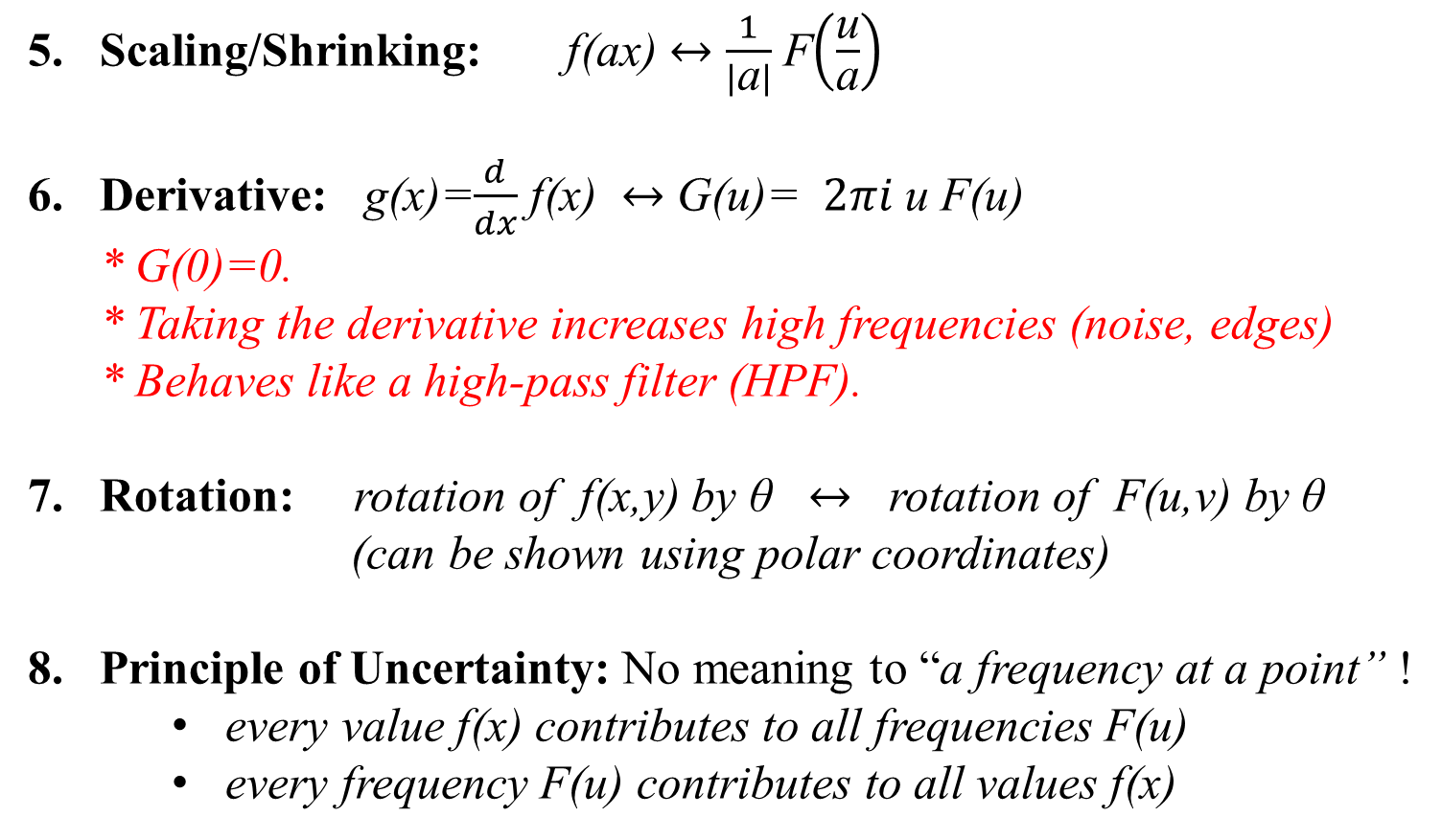
Fourier Properties
Scaling/Shrinking: f(ax) $↔$ $\frac{1}{\left|\text{a}\right|}$ F$\left(\frac{\text{u}}{\text{a}}\right)$
Derivative: g(x)=$\frac{d}{dx}$ f(x) $↔$ G(u)= $2πi$u F(u)
* G(0)=0.
* Taking the derivative increases high frequencies (noise, edges)
* Behaves like a high-pass filter (HPF).
Rotation: rotation of f(x,y) by θ $↔$ rotation of F(u,v) by θ
(can be shown using polar coordinates)
Principle of Uncertainty: No meaning to “a frequency at a point” !
    every value f(x) contributes to all frequencies F(u)
    every frequency F(u) contributes to all values f(x)

Slide 27
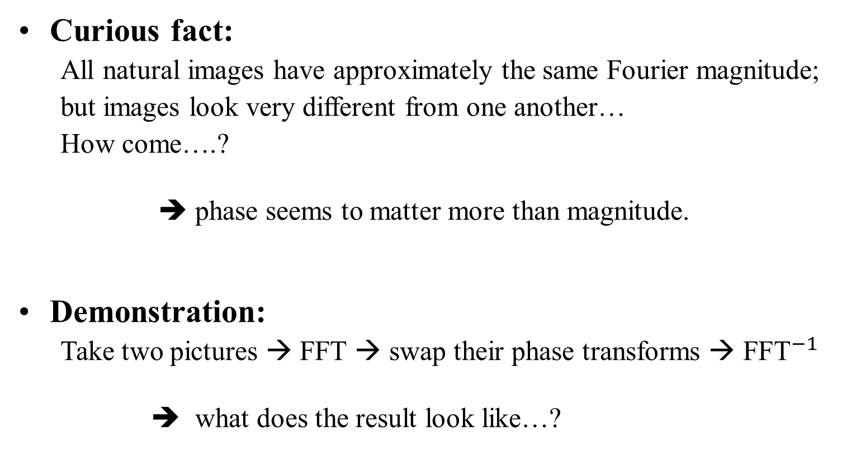
Importance of Phase vs. Magnitude
Curious fact:
  All natural images have approximately the same Fourier magnitude;
  but images look very different from one another…
  How come….?
  ➔ phase seems to matter more than magnitude.
Demonstration:
  Take two pictures → FFT → swap their phase transforms → ${\text{FFT}}^{−1}$
  ➔ what does the result look like…?

Slide 28
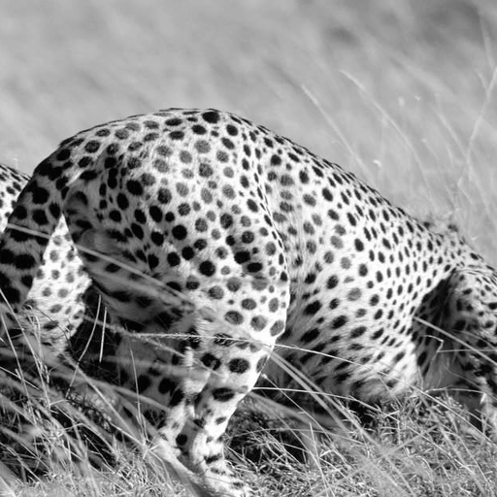
Slide: Freeman & Durand

Slide 29
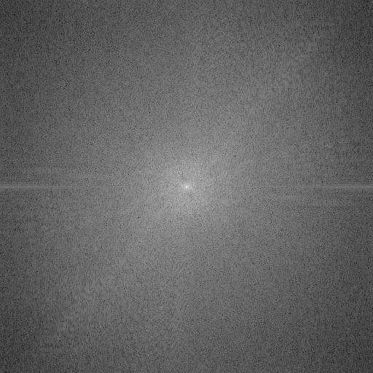
This is the magnitude transform of the cheetah pic
Slide: Freeman & Durand

Slide 30
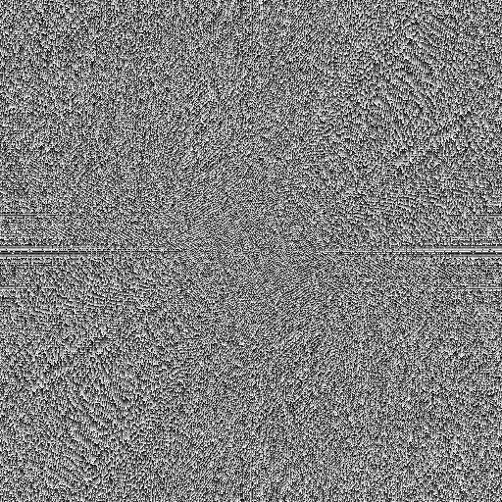
This is the phase transform of the cheetah pic
Slide: Freeman & Durand

Slide 31
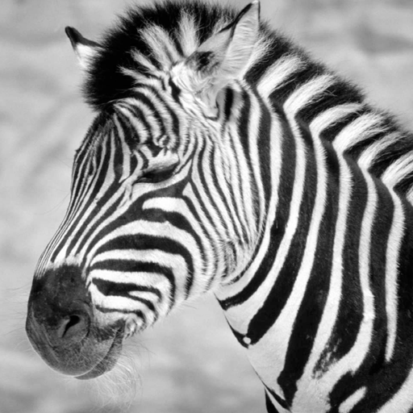
Slide: Freeman & Durand

Slide 32
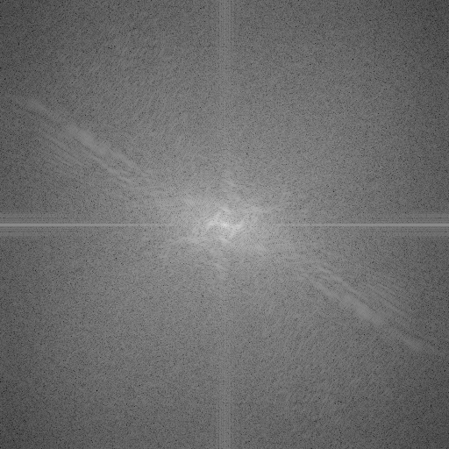
This is the magnitude transform of the zebra pic
Slide: Freeman & Durand

Slide 33
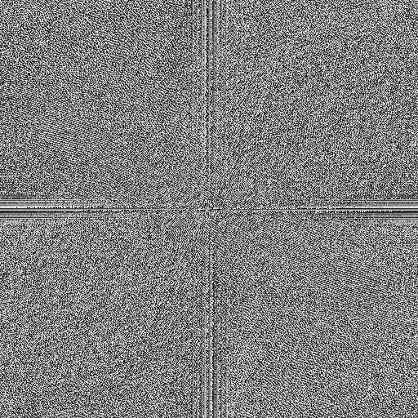
This is the phase transform of the zebra pic
Slide: Freeman & Durand

Slide 34
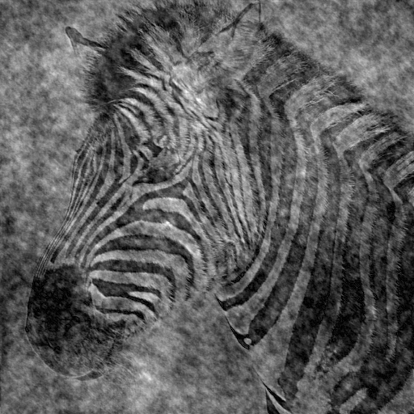
Reconstruction with zebra phase, cheetah magnitude
Slide: Freeman & Durand

Slide 35
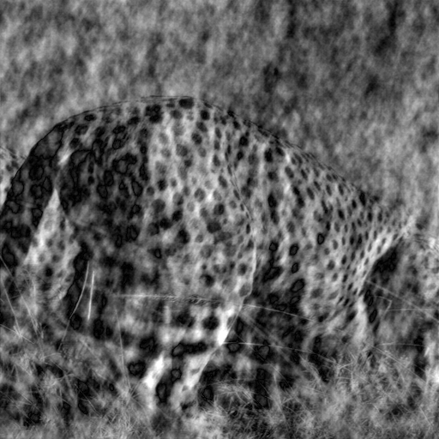
Reconstruction with cheetah phase, zebra magnitude
Slide: Freeman & Durand

Slide 36
Slide: Freeman & Durand

Slide 37
Fast Fourier Transform - FFT
O(N²) operations,
if performed as is
u = 0, 1, 2, ..., N-1
FFT:
even x
odd x
Fourier Transform of
of N/2 even points
Fourier Transform of
of N/2 odd points
The Fourier transform of N inputs, can be performed as 2 Fourier Transforms of N/2 inputs each + one complex multiplication and addition for each value.
Thus, if F(N) is the computation complexity of FFT:
F(N)=F(N/2)+F(N/2)+O(N) ⇒ F(N)=N logN

Slide 38
F(0) F(1) F(2) F(3) F(4) F(5) F(6) F(7)
F(0) F(2) F(4) F(6)
F(1) F(3) F(5) F(7)
F(0) F(4)
F(2) F(6)
F(1) F(5)
F(3) F(7)
F(0) F(1) F(2) F(3) F(4) F(5) F(6) F(7)
2-point
transform
4-point
transform
FFT
FFT :
O(N log(N)) operations
FFT of NxN Image: O(N² log(N)) operations

Slide 39
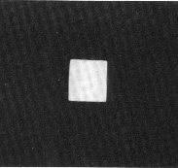
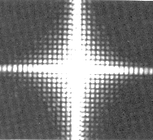
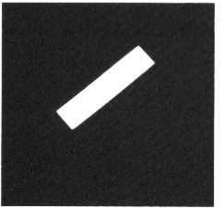
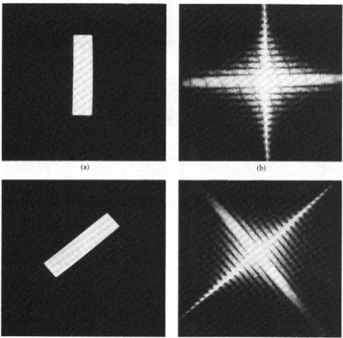
2D Image
Fourier Spectrum

Slide 40
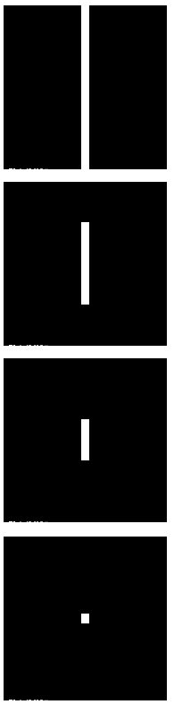
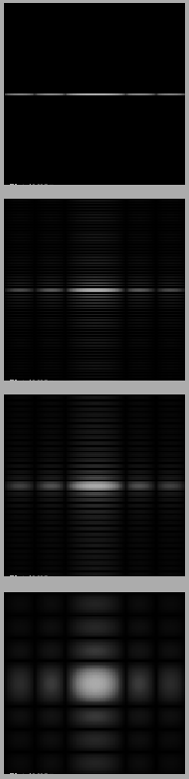
Fourier Transform -- Examples
Image
Fourier spectrum

