Slide 1
Course website – look under:
www.wisdom.weizmann.ac.il/~vision
To be added to course mailing-list:
Send email to one of the TAs:
<assaf.shocher@weizmann.ac.il>
<netalee.efrat@weizmann.ac.il>
<yoni.kasten@weizmann.ac.il>
Vision & Robotics Seminar (not for credit):
Thursdays at 12:15-13:15 (Ziskind 1)
  Send email to Amir Gonen:
<amir.gonen@weizmann.ac.il>
Dec. 10 – Israel Computer Vision Day
(If you wish to attend -- please register!)

Slide 2
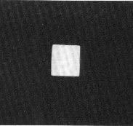
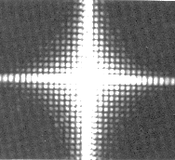
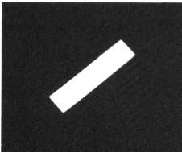
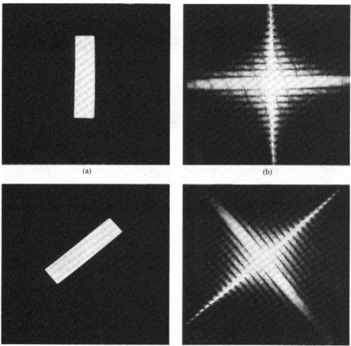
2D Image
Fourier Spectrum

Slide 3
Convolution
Good for:
- Pattern matching
- Filtering
- Understanding Fourier properties

Slide 4
Convolution Properties
Commutative:
    f*g = g*f
Associative:
    (f*g)*h = f*(g*h)
Homogeneous:
    f*(λg)= λ f*g
Additive (Distributive):
    f*(g+h)= f*g+f*h
Shift-Invariant
    f*g(x-x0,y-yo)= (f*g) (x-x0,y-yo)
Proofs: Homework

Slide 5
Spatial Filtering Operations
Example
3 x 3
h(x,y) = 1/9 Σ f(n,m)
(n,m)
in the 3x3 neighborhood
of (x,y)

Slide 6
Noise Cleaning
Salt & Pepper Noise
3 X 3 Average
5 X 5 Average
7 X 7 Average
Median

Slide 7
Noise Cleaning
Salt & Pepper Noise
3 X 3 Average
5 X 5 Average
7 X 7 Average
Median

Slide 8
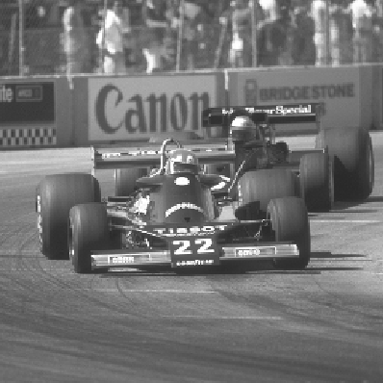
A very simplistic
“Edge Detector”
Gradient magnitude
x derivative
y derivative

Slide 9
The Convolution Theorem
and similarly:
Proof: Homework

Slide 10
Going back to the Noise Cleaning example…
Salt & Pepper Noise
3 X 3 Average
Convolution with a rect ⬅➔ Multiplication with a sinc in the Fourier domain
= LPF (Low-Pass Filter)
5 X 5 Average
7 X 7 Average
Wider rect ⬅➔ Narrower sinc = Stronger LPF

Slide 11
Examples
What is the Fourier Transform of ?
*

Slide 12
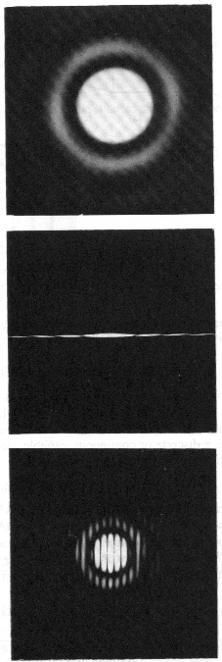
Image Domain
Frequency Domain

Slide 13
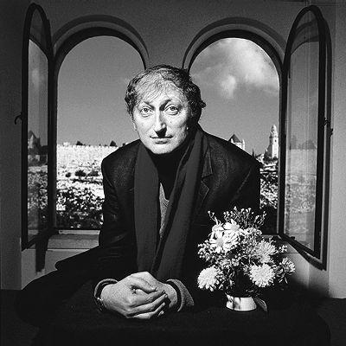
The Sampling Theorem
(developed on the board)
Nyquist frequency, Aliasing, etc…

Slide 14
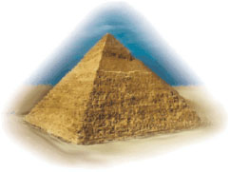
Multi-Scale Image Representation
Gaussian pyramids
Laplacian Pyramids
Wavelet Pyramids
Good for:
- pattern matching
- motion analysis
- image compression
- other applications

Slide 15
Image Pyramid
Low resolution
High resolution

Slide 16
Fast Pattern Matching
search
search
search
search

Slide 17
The Gaussian Pyramid
Low resolution
blur
down-sample
blur
down-sample
down-sample
blur
down-sample
blur
High resolution

Slide 18






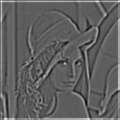
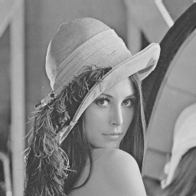

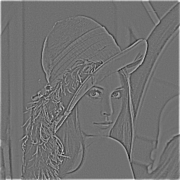
The Laplacian Pyramid
Gaussian Pyramid
Laplacian Pyramid
expand
-
=
expand
-
=
expand
-
=

Slide 19
Laplacian ~ Difference of Gaussians
-
=
DOG = Difference of Gaussians
More details on Gaussian and Laplacian pyramids
can be found in the paper by Burt and Adelson
(link will appear on the website).

Slide 20
Computerized Tomography (CT)
v
F(u,v)
u
f(x,y)

Slide 21
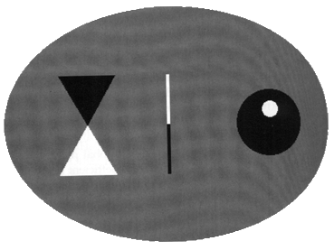
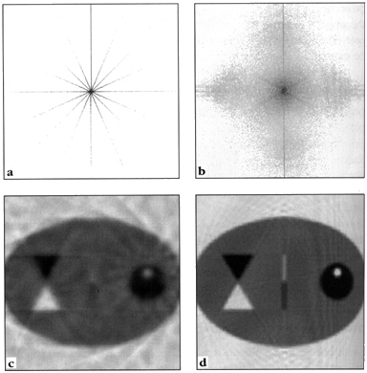
Computerized Tomography
Original
(simulated)
2D image
8 projections-
Frequency
Domain
120 projections-
Frequency
Domain
Reconstruction from
8 projections
Reconstruction from
120 projections

Slide 22
End of Lesson...
Exercise#1 -- will be posted on the website.
(Theoretical exercise: To be done and submitted individually)
To be added to course mailing-list, send email to: <netalee.efrat@weizmann.ac.il>
Course website:
http://www.wisdom.weizmann.ac.il/~vision/courses/2018_1/intro_to_vision/index.html
(or just google “Weizmann Vision”).

