Slide 1
Geometry 3: Stereo Reconstruction
Introduction to Computer Vision
Ronen Basri
Weizmann Institute of Science

Slide 2
Material covered
Pinhole camera model, perspective projection
Two view geometry, general case:
Epipolar geometry, the essential matrix
Camera calibration, the fundamental matrix
Two view geometry, degenerate cases
Homography (planes, camera rotation)
A taste of projective geometry
Stereo vision: 3D reconstruction from two views
Multi-view geometry, reconstruction through factorization

Slide 3
Summary of last lecture
 | Homography | Perspective (calibrated) | Perspective (uncalibrated) | Orthographic
Form | $$q∝Hp$$ | $q^{T}Ep=$0 | $q^{T}Fp=$0 | $q^{T}Fp=$0
Properties | One-to-one (group) | Concentric epipolar lines | Concentric epipolar lines | Parallel epipolar lines
DOFs | 8(5) | 8(5) | 8(7) | 4
Eqs/pnt | 2 | 1 | 1 | 1
Minimal configuration | 4 | 5+ (8,linear) | 7+ (8,linear) | 4
Depth | No | Yes, up to scale | Yes, projective structure | Affine structure (third view required for Euclidean structure)

Slide 4
Camera rotation
Images obtained by rotating the camera about its optical axis are related by homography:
$q∝Rp$ ($t=0$)
Verify that $q$ does not depend on $Z$:
$x^{′}=\frac{f(r_{11}X+r_{12}Y+r_{13}Z)}{r_{31}X+r_{32}Y+r_{33}Z}$, $y^{′}=\frac{f(r_{21}X+r_{22}Y+r_{23}Z)}{r_{31}X+r_{32}Y+r_{33}Z}$
$x^{′}=\frac{r_{11}x+r_{12}y+r_{13}f}{r_{31}x+r_{32}y+r_{33}f}$, $y^{′}=\frac{f(r_{11}x+r_{12}y+r_{13}f)}{r_{31}x+r_{32}y+r_{33}f}$

Slide 5
Planar scene
For a planar scene $q∝Hp$, with $H=R+\frac{1}{d}tn^{T}$
$Q=RP+t$ and $aX+bY+cZ=d$
$$ax+by+cf=\frac{df}{Z}$$
$x^{′}=\frac{f(r_{11}X+r_{12}Y+r_{13}Z+t_{x})}{r_{31}X+r_{32}Y+r_{33}Z+t_{z}}$ $y^{′}=\frac{f(r_{21}X+r_{22}Y+r_{23}Z+t_{y})}{r_{31}X+r_{32}Y+r_{33}Z+t_{z}}$
$x^{′}=\frac{r_{11}x+r_{12}y+r_{13}f+t_{x}f/Z}{r_{31}x+r_{32}y+r_{33}f+t_{z}f/Z}$ $y^{′}=\frac{r_{21}x+r_{22}y+r_{23}f+t_{y}f/Z}{r_{31}x+r_{32}y+r_{33}f+t_{z}f/Z}$

Slide 6
Epipolar lines
epipolar plane
epipolar lines
epipolar lines
O
Baseline
O’
$${p′}^{ T}Ep=0$$

Slide 7
Rectification
Rectification: rotation and scaling of each camera’s coordinate frame to make the epipolar lines horizontal and equi-height, by bringing the two image planes to be parallel to the baseline
Rectification is achieved by applying homography to each of the two images

Slide 8
Rectification
$$H_{l}$$
$$H_{r}$$
O
Baseline
O’
$${q′}^{ T}{H_{l}}^{−T}E{H_{r}}^{−1}q=0$$

Slide 9
Cyclopean coordinates
Given a rectified stereo rig with baseline length $b$, we place the origin at the midpoint between the camera centers.
a point $\left(X,Y,Z\right)$ is projected to:
Left image: $x_{l}=\frac{f(X−b/2)}{Z}$, $y_{l}=\frac{fY}{Z}$
Right image: $x_{r}=\frac{f(X+b/2)}{Z}$, $y_{r}=\frac{fY}{Z}$
Cyclopean coordinates:
$$X=\frac{b(x_{r}+x_{l})}{2(x_{r}−x_{l})}, Y=\frac{b(y_{r}+y_{l})}{2(x_{r}−x_{l})}, Z=\frac{fb}{x_{r}−x_{l}}$$

Slide 10
Disparity
$$x_{r}−x_{l}=\frac{fb}{Z}$$
Disparity is inverse proportional to depth
Constant disparity $⟺$ constant depth
Larger baseline, more stable reconstruction of depth (but more occlusions, correspondence is harder)
(Note that disparity is defined in a rectified rig in a cyclopean coordinate frame)

Slide 11
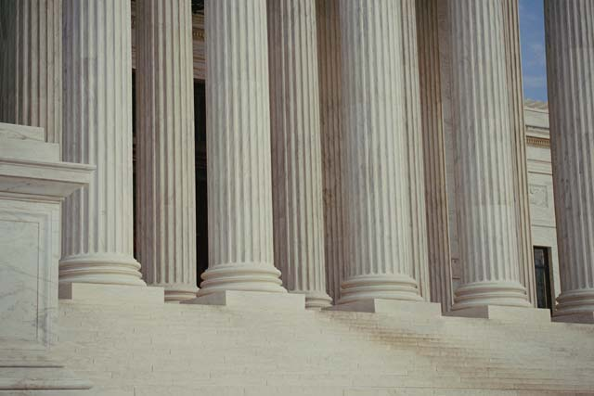
The correspondence problem
Stereo matching is ill-posed:
Matching ambiguity: different regions may look similar

Slide 12
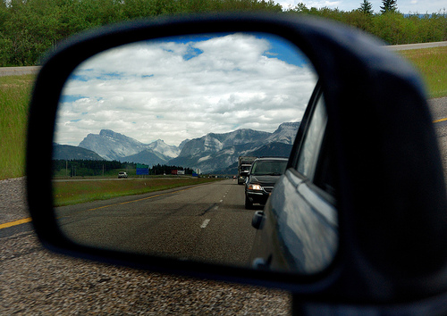
The correspondence problem
Stereo matching is ill-posed:
Matching ambiguity: different regions may look similar
Specular reflectance: multiple depth values

Slide 13
Random dot stereogram
Depth is perceived from a pair of random dot images
Stereo perception is based solely on local information (low level)

Slide 14
Moving random dots

Slide 15
Compared elements for correspondence
Single pixel intensities
Pixel color
Small window (e.g. $3×3$ or $5×5$), often using normalized correlation to offset gain
Features and edges
Mini segments

Slide 16
Dynamic programming
Each pair of epipolar lines is compared independently
Local cost, sum of unary term and binary term
Unary term: cost of a single match
Binary term: cost of change of disparity (occlusion)
Analogous to string matching (‘diff’ in Unix)

Slide 17
String matching
Swing → String
S t r i n g
Start
S w i n g
End

Slide 18
String matching
Cost: #substitutions + #insertions + #deletions
S t r i n g
S w i n g

Slide 20
Stereo with dynamic programming
Shortest path in a grid
Diagonals: constant disparity
Moving along the diagonal – pay unary cost (cost of pixel match)
Move sideways – pay binary cost, i.e. disparity change (occlusion, right or left)
Cost prefers fronto-parallel planes. Penalty is paid for tilted planes

Slide 21
Dynamic programming on a grid
Start
$T_{ij}=\max_{}{(T_{i−1,j}+C_{i−1,j→i,j}, }$
$T_{i−1,j−1}+C_{i−1,j−1→i,j}$,
$T_{i−1,j−1}+C_{i,j−1→i,j})$
Complexity?

Slide 22
Probability interpretation: the Viterbi algorithm
Markov chain
States: discrete set of disparity
$$P\left(d_{1},…,d_{n}\right)=P_{1}(d_{1})\prod_{i=2}^{n}{P_{i}\left(d_{i}\right)P_{i−1,i}(d_{i−1},d_{i})}$$
Log probabilities: product $⟹$ sum

Slide 23
Probability interpretation: the Viterbi algorithm
Markov chain
States: discrete set of disparity
$$−\log{P\left(d_{1},…,d_{n}\right)}=−\log{P_{1}\left(d_{1}\right)}−\sum_{i=2}^{n}{(logP_{i}\left(d_{i}\right)+logP_{i−1,i}\left(d_{i−1},d_{i}\right))}$$
Maximum likelihood: minimize sum of negative logs
Viterbi algorithm: equivalent to shortest path

Slide 24
Dynamic programming: pros and cons
Advantages:
Simple, efficient
Achieves global optimum
Generally works well
Disadvantages:

Slide 25
Dynamic programming: pros and cons
Advantages:
Simple, efficient
Achieves global optimum
Generally works well
Disadvantages:
Works separately on each epipolar line, does not enforce smoothness across epipolars
Prefers fronto-parallel planes
Too local? (considers only immediate neighbors)

Slide 26
Markov random field
Graph $G=\left(V,E\right)$ In our case: graph is a 4-connected grid representing one image
States: disparity
Minimize energy of the form
$$E(𝒟)=\sum_{(p,q)∈E}{V_{p,q}\left(d_{p},d_{q}\right)+\sum_{p∈V}{D_{p}(d_{p})}}$$
Interpreted as negative log probabilities

Slide 27
Iterated conditional modes (ICM)
Initialize states (= disparities) for every pixel
Update repeatedly each pixel by the most likely disparity given the values assigned to its neighbors:
$$\min_{d_{p}}{\sum_{q∈𝒩(p)}{V_{p,q}\left(d_{p},d_{q}\right)+D_{p}(d_{p})}}$$
Markov blanket: the state of a pixel only depends on the states of its immediate neighbors
Similar to Gauss-Seidel iterations
Slow convergence to (often bad) local minimum

Slide 28
Graph cuts: expansion moves
Assume $D\left(x\right)$ is non-negative and $V\left(x,y\right)$ is metric:
$V\left(x,x\right)=0$
$V\left(x,y\right)=V\left(y,x\right)$
$V\left(x,y\right)≤V\left(x,z\right)+V\left(z,y\right)$
We can apply more semi-global moves using minimal s-t cuts
Converges faster to a better (local) minimum

Slide 29
α-Expansion
In any one round, expansion move allows each pixel to either
change its state to α, or
maintain its previous state
Each round is implemented via max flow/min cut
One iteration: apply expansion moves sequentially with all possible disparity values
Repeat till convergence

Slide 30
α-Expansion
Every round achieves a globally optimal solution over one expansion move
Energy decreases (non-increasing) monotonically between rounds
At convergence energy is optimal with respect to all expansion moves, and within a scale factor from the global optimum:
$$E(𝒟_{expansion})≤2cE(𝒟^{∗})$$
where
$$c=\frac{\max_{α≠β∈𝒟}{V(α,β)}}{\min_{α≠β∈𝒟}{V(α,β)}}$$

Slide 31
α-Expansion (1D example)
$d_{p}$ $d_{q}$

Slide 32
α-Expansion (1D example)
$$α$$
$$\overline{α }$$

Slide 33
α-Expansion (1D example)
$$α$$
$$D_{p}(α)$$
$$D_{q}(α)$$
$$V_{pq}\left(α,α\right)=0$$
$$\overline{α }$$

Slide 34
α-Expansion (1D example)
$$α$$
But what about $V_{pq}(d_{p},d_{q})$?
$$D_{p}(d_{p})$$
$$D_{q}(d_{q})$$
$$\overline{α }$$

Slide 35
α-Expansion (1D example)
$$α$$
$$V_{pq}(d_{p},d_{q})$$
$$D_{p}(d_{p})$$
$$D_{q}(d_{q})$$
$$\overline{α }$$

Slide 36
α-Expansion (1D example)
$$α$$
$$D_{q}(α)$$
$$V_{pq}(d_{p},α)$$
$$D_{p}(d_{p})$$
$$\overline{α }$$

Slide 37
α-Expansion (1D example)
$$α$$
$$D_{p}(α)$$
$$V_{pq}(α,d_{q})$$
$$D_{q}(d_{q})$$
$$\overline{α }$$

Slide 38
α-Expansion (1D example)
$$α$$
$$V_{pq}(d_{p},α)$$
$$V_{pq}(α,d_{q})$$
$$V_{pq}(d_{p},d_{q})$$
Such a cut cannot be obtained due to triangle inequality:
$${V_{pq}(α,d_{q}) ≤V}_{pq}\left(d_{p},d_{q}\right)+V_{pq}(d_{p},α)$$
$$\overline{α }$$

Slide 39
Common metrics
Potts model:
$$V\left(x,y\right)=\left\{\begin{aligned}\begin{matrix}0 & x=y\end{matrix} \\ \begin{matrix}1 & x≠y\end{matrix}\end{aligned}\right.$$
$V\left(x,y\right)=\left|x−y\right|$
$V\left(x,y\right)={\left\|x−y\right\|}_{2}$
Truncated $ℓ_{1}$:
$$V\left(x,y\right)=\left\{\begin{aligned}\left|x−y\right| \left|x−y\right|<T \\ T otherwise\end{aligned}\right.$$
Truncated squared difference is not a metric

Slide 40
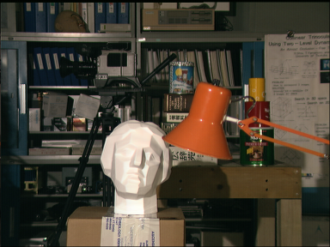
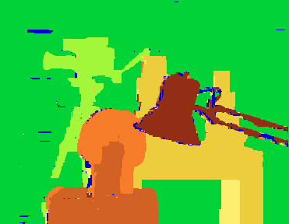
Reconstruction with graph-cuts
Original Result Ground truth

Slide 41
A different application: detect skyline
Input: one image, oriented with sky above
Objective: find the skyline in the image
Graph: grid
Two states: sky, ground
Unary (data) term:
State = sky, low if blue, otherwise high
State = ground, high if blue, otherwise low
Binary term for vertical connections:
If state(node)=sky then state(node above)=sky (infinity if not)
If state(node)=ground then state(node below)= ground
Solve with expansion move. This is a two state problem, and so graph cut finds the global optimum in one expansion move

