Slide 1
Contour-Based Joint Clustering of Multiple Segmentations
Daniel Glasner *¹
Shiv N. Vitaladevuni *²
Ronen Basri ¹
* equal contribution authors
1
2

Slide 2
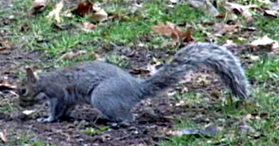
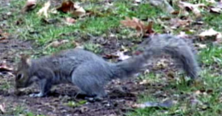
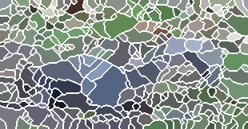
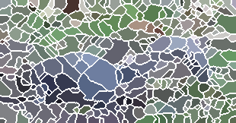
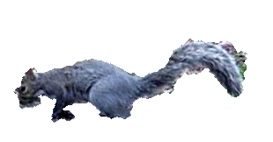
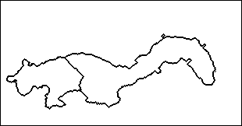
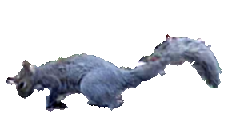
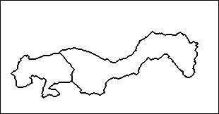
Joint-Clustering of Image Segments
Objective: 1. Similar shape across frames
2. Coherent regions within frames
Input frame
Segments /
Super-pixels
Our clustering result
1
1
1
1
Object contours →can be matched
Oversegmentation artifacts → can not
2
2
2
3
2
3
3
3

Slide 3
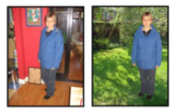
Related Work
This Work
Co-segmentation [Rother et al.06, Bagon et al.08, Hochbaum et al.09, Joulin et al.10]
Co-clustering of image segments[Vitaladevuni and Basri 2010]
Large deformation histograms are similar
Single object
Small deformation shapes are similar
Full image segmentation # objects unknown
Inter image similarity:
Shape
Intra Image similarity:
Color / optical flow etc.
Inter image similarity:
Overlap
Color

Slide 4
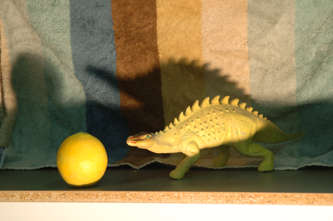
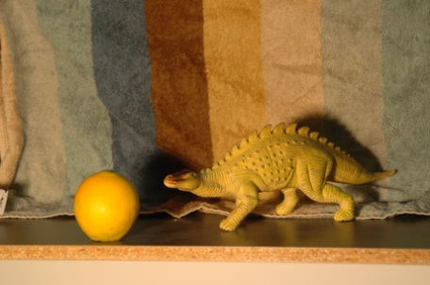
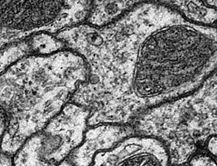
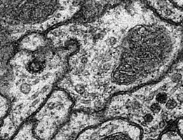
Some Applications
Video segmentation
Different lighting conditions
EM slices
[Vitaladevuni & Basri CVPR10]

Slide 5
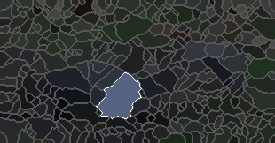
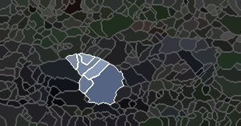
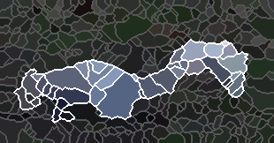
Searching for a Good Cluster
Convex functional of unions of segments
Bounding contours match - across frames
Coherent regions - within frame
Exterior bounding contours match
( , )
Shape similarity across frames | ×
Coherency within frame | ✓
F(union) = Shape-sim
✓
( )
( )
+ Coherency
+ Coherency

Slide 6
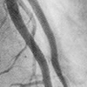
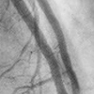
Incorporating Shape
Shape-based
similarity
Intersection
Input frames
Shape-based joint clustering

Slide 7
A Novel Contour Descriptor
Descriptor (segment) = bounding contour
Image 1
3
3
3
dimension = # contour samples in image 1
e^{iφ}
0
0
e^{iα}
e^{iθ}
e^{i(θ+π)}

Slide 8
Additive Descriptor & Contour Cancellation
Descriptor (union) = its bounding contour
union
dimension = #contour samples
₊
₌
e^{iφ}
0
e^{iφ}
e^{iθ}
e^{i(θ+π)}
0

Slide 9
Comparing Shapes Across Images
Image 1
Image 2
# segments image 1
# segments image 2
B₁
B₂
0
# contour elements image 1
0
e^{iθ}
# contour elements image 2

Slide 10
Comparing Shapes Across Images
Image 1
Image 2
B₁
Binary indicator of segments in image 1
B₂
Binary indicator of segments in image 2
=
=
x₁
x₂
Contour descriptor in image 1
Contour descriptor in image 2

Slide 11
Comparing Shapes Across Images
( , )
?
Shape-sim
=
# contour elements image1
X
# contour elements image2
B₁
B₁^{H}
^{Correspondence}
^{Matrix}
W^{1,2}
=
B₂
=
x₁^{T}
?
x₁
x₂

Slide 12
Comparing Shapes Across Images
Q^{1,2}
B₁^{H}
W^{1,2}
B₂
=
x₁^{T}
x₂
Contour descriptor of shape in image 1
# segments image1
X
# segments image2
# contour elements image1
X
# contour elements image2
Contour descriptor of shape in image 2

Slide 13
For arbitrary selection of segments
Similar shape across frames
Coherent regions within frames
=
Q^{1,1}
Q^{1,2}
x^{T}
Q^{1,2H}
Q^{2,2}
x
( , )
= Shape-sim
( )
( )
=
+ Coherency
+ Coherency

Slide 14
Optimization
NP-hard [Garey and Johnson 1979]
Vitaladevuni and Basri CVPR 2010

Slide 15
Convex Relaxation
Efficient linear programming relaxation [Vitaladevuni & Basri 2010, Charikar et al. 2003]
Q is hermitian → objective is real

Slide 16
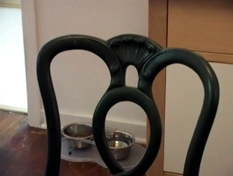
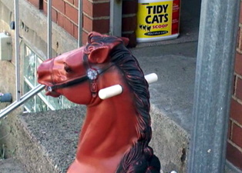
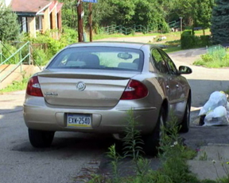
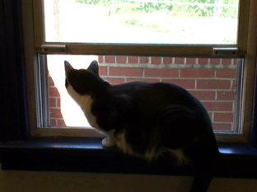
Video Dataset for Occlusion/Object Boundary Detection
reference frame
ground truth
Stein and M. Hebert.
Occlusion boundaries from motion: low-level detection and mid-level reasoning. IJCV, 82(3), 2009. 2
http://www.cs.cmu.edu/~stein/occlusion_data/

Slide 17
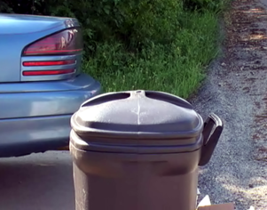
Qualitative Results
Reference frame:
Our result:

Slide 18
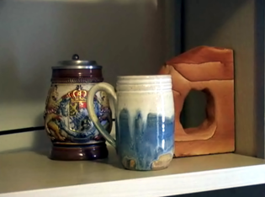
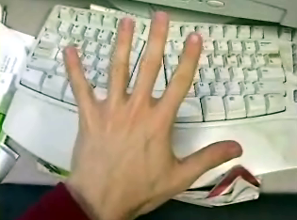
Qualitative Results
Reference frame:
Our result:

Slide 19
Summary
Joint segmentation of closely related images
Additive contour representation
Ignores internal contours of unions of segments
Efficient convex optimization to find subsets of segments with a similar shape
Combine inter and intra image similarity

Slide 20
Thank you!

